Slide 1

Presented By: M.Abdul Gani Baig – 19691A0501 R.Hemanth Kumar – 19691A0547 S.Ameer Suhail – 19691A0506 R.Arjun Reddy – 19691A0510
MADANAPALLE INSTITUTE OF TECHNOLOGY AND SCIENCE
Smart Screen Monitoring using AI
Under the Guidance of
Dr. Mahboob Basha

Slide 2
CONTENTS
Problem Formulation
Literature Survey
Requirements
Proposed System
objectives
Reference

Slide 3
Problem Formulation
With the development of ubiquitous computing, current user interaction approaches with keyboard, mouse and pen are not sufficient. Due to the limitation of these devices the usable command set is also limited. Direct use of hands can be used as an input device for providing natural interaction. In this project, we are developing an advanced media player which plays and pauses the video by detecting the users face looking at screen or not and also the field of computer vision based hand gesture interfaces for Human-Computer Interaction (HCI). System monitors whether the user is looking at the screen or not using a web camera. If yes then doesn't interrupts the video and allows it to play. Along with these, the web camera will also detect the users hand gestures which can be used for performing various events like increasing or decreasing the volume, changing to next video or previous video, etc. In case if the user is not looking at the or say the system couldn't detect the users face then it immediately stops the video.

Slide 4
Literature Survey
S.No | TITLE | AUTHOR’S NAME | RESULT | DISADVANTAGES
1 | Emotion Detection Using Facial Expression | Jyoti Rani ,etc ,All | Automated Facial Expression Recognition System | May occur delay while displaying results
2 | A Vision Based Hand Gesture Interface for Controlling VLC Media Player | Sidharth Rauta ray,etc,All | Can easily control VLC Media player using Hand gestures | Use of complex algorithms such knearest, neighbor hood pyramid , lucas kanade optical flow
3 | Controlling Multimedia Applications Using Hand Gesture Recognition | Neha Roka de,etc,All | Easy & simple to control Real time system such as multimedia apps | Conversion of original image into so many forms such as HSV Scale image, Threshold image, Filtered imag

Slide 5
Requirements
HARDWARE REQUIREMENTS:
1 GB ram
200 GB HDD
Intel 1.66 GHz Processor Pentium 4
Web Camera
SOFTWARE REQUIREMENTS:
Windows XP, Windows 7,8 and above versions
Python 3 and above version
Visual Studio 2010
Windows Operating System

Slide 6
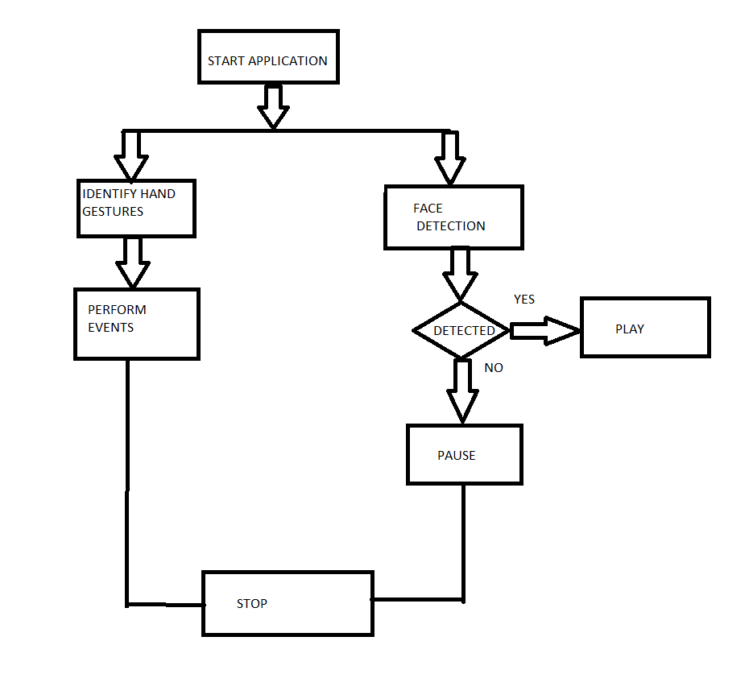
Proposed System
In our project, we implement a
recognition system for incoming
hand images as well as
detecting face in realtime as shown
In the figure.

Slide 7
Objectives
It helps the user to interact with the media player without touching the screen.
This system also provides the feature of controlling other functions of media player such as volume up, volume down, forward and backward using hand gestures.
The media player pause the video as soon as the user face is not detected.
The hand gestures should be captured accurately and actions associated to them should performed perfectly.

Slide 8
Reference
Harsha Jadhav, Sabiha Pathan, Neha Rokade et Uma Annamalai “Hand Gesture Recognition System For Multimedia Applications”, International Research Journal of Engineering and Technology (IRJET) Volume: 03 Issue: 04 | Apr-2016, Apr2016.
Harshala Chaudhari , Amrapali Waghmare , Reshma Ganjewar , Dr. Abhijit Banubakode “A Media Player which operates depending on Human Emotions” International Journal of Advanced Research in Computer and Communication Engineering Vol. 4, Issue 5, May 2015.
Jyoti Rani et Kanwal Garg, “Emotion Detection Using Facial Expression”, Journ. International Journal Of Advanced ResearchIn Computer Science & Software Engineering, Vol. 4, PP-465467, April 2016.
N. Krishna Chaitanya et R. Janardan Rao “Controlling OF Windows Media Player Using Hand Recognition System”, Journ. The International Journal Of Engineering And Science (IJES), vol. 3, PP 01-04, 2014.
Deepak, M. Vikas, “Speech Recognition using FIR Wiener Filter”, International Journal of Application or Innovation in Engineering & management (IJAIEM),pp.204-20,2013.[6] Madhu N: Note on measures for spectral flatness. Electron. Lett 2009,45(23):1195–1196 Khoa PC: Noise robust voice activity detection. Master’s thesis, NangYang Technological University, 2012

