Slide 1

Presented By: M.Abdul Gani Baig – 19691A0501 R.Hemanth Kumar – 19691A0547 S.Ameer Suhail – 19691A0506 R.Arjun Reddy – 19691A0510
MADANAPALLE INSTITUTE OF TECHNOLOGY AND SCIENCE
Smart Screen Monitoring using AI(SSM)
Under the Guidance of
Dr. Mahboob Basha

Slide 2
CONTENTS
Problem Formulation
Literature Survey
Usecase Diagram
Block Diagram
Methodology
Algorithms and Modules
Functions
Objectives
Summary
Reference

Slide 3
Problem Formulation
With the development of ubiquitous computing, current user interaction approaches with keyboard, mouse and pen are not sufficient. Due to the limitation of these devices the usable command set is also limited. Direct use of hands can be used as an input device for providing natural interaction. In this project, we are developing a python program to control media. The web camera will detect the users hand gestures which can be used for performing various events like increasing or decreasing the volume, changing to next video or previous video, etc.

Slide 4
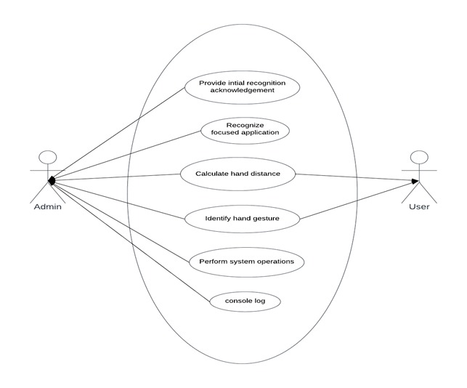
Use Case Diagram

Slide 5
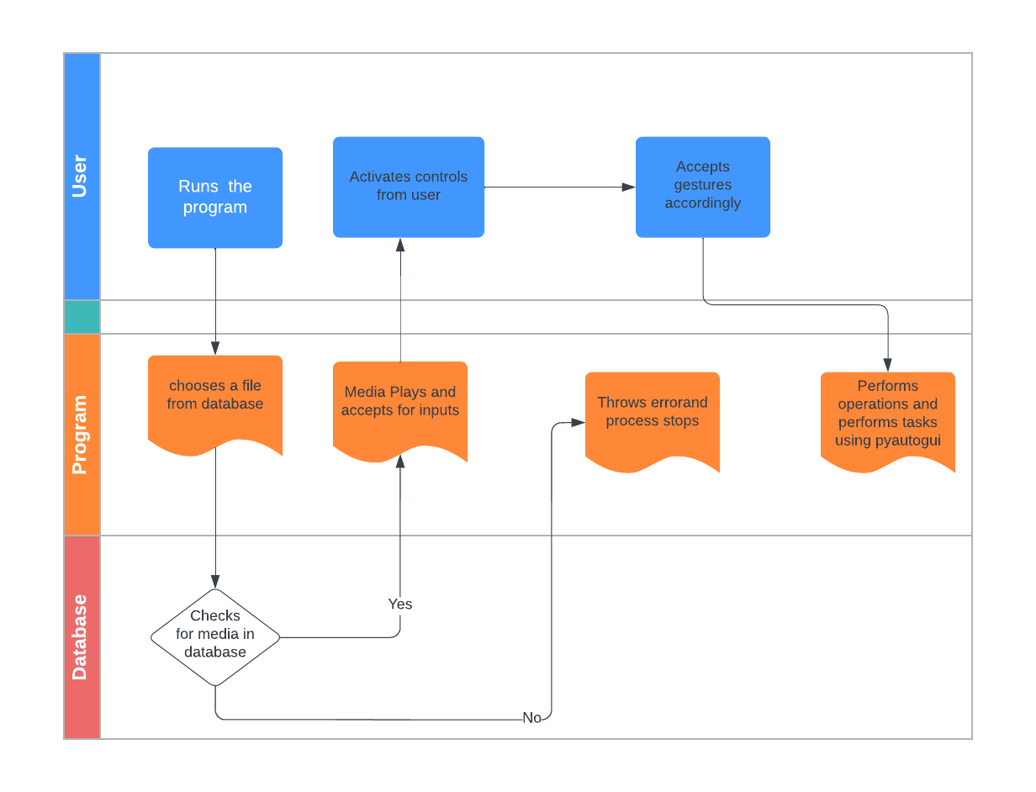
Block Diagram

Slide 6
Methodology
Steps to execute SSM
downloading... virtual environment
pip install virtualenv
ensuring pip is up to date
python -m pip install -U pip
creating virtual environment with name venv
python -m venv venv
activate virtual environment by running activate script
.\venv\Scripts\activate
installing required modules or packages
pip install -r requirements.txt
running the source file
python .\public\main.py

Slide 7
Algorithms and Modules
Algorithms and formulas used:
Cosine Theorem
Distance formula
Modules Used:
OpenCV
Mediapipe
Pyautogui

Slide 8
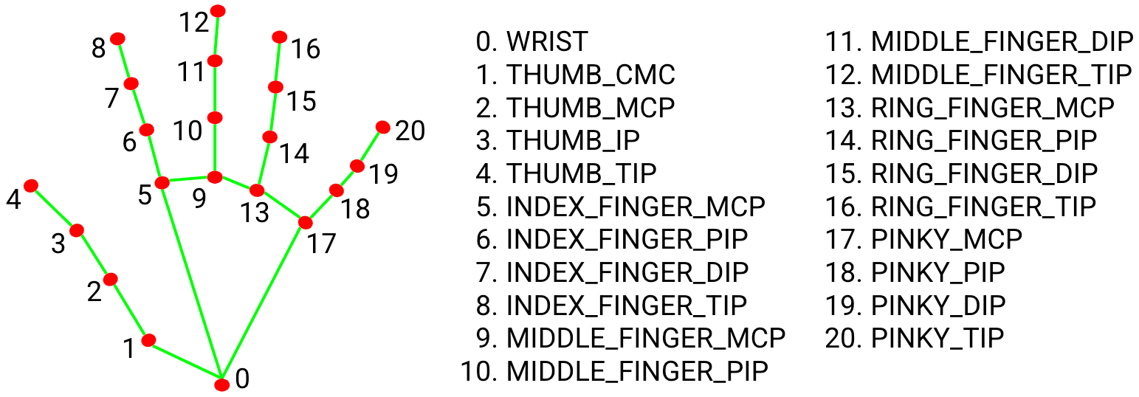
Hand detection using mediapipe

Slide 9
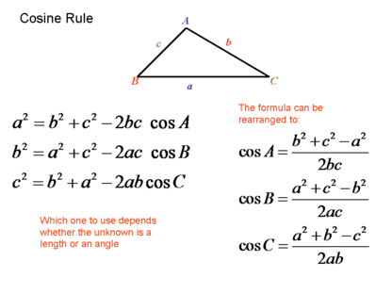
Cosine theorem
Cosine theorem is used for calculating angles
between three points by the distances
among the points.

Slide 10
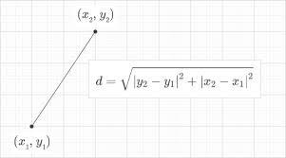
Distance between two points
It is used to calculate the distance between two points.

Slide 11
Available Functionalities
Pause
Play
Forward
Backward
Volume up
Volume down
Activate controls
Deactivate controls

Slide 12
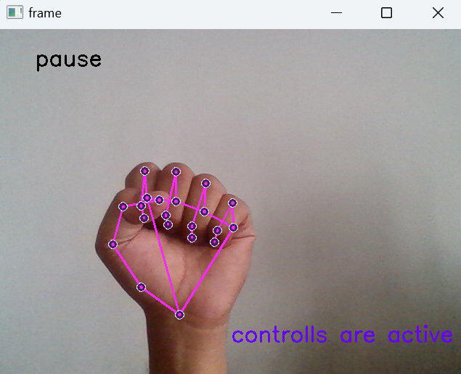
Pause operations
By holding the fist
That means angle for every
finger must be less than
50 degrees.
Angle is considered by
points TIP, PIP, MCP

Slide 13
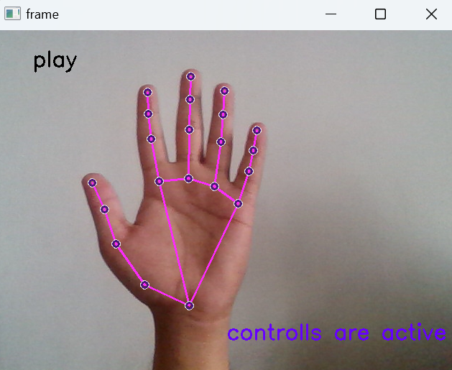
Play operation
By opening palm
That means angle between
every hand must be grater
than 150.
Angle is considered by
points TIP, PIP, MCP

Slide 14
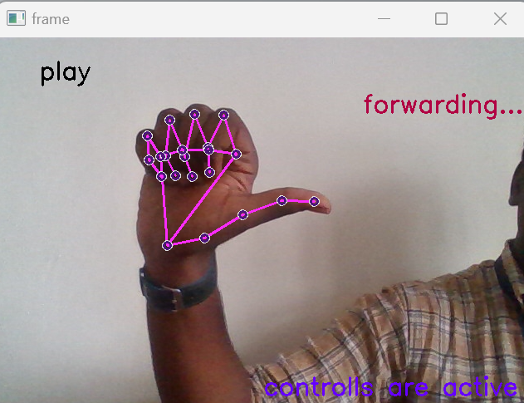
Forward operation
By exposing left hand thumb
and closing remaining fingers
That means left hand thumb
angle must be grater than 150
degrees, and remaining must
be less than 50 degrees

Slide 15
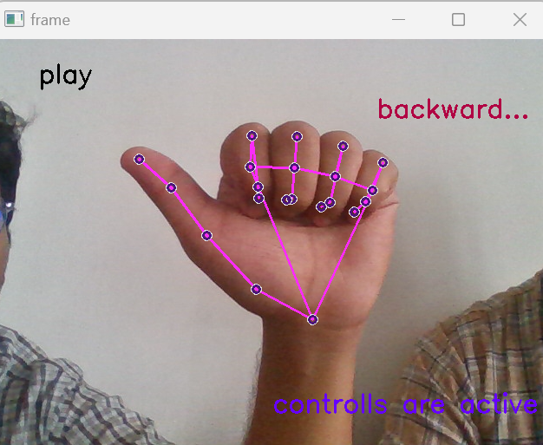
Backward operation
By exposing right hand thumb
and closing remaining fingers
That means right hand thumb
angle must be grater than 150
degrees, and remaining must
be less than 50 degrees

Slide 16
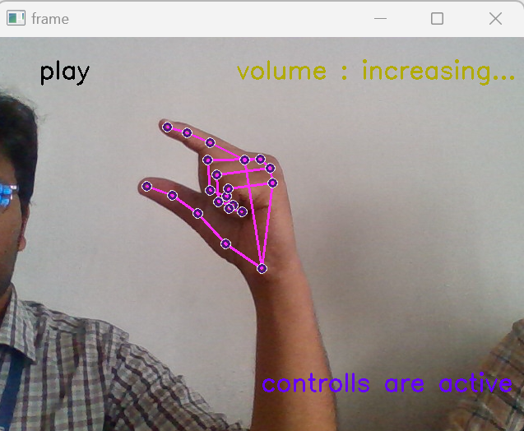
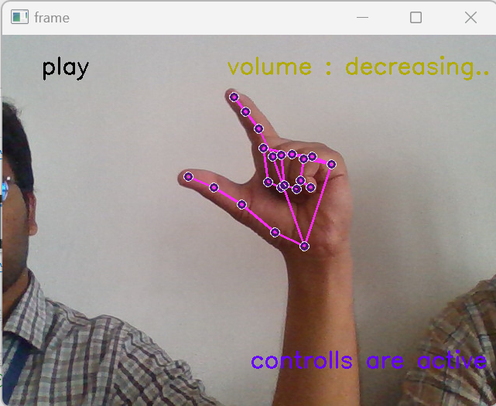
Volume up and down
By maintaining distance between index finger and thumb either decrease the distance or increase for volume down and up respectively.

Slide 17
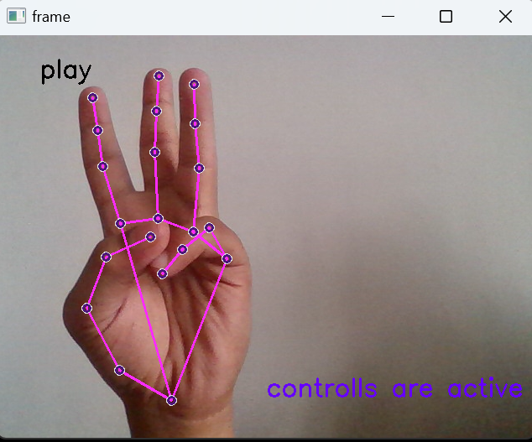
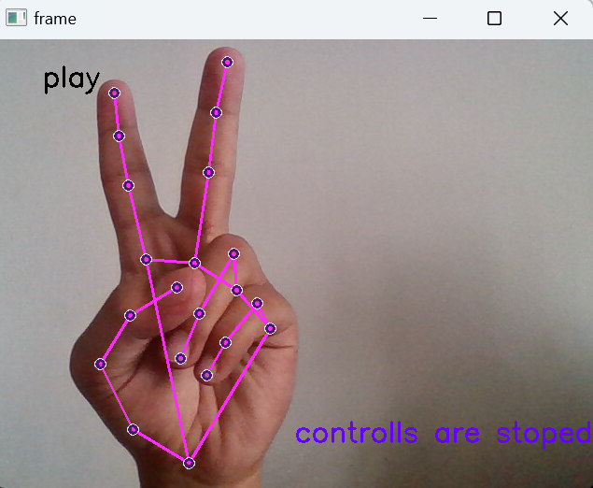
Activate and deactivate controls
We may get unwanted hand detection
when we won’t need. For that we can
deactivate controls and activate controls.
For activation angle for index and
middle finger must be grater than
150 degrees. And remaining all must be
lesser than 50 degrees.
For deactivation angle for index , middle
and ring finger must be grater than 150
degrees. And remaining all must be lesser
than 50 degrees.

Slide 18
Objectives
It helps the user to interact with the media player without touching the screen.
This system also provides the feature of controlling other functions of media player such as volume up, volume down, forward and backward using hand gestures.
The media player pause the video as soon as the user face is not detected.
The hand gestures should be captured accurately and actions associated to them should performed perfectly.

Slide 19
Summary
The look based media player provides added features as compared to the standard media player which includes eye detection, gesture controls etc ,which makes an overall better experience for any user using this media player.
Eye detection feature is used to play and pause the media automatically while the hand gesture detection feature is used to access the components of the media player without touching the screen.
The main goal of our project is to provide a better experience for the users while using this media player

Slide 20
Reference
Harsha Jadhav, Sabiha Pathan, Neha Rokade et Uma Annamalai “Hand Gesture Recognition System For Multimedia Applications”, International Research Journal of Engineering and Technology (IRJET) Volume: 03 Issue: 04 | Apr-2016, Apr2016.
Harshala Chaudhari , Amrapali Waghmare , Reshma Ganjewar , Dr. Abhijit Banubakode “A Media Player which operates depending on Human Emotions” International Journal of Advanced Research in Computer and Communication Engineering Vol. 4, Issue 5, May 2015.
Jyoti Rani et Kanwal Garg, “Emotion Detection Using Facial Expression”, Journ. International Journal Of Advanced ResearchIn Computer Science & Software Engineering, Vol. 4, PP-465467, April 2016.
N. Krishna Chaitanya et R. Janardan Rao “Controlling OF Windows Media Player Using Hand Recognition System”, Journ. The International Journal Of Engineering And Science (IJES), vol. 3, PP 01-04, 2014.
Deepak, M. Vikas, “Speech Recognition using FIR Wiener Filter”, International Journal of Application or Innovation in Engineering & management (IJAIEM),pp.204-20,2013.[6] Madhu N: Note on measures for spectral flatness. Electron. Lett 2009,45(23):1195–1196 Khoa PC: Noise robust voice activity detection. Master’s thesis, NangYang Technological University, 2012

