Slide 1
CAPSTONE PROJECT
TICKET BOOKING SYSTEM IN PYTHON WITH SOURCE CODE
Presented By:
1. HEMANTH KUMAR K - Btech textile technology, Alagappa college of Technology, Anna University, Chennai.

Slide 2
OUTLINE
Problem Statement
Proposed System/Solution
System Development Approach
Algorithm & Deployment
Result
Conclusion
Future Scope
References

Slide 3
PROBLEM STATEMENT
A Python booking system with source code may face the following problem statements:
1. *Scalability*: Handling a large volume of bookings and users.
2. *Data Security*: Ensuring sensitive information like payment details and user data is secure.
3. *Concurrency*: Managing multiple bookings and updates simultaneously.
4. *User Experience*: Providing an intuitive and user-friendly interface.
5. *Payment Processing*: Integrating secure payment gateways.

Slide 4
PROBLEM STATEMENT
6. *Availability and Scheduling*: Managing real-time availability and scheduling.
7. *Notifications and Reminders*: Sending timely notifications and reminders.
8. *Data Analytics*: Providing insights into booking trends and user behavior.

Slide 5
PROPOSED SOLUTION
1. *Scalability*:
- Use a cloud-based infrastructure (e.g., AWS, Google Cloud) for scalability.
- Implement load balancing and auto-scaling.
- Use a distributed database (e.g., MongoDB, Cassandra) for handling large data volumes.
2. *Data Security*:
- Implement encryption for sensitive data (e.g., SSL/TLS, AES).
- Use secure password hashing (e.g., bcrypt, Argon2).
- Validate and sanitize user input.

Slide 6
PROPOSED SOLUTION
3. *Concurrency*:
- Use a message queue (e.g., RabbitMQ, Celery) for handling concurrent bookings.
- Implement locking mechanisms (e.g., Redis, database locks) for preventing race conditions.
4. *User Experience*:
- Design a user-friendly interface with clear booking steps.
- Implement responsive design for various devices.
- Use caching (e.g., Redis, Memcached) for fast data retrieval.

Slide 7
PROPOSED SOLUTION
5. *Payment Processing*:
- Integrate a secure payment gateway (e.g., Stripe, PayPal).
- Implement tokenization for storing payment information.
6. *Availability and Scheduling*:
- Use a scheduling algorithm (e.g., cron, schedule) for managing bookings.
- Implement real-time availability checks.
7. *Notifications and Reminders*:
- Use a notification service (e.g., Twilio, Sendgrid) for sending emails and SMS.
- Implement a reminder system with customizable notifications.

Slide 8
PROPOSED SOLUTION
A Ticket Reservation System Python is a simple console application, the user can access the system freely by just entering certain keys. The user can add a customer name, view PNR status, and generate the total booked ticket

Slide 9
SYSTEM APPROACH
1. *Presentation Layer* (Flask or Django):
- Handles user input and displays booking information
- Implements responsive design for various devices
2. *Application Layer* (Flask or Django):
- Manages booking logic and validation
- Integrates with payment gateway and notification service
3. *Business Logic Layer* (Python modules):
- Encapsulates booking rules and validation
- Implements scheduling algorithm and availability checks
4. *Data Access Layer* (SQLAlchemy or Django ORM):
- Interacts with database for storing and retrieving data
5. *Database* (MySQL or MongoDB):
- Stores user information, booking data, and availability.

Slide 10
ALOGORITHM AND DEPLOYMENT
Step 1: Create a project name.
First open Pycharm IDE and then create a “project name” after creating a project name click the “create” button.
Step 2: Create a python file.
Second after creating a project name, “right click” your project name and then click “new” after that click the “python file“.

Slide 11
ALGORITHM & DEPLOYMENT
Step 3: Name your python file.
Third after creating a python file, Name your python file after that click “enter“.
Step 4: The actual code.
You are free to copy the code given below and download the full source code below.

Slide 12
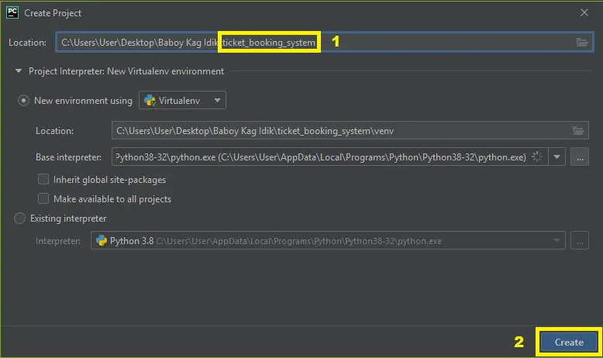
ALGORITHM & DEPLOYMENT

Slide 13
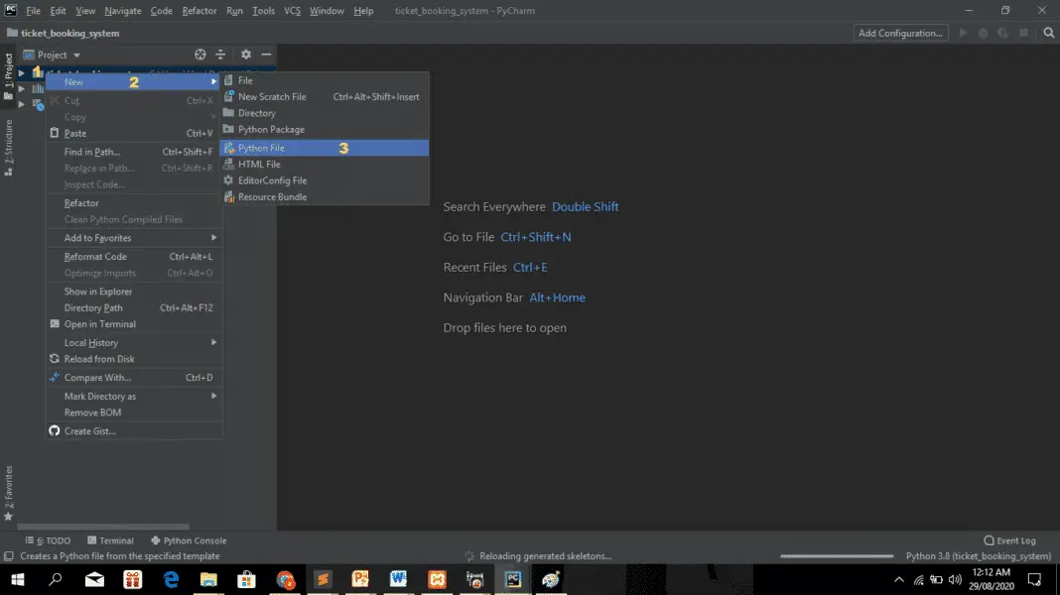
ALGORITHM & DEPLOYMENT

Slide 14
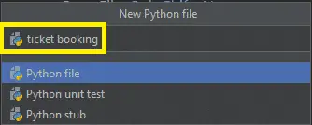
ALGORITHM & DEPLOYMENT

Slide 15
RESULT
The code given is the complete source code of Ticket Booking System In Python.

Slide 16
CONCLUSION
The Ticket Booking System In Python is written in Python programming language, Python is very easy to research the syntax emphasizes readability and it is able to reduce time ingesting in developing.

Slide 17
FUTURE SCOPE
The future scope of Python extends well beyond just the technology sector. Its applications are increasingly visible in sectors such as finance, healthcare, and entertainment. For instance, in finance, Python is used for algorithmic trading, risk management, and data analysis

Slide 18
REFERENCES
Hangman Game In Python With Source Code
Aircraft War Game in Python with Source Code
Snake Game In Python Code
How to Make Bouncing Ball Game in Python with Source Code
How to Create Rock-Paper-Scissor Game in Python

Slide 19
THANK YOU

