Slide 1

EDUTECH / LEARNING MANAGEMENT SYSTEM
DATA ANALYTICS AND VISUALIZATION
HEMANTH R

Slide 2
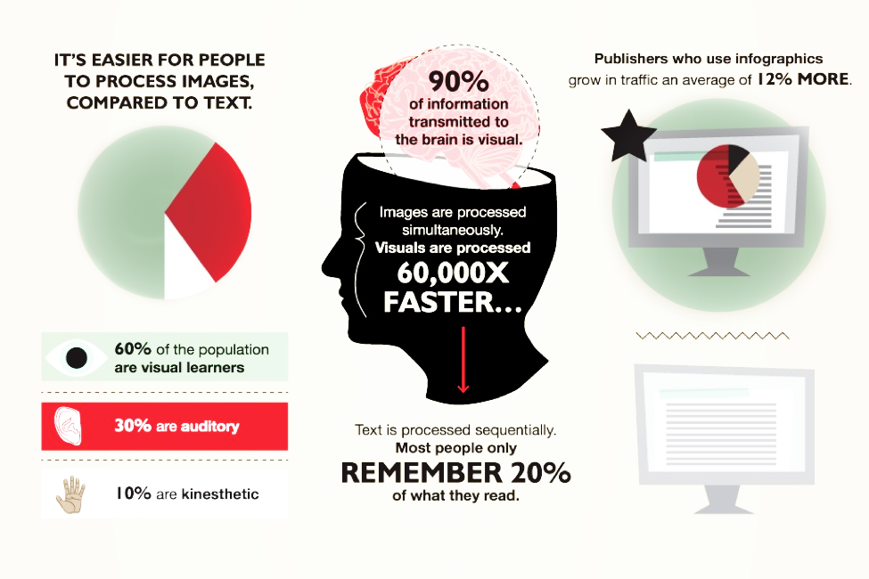

Slide 3
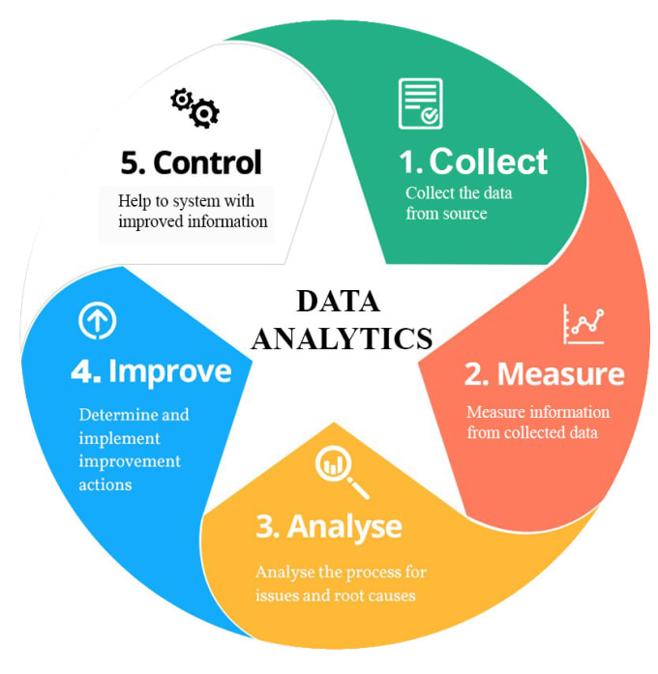
PROCESS OF DATA ANALYSIS

Slide 4


Slide 5
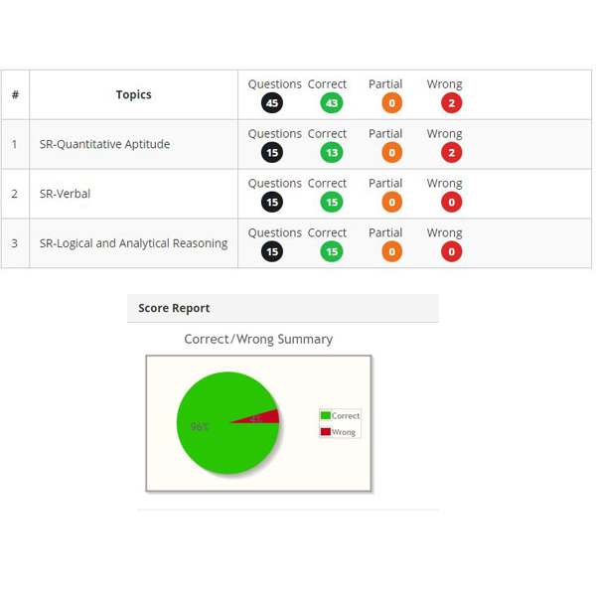
REPO
To generate Graphical Reports from the physical reports and analysis of the course finished
To predict and advice the students on what suitable and trending course to be taken next
To assesses learners’ performance and measure their progress in different time intervals, or after the course is finished
Course overview reports provide a general picture of how successfully users studied a specific piece of content
Help them through the right course of placement by analysing their patterns, Notifications help learners stay on top of things: their course completions, assignments, achievements, comments, upcoming events, and more
To track what percentage of learners completed a course, how much time they needed to view each activity, and what average score they got

Slide 6
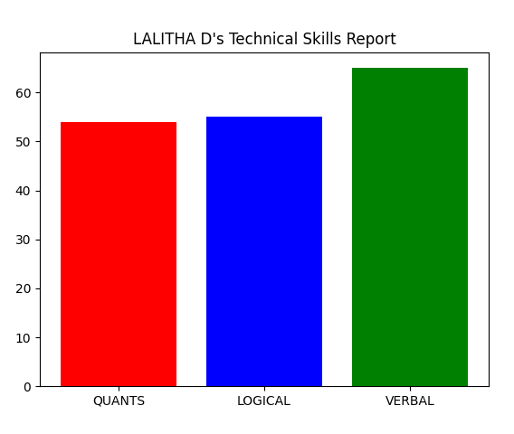
OBJECTIVE
Use of College Data for Data Analytics
Automatic generation of student reports based on the input data to their email
Suggestion of courses

Slide 7
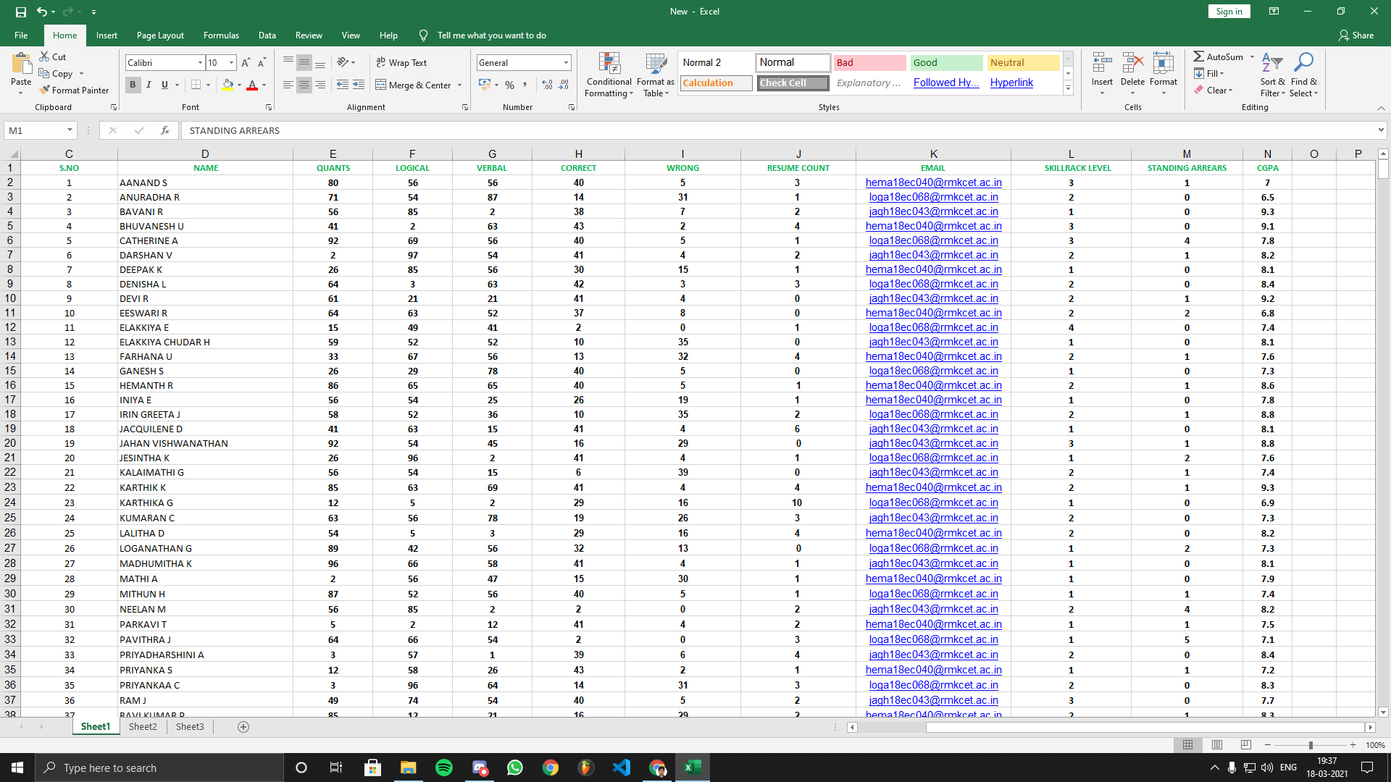

Slide 8
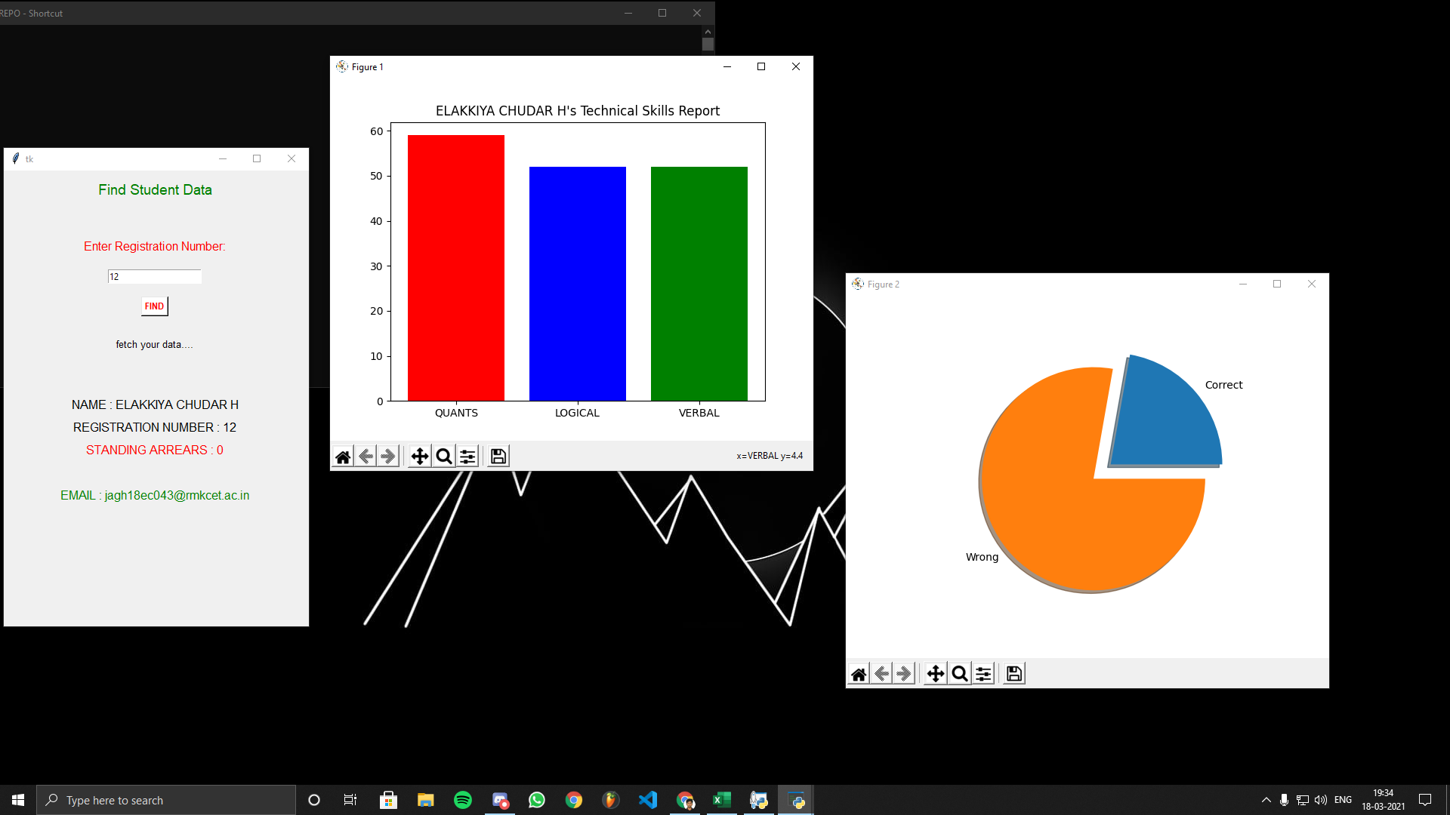

Slide 9
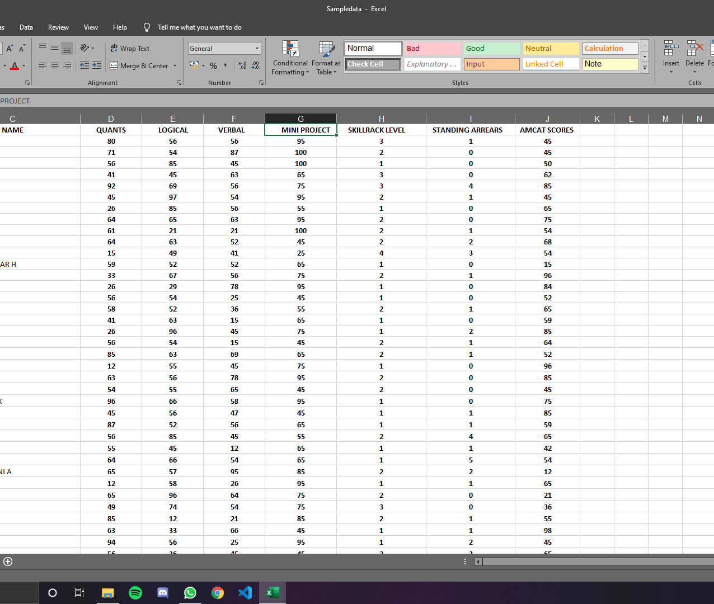
ANALYSIS OF SKILLRACK AND COLLEGE DATA
Gather Hidden Insights – Hidden insights from data are gathered and then analyzed with respect to requirements of the college.
Generate Reports – Reports are generated from the data and are passed on to the respective departments and students to deal with further actions for further improvements.
Perform Student Analysis – Student Analysis can be performed to understand the strengths and weaknesses .
Improve Requirement – Analysis of Data allows improving score to the requirements and experience.

Slide 10

THANK YOU!
.

