Slide 1
Revanth – 22BAI1168
Rahul – 22BAI1245
Hemanth – 22BAI1257
Federated Learning Model
Using
Adaptive Clustering

Slide 2
Problem Statement
To construct a Federated Learning Model using an Adaptive Clustering scheme for client selections.
Revanth – 22BAI1168
Rahul – 22BAI1245
Hemanth – 22BAI1257
Federated Learning Model
Using
Adaptive Clustering

Slide 3
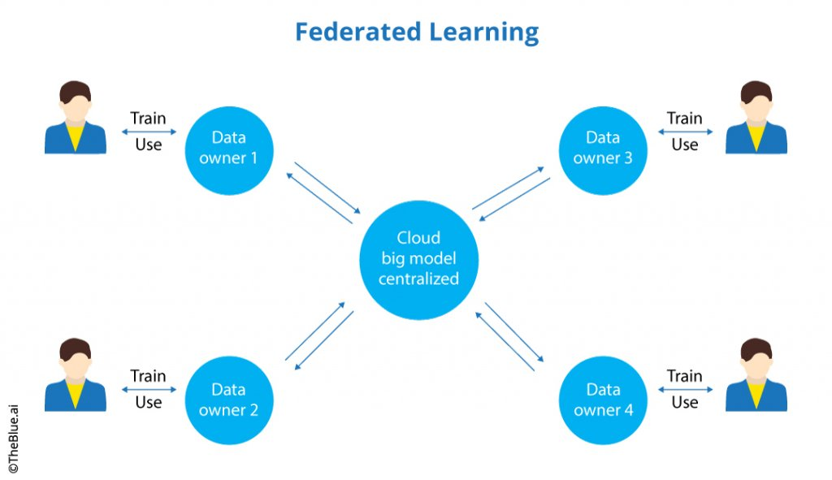
Federated Learning
Federated learning works by training a central model across decentralized devices or servers. Instead of moving all data to a central location, the model is trained locally on each device, and only the model updates are shared. This maintains privacy and allows collaborative learning without sharing raw data.

Slide 4

Federated Learning
Adaptive Clustering
Federated learning works by training a central model across decentralized devices or servers. Instead of moving all data to a central location, the model is trained locally on each device, and only the model updates are shared. This maintains privacy and allows collaborative learning without sharing raw data.
The Adaptive clustering approach dynamically clusters clients, starting with individual clusters and merging them based on training progress. Simulated Annealing-like randomness helps escape local minima, while stabilization rounds promote convergence. This adaptation to data distribution and local performance can improve overall model performance.It determines optimal cluster numbers, based on the Loss reduction ratio, and updates the number of clusters, enhancing accuracy and robustness.
Adapt to the Situations

Slide 5
Adaptive Clustering
Adaptive clustering supports the reuse of clusterings by memorizing what worked well in the past. It also has the capability of exploring multiple paths in parallel when searching for good clusters. It determines optimal cluster numbers, adapts to noise and outliers, and updates clusters incrementally, enhancing accuracy and robustness.
Adapt to the Situations
Stabilization Techniques:
SA - like:
-> The SA-like stabilization technique uses a Probability – based approach to decide whether to keep the current number of clusters or decrease it.

Slide 6
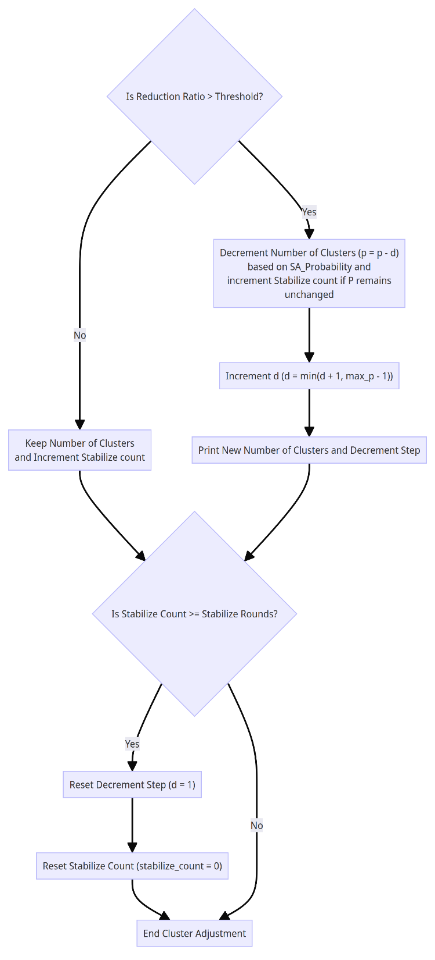
SA - Like Flow

Slide 7
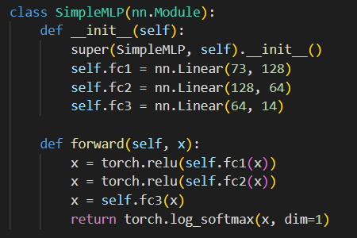
Adaptive Clustering
Adaptive clustering supports the reuse of clusterings by memorizing what worked well in the past. It also has the capability of exploring multiple paths in parallel when searching for good clusters. It determines optimal cluster numbers, adapts to noise and outliers, and updates clusters incrementally, enhancing accuracy and robustness.
Adapt to the Situations
Implementation:
1. Simple MLP and Data split
->The SimpleMLP class defines a feedforward neural network with three fully connected layers
->ReLU activation is applied after the first two layers (fc1 and fc2), introducing non-linearity to the model
->The final layer (fc3) produces logits which are normalized using log_softmax for multi-class classification tasks.
->The data split is performed using multiple data loaders (train_loaders), where each data loader represents a subset of the training data assigned to a specific client (or device) participating in the federated learning process

Slide 8
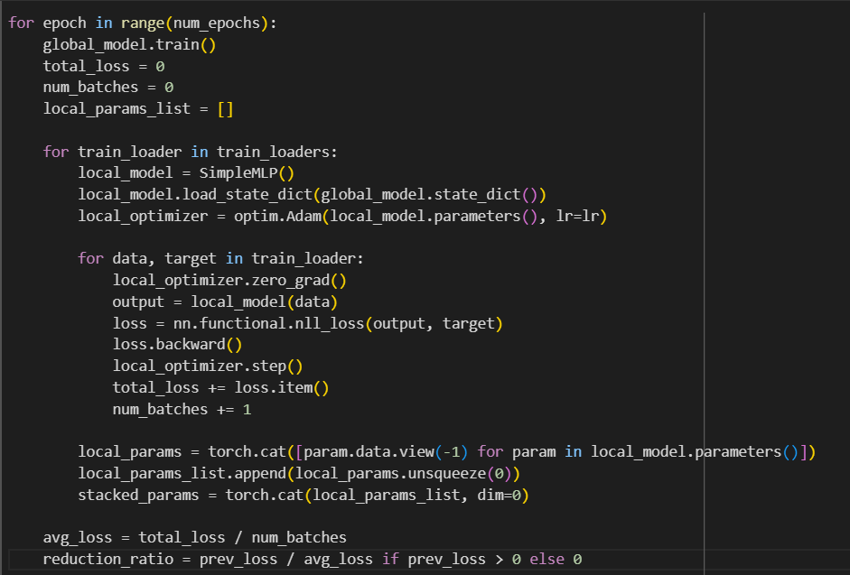
Adaptive Clustering
Adaptive clustering supports the reuse of clusterings by memorizing what worked well in the past. It also has the capability of exploring multiple paths in parallel when searching for good clusters. It determines optimal cluster numbers, adapts to noise and outliers, and updates clusters incrementally, enhancing accuracy and robustness.
Adapt to the Situations
2. Global Model initialization and clients training:
->Set the global model in training mode (global_model.train()).
->Initialize `total_loss` and `num_batches` for calculating the average loss.
->Train each client after initializing it with the global model on its respective `train_loader` in `train_loaders`.
->Store the client model weights in `stacked_params`.
->For each epoch i (i = 1..m), compute the average losses Li from all clients. Then calculate the reduction ratio between Li−1 and Li

Slide 9
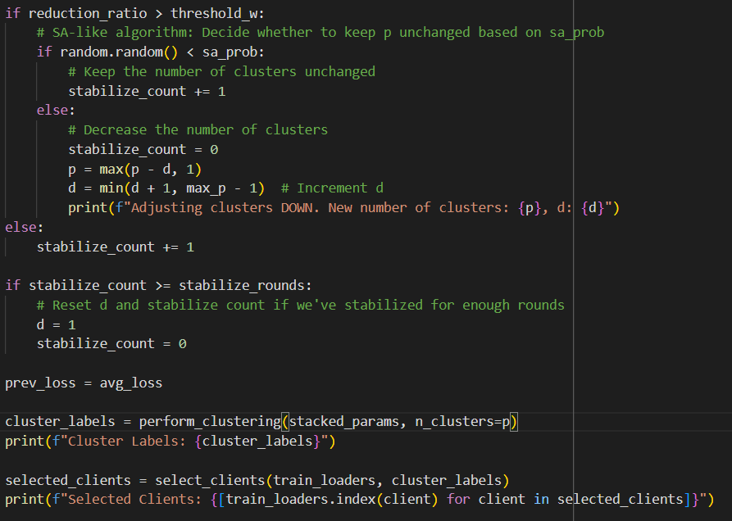
3. Cluster Adjustment and Client Selection:
->Check if the reduction ratio meets the threshold (threshold_w) for potential cluster adjustment.
->If yes, decide whether to keep the number of clusters unchanged based on the simulated annealing probability (sa_prob).
->Adjust the number of clusters (p) and the increment factor (d) accordingly.
->Perform clustering (perform_clustering) using the global model and stacked parameters (stacked_params) with the updated number of clusters (p).
->Select clients (selected_clients) based on the cluster labels using select_clients.

Slide 10
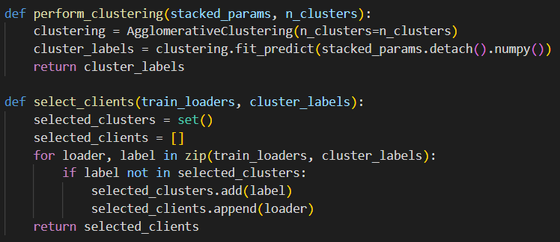
4. Cluster Adjustment and Client Selection:
->Utilizes AgglomerativeClustering to cluster clients based on weights similarity.
->Picking one client from each cluster at random

Slide 11
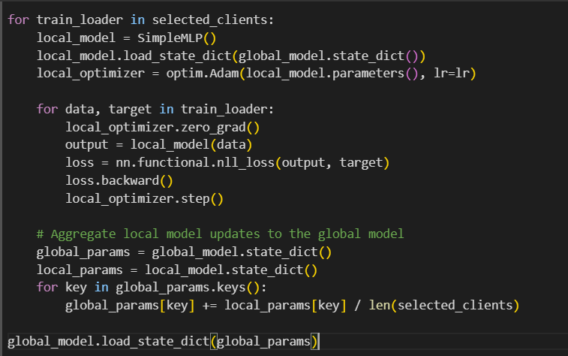
5. Model Aggregation:
->Iterate over selected clients (selected_clients) for training.
->Initialize local models for each of the selected clients and load the state of the global model.
->Train the local models using its respective data (train_loader).
->Aggregate the local model updates to the global model (global_model) by averaging the parameters across selected clients.
->Update the global model's parameters (global_model) with the aggregated updates.

Slide 12
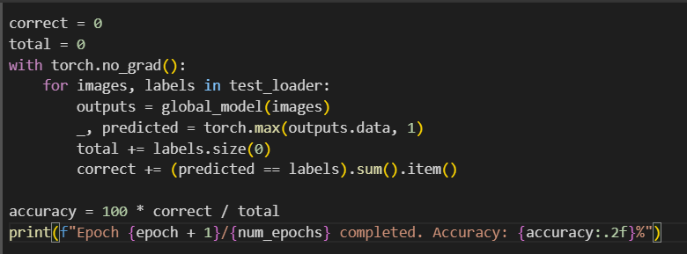
6. Evaluation:
Explanation:
->Evaluate the performance of the trained global model (global_model) on the test dataset (test_loader).
->Compute the accuracy of the model by comparing predicted labels with ground truth labels.
->Print the accuracy after each epoch to monitor the model's progress during training.

Slide 13
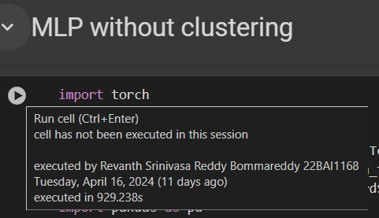
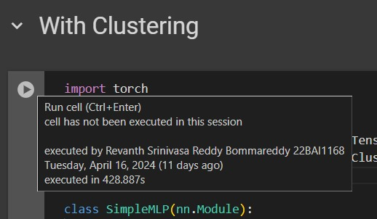
Execution Time

Slide 14
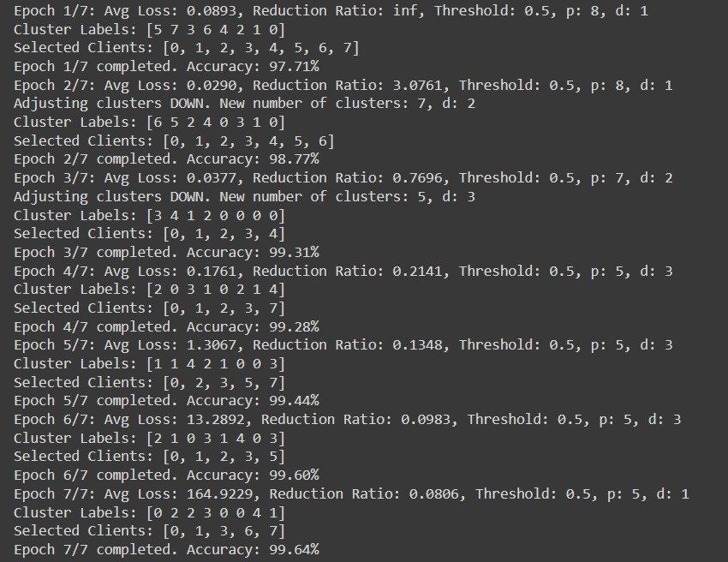
Output

Slide 15
Thank You

