Slide 1

Similar Document Template Matching Algorithm
Revanth.B
22BAI1168
Hemanth Raju.N
22BAI1257
Harshitha.Y
22BCE1645
Venkata Rahul.B
22BAI1245

Slide 2
Similar Document Template Matching Algorithm

Slide 3



Similar Document Template Matching Algorithm
INTRODUCTION:
Healthcare organizations handles a huge volume of medical invoices, prescriptions, and lab test reports from diverse providers such as doctors, hospitals, labs, and customers. There is a chance of identical document templates with subtle modifications.
These type of Fraudulent claims can lead to significant financial losses and erode the trust in their systems. Our proposed algorithm aims to fortify our defenses against such threats.

Slide 4
Similar Document Template Matching Algorithm
INTRODUCTION:
Healthcare organizations handles a huge volume of medical invoices, prescriptions, and lab test reports from diverse providers such as doctors, hospitals, labs, and customers. There is a chance of identical document templates with subtle modifications.
These type of Fraudulent claims can lead to significant financial losses and erode the trust in their systems. Our proposed algorithm aims to fortify our defenses against such threats.

Slide 5
Challenges in Document Processing:
->Huge Volume of documents from diverse providers and customers
->Fraudulent claims exploit identical templates
->Minor modifications make fraud detection difficult

Slide 6
Solution Overview:
Similar Document Template Matching Algorithm

Slide 7
Solution Overview:
Similar Document Template Matching Algorithm
->Template Extraction
->Template Comparison
->Fraud Detection
->Scalability and Efficiency

Slide 8


Solution Overview:
Similar Document Template Matching Algorithm
Template Extraction
->Template Extraction
->Template Comparison
->Fraud Detection
->Scalability and Efficiency

Slide 9
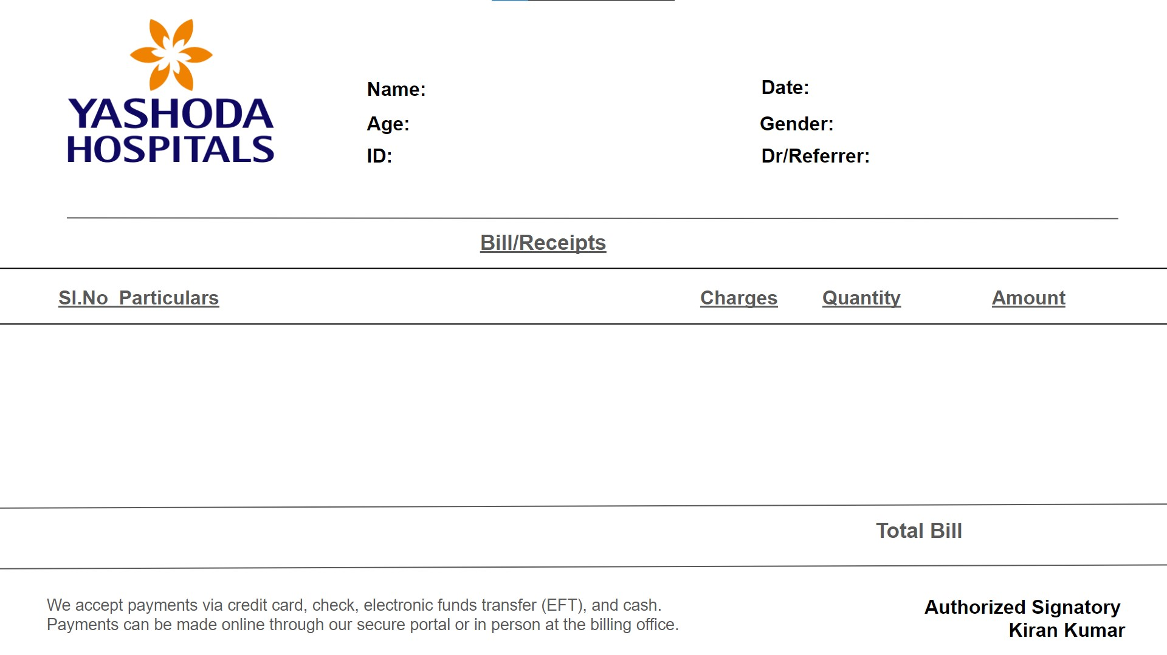
Template Extraction

Slide 10
Template Extraction

Slide 11
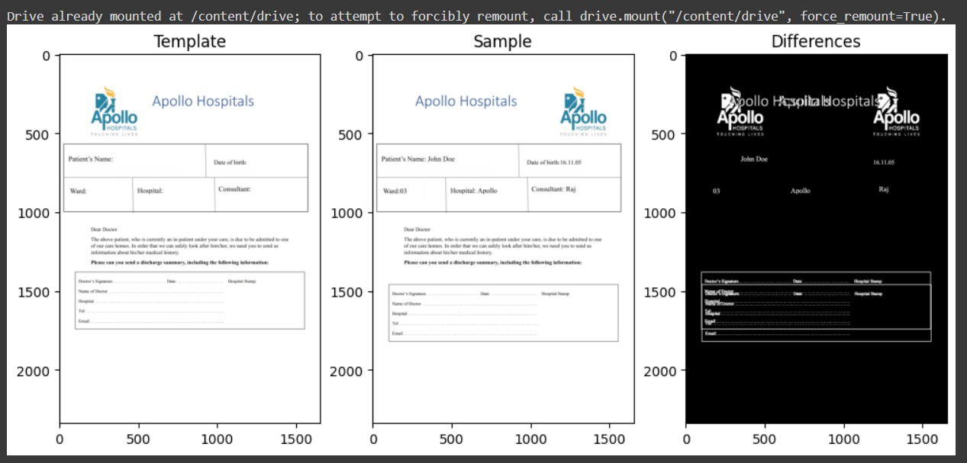

Template Comparison
Template Extraction

Slide 12
Template Comparison
Fraud
(Because of Template Mismatch)

Slide 13
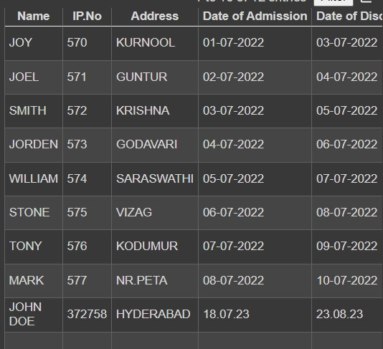
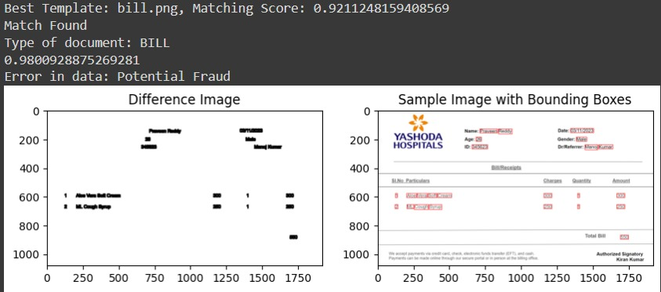

Template Comparison
Fraud Detection

Slide 14
Fraud Detection

Slide 15
Fraud Detection

Slide 16
Fraud Detection
Fraud
(Because the given context is not found in the DataSet)

Slide 17
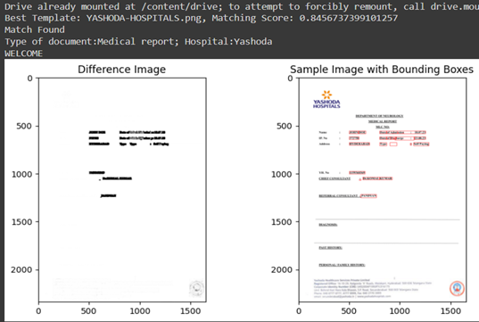

True Document

Slide 18
True Document
Match Found

Slide 19
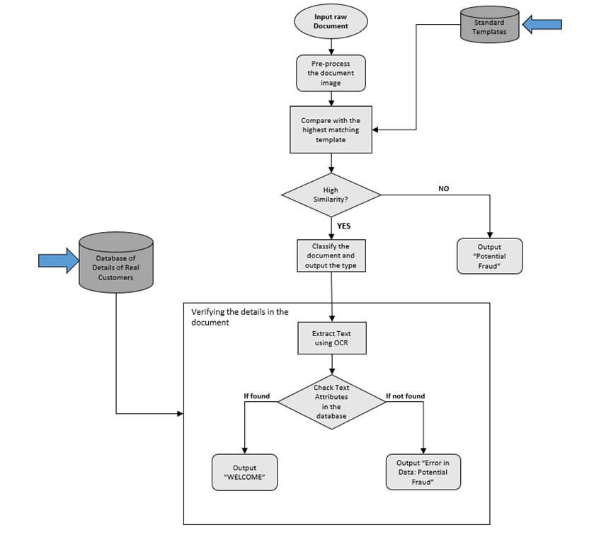
Architecture of the Algorithm

Slide 20
Conclusion
In conclusion, the proposed methodology offers a sophisticated and comprehensive solution to the challenges of medical document verification. By leveraging advanced techniques in template extraction and comparison, coupled with fraud detection mechanisms utilizing SSIM computation and OCR technology, the system demonstrates a high degree of accuracy and reliability. The flexibility embedded in the methodology, achieved through adaptive parameters, ensures adaptability to diverse medical document layouts, making it well-suited for real-world applications.

