Slide 1
Case-Based Analysis ofAlgorithm Efficiency
O(nlogn)
A Deep Dive into Merge Sort Performance Bounds
Academic Analysis Presentation
July 21, 2026

Slide 2
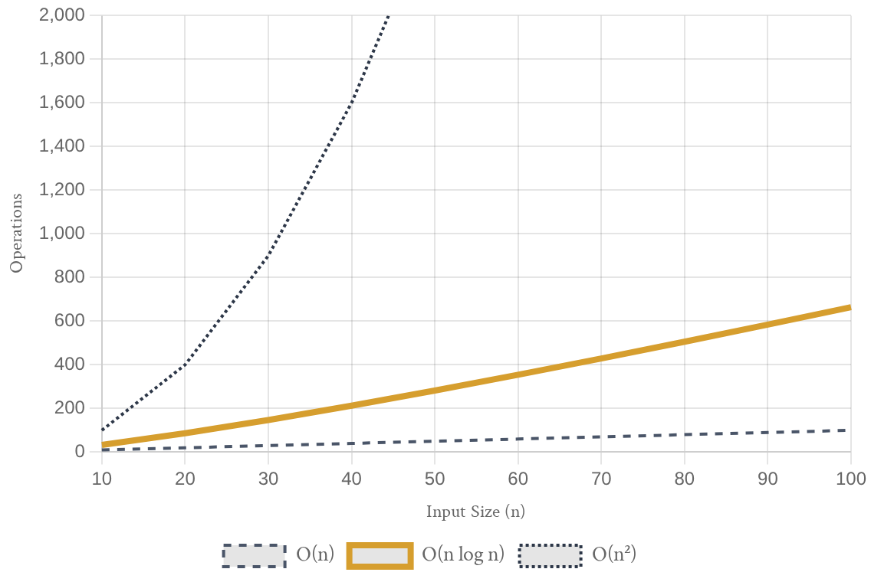
Fundamental Metrics ofAlgorithm Performance
EÆciency Metrics
Performance is primarily evaluated through **Time Complexity** (computational steps) and **Space Complexity** (memory allocation).
Asymptotic Notation
Mathematical tools like **Big O (O)**, **Omega (fi)**, and
**Theta (Θ)** define the upper, lower, and tight bounds of resource scaling.
Significance of Cases
Analyzing **Best**, **Average**, and **Worst** cases ensures a robust understanding of an algorithm's reliability across diverse inputs.
Complexity Class Comparison
Visualizing growth rates: O(n), O(n log n), and O(n²)

Slide 3
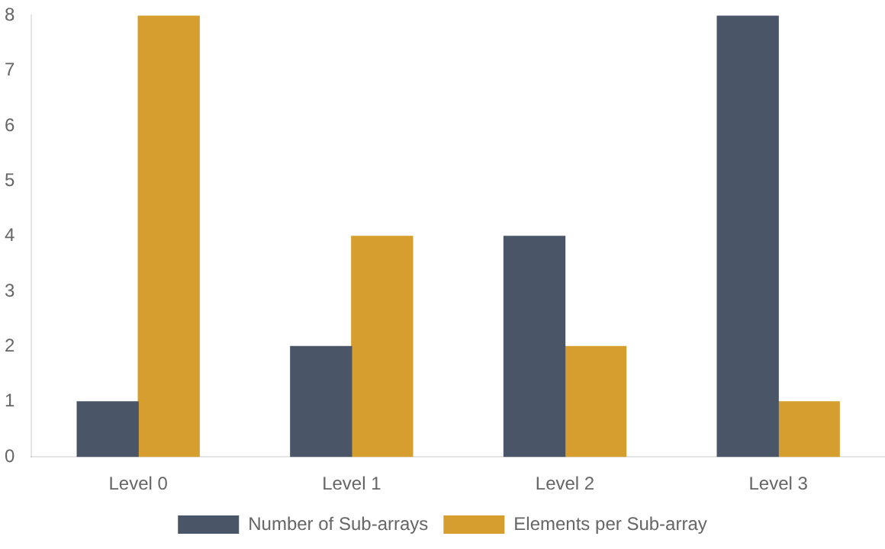
Merge Sort: The Divide and Conquer Paradigm
Core Principle
Merge Sort recursively splits an array into atomic sub-units, then merges them in a sorted sequence, ensuring a predictable O(n log n) scaling.
Structural Breakdown of Recursion
Recursion Depth
log n
Tree Height
Work Per Level
n
Merging Cost
Algorithmic Stability
Merge Sort is a **stable** algorithm. It preserves the relative order of equal elements, making it essential for sorting multi-key data structures.
Key Insight
The "Divide" phase takes O(1) per step, while the "Merge" phase performs the heavy lifting with O(n) complexity per level.
Visualizing log(n) recursion depth with n operations per level

Slide 4
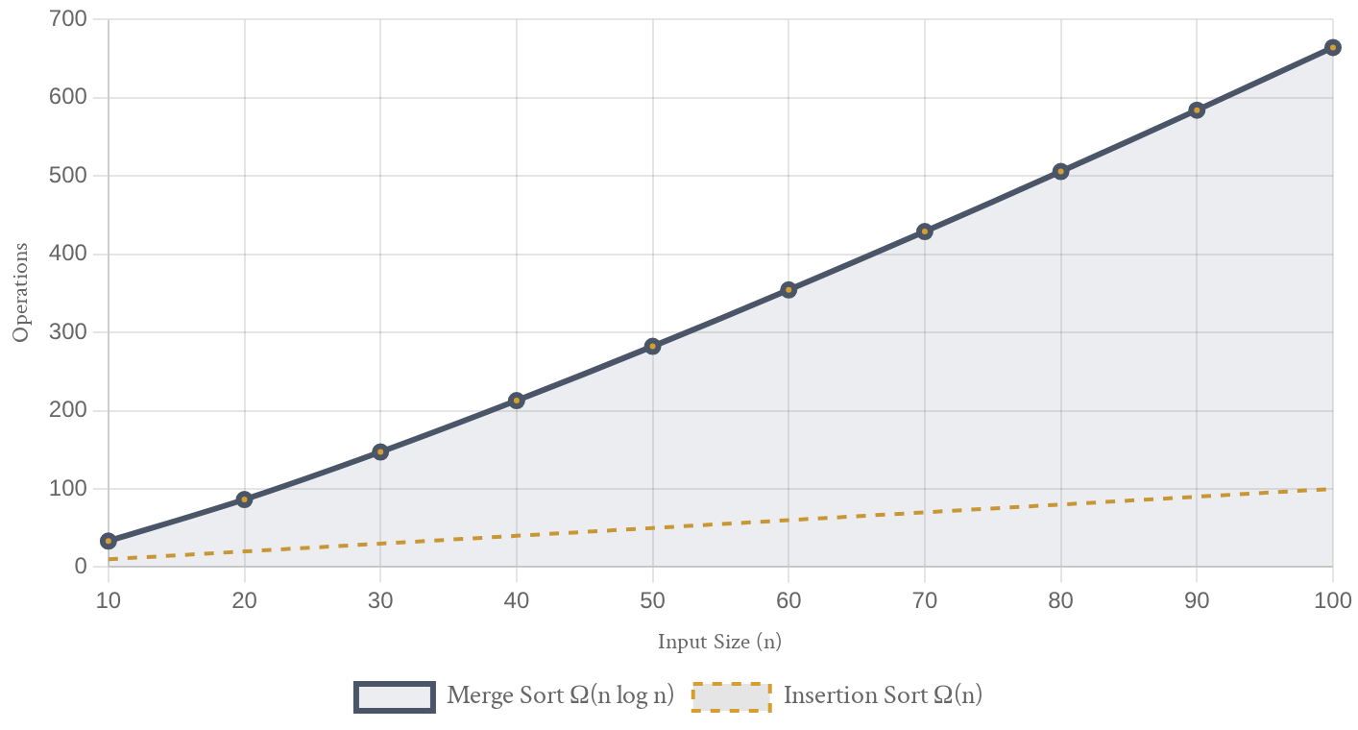
Best-Case Scenario: Performance on Sorted Data
Input Condition
The best case occurs when the input array is already sorted. However, Merge Sort's structure remains rigid.
Structural Consistency Recursive splitting always occurs Merging process is still executed No "short-circuit" mechanism Guaranteed Ω(n log n) bound
Key Comparison
Unlike Insertion Sort, which achieves O(n) on sorted data, Merge Sort maintains its logarithmic overhead.
Best-Case Complexity Comparison
Merge Sort (Ω(n log n)) vs. Adaptive Algorithms (Ω(n))

Slide 5
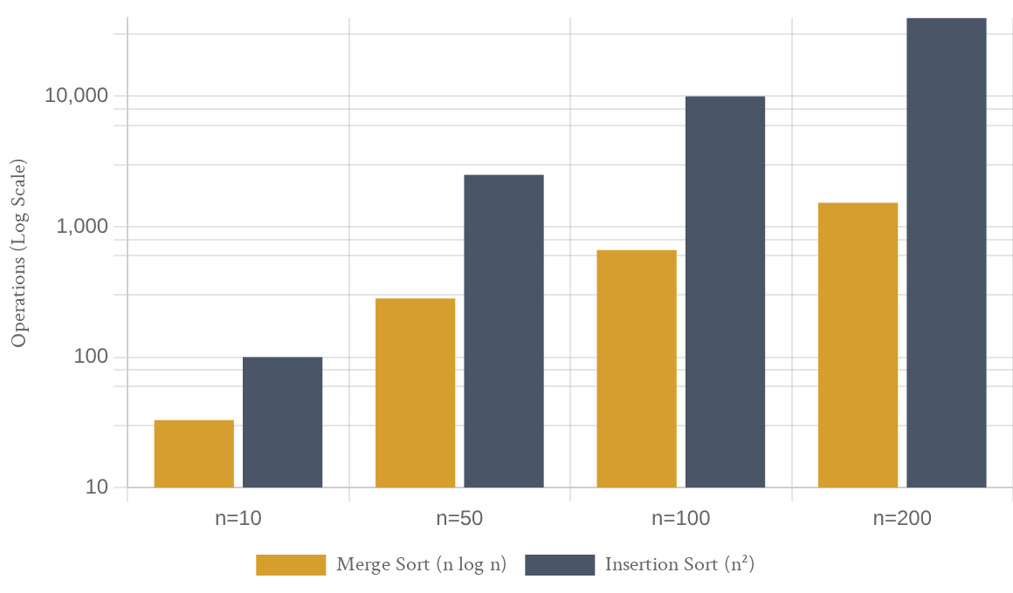




Average-Case Scenario: Predictable Performance
Mathematical Consistency
In the average case, where data is randomly distributed, Merge Sort maintains a tight bound of **Θ(n log n)** due to its fixed recursive structure.
Average-Case Complexity Comparison
Random Data
Handles arbitrary input sequences with uniform efficiency.
Fixed Depth
Recursion depth remains log(n) regardless of data order.
Scalability
Ideal for large-scale datasets in production environments.
Reliability
Performance does not degrade with "unlucky" pivots.
Strategic Implication
Merge Sort's average-case performance is identical to its worst-case, providing a level of determinism that is highly valued in real-time systems.
Operations comparison for random input distributions

Slide 6




Worst-Case Scenario: Guaranteed Performance Bounds
Algorithmic Performance Matrix
The O(n log n) Guarantee
Unlike Quick Sort, which can degrade to O(n²) on adversarial inputs, Merge Sort maintains a strict **O(n log n)** upper bound regardless of initial data distribution.
Merge Sort Stable & O(n log n) | Heap Sort Unstable & O(n log n)
Insertion Sort Stable & O(n²) | Quick Sort Unstable & O(n²)
Worst-Case (O(n log n) ↑ O(n²) ↓)
Predictability
Execution time is highly consistent, making it ideal for real-time systems.
Security
Protects against "Algorithmic Complexity Attacks" that exploit O(n²) weaknesses.
Strategic Implications
Essential for Service Level Agreements (SLAs) in cloud computing. Preferred in standard libraries (e.g., Java, Python's Timsort).
Trade-off: Guaranteed speed requires O(n) auxiliary space.
Stability (Stable ← → Unstable)
Comparing Worst-Case Complexity vs. Stability

Slide 7



Comparative Eficiency Matrix: Merge Sort
Strategic Advantage
Unlike Quick Sort or Insertion Sort, Merge Sort provides a **guaranteed upper bound**, making it the primary choice for systems requiring predictable latency.
Asymptotic Performance Consistency
1,000
800
Merge Sort (All Case
Best Case: Ω(n log n)
Occurs with already sorted data. While other algorithms might reach O(n), Merge Sort's structural overhead remains constant due to its recursive nature.
Quick Sort (Worst Case)
Operations
600
400
Average Case: Θ(n log n)
The standard expectation for random data. The algorithm consistently performs log n levels of work with n comparisons per level.
200
0
0
20
40
60
80
100
Input Size (n)
Worst Case: O(n log n)
Even with adversarial or reversed inputs, Merge Sort never degrades to quadratic time, providing critical protection against performance spikes.
Merge Sort maintains O(n log n) across all input distributions.

Slide 8
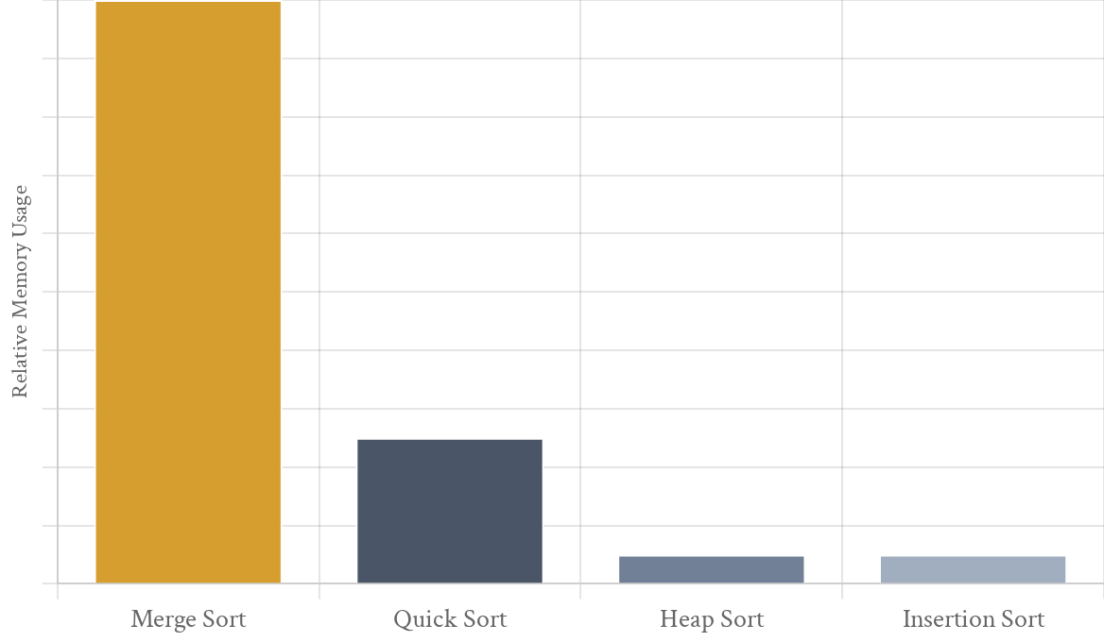
Space Complexity and Architectural Trade-oks
Auxiliary Space Requirements
Merge Sort requires **O(n)** additional space to store temporary sub-arrays during the merge phase, making it a non-in-place algorithm.
Memory Constraints
High overhead for large datasets in RAM
Less ideal for memory-constrained embedded systems Recursive stack depth adds **O(log n)** space
The Stability Trade-o9
The cost of **O(n)** space is the price paid for **guaranteed O(n log n)** time complexity and **algorithmic stability**.
Space Complexity Comparison
Comparing auxiliary memory requirements across sorting algorithms

Slide 9



The Verdict: Strategic Application of Merge Sort
The Reliability Advantage
Merge Sort's **guaranteed O(n log n)** performance and **stability** make it the gold standard for mission-critical systems where predictability is non-negotiable.
Algorithm Selection Framework
ty Required
Insertion Sort
Merge Sort
EÆciency Leader
Consistently outperforms quadratic algorithms on large datasets. Its performance remains robust even under adversarial input conditions.
Selection Sort
Quick Sort
Universal Scaling
The $n \log n$ scaling across all cases makes it a "safe" choice for general-purpose libraries and high-throughput data pipelines.
ot Required
Small Data
Large Data
Selection Criteria
Prioritize Merge Sort when **stability** is required and **O(n) auxiliary space** is available. Consider alternatives only for strict O(1) space limits.
Choosing the right algorithm based on constraints and requirements.

