Slide 1
AI/NLP Financial Risk Engine
S&P GLOBAL & CRISIL CAMPUS HACKATHON 2026
From headlines and posts to explainable risk signals, a sentiment-driven index and an event-driven portfolio stress test
[Your Full Name]
[Your College Name]
Notes:
Introduce yourself and the one-line pitch: the engine turns unstructured news and social media into structured, explainable risk signals, then uses them in both downstream modules from the brief.

Slide 2
Risk news never reaches the portfolio
The problem
One engine, three fields per signal
Analysts scan thousands of headlines and posts a day; coverage is slow and inconsistent
A sentiment number alone does not say what happened or how much it matters
A score nobody can explain will not pass model validation
Sentiment score
-1 to 1, from FinBERT
1
Event classification
11 event types, from geopolitical to credit event
2
Impact score
1 to 10, fitted to how far prices really moved
3
Both downstream modules run on the same signal feed: Module A (index rebalancer) and Module B (portfolio stress test).
Notes:
State the business problem in your own words, then the approach: every document becomes a signal with three fields. Stress that the impact score is calibrated on realised price moves, and that both modules were built, not just one.

Slide 3
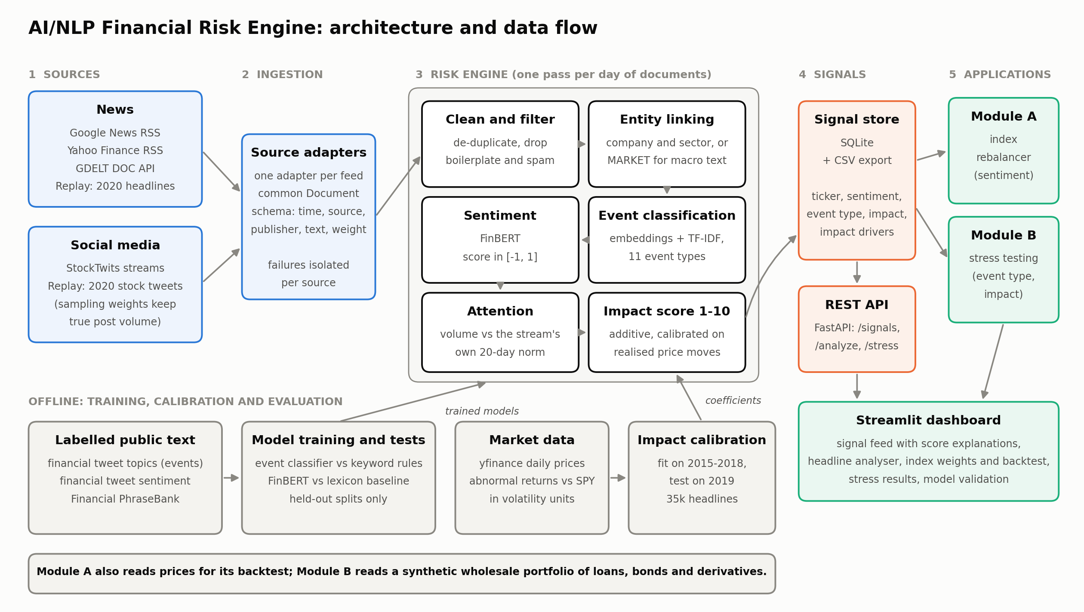
From raw text to portfolio impact
Notes:
Walk left to right: two source types, adapters to one schema, six engine stages, the signal store and API, then the two modules and the dashboard. The bottom row is offline training and calibration. Replay mode and live mode use the same engine.

Slide 4
Four choices that make signals trustworthy
1
Entity linking that knows roles
2
Impact fitted to the market
A bank quoted as the broker ("rating reaffirmed at JPMorgan") is not the subject. Social posts link by cashtag only.
An additive model trained on abnormal price moves after 35,000 headlines. Every score shows its drivers.
3
Attention measured honestly
4
Fully local and reproducible
Volume against each stream's own norm; share of voice for social, where the collector sets the volume.
Open models on CPU, no paid API. Score cache, replay and live modes, REST API, 45 automated tests.
Notes:
Pick two of these to talk through in detail. The broker-role rule and the share-of-voice fix both came from looking at real failures in the data, which is worth saying out loud.

Slide 5
Each model beats its naive baseline
71.6%
Sentiment accuracy
lexicon baseline 49.6%
85.9%
Event classification
keyword rules 54.7%
38%
Big move when impact > 7
any stock-day 8%
Impact tested on 5,969 headlines from 2019, fitted on 2015-2018. Move is the abnormal return over two days, in units of the stock's own volatility.
Notes:
Three numbers and one chart. Say clearly what each baseline is. Mention that FinBERT's 97% on Financial PhraseBank is deliberately not shown because it was trained on that data, and that the impact test year was held out.

Slide 6
Signals priced two real stress days
Module B: stress testing
Module A: index rebalancer
-$162m
10 Mar 2020, after the oil-price crash
+10.8%
sentiment-tilted index, Jan-Jul 2020
-$135m
2 Apr 2020, record US jobless claims
+11.2%
equal-weight index, same 18 stocks
Triggered automatically on a $7.4bn synthetic book of loans, bonds and derivatives
Both days had the VIX near 50; credit spreads drove the loss
No outperformance, slightly lower volatility and drawdown
Sentiment tracks the same day's return but not the next tradable one: it describes moves, it does not forecast them
Notes:
Module B is the stronger story: the engine fired twice, both on genuine stress days, and each loss is split by risk factor, sector and position in the dashboard. Be upfront on Module A: it works as built, the backtest is deliberately conservative (trade at the close of t+1), and the honest finding is that sentiment is coincident with returns. SPY returned +0.7% over the same window.

Slide 7
What is not yet proven, and what is next
Limitations
Next steps
Market-wide impact is not validated: the public headlines are stock commentary, not a macro newswire
Coverage volume drives most of the impact score; event type adds little
One six-month window that includes the COVID crash
Stress model is a simplified sensitivity revaluation on a synthetic book
Time-stamped newswire or GDELT events for the market scope
1
Sentiment per company inside one headline
2
A continuous live poller, so attention is measured on live data
3
Rating migration and correlated shocks in the stress engine
4
Notes:
Lead with the limitations yourself before the jury asks. The first one is the most important: the market-scope fit showed no relationship in 2019, so it reuses the single-company coefficients, and a better feed is the first fix.

