Slide 1


Communication and Computation for Drones
BITS Pilani
Pilani Campus
Dr. Vinay Chamola
Department of Electrical and Electronics, Pilani Campus
Date: 1st Aug,2025

Slide 2
Operation Spider Web – A Modern Drone Tactic
Drones are no longer used only for surveillance; they are now being deployed for offensive operations.
Operation Spider Web is a real military mission where many small drones worked together like a spider’s web.
These drones were used to carry out a precise strike deep inside enemy territory.
Watch carefully to see how technology, communication, and coordination are key to modern drone warfare.

Slide 3
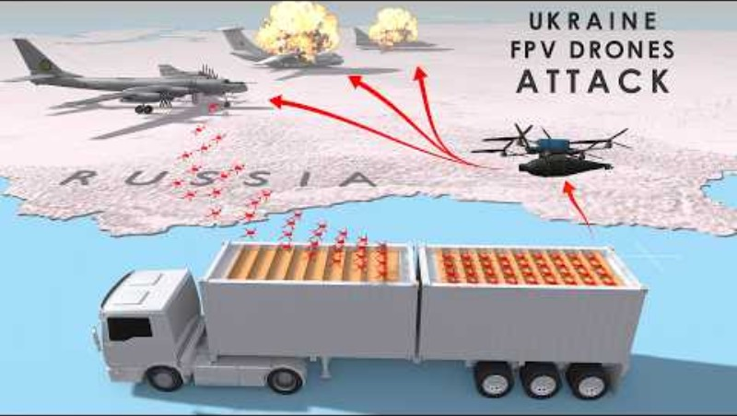
Operation Spider Web – A Modern Drone Tactic

Slide 4
Operation Spider Web – A Modern Drone Tactic
Q1: What are the key components of the drones used in Ukraine's operations?
Notes:
Airframe: lightweight carbon fiber for speed and durability.
Propulsion: counter-rotating propellers for stability and maneuverability.
Payload: cameras for real-time control, RPG warheads, high-explosive and shaped charges.
Communication: fiber optic links resistant to jamming; encrypted activation signals.

Slide 5
Operation Spider Web – A Modern Drone Tactic
Q1: What are the key components of the drones used in Ukraine's operations?
Q2:How do Ukrainian drones differ in their control mechanisms compared to conventional models?
Notes:
Fiber optic cables ensure secure, interference-free communication.
AI and real-time video navigation guide drones to precise targets.
GPS-denied operations with hidden launch sites and signal shielding.
Secondary drones boost signal strength to counteract enemy jamming.

Slide 6
Operation Spider Web – A Modern Drone Tactic
Q1: What are the key components of the drones used in Ukraine's operations?
Q2:How do Ukrainian drones differ in their control mechanisms compared to conventional models?
Q3:What practical advantages do these drone technologies offer in military operations?
Notes:
Covert launch systems near targets reduce enemy reaction time.
Precision strikes on air bases, fuel depots, and strategic bombers.
Reduced risk to personnel and lower operational costs.
Flexible warhead deployment for varied mission objectives.

Slide 7
Operation Spider Web – A Modern Drone Tactic
Q1: What are the key components of the drones used in Ukraine's operations?
Q2:How do Ukrainian drones differ in their control mechanisms compared to conventional models?
Q3:What practical advantages do these drone technologies offer in military operations?
Q4:How can these developments influence the future of drone technology and warfare?
Notes:
Demonstrates advanced stealth and autonomous operation techniques.
Encourages development of resilient communication systems.
Expands strategic targeting beyond traditional battle zones.
Raises new challenges in countermeasures, ethics, and defense planning.

Slide 8
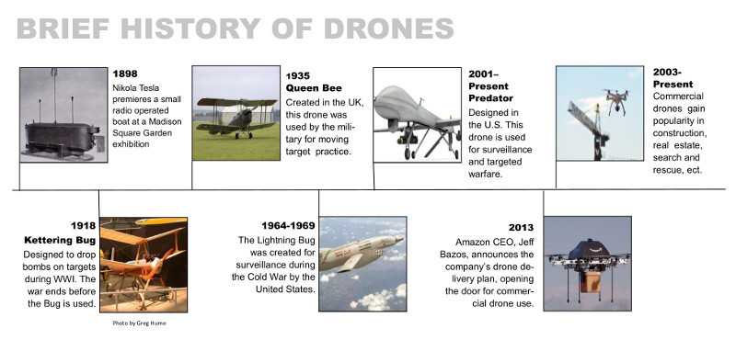
History of Drones

Slide 9

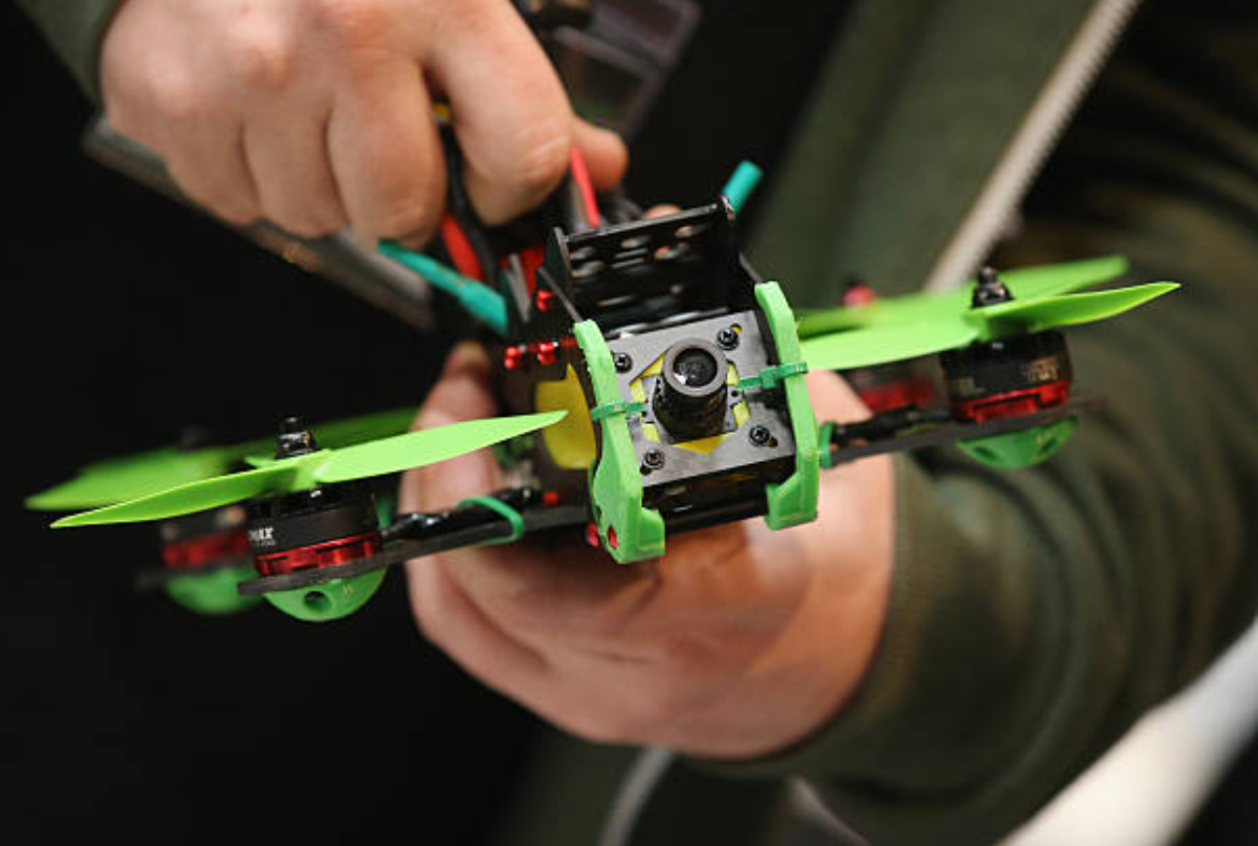
Types of Drone Users
User Type | Most Common Vehicle | Programming Tools | Knowledge Required | Examples
Pilot | Closed architecture drones | GUI-based software | Basic technical knowledge, flight rules | Racing pilot, photographer

Slide 10
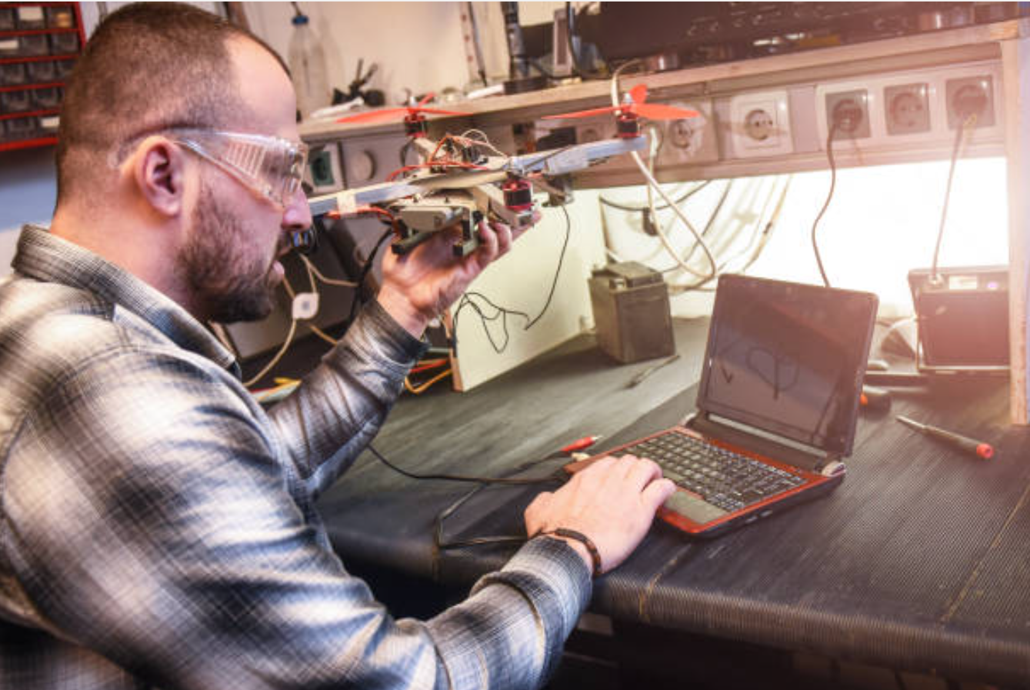
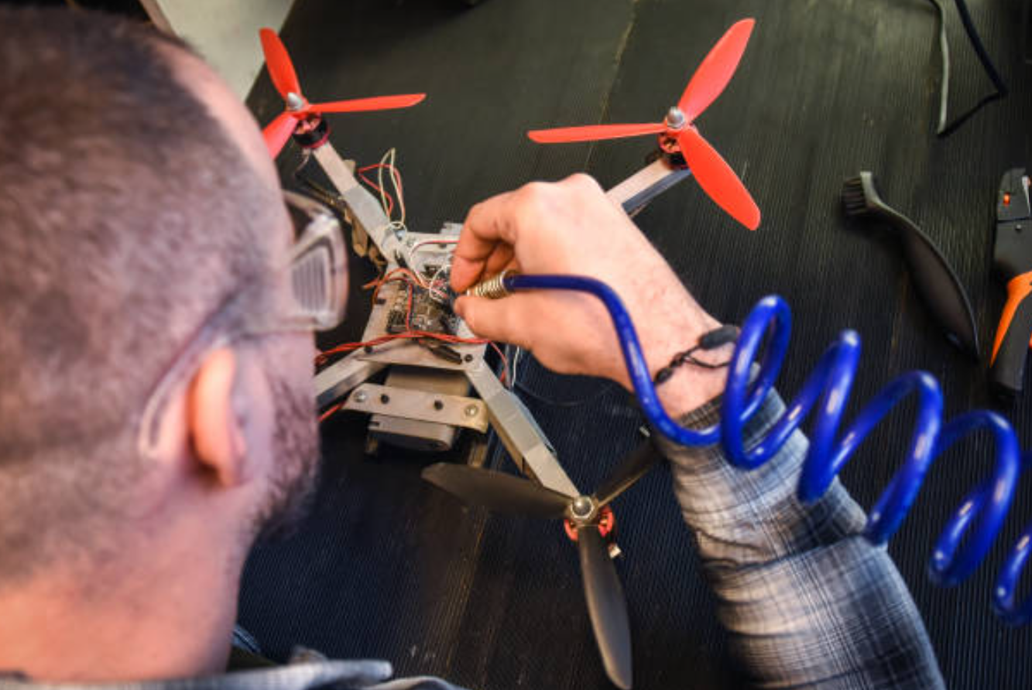
Types of Drone Users
User Type | Most Common Vehicle | Programming Tools | Knowledge Required | Examples
Researcher (using drones as tools) | Mostly closed or limited open systems | GUI or SDK Type 1 | Maker-style knowledge; research tasks unrelated to drone design | AI, SLAM algorithms

Slide 11
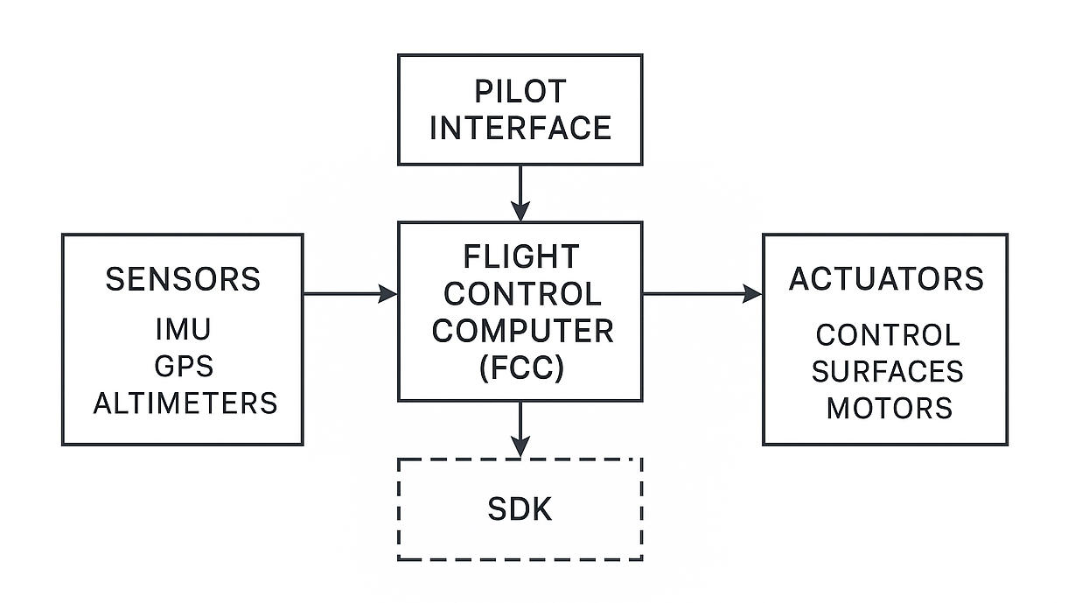
Types of Drone Users
User Type | Most Common Vehicle | Programming Tools | Knowledge Required | Examples
Specialist Researcher | Kit-like open architectures | SDK Type 2 or 3 | Scientific knowledge on robotics and controls | Advanced research platforms
Designer | Open architecture designs | SDK Type 3 | In-depth knowledge of aircraft control and design | Aircraft system designers

Slide 12
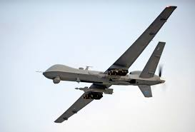
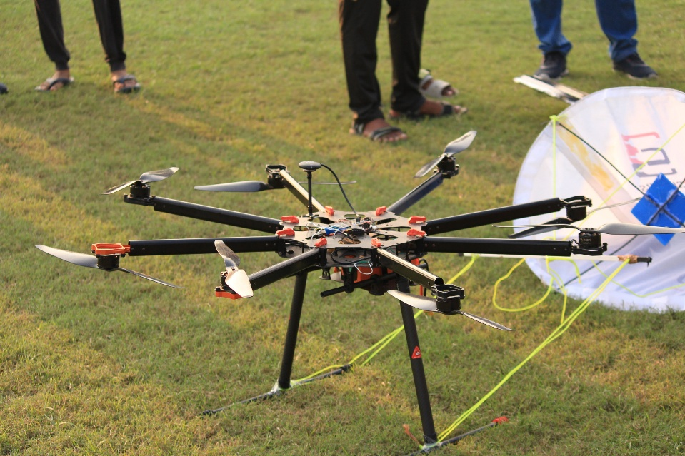
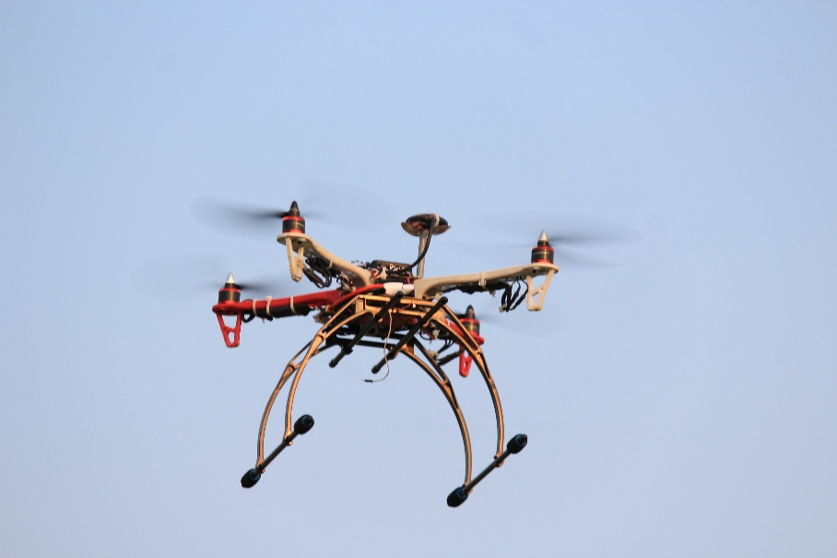
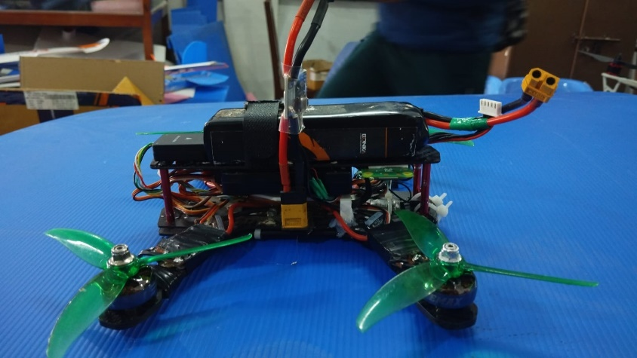
Introduction to Drones
Drone (UAV): An Unmanned Aerial Vehicle (UAV) is an aircraft that operates without a human pilot onboard. It is either remotely controlled or flies autonomously through pre-programmed flight plans.

Slide 13
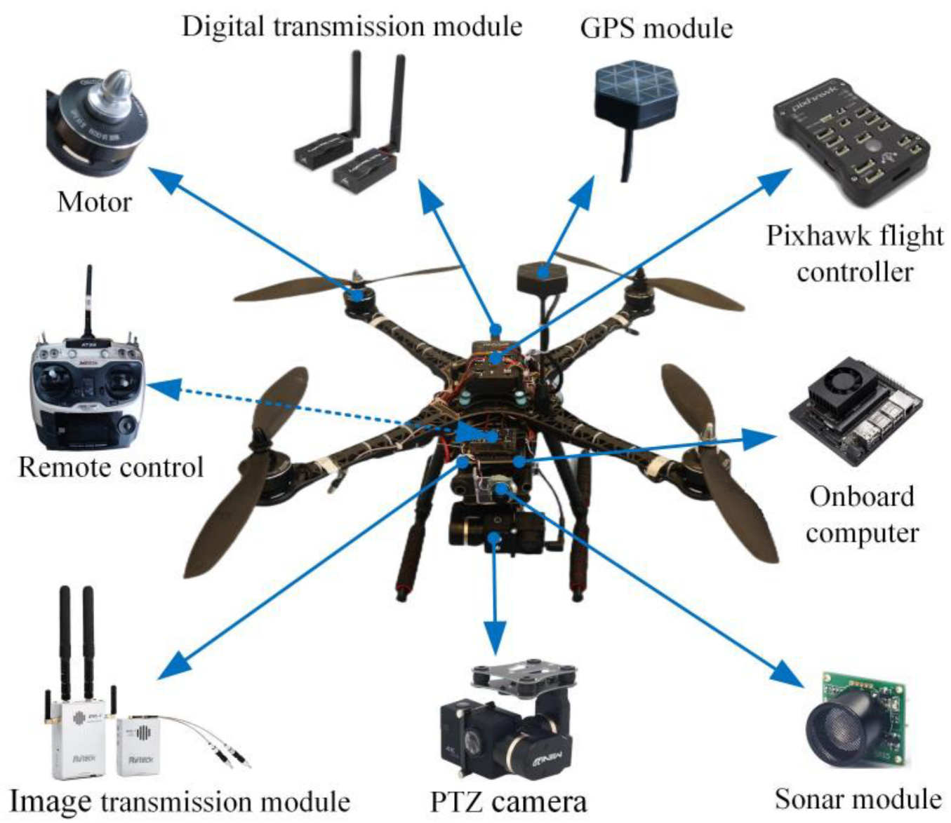
Key Components:
Airframe: The structural body of the drone.

Slide 14
Key Components:
Airframe: The structural body of the drone.
Propulsion System: Includes motors, rotors/propellers, and possibly fuel or batteries that generate thrust.

Slide 15
Key Components:
Airframe: The structural body of the drone.
Propulsion System: Includes motors, rotors/propellers, and possibly fuel or batteries that generate thrust.
Navigation & Control Systems: Comprise GPS, sensors, and autopilot algorithms that determine flight path and stabilize the vehicle.

Slide 16
Key Components:
Airframe: The structural body of the drone.
Propulsion System: Includes motors, rotors/propellers, and possibly fuel or batteries that generate thrust.
Navigation & Control Systems: Comprise GPS, sensors, and autopilot algorithms that determine flight path and stabilize the vehicle.
Payload: Any additional equipment such as cameras, sensors, or weapons.

Slide 17
Key Components:
Airframe: The structural body of the drone.
Propulsion System: Includes motors, rotors/propellers, and possibly fuel or batteries that generate thrust.
Navigation & Control Systems: Comprise GPS, sensors, and autopilot algorithms that determine flight path and stabilize the vehicle.
Payload: Any additional equipment such as cameras, sensors, or weapons.
Applications: Drones are used in photography, surveillance, agriculture, delivery, research, and military operations.

Slide 18
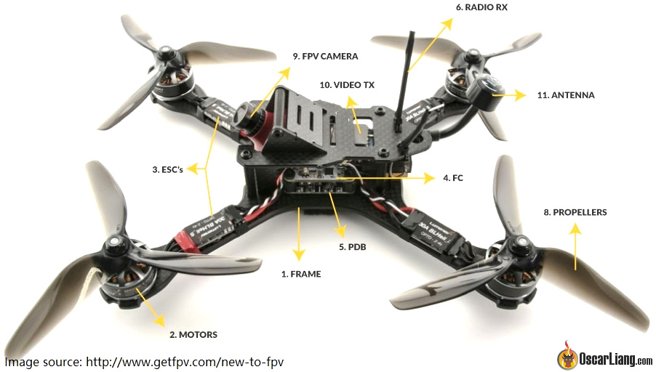

Slide 19
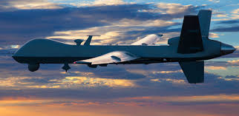
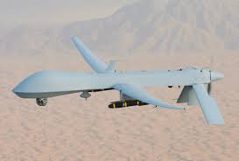
Drone History & Evolution (Civil vs. Military Applications)
Evolution and Divergence:
Military Drones:
Initially designed for reconnaissance, target practice, and later for armed strikes, military drones have evolved into high-end platforms like the MQ-1 Predator and MQ-9 Reaper. They are built with advanced sensors, stealth technology, and precision weapons.
Reconnaissance: The use of drones to gather intelligence by collecting imagery or sensor data without engaging the enemy directly.
MQ-1 Predator
MQ-9 Reaper

Slide 20
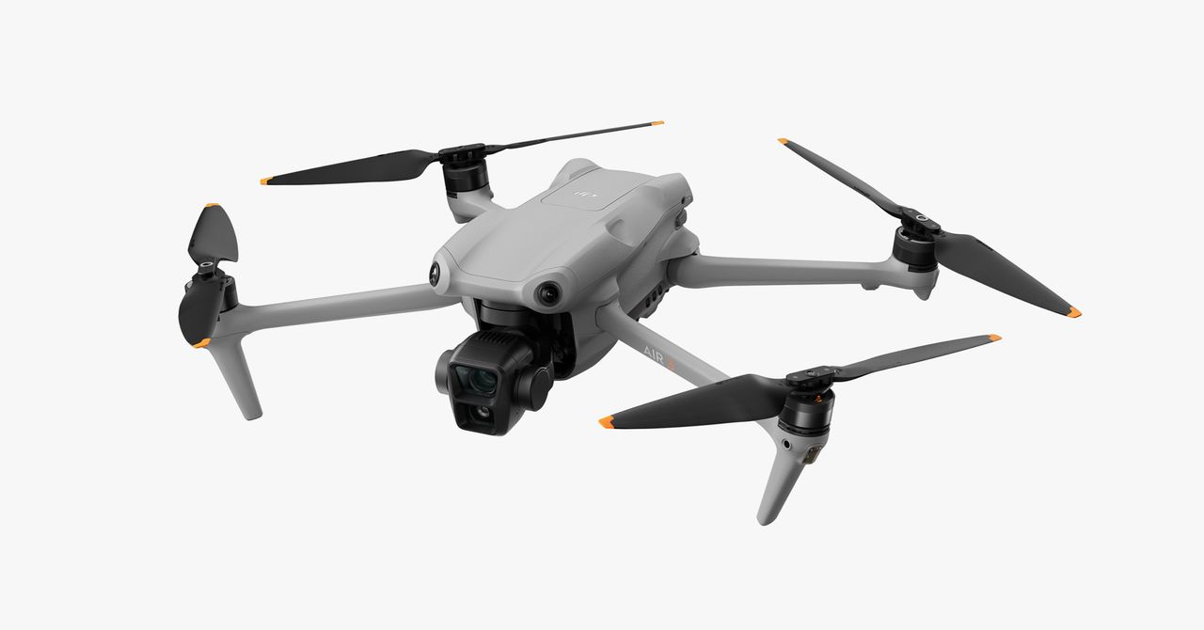
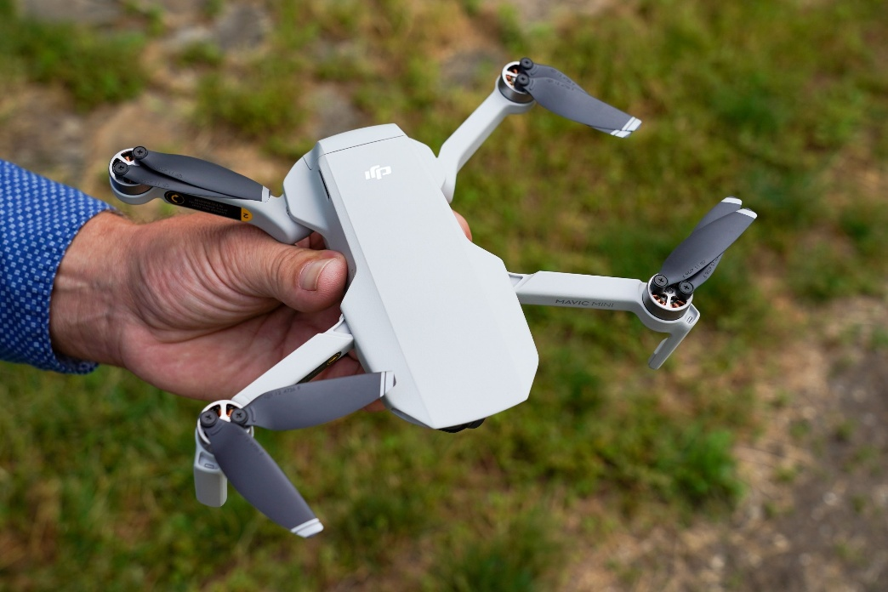
Civilian Drones:
In recent decades, smaller, cost-effective drones have been developed for commercial and recreational purposes. They serve in aerial photography, surveying, agriculture, and package delivery.

Slide 21
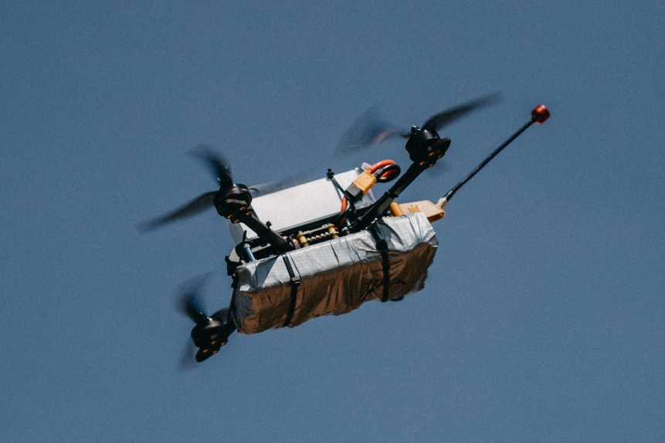
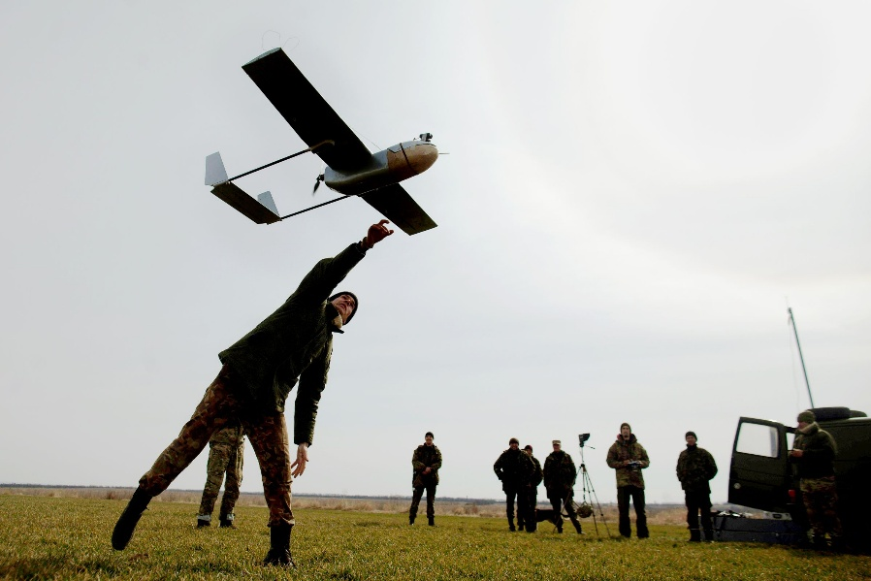
FPV Drone(First Person View):
Used for precision “kamikaze” strikes on enemy armor and artillery.
Operated by troops (often assembled by civilians) to deliver close-range, real-time video and rapid, targeted attacks.
Fixed Wing Cardboard Drones:
Provide live aerial reconnaissance and mapping of Russian positions.
Help commanders coordinate artillery fire and adjust troop movements using high-resolution video feeds.
Overall Impact:
This dual approach boosts situational awareness and offers a cost-effective means to disrupt enemy forces.

Slide 22
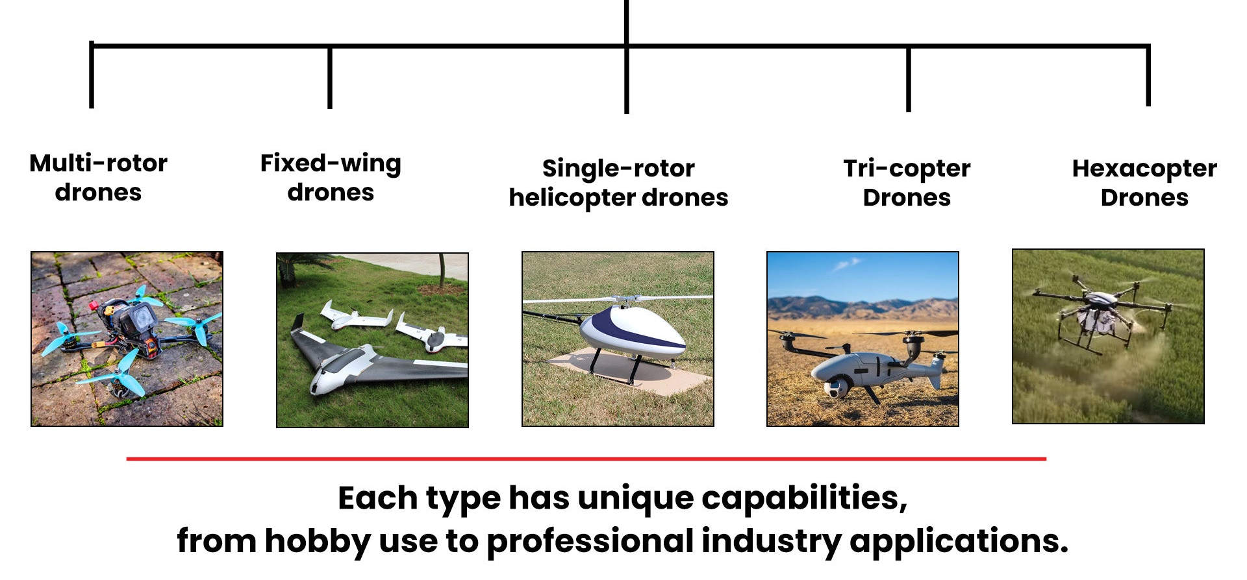
Types of Drones

Slide 23
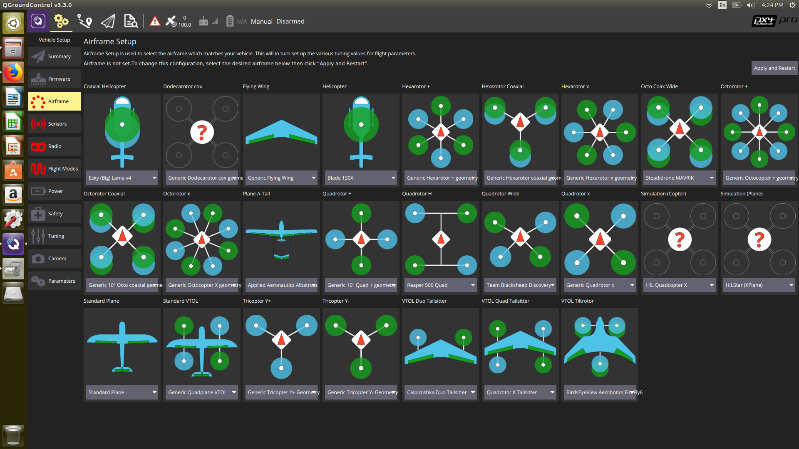

Slide 24
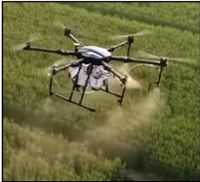
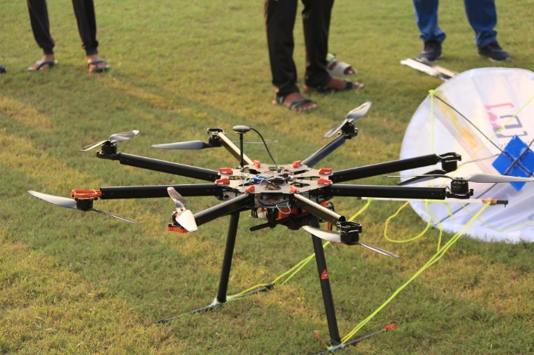
Types of Drones
Multirotors: UAVs that have multiple rotors for thrust, lift and control purposes. These are the most common types of drones used for versatility and the ability to hover. These are used for both hobby and military use.
There are many types of multirotor drones with N number or rotors in many configurations. Most common ones are the Quadcopters and Hexacopters with 4 rotors and 6 rotors respectively.
Quadcopters- 4 rotors: Most common & stable
Tricopters- 3 rotors: Needs a Servo
Hexacopters- 6 rotors: More life, redundancy
Octocopters- 8 rotors: Heavy payload
Y6/X8- Coaxial stacked rotors

Slide 25
Types of Drones
Multirotors- Advantages and Disadvantages
Advantages
VTOL- Vertical take-off & Landing. No runway needed.
Hovering capability
Easy to Control
Precise maneuvers
Disadvantages
Short flight time (Battery)
Payload constrains
Wind sensitivity
Less efficient for long range.

Slide 26
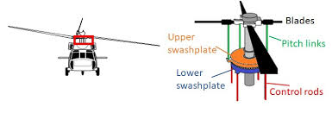
Types of Drones
Swash Plate Systems: A swash plate is a mechanical assembly used in helicopters to control the pitch of the main rotor blades, enabling lift generation and maneuvering. It acts as the interface between the pilot’s controls and the rotating rotor system. The swash plate consists of two main parts: a non-rotating (fixed) plate, which is connected to the control linkages, and a rotating plate, which spins with the rotor blades.

Slide 27
Types of Drones
Swash Plate Systems: Advantages and Disadvantages
Advantages
Dynamic Maneuverability
Efficient Hovering
High lift capacity
VTOL Capacity
Disadvantages
Mechanical Complexity
Added weight
Higher Costs
Vibration sensitivity

Slide 28
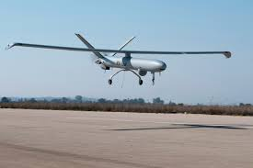
Types of Drones
Fixed Wing Drones: Fixed-wing UAVs rely on aerodynamic wings to generate lift during forward motion, enabling efficient long-range and high-endurance flight, with control provided by conventional aerodynamic surfaces.
The parts needed for making a Fixed-wing drones are-
Wings- Generate lift, shape effects the performance
Fuselage- Avionics, Power and Payload
Control Surfaces- Ailerons (Elevons in delta wings) and Elevators
Propulsion- Motor/Propellor or Jet
Landing Gears- Fixed or retractable

Slide 29
Types of Drones
Fixed Wing Drones: Advantages and Disadvantages
Advantages
Longer Flight Duration
Energy Efficient
High Speeds
Glide Capacity
Disadvantages
Needs runway or a launcher
Cannot Hover
Complex operation
Stall Risk in Low speeds

Slide 30
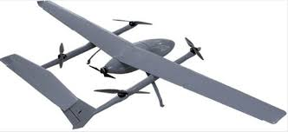
Types of Drones
IV. Hybrid UAVs- Hybrid unmanned aerial vehicles combine the characteristics of both fixed-wing and rotary-wing aircraft to achieve vertical take-off and landing (VTOL) capability along with efficient forward flight. These systems use rotors to generate lift during take-off, landing, and hovering, while fixed wings provide aerodynamic lift during cruise, significantly improving range and endurance compared to pure rotary-wing UAVs.
Types of Hybrid UAVs-
Tilt-rotor: Rotors tilt vertical/horizontal
Quadplane: Fixed-wing + VTOL rotors
Powered-lift: Separate systems
Tail-sitter: Takes off on tail

Slide 31
Types of Drones
IV. Hybrid UAVs- Advantages and Disadvantages
Advantages
No runway needed
Energy efficient cruise
Versatile missions
Good payload capacity
Disadvantages
Complex mechanisms
Added weight
Efficiency trade-offs
More maintenance

Slide 32
Ethical Concerns and Legal Considerations
Privacy Issues:
The risk that drones may capture images, videos, or data of private citizens without consent, leading to breaches of personal privacy and unauthorized data collection.
Safety & Airspace Management:
Ensuring drones do not collide with other aircraft or objects. Regulatory bodies such as the FAA (Federal Aviation Administration in the US) set rules regarding altitude limits, no-fly zones, and registration requirements.
Ethical Debates:
Concerns regarding the use of drones in military operations, surveillance, and targeted strikes raise questions about accountability
proportionality, and civilian safety.

Slide 33
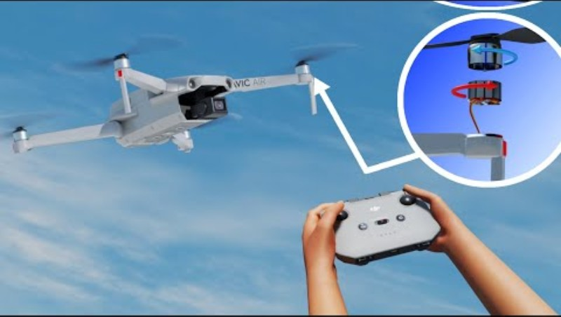
Flight Control Dynamics

Slide 34
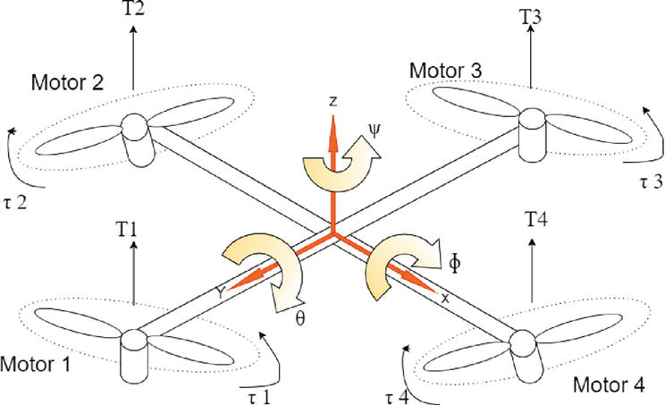
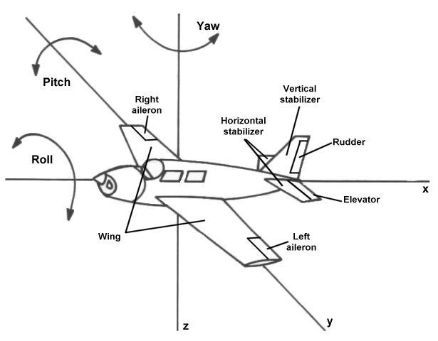
Flight Control Dynamics

Slide 35
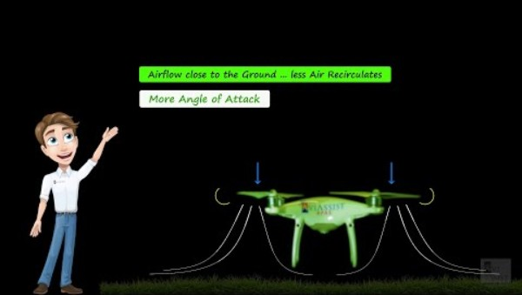
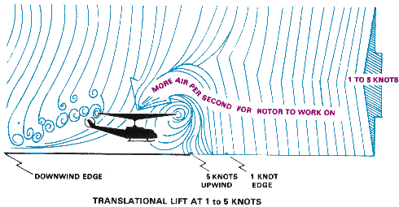
Translational Lift
Translational Lift: Definition: Additional lift generated when a drone transitions from hover to forward flight. As the drone moves forward, the airflow improves rotor efficiency, increasing lift.

Slide 36
Vortex Rings
Vortices in Aerodynamics (Airplanes/Fixed-Wing Aircrafts): Generally, vortices, from the perspective of the lift, is not that bad. Instead, it is directly related to delaying of the stall of the aircraft. In Rotorcrafts, however, the Vortex Rings, much better known as VRS (Vortex Ring State) is anything but useful.
Stalling: Stalling is an aerodynamic phenomenon that makes the aircraft unstable, out of control and can drastically lose lift (can go into a nose-dive). In terms of aerodynamics, it is when the wind “separates“ too much from the wing’s upper surface due to high Angle of Attack. (More on these in the next slides) Lift comes from the pressure difference between the upper and lower surfaces of the wing, created by the wing’s shape and angle of attack, which accelerate airflow over the top and deflect air downward. The wind tunnel tests on the wings are a nice way to see the effect of the pressure difference. It also tells us why the wing is shaped as it is, from the side view. Before diving deeper with big jargons, let’s clear few things.
To understand the stalling better, we will be diving into the Aerodynamics of Aircrafts in general.

Slide 37
Aerodynamics: Mind Map
Aerodynamics-
Basics
Critical Analysis of Teardrop Shape
Stall
Lift
Drag
Why & How
Coanda Effect
Separation & Wake Region
Angle of Attack (AoA)
AoA in Rotorcrafts & Fixed-wing Aircrafts
Lift & Drag (of Teardrop Shape)
Critical AoA

Slide 38
Aerodynamics: Basics
Quick Question:
Which Part of the Aircraft is responsible for generating lift?

Slide 39
Aerodynamics: Basics
Quick Question:
Which Part of the Aircraft is responsible for generating lift?
Answer: The entire Aircraft!

Slide 40
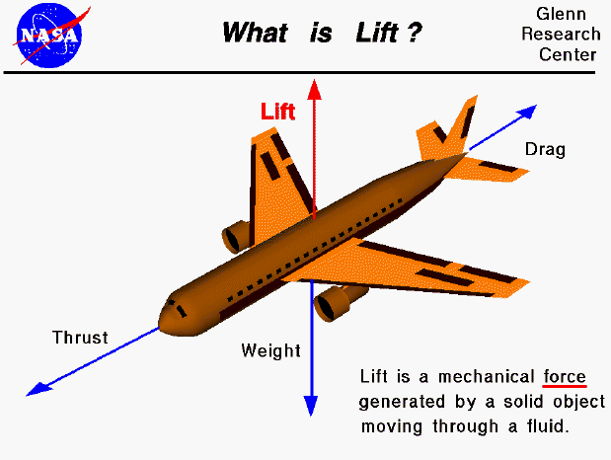
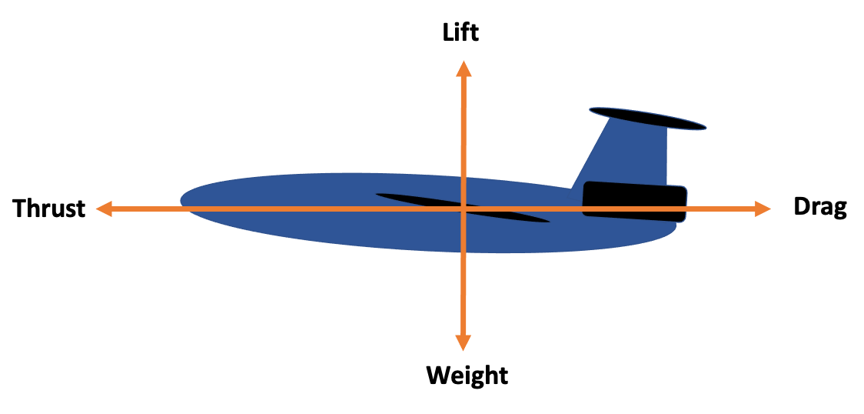
Aerodynamics: Basics
Generating Lift: Anything, ANYTHING, that is moving in a fluid can produce lift!
But in most scenarios that we see daily, the lift isn’t enough to overcome the object’s weight because the relative speed isn’t high enough!
In our daily lives, the cars or vehicles are not fast moving or not designed in a specially shaped surface (like wings) to generate enough lift to sustain flight.
supplementary video link

Slide 41
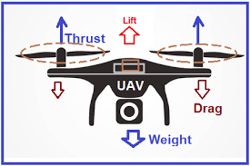
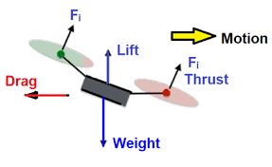
Aerodynamics: Basics
Generating Lift: In Rotorcrafts, the thrust and lift is upwards during the lift-off. Hence gaining altitude, though the aircraft stays (almost) in the same position. Lift is always upwards.
Different phases of flight, in rotorcrafts, effect where the thrust would be pointing to. In lift-off phase, the thrust and lift are upwards. During forward movement, the thrust moves diagonally to the front. In the hovering phase, the thrust (upwards first) would then become zero with lift upwards again.

Slide 42
Aerodynamics: Basics
Calculating Lift: There’s no universal equation to find out lift, but we can get a good approximation with the above equation. Better way to see the lift is using CFD (Computational Fluid Dynamics) as it provides a 3D environment and adds many factors to calculate the lift, but this equation is a good approximation.
$$L =\frac{1}{2} ρv^{2}S C_{L}$$
Where,
𝝆 = air density
$v$ = airspeed relative to the aircraft
$S$ = surface area / blades’ disc area (hovercrafts)
$C_{L}$ = lift coefficient

Slide 43
Aerodynamics: Basics
Calculating Lift: Now with this formula in mind, we can now calculate the lift required for any object. To lift the aircraft from the ground, the minimum lift required is equal to the weight of the aircraft ( W = m x g)
In other words,
$$L =W= \frac{1}{2} ρv^{2}S C_{L}$$
Where,
𝝆 = air density
$v$ = airspeed relative to the aircraft
$S$ = surface area / blades’ disc area ($πr^{2}$) (hovercrafts, r = Blade Length)
$C_{L}$ = lift coefficient

Slide 44
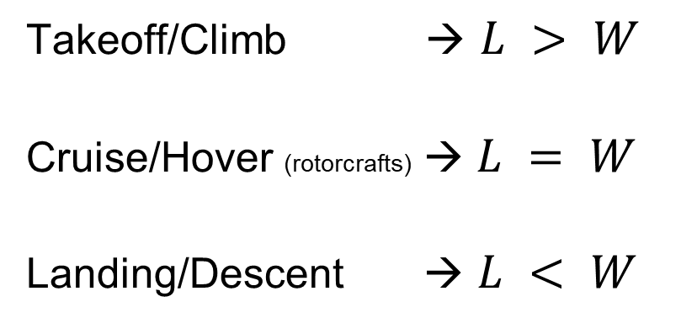
Aerodynamics: Basics
Calculating Lift: Different phases of flight needs different lift. Takeoff needs lift more than the weight, cruising needs lift equal to the weight (maintaining altitude) and descent needs a lift less than the weight.
In other words,
Takeoff/Climb → $L > W$
Cruise/Hover (rotorcrafts) → $L = W$
Landing/Descent → $L < W$

Slide 45
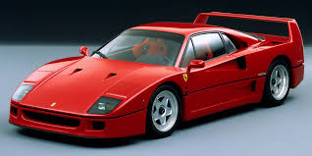
Aerodynamics: Basics
Generating Lift: Example of lift being produced without any wings is a fast car like a Sports Car.
In fast cars like a race car, Formula 1 cars, etc, lift is produced as they gain fast speeds in a fluid (air). But in Sports like these, lift is a disadvantage as it reduces the traction of the car (The contact between the car and the ground) as it tends to lift upwards. Hence, automobile engineers came up with a solution to counter this exact problem of being lifted upwards. They made inverted wings. These inverted wings will make sure that the wind is directed upwards, hence keeping the car grounded. These wings are called Spoilers (As they spoil the wind)
Spoiler

Slide 46
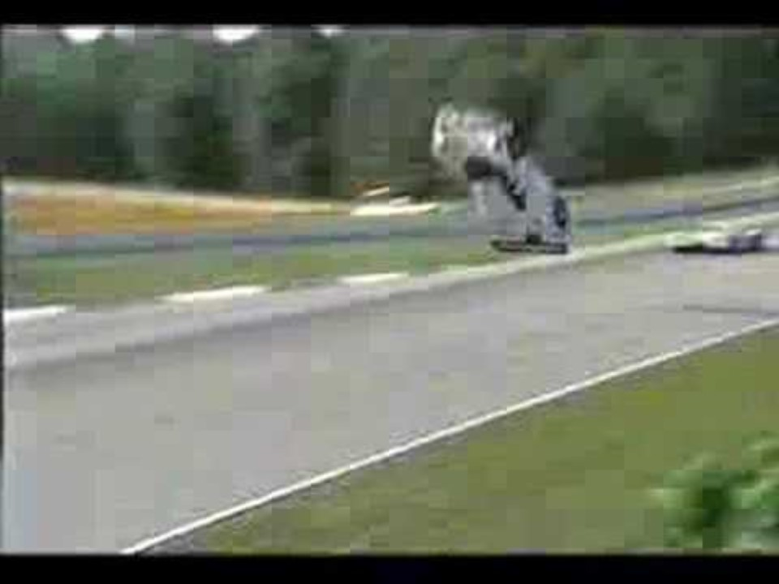

Aerodynamics: Basics

Slide 47
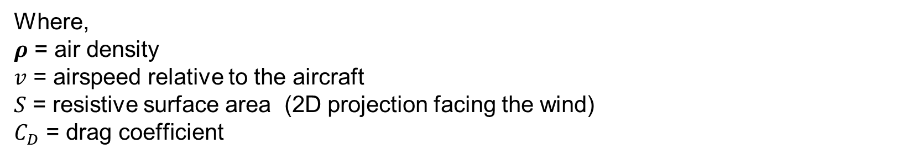
Aerodynamics: Basics
Drag: Drag is the resistive aerodynamic force acting opposite to the relative motion of an aircraft through the air. It arises from two main sources: viscous effects (skin friction) and pressure differences (form drag and induced drag), along with additional contributions such as wave drag at high speeds.
Basically, there are three main types of drag (more on these later). But mathematically, the formula is given as (approx.)
$$D=\frac{1}{2} ρv^{2}S C_{D}$$
Where,
𝝆 = air density
$v$ = airspeed relative to the aircraft
$S$ = resistive surface area (2D projection facing the wind)
$C_{D}$ = drag coefficient

Slide 48


Aerodynamics: Basics
Drag: One intuitive way to understand drag is by extending your arm out of the car window. The way wind affects you hand as the car speeds is a nice way to visualize the drag and lift and how the wind pushes the hand upwards if given certain angles (Angle of attack, more on this in the upcoming slides). But for now, let’s imagine only 0° and 90° (made by arm with respect to the wind flow)
90° wrt the wind, maximum drag and hence pushes your hand backward
0° wrt the wind, hence no drag

Slide 49
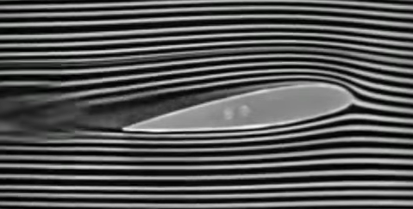
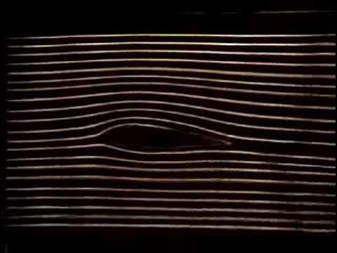
Aerodynamics: Basics
Wing shape of the Aircrafts (Fixed-winged): The shape of the wing, from the top-down view depends on the purpose of the aircraft- Military jets are more likely to take a Delta shape as it gives more freedom in terms of maneuverability for dogfights (Aerial combat). Rectangular wings are useful for fuel efficiency and low speed missions. (Cessna 172- the most famous trainer plane)
But from the side view, it is almost always in a teardrop shape. This shape is aerodynamically and structurally advantageous

Slide 50
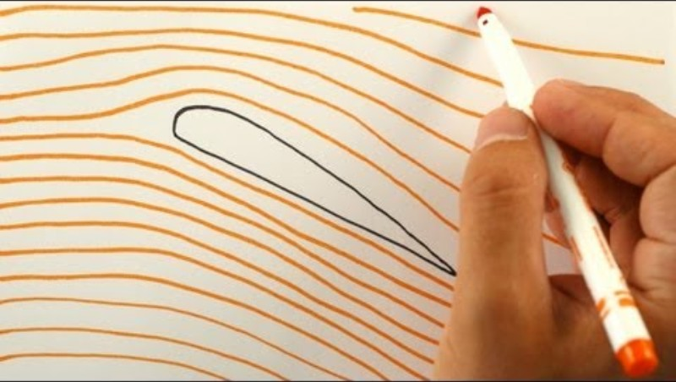
How does Wing Work?

Slide 51
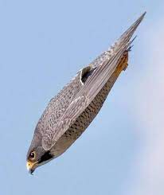
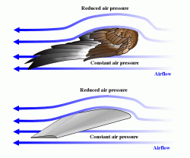
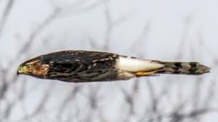
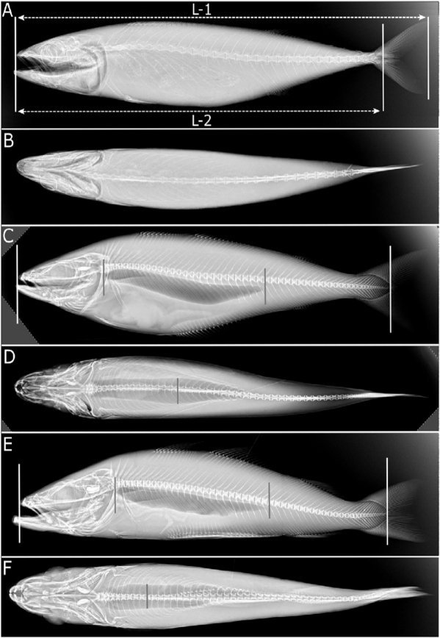
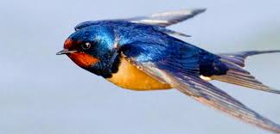
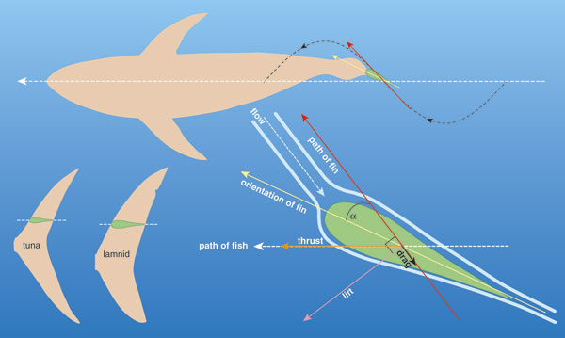
Aerodynamics: Critical Analysis of Teardrop
Critical Analysis of Teardrop shape: This shape can be seen everywhere in the nature that has some level of interaction with the fluids (can be liquid or air). This can be seen in both Aerodynamics and Hydrodynamics, nature too always tend to take the teardrop shape- this can be seen in birds (in flight) like Swallow or Swifts, in fishes like Tuna or Sharks, they all evolved to take the teardrop shape to be fast and agile.

Slide 52
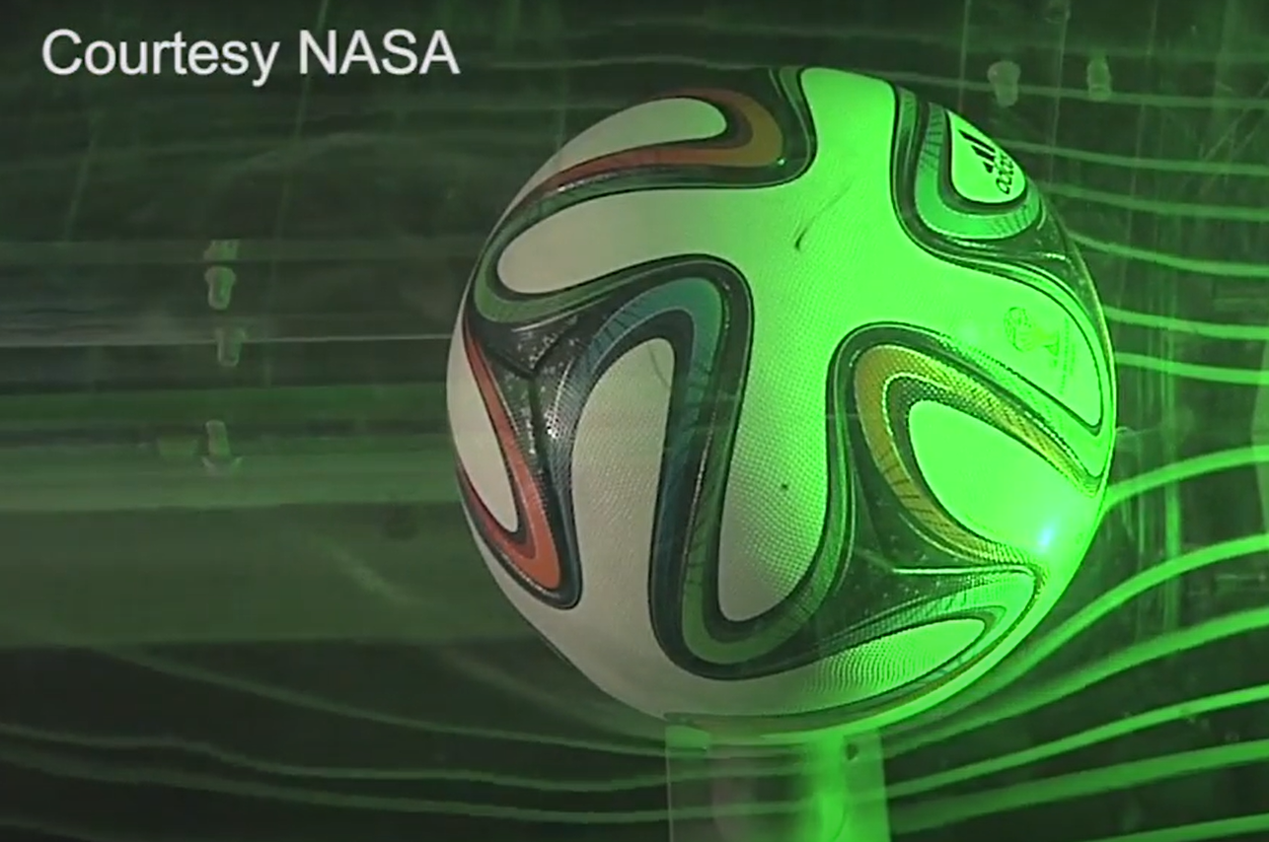
Aerodynamics: Critical Analysis of Teardrop
Critical Analysis of Teardrop shape: But why did the teardrop shape became the most streamlined shape in nature? Let’s start from the most basic shape in the nature- A Sphere.
The Wind Direction, in the image, is from Right to Left and as we can see, the wind pressure is not smooth at the back of the ball, making it a little less aerodynamic, as compared to the golf balls. Smoother the pressure difference at the back of the object, lesser the drag
Coanda Effect
The Wind Tunnel test of the 2014 FIFA World Cup
Also known as the Brazuca Ball.

Slide 53
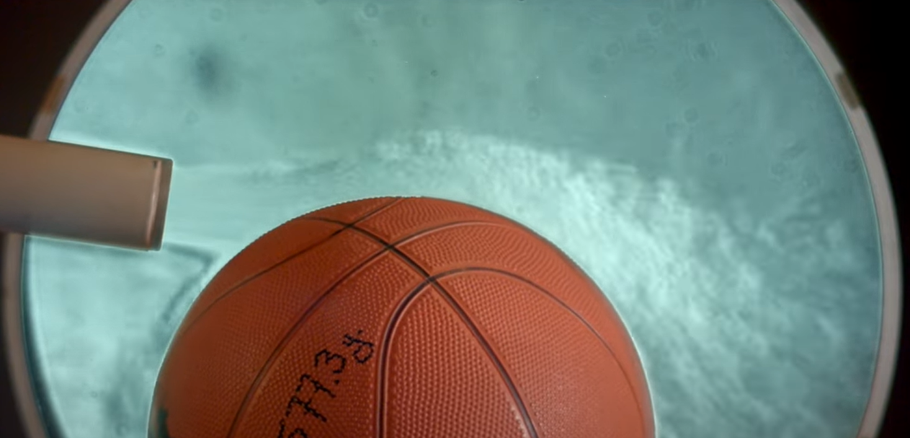
Aerodynamics: Critical Analysis of Teardrop
Coanda effect: The tendency of a fluid to “Stick“ to the object’s surface and flow along its curvature is called Coanda effect.
In this image, the Basketball’s curvature is affecting the flow of air, the wind is being curved with the curve of the ball.
Due to this, the lift is possible, aerodynamically, in wings. The wind will “stick” to the upper surface of the wing and flow to the trailing end of the wing.

Slide 54
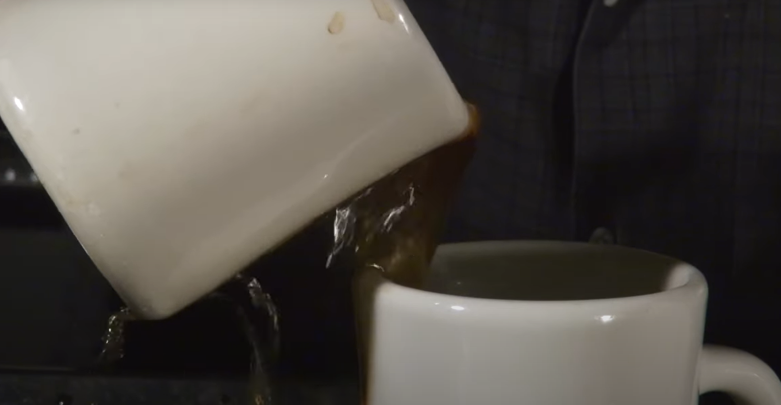
Aerodynamics: Critical Analysis of Teardrop
Coanda effect: This can also be seen other places, the frustrating moment when the coffee sticks to the cup and flow with the cup’s surface rather than pouring down into the other cup below directly.
The same principle is also seen in the aerodynamics of the wings; in the most photos we see about it. This is one of the main reason why the wind “sticks“ to the wing on the upper surface even though intuitively we think it would bounce off reflect like a beam of light.

Slide 55

Aerodynamics: Critical Analysis of Teardrop
Critical Analysis of Teardrop shape: The drag on an object depends on how small the Wake Region is (Behind the object). The Coanda Effect is negligible on the smooth ball.
The difference between these two balls will be discussed in the upcoming slides
Wake Region: Turbulent, low pressured air caused by the Separation of the Air from the surface of the object The major difference here is the Separation of the wind from the surface of the ball. This is the most crucial part of Aerospace Engineering as this one property vaguely means
Smaller the Wake Region = Lesser the Drag
and as drone designers/aerodynamicist we need the drag to be minimum.

Slide 56

Aerodynamics: Critical Analysis of Teardrop
Separation and Wake Regions: Separation, as the name says, is the point where the wind “separates” from the surface of the object. The Wake Region is the region, starting from Separation (the wind in this region is turbulent, random and messy)
Now if we start stretching out the sphere to make the Wake Region smaller (basically extending the surface of the sphere “backwards“/in the direction of the wind so that the Coanda effect can make the wind slide till the end of the wing so that there will be close to no separation, no Wake Region, hence reducing the drag.)
By doing this, we ended up with the Teardrop shape which not only uses the Coanda effect to reduce drag, it also has close to no separation and gives higher lift.
BUT, it has close to no separation and no wake region only when the Angle of Attack (AoA) is nearly 0° also known as leveled to the wind flow.

Slide 57

Angle of Attack

Slide 58


Aerodynamics: AoA (Fixed-Wing Aircrafts)
Angle Of Attack (𝛂) : The angle made by the wing’s chord (in Fixed-Wing Aircrafts) with respect to the direction of the wind is called Angle of Attack, better known as AoA.
Chord: The imaginary line that is connecting the leading end of the wing to the trailing end of the wing. This line is not necessarily straight and can change with the shape of the wing. It can be curved as well!
When enough speed is reached, the wings can be angled slightly upwards (increased angle of attack) to generate more lift. From the pilot’s perspective, the pitch angle is the angle between the aircraft’s longitudinal axis (nose-to-tail) and the horizon.

Slide 59


Aerodynamics: AoA (Rotorcrafts)
Angle Of Attack (𝛂) : For rotorcrafts (such as drones or helicopters), the Angle of Attack is the angle between the rotor’s (aerodynamically considered as a disc) or body’s reference line (typically the plane of the rotor disk or the copter frame) and the relative airflow.
The Angle of Attack can also be derived from the angle difference of the Forces. The angle difference between the $F_{Weight}$ (Red arrow) and $F_{Downwash}$ (Green Arrow) is also the Angle of Attack.

Slide 60

Aerodynamics: AoA
Pitch vs AoA: The angle made by the wing’s chord with respect to the direction of the wind is called Angle of Attack, on the other hand, the angle made by the aircraft with respect to the horizon is called pitch angle.
Optimal Pitch and AoA: The image beside shows the avionics of an Airbus A320, the pilot, almost always rely on the avionics to know about the angles (the numbers in the blue and brown area). For most of the Aircrafts, commercial or transport, including aircrafts like Military fixed-wing drones need a pitch angle range of 8° – 15° during the takeoff (this angle depends on the weight of the aircraft as well).
The AoA at takeoff is almost the same as the Pitch angle, with the range of 10° – 15°, this is because during takeoff, the airflow relative to the wings is nearly aligned with the ground (Wind is almost leveled to the ground angle, ~0° angle difference)

Slide 61
Aerodynamics: AoA
The Angles for Typical Pitch and AoA in Different Aircrafts:
Takeoff Angles:
A320-
Pitch -> 8° and 15°
AoA -> 8° and 15°
MQ-9 Reaper Drone-
Pitch -> 8° and 15°
AoA -> 8° and 12°
These are the general angles at which the aircraft takes off. The actual takeoff angle depends heavily on the aircraft’s speed: higher speeds allow for steeper climb angles, while lower speeds require shallower climbs to maintain lift and avoid stall.

Slide 62
Aerodynamics: AoA
Calculating AoA: At higher altitudes and higher speeds, the wind might be different, needing for an AoA even when trying to maintain a constant altitude. Mostly, the Autopilot on board can calculate and set the AoA to maintain the constant altitude using control systems, but we can also do it mathematically, given all the values.
$$L =\frac{1}{2} ρv^{2}S C_{L}$$
$$C_{L}=C_{L_{0}}+aα$$
Here,
$C_{L_{0}}$ = lift coefficient at zero AoA (from wind tunnel tests or CFD)
$a$ = lift curve slope (~0.1 per degree or 2𝝅 per radian)
$α$ = Angle of Attack

Slide 63
Aerodynamics: AoA
Calculating AoA: The AoA also has an effect on the Drag too, from the formula of the Drag from the previous slides
$$D=\frac{1}{2} ρv^{2}S C_{D}$$
$$C_{D}=C_{D_{0}}+C_{D_{i}}$$
Where, $C_{D_{i}}=\frac{C_{L}^{2}}{π e AR}$
$C_{L}=C_{L_{0}}+aα$
$AR=\frac{b^{2}}{s_{w}}$ → ($\frac{Wing span^{2}}{Wing Area}$)
Here,
$C_{D_{0}}$ = Drag coefficient at zero Lift (AKA Parasite Drag Coefficient) (CFD)
$e$ = Oswald Coefficient Factor (~0.7 for elliptical wings)
$AR$ = Aspect Ratio of the Aircraft/Rotorcraft ($\frac{b^{2}}{s_{w}}$)
$C_{L}$ = lift coefficient
$a$ = lift curve slope
$α$ = Angle of Attack

Slide 64
Aerodynamics: Formulae (Sum up)
NOTE: The Formulae for Lift and Drag are universal for all types of Aircrafts (Fixed-wing or Rotorcraft)
Lift-
Drag-
$$D=\frac{1}{2} ρv^{2}S C_{D}$$
$$C_{D}=C_{D_{0}}+C_{D_{i}}$$
$$L =\frac{1}{2} ρv^{2}S C_{L}$$
$$C_{L}=C_{L_{0}}+aα$$
Where, $C_{D_{i}}=\frac{C_{L}^{2}}{π e AR}$
$C_{L}=C_{L0}+aα$
$AR=\frac{b^{2}}{s_{w}}$ → ($\frac{Wing span^{2}}{Wing Area}$)
$S=A= πr^{2}$ for Rotorcrafts, r = blade length

Slide 65
Aerodynamics: AoA
Question: An MQ-9 Reaper Drone is cruising at an altitude of 500 ft in a reconnaissance mission and needs to stay at that altitude to avoid detection by radars or avoid visual detection. The air density (𝝆) at the altitude of 500 ft is 1.225 kg/$m^{2}$ and the true airspeed is 62 m/s. The weight of the drone (W = mg) is given as 37,278 N and Wing area is 26.7 $m^{2}.$
The lift coefficient at 0° AoA ($C_{L_{0}}$) = 0.20
Lift slope curve (a) = 0.1°
Determine the required AoA (in degrees) for the Drone to maintain the altitude of 500 ft.

Slide 66
Aerodynamics: AoA
Solution: Need to maintain the altitude, so L = W
Given,
W = 37,278 N
$v$ = 62 m/s
S = 26.7 $m^{2}$
𝝆 = 1.255 kg/$m^{3}$
$C_{L0}$ = 0.20
a = 0.1°
$α$ = AoA
We need $C_{L}$ to get $α$
$$L =W= \frac{1}{2} ρv^{2}S C_{L}$$
$$C_{L}=C_{L_{0}}+aα$$
$$α=\frac{C_{L}−C_{L_{0}}}{a}$$

Slide 67
Aerodynamics: AoA
Solution: From equating L with W, we get $C_{L}$
Substituting the values, we get the $C_{L}$ as 0.592996 (≈ 0.593)
$$L =W= \frac{1}{2} ρv^{2}S C_{L}$$
$$C_{L}=\frac{2W}{ρv^{2}S}$$

Slide 68
Aerodynamics: AoA
Solution: Now substituting the value of $C_{L}$ in the formula of AoA, we get
Hence, the AoA required to keep the drone at constant altitude of 500ft (and the given parameters) is 3.93°
$$C_{L}=C_{L_{0}}+aα$$
$$α=\frac{C_{L}−C_{L_{0}}}{a}$$
$α=\frac{0.593 −0.20}{0.1}$
$α=3.93$°

Slide 69


Aerodynamics: Critical Analysis of Teardrop (Contd.)
Lift & Drag of Teardrop Shape: We do know at this point that At 0° Angle of Attack (AoA), the teardrop-shaped airfoil produces very little drag and almost no wake region. As the AoA increases, both lift and drag increase significantly (until critical angle is reached)
NOTE: This doesn’t mean that the Lift or Drag is 0. The AoA is only one, yet, factor that affects the Lift and Drag as seen mathematically in both the formulae of Lift and Drag (Directly or Indirectly) so far.

Slide 70


Aerodynamics: Critical Analysis of Teardrop (Contd.)
Lift in Teardrop Shape: It’s a famous debate on whether it is the Bernoulli’s principle that generates lift, or is it the Newton’s 3rd Law that generates lift. But it’s both of these which help in the lift of an aircraft. Bernoulli’s Principle: Air flowing over the curved top surface of the wing moves faster than the air beneath. Faster flow means lower pressure (Bernoulli’s principle). The pressure beneath the wing is therefore higher than the pressure above, and this pressure difference pushes the wing upward, creating lift.

Slide 71


Aerodynamics: Critical Analysis of Teardrop (Contd.)
Lift in Teardrop Shape: Similarly,
Newton’s 3rd Law: The wing pushes the wind downwards (downwash) with a Force ($\overset{⃑}{F}$), hence as a consequence, the same amount of Force (Equal Force $\overset{⃑}{F}$) acts upwards (Opposite Direction) on the wing, producing lift upwards.
Therefore, the force upwards (Lift) is produced both by the Pressure difference on the surfaces and the Downwash of the Wind because of the Wing Shape.

Slide 72
Aerodynamics: Critical Analysis of Teardrop (Contd.)
Drag in Teardrop Shape: There’re three main types of Drag-
Parasite Drag: Drag which is not caused by the lift, further classified into THREE more drags-
Form Drag
Skin Friction Drag
Interference Drags
Induced Drag: Drag which is caused by the lift, mainly due to vortices (Wingtips)
Wave Drag: Drag which is only caused by high speeds (Supersonic Speeds) due to shockwaves.

Slide 73

Aerodynamics: Critical Analysis of Teardrop (Contd.)
Drag in Teardrop Shape: Parasite Drag
Form Drag (Pressure Drag): The drag that is experienced on the wing due to the pressure difference between the Front (Leading End @ 0°, the Bottom surface at AoA > 0°) of the Wing and the Back (Trailing End @ 0°, the Upper surface at AoA > 0°). Here, the wind separates at a point in the upper surface at an AoA of 10°. From that point onwards, the wind is turbulent and hence less speed, less pressure at the Wake Region. The higher pressure at the bottom surface (now, basically the front surface) tries to move towards the lower pressure region (Wake Region) by pushing the wing towards it (backwards), hence creating Pressure Drag, negative force
Coanda Effect
Separation
Chord
10°
Wind flow

Slide 74
Aerodynamics: Critical Analysis of Teardrop (Contd.)
Drag in Teardrop Shape: Parasite Drag
Form Drag (Pressure Drag): This is the reason why we feel our hand pushed backwards when we extend it out of the car window at 90°. It is because our hand is now separating the Wind earlier, creating a huge Wake Region behind the arm, creating low pressure behind. The higher pressure on the front of the arm pushes the arm backwards, towards the lower pressure and hence you feel your hand pushed backwards. This is Form Drag/Pressure Drag.
Coanda Effect
Separation
Chord
10°
Wind flow

Slide 75

Aerodynamics: Critical Analysis of Teardrop (Contd.)
Drag in Teardrop Shape: Parasite Drag
Skin Friction: Produced by the air molecules rubbing against the surface of the aircraft.
Smoother the Surface = Lesser the Skin Friction Drag

Slide 76


Aerodynamics: Critical Analysis of Teardrop (Contd.)
Drag in Teardrop Shape: Parasite Drag
3. Interference Drag: Interference drag is an aerodynamic force that occurs when the airflows around two or more adjacent aircraft components, such as the wing and fuselage, interact and disrupt each other, creating turbulence and localized high-pressure areas that increase the total drag on the aircraft

Slide 77

Aerodynamics: Critical Analysis of Teardrop (Contd.)

Slide 78


Aerodynamics: Critical Analysis of Teardrop (Contd.)
Drag in Teardrop Shape: Parasite Drag
3. Interference Drag: This is a comparison between an Airliner (Airbus A310) and a Stealth Bomber (B2-Spirt) and the Bomber is much more streamlined as compared to the Airliner. The Airliner has more interference drag.
>

Slide 79

Aerodynamics: Critical Analysis of Teardrop (Contd.)
Drag in Teardrop Shape: Induced Drag: (Due to Lift) ($C_{D_{i}}$) When a wing generates lift, air pressure is higher beneath the wing and lower above it. Across most of the wing, these regions stay separated, but at the wingtips the high-pressure air curls around into the low-pressure region, creating wingtip vortices. These vortices deflect the airflow downward (downwash), which tilts the lift vector slightly backward. The rearward component of this tilted lift is called induced drag, and it is strongest at high angles of attack or low speeds.

Slide 80

Aerodynamics: Critical Analysis of Teardrop (Contd.)
Drag in Teardrop Shape: Induced Drag: (Due to Lift) ($C_{D_{i}}$) This has a great effect, as seen by the mathematical formula, $C_{D_{i}}$ has a huge role in drag. Solution? Winglets! The peaks/sheet that we see at the end of the plane’s wing is to reduce the drag produced by the vortices at the wingtips. However, these are not a good idea for applications like Military drones as these winglets can reflect back the signals from enemy radars and give away the position of the aircraft, hence losing all the stealth capabilities.

Slide 81

Aerodynamics: Critical Analysis of Teardrop (Contd.)

Slide 82

Aerodynamics: Critical Analysis of Teardrop (Contd.)
III. Drag in Teardrop Shape: Wave Drag: (Due to High Speeds) When an aircraft approaches the speed of sound, the airflow over different parts of the wing and body does not all move at the same speed. Some parts accelerate faster and can reach supersonic speeds even before the aircraft itself is supersonic. This creates shock waves- thin regions where pressure and density of the air change suddenly.
Gradual increase in Cross-Section Area (all sides of the plane) = Lesser Shockwaves at Higher Speeds
These shock waves disrupt the smooth airflow, causing energy losses and increasing resistance. This extra resistance is called wave drag. It becomes noticeable in the transonic speed range (around Mach 0.8 - 1.2) and rises sharply as the aircraft goes faster. At supersonic speeds, wave drag is one of the biggest challenges in design, which is why aircraft like Concorde or fighter jets use swept wings, delta wings, and slender fuselages to reduce it.

Slide 83

Aerodynamics: Critical Analysis of Teardrop (Contd.)
III. Drag in Teardrop Shape: Wave Drag: (Due to High Speeds) As the jet approaches Mach 1, the air cannot move out of the way smoothly- instead, it compresses and piles up around the widest parts of the aircraft (higher cross-section). This compressed air is then forced to expand suddenly as it flows past narrower sections, creating strong shock waves. These shock waves cause energy loss, producing wave drag.
This is also why we see the cone-like shape (Mach cone) around jets flying at or near Mach speeds- it’s the visible effect of shock waves and compressed air spreading outward.

Slide 84



Aerodynamics: Critical Analysis of Teardrop (Contd.)
III. Drag in Teardrop Shape: Wave Drag: (Due to High Speeds) Due to this, Engineers have streamlined the design of Supersonic and Transonic jets. Ex- Concorde (Discontinued Supersonic passenger Jet), F-22 Raptor, Eurofighter Typhoon, etc.
These aircrafts have Delta Shaped Wings and their shape streamlined to the teardrop shape to an extent where the aircrafts are sleek and have a very gradual difference in cross-sectional area in all sides. Front, Top and Side.

Slide 85


Aerodynamics: Stall (Fixed-wing)
Stall: Stalling is an aerodynamic phenomenon that makes the aircraft unstable, out of control and can drastically lose lift (can go into a nose-dive). In terms of aerodynamics, it is when the wind “separates“ too early from the wing’s upper surface due to high Angle of Attack.

Slide 86
Aerodynamics: Stall (Myth-breaker)
Stall: During stall, the aircraft still moves forward. At the critical AoA, lift reaches its maximum value, and any further increase in AoA causes lift to decrease, leading to loss of altitude. Both type of stall exists in fixed-wing aircraft- Low-speed stall and High-speed (accelerated) stall
Low-speed
Speed: Low airspeed
Flight Condition: Take-off, Landing, slow climb
Load Factor: 1G (G Force)
AoA: > Critical AoA
Reason: High AoA to compensate for low speed to maintain the lift
High-speed (Accelerated)
Speed: High airspeed
Flight Condition: Pull-ups, Turnings, Maneuvers
Load Factor: > 1G (G Force)
AoA: > Critical AoA
Reason: High AoA to generate lift required by the higher load factor

Slide 87

Aerodynamics: Stall (Fixed-wing)

Slide 88

Aerodynamics: Stall (Fixed-wing)
Critical AoA: Stalling occurs when the AoA of the aircraft is more than the critical AoA. The critical AoA is different for different airfoils and is determined experimentally or using CFD (Computational Fluid Dynamics) The typical critical AoA is around 12°-16° after which the coefficient of lift, $C_{L}$, is maximum (maximum lift at critical AoA, but lose lift after critical AoA) and aircraft will start to descend. If no corrective action is taken, the aircraft will lose control
Airliners (and subsonic aircrafts) → 12°-16°
Highly cambered / high-lift airfoils → 16°-18°
Delta Wing Aircrafts (Swept-wing / leading-edge vortices) → >20°
This is why military and high-maneuver aircrafts are designed with a delta / swept wing shape. The critical AoA is higher, giving them the ability to maneuver at higher angles.

Slide 89



Aerodynamics: Stall (Fixed-wing)
Critical AoA: To calculate Critical AoA, the airfoil/wing is kept in a wind tunnel (CFD test if no access) and calculate the Coefficient of Lift, $C_{L}$, and plot it against the AoA of the airfoil. This gives a plot which looks as follows
$$AR=\frac{{\left(Wing span\right)}^{2}}{Wing area}$$
In the graphs, the AoA at which Coefficient of Lift is Maximum is called as the Critical AoA. If the aircraft is forced more than that angle, it stalls and loses the Coefficient of Lift and hence loses altitude after the stall.

Slide 90

Aerodynamics: Stall (Fixed-wing)
Critical AoA: In other words, as the AoA increases, the Coefficient of Lift increases until a point after which the Separation (of the wind from the wing’s surface) is maximum, then lift starts decreasing after that AoA. This is called Stalling.
Mathematically,
At Stall: $\frac{dC_{L}}{dα}=0$
$$L_{stall}=W$$
$$C_{L}=C_{L_{max}}$$
$$⇒L_{stall}= \frac{1}{2}ρV^{2}SC_{L_{max}}$$
This equation is used to find the Stall Velocity, the velocity at which the stall happens and is dependent on $C_{L_{max}}$

Slide 91


Aerodynamics: Stall (Fixed-wing)
Stall Velocity: Stall speed is the minimum speed at which the aircraft can still generate enough lift to balance its weight without exceeding the critical AoA. Not the speed at which the aircraft stalls, the speed isn’t the reason for the stall. The stall speed is dependent on the $C_{L_{max}}$, its weight, surface area (affected by flaps) and the air density (𝜌, dependent on height)
Mathematically, at Stall:
$$L_{stall}= \frac{1}{2}ρV^{2}SC_{L_{max}}$$
$$L_{stall}=W$$
$$⇒V= \sqrt{\frac{2W}{ρSC_{L_{max}}}}$$
This equation is the Stall Velocity, the velocity at which the stall happens and is not constant

Slide 92

Aerodynamics: Stall (Fixed-wing)
High-speed stalls: A high-speed stall occurs when an aircraft exceeds the critical angle of attack at high speed due to increased load factor during aggressive maneuvers, despite having high forward velocity.
This strongly depends on load factor, as increased load factor raises the required lift and forces the aircraft to exceed the critical angle of attack, even at high speeds.
$$Load Factor n= \frac{Lift}{Weight}$$
n = 1G→ sitting still/cruising
n > 1G → Higher lift/elevator going up/turns
n >> 1G → Fighter jet manuever (~6G-9G)
n < 1G → Low lift/descent
Mathematically:
In high-speed stalls, increased load factor is the primary reason the aircraft reaches the critical angle of attack at higher speeds.

Slide 93

Aerodynamics: Stall (Fixed-wing)
Load Factor: As load factor increases during high-g maneuvers such as tight turns or rapid pull-ups, the pilot experiences an apparent increase in body weight due to increased acceleration forces acting along the vertical axis. High positive g-loads force blood toward the lower extremities, reducing blood flow to the brain and potentially causing visual impairment (grey-out or black-out) and, in extreme cases, g-induced loss of consciousness (G-LOC). To counter these effects, pilots use anti-g straining maneuvers and wear anti-G suits, which apply pressure to the abdomen and legs to maintain cerebral blood flow and improve tolerance to high load factors.

Slide 94



Aerodynamics: Stall (Fixed-wing)
Load Factor: If the lift generated by an aircraft approaches zero, the load factor also approaches 0G, a condition commonly known as free fall. To generate zero lift, the aircraft must be flown at a negative AoA, which cancels the zero-lift offset $C_{L_{0}}$in the lift-coefficient relation $C_{L}=C_{L_{0}}+aα.$ In this condition, the aircraft follows a ballistic trajectory (under gravity alone), resulting in a near-zero load factor. As both the aircraft and its passengers accelerate downward together, the passengers experience apparent weightlessness, often referred to as microgravity, giving the sensation of floating/in space. Very known example is the 0G Flights

Slide 95


Aerodynamics: Stall (Fixed-wing)
High-speed stalls: This is most commonly seen during turnings, the turning maneuvers require more lift to maintain the same altitude, for which the AoA might exceed th critical AoA, hence causing the accelerated stall. This turn angle is known as Bank Angle. This makes the Lift vector shift. The Load Factor depends on the Bank Angle

Slide 96

Aerodynamics: Stall (Fixed-wing)
High-speed stalls: This is most commonly seen during turnings, the turning maneuvers require more lift to maintain the same altitude, for which the AoA might exceed th critical AoA, hence causing the accelerated stall. This turn angle is known as Bank Angle. This makes the Lift vector shift. The Load Factor depends on the Bank Angle. Bank angle is denoted by 𝜙
Mathematically:
$$\frac{Lift}{Weight}=n= \frac{1}{\cos{φ}}$$
$$V_{stall, accelerated}=V_{stall @1G}×\sqrt{n}$$

Slide 97
Aerodynamics: Stall (Fixed-wing)
High-speed stalls: This is most commonly seen during turnings, the turning maneuvers require more lift to maintain the same altitude, for which the AoA might exceed th critical AoA, hence causing the accelerated stall.
Bank Angle Load Factor
30˚ 1.15G
45˚ 1.41G
60˚ 2.00G (Double the Lift needed)
75˚ 3.86G
In other words, when the aircraft is banking at 60˚, the G force that it experiences is 2Gs (L = 2W) and to meet the Lift needed to stay in that altitude, Speed and AoA is increased. When AoA crosses Critical AoA, stall occurs and this stall is known as High-speed stall.

Slide 98




Aerodynamics: Stall (Rotorcrafts)
Stall: Fixed-wing aircraft stall when the wing exceeds its critical angle of attack, causing flow separation and loss of lift. Rotorcraft do not experience a single global wing stall. Instead, they experience localized blade stalls, retreating blade stall, and vortex ring state, each governed by rotor aerodynamics.

Slide 99


Vortex Ring State
Vortex Ring State: A hazardous flight condition, primarily in rotorcraft, where a drone (or helicopter) descends into its own rotor downwash. This re-circulation of turbulent air can cause a sudden loss of lift and control.

Slide 100



Aerodynamics: Wing Planform
Planform: The Top-down view of the Aircraft is called as Planform. The planform design of the wing is very essential as the cross-section design of the wing. This gives many advantages for different missions. Wing Planform are simply divided into Five main types-
Rectangular wings
Elliptical wings
Tapered wings
Swept wings
Delta Wings

Slide 101


Aerodynamics: Wing Planform
Rectangular wings: A rectangular wing has nearly uniform lift distribution and highly predictable aerodynamic behavior. It exhibits gentle stall characteristics, which provide good controllability and safety at low speeds.
However, it produces relatively high induced drag and is structurally less efficient for high-speed flight.
Rectangular wings are therefore commonly used in training aircraft, reconnaissance UAVs, and low-speed applications where stability and simplicity are prioritized over aerodynamic efficiency.

Slide 102


Aerodynamics: Wing Planform
Elliptical wings: An elliptical wing planform ideally produces an elliptical lift distribution, which minimizes induced drag for a given span and lift. This makes it aerodynamically the most efficient planform in theory.
However, elliptical wings are structurally complex and expensive to manufacture, and they tend to stall abruptly at the wingtips, leading to poor low-speed handling. Due to these drawbacks, they are rarely used in modern aircraft despite their aerodynamic advantages.

Slide 103


Aerodynamics: Wing Planform
Tapered wings: A tapered wing has a chord length that decreases from root to tip, providing a lift distribution close to an elliptical wing while being easier to manufacture. It offers lower induced drag and reduced structural weight compared to rectangular wings.
With proper design features tapered wings can maintain acceptable stall behavior. As a result, this planform is widely used in modern subsonic aircraft due to its balance of aerodynamic efficiency, structural performance, and handling qualities.

Slide 104


Aerodynamics: Wing Planform
Swept wings: Swept wings delay compressibility effects and allow efficient transonic flight, but they reduce low-speed performance and require high-lift devices. They are commonly used in jet and commercial aircraft optimized for high-speed cruise.
Front swept wings- In a forward-swept wing, airflow moves from wingtip toward the root. This causes the wing root to stall first, while the wingtips and ailerons remain effective. This give control even when the root is stalled.

Slide 105


Aerodynamics: Wing Planform
Delta wings: A delta wing has a triangular planform with a large sweep angle, is structurally strong and simple in construction. At high AoA, it generates lift through leading-edge vortices, allowing it to sustain controlled flight beyond the stall angles. Delta wings perform exceptionally well at supersonic speeds but suffer from high induced drag and high landing speeds. Consequently, they are primarily used in supersonic aircraft and high-performance military fighters.

