Slide 1
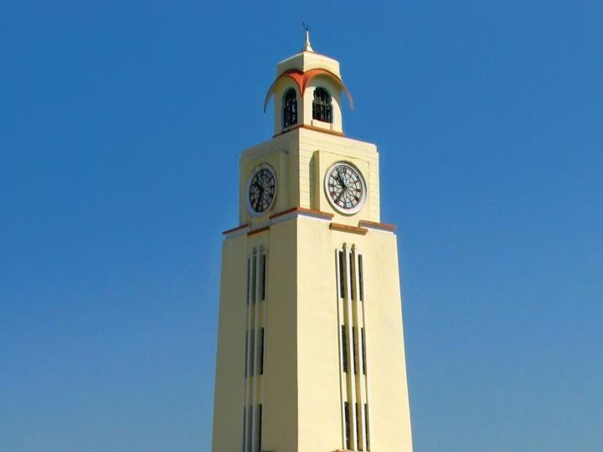

Communication and Computation for Drones
BITS Pilani
Pilani Campus
Dr. Vinay Chamola
Department of Electrical and Electronics, Pilani Campus
Date: 1st Aug, 2025

Slide 2
Module 8
Artificial Intelligence in Drones
Date: 1st Aug, 2025

Slide 3
Lecture 35-
OpenCV – Computer Vision
Date: 1st Aug, 2025

Slide 4
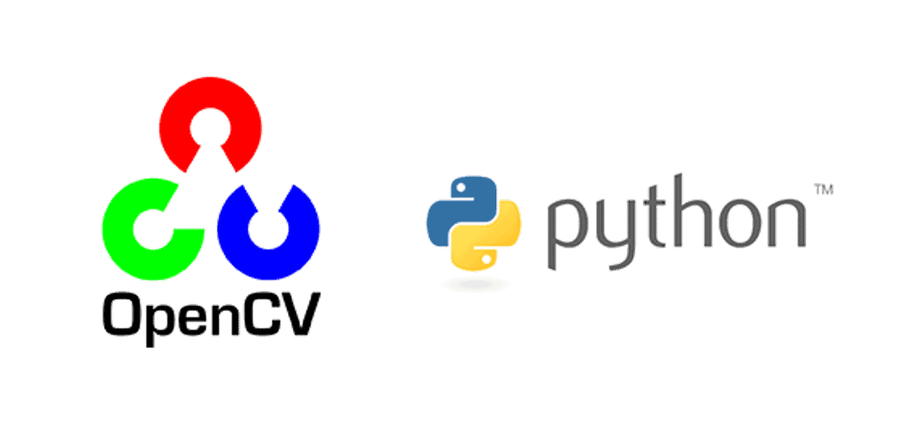
Artificial Intelligence in Drones
Computer Vision: Computer Vision is the technology that gives the drone its eyes. It processes images and videos from the onboard camera in real time to help the drone understand its surroundings. Using Python’s OpenCV library, we can extract important information from the live video feed such as detecting faces, objects, or edges and use that information to decide the drone’s next actions. OpenCV (Open-Source Computer Vision) library will be used to analyze the video feed from the camera.

Slide 5
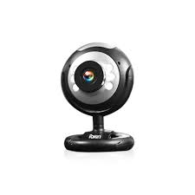

Artificial Intelligence in Drones- Computer Vision
Computer Vision: Now, the prerequisites for computer vision is as follows
Any Webcam
VS Code
Python Libraries-
opencv-python
numpy
os

Slide 6
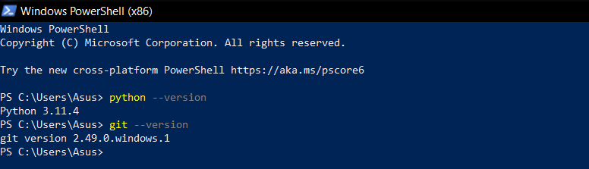
Artificial Intelligence in Drones- Computer Vision
Installations: (Python & Git): Download Python and Git from the links below
https://www.python.org/downloads
https://git-scm.com/downloads
Open your PowerShell (x86) and run these commands- “python --version“ and “git --version“
If it is installed correctly, it’d show a message like this

Slide 7
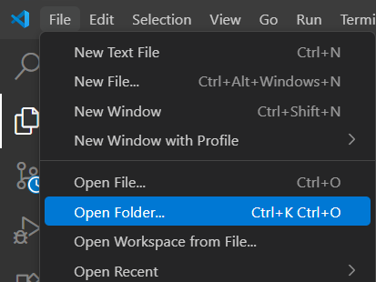
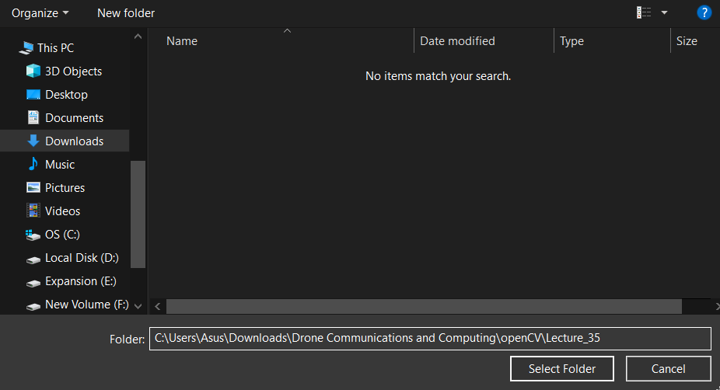
Artificial Intelligence in Drones- Computer Vision
Installations: (New Directory): Create a New Folder (any drive on your device), name it and make sure that this folder is opened on your VS Code. This folder will be used from now on to work on the OpenCV.
Navigate

Slide 8
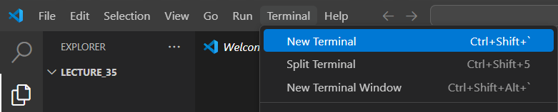

Artificial Intelligence in Drones- Computer Vision
Installations: (Haar-cascades): Next, Haar Cascades are .XML files that contain pre-trained models used to detect objects like faces, eyes, and other patterns from images or video feeds. These files are needed for object detection tasks in drones, such as recognizing obstacles or tracking targets in real time. The files are available on the OpenCV’s GitHub repository, which you can download by cloning the entire repository using the link- https://github.com/opencv/opencv.git
Git clone all the OpenCV files in a new folder in your VS Code folder.

Slide 9
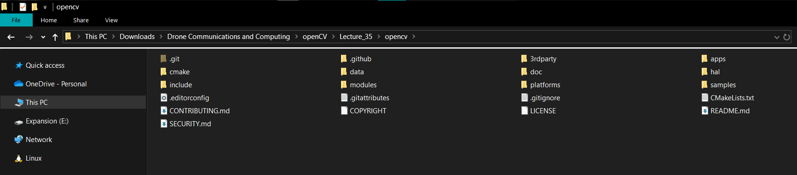
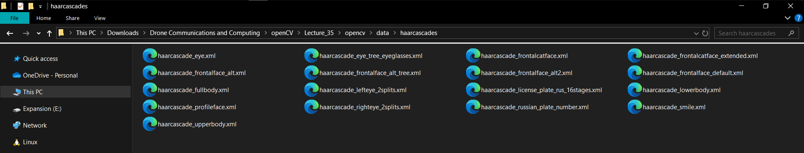
Artificial Intelligence in Drones- Computer Vision
Installations: (Haar-cascades): If downloaded correctly, the openCV files would be downloaded into the VS Code folder that was open. In that newly cloned folder, we can find the Haar-Cascades in /data/haarcascades/

Slide 10
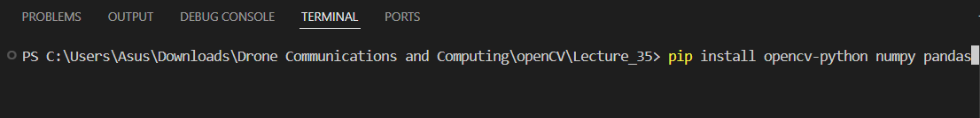
Artificial Intelligence in Drones- Computer Vision
Installations: (Libraries): Next, we will be downloading all the python libraries that we will be using in the OpenCV for Drones. In the VS Code terminal, run this command- “pip install opencv-python numpy pandas”
If you are facing errors while running this command even after spell checks, reinstall python on your computer, making sure that while installation process Python was added to the path. (Add Python to Path)

Slide 11
Artificial Intelligence in Drones- Computer Vision
OpenCV: This library has few functions that will be used heavily from image detection to video analysis.
cv2.imread(‘path’) → load an image from the path [ Ex: img1 = cv2.imread(‘Photos/Mona_Lisa.jpg‘) ]
cv2.imshow(‘Window’, img) → display the image named “img” in the code in a new window named “Window“
cv2.imwrite(‘output.jpg’, img) → save an image and name it “output.jpg“
cv2.VideoCapture(0) → open webcam (or video file later) [ Ex: cap1 = cv2.VideoCapture(0) ]
ret, frame = cap.read() → read a frame from video
cv2.waitKey(x) → wait for key press “x“ milli-seconds, if 0, then keep it on until a key is pressed.
cv2.destroyAllWindows() → close all windows that were opened.

Slide 12
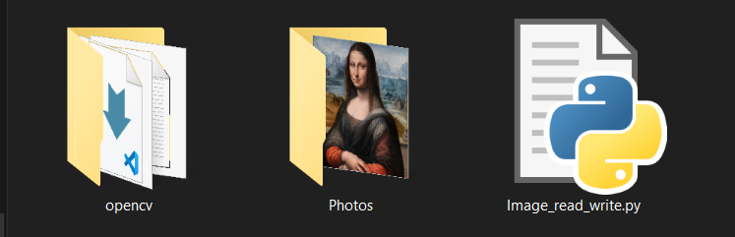
Artificial Intelligence in Drones- Computer Vision
Image Analysis: Basics: Using the OpenCV library, we can analyze and manipulate the images and video feed. Let’s start with the basic image manipulation using the built-in functions of OpenCV.
Download an Image into a new “Photos” folder in the root directory of your python folder.
Copy the path of the image.
For this, the path would be “Photos/Mona_Lisa.jpg”
NOTE: If you downloaded the image in a folder that is not in the same folder as your .py file, you would need to give the full path of the image i.e. “D:\python\Photos\Mona_Lisa.jpg“

Slide 13
Artificial Intelligence in Drones- Computer Vision
Image Analysis: Basics:
Using the OpenCV library, try to load the image and show it in a window named “Original Image“

Slide 14
Artificial Intelligence in Drones- Computer Vision
Image Analysis: Basics: Using the OpenCV library, try to load the image and show it in a window named “Original Image“
Import the OpenCV Library
Load the Image into a new variable (Ex: img1 = cv2.imread(‘Photos/Mona_Lisa.jpg’))
Display the Image using the cv2.imshow(‘window name’, image) function
Add the cv2.waitKey(), put 0 to display until closed manually.
If the image is out of frame, then use the cv2.resize(img1, (lengpx, brdthpx)) function
Ex: img = cv2.resize(img1, (800, 1000)) → Resize to your liking
cv2.imshow(‘Original Image‘, img)

Slide 15
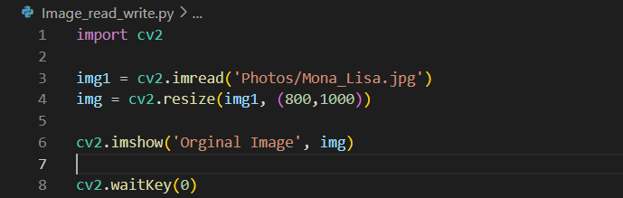
Artificial Intelligence in Drones- Computer Vision
Image Analysis: Basics: Using the OpenCV library, try to load the image and show it in a window named “Original Image“
This will display the image in a window named “Original Image“

Slide 16
Artificial Intelligence in Drones- Computer Vision
OpenCV (contd.): Few Important Manipulations of the images.
img0 = cv2.cvtColor(img1, cv2.COLOR_BGR2GRAY) → cv2.COLOR_BGR2GRAY for grayscale → color code.
img0 = cv2.GaussianBlur(img1, (oddnum, oddnum), cv2.BORDER_DEFAULT) → to blur the image “img1“, (oddnum, oddnum) is called kernel and it should always be an odd number. We need a border type, so we used the default blur border in the cv2 library. Higher the Kernel Value, Higher the Blur.
img0 = cv2.Canny(img1, 125, 175) → To get all the edges present in an image. (125, 175) are the threshold values. This will be used in object detection from the video feed.

Slide 17
Artificial Intelligence in Drones- Computer Vision
Image Analysis: Basics:
Using the OpenCV library, try to Blur, Grayscale and pass ALL of them through the Canny Function and display all of them with appropriate window names.
(including Canny of the Original Image)

Slide 18
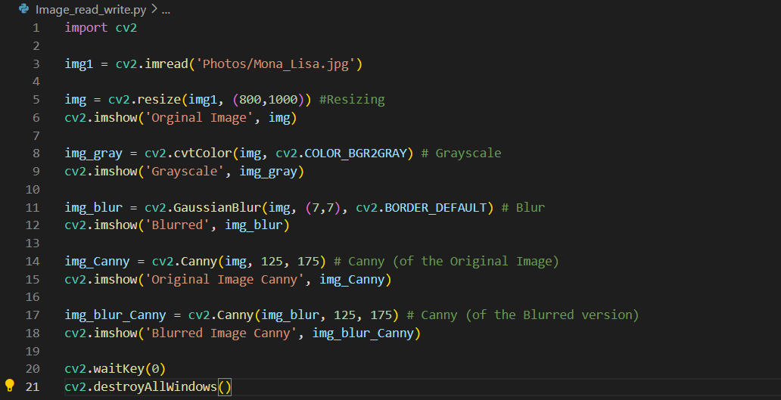
Artificial Intelligence in Drones- Computer Vision
Image Analysis: Basics: Using the OpenCV library, try to Blur, Grayscale and pass ALL of them through the Canny Function and display all of them with appropriate window names. (including Canny of the Original Image)

Slide 19
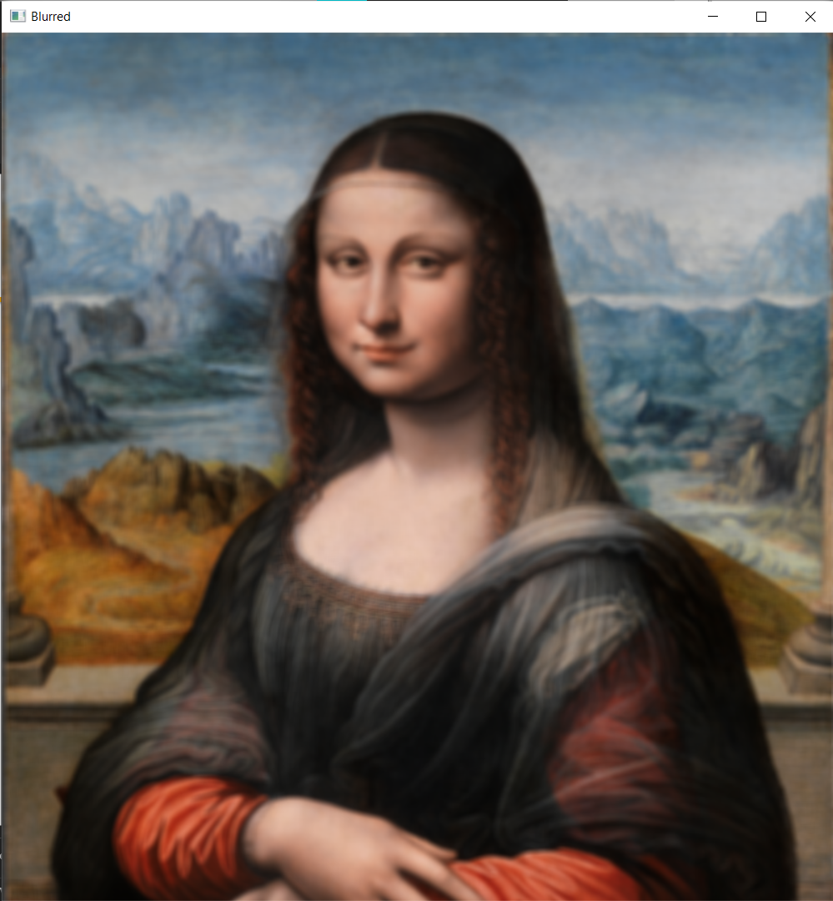
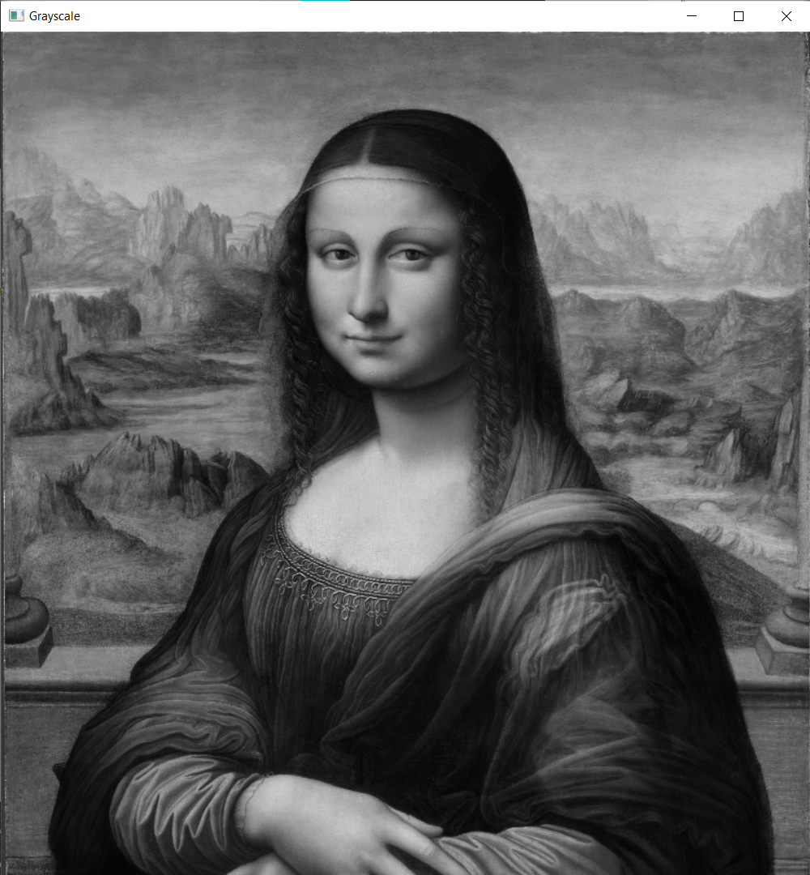
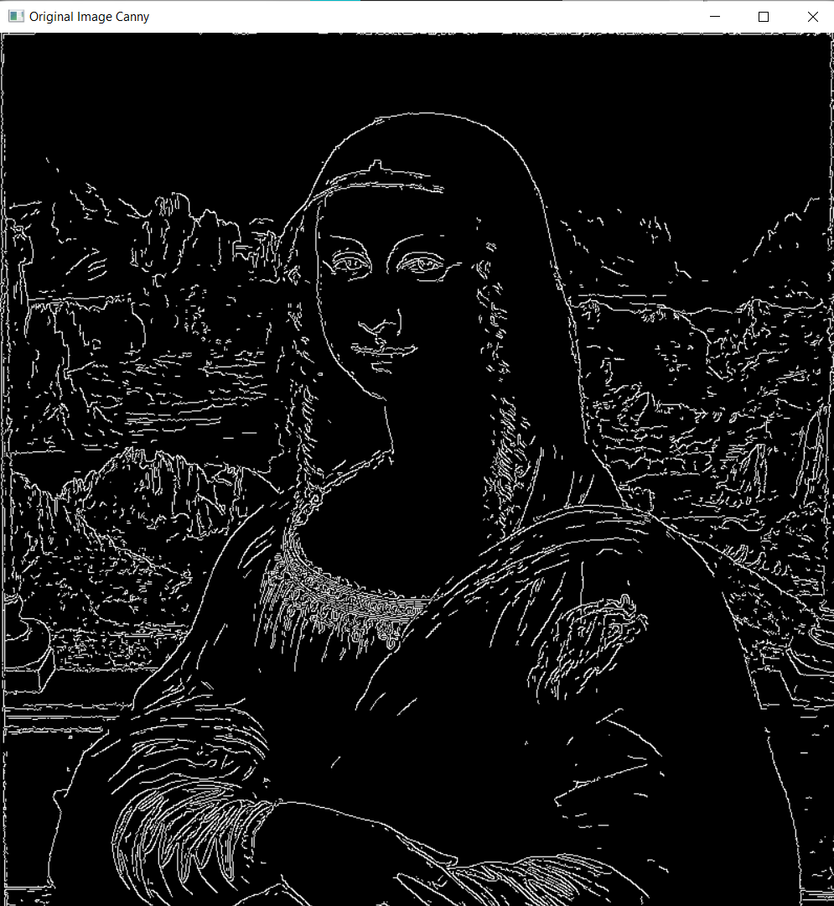
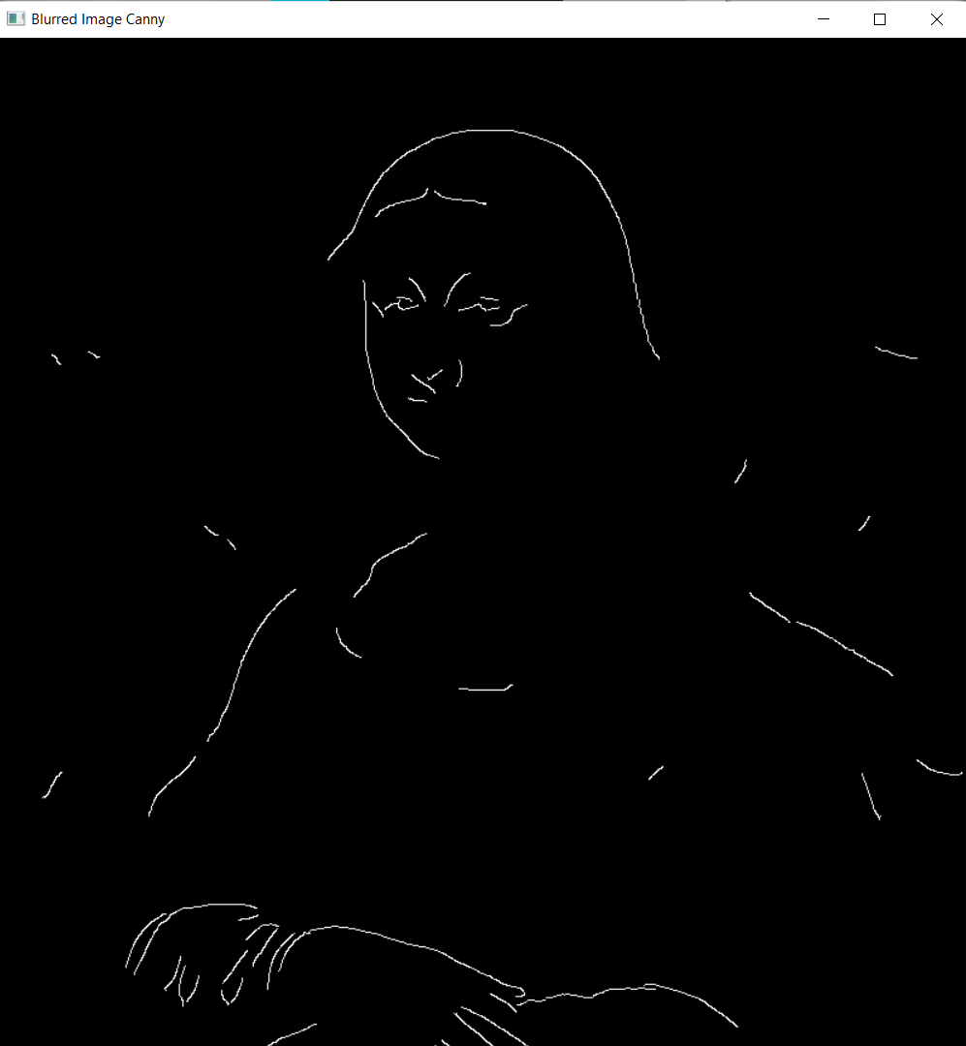
Artificial Intelligence in Drones- Computer Vision
Image Analysis: Basics: These are the expected outputs; these windows will pop up when you run the code.
Can you note the difference between the Canny of the Original and the Blurred one? More precise edges, less noise
Blurred Grayscale Canny (Of Original Image) Canny (Of Blurred Image)

Slide 20
Artificial Intelligence in Drones- Computer Vision
Image Analysis: Basics:
Try this again with a photo of a landscape. You can play with the Kernel of the GaussianBlur()
Lower the Kernel, more the noise

Slide 21
Artificial Intelligence in Drones- Computer Vision
Video Analysis: Basics: Using the OpenCV library, we can analyze and manipulate the video feed. Let’s start with the basic video manipulation using the built-in functions of OpenCV.
Connect the Webcam to your computer or Laptop (If built-in, make sure it is in working condition)
Use the following functions to access the video feed.
Video_feed = cv2.VideoCapture(0) → Your webcam feed can now be accessed in the script using this new variable
Video_feed.isOpened() → To see if the Webcam is available. If not, it will return “False“
ret, frame = Video_feed.read() → “ret” will become false if no frames are detected, “frame” is your frame at any given instant.
Video_feed.release() → To release the webcam (at the end of the code)

Slide 22
Artificial Intelligence in Drones- Computer Vision
Video Analysis: Basics: Using the OpenCV library, we can analyze and manipulate the video feed. Let’s start with the basic video manipulation using the built-in functions of OpenCV.
In the video, we manipulate each frame and display each frame as an image, but as this is a video feed, it will have many frames so it becomes a continuous slide show of images which appears as a video to us.
Let’s try to grayscale the video feed from the webcam in one window and blur in the other.

Slide 23
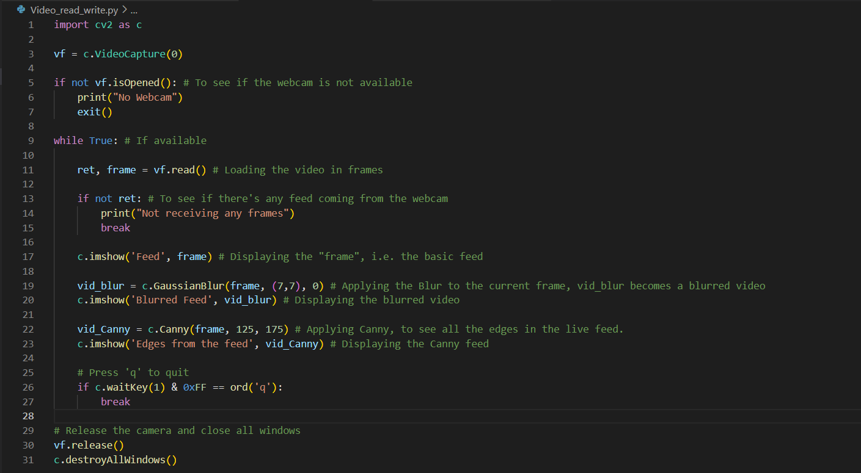
Artificial Intelligence in Drones- Computer Vision
Image Analysis: Basics: Here, the Kernel of the Blur is very strong (7,7) and hence you can see a nice blurry video, try taking the Canny of that feed to see how the noise reduces.

Slide 24
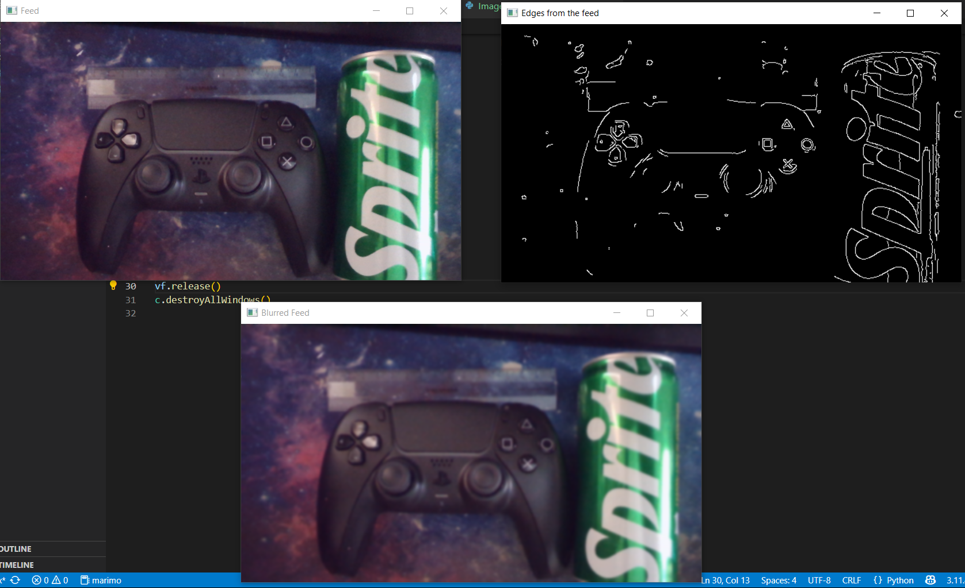
Artificial Intelligence in Drones- Computer Vision
Image Analysis: Basics: These are the three outputs; these windows will pop up when you run the code.
The effects are applied in real-time as the frames are being processed and displayed in matter of seconds

Slide 25
Artificial Intelligence in Drones- Computer Vision
OpenCV (Detection): These are the functions that are needed to detect objects, faces, etc.
cv2.cvtColor(img, cv2.COLOR_BGR2HSV) → convert BGR image to HSV color space
[ Ex: hsv = cv2.cvtColor(img, cv2.COLOR_BGR2HSV) ]
cv2.inRange(hsv, lower, upper) → create a binary mask (black & white) selecting only colors in given HSV range
[ Ex: mask = cv2.inRange(hsv, (0,120,70), (10,255,255)) ] → makes the color red white and others black
cv2.bitwise_and(img, img, mask=mask) → apply the mask on the image/frame, keep only detected regions
[ Ex: result = cv2.bitwise_and(img, img, mask=mask) ] → works for both photos and live webcam frames

Slide 26
Lecture XX-
YOLOv8 – You Only Look Once
Date: 1st Aug, 2025

Slide 27

Deep Learning in Drones – YOLOv8
YOLOv8: You Only Look Once is a Single-shot object detector using deep learning. This is useful in detecting multiple objects in a single look- meaning- we can detect objects in an image or video feed in real-time No need for manual detection pipeline like in OpenCV (HSV → mask → contours), now we can directly detect with close to no delay. Uses-
Detect obstacles or landing zones
Follow a colored object/person
Fly through hoops or loops autonomously

Slide 28
Deep Learning in Drones- YOLOv8
YOLOv8: follows There are three versions of YOLOv8, each version is tailored for different devices- YOLOv8 is very hardware intensive, hence we need to choose our version before. The syntaxes and functions are the same
YOLOv8n.pt – Extremely fast. ‘n‘ stands for nano and ‘.pt’ for pre-trained. Good for Raspberry Pi and Jetson Nano. Lowest Accuracy
YOLOv8s.pt – Very fast. ‘s‘ stands for small and ‘.pt’ stands for pre-trained. Good for Laptops and Jetson Nano. Low Accuracy
YOLOv8m.pt – Fast. ‘ m‘ stands for medium and ‘.pt’ stands for pre-trained. Good for Laptops with a good GPU. Medium Accuracy
YOLOv8l.pt – Slow. ‘l‘ stands for large and ‘.pt’ stands for pre-trained. Good with GPUs. High Accuracy
YOLOv8x.pt – Very Slow. ‘x‘ stands for extra large and ‘.pt’ for pre-trained. Best GPUs. Highest Accuracy.

Slide 29
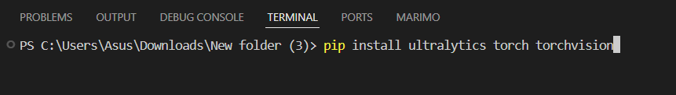
Deep Learning in Drones- YOLOv8
Installations: (Libraries): Next, we will be downloading all the python libraries that we will be using in the YOLOv8 for Drones. In the VS Code terminal, run this command- “pip install ultralytics torch torchvision”
If GPU is available – “pip install torchaudio --index-url https://download.pytorch.org/whl/cu121“
If GPU is not available – “pip install torchaudio --index-url https://download.pytorch.org/whl/cpu“

Slide 30
Deep Learning in Drones- YOLOv8
Ultralytics: This library has few functions that will be used heavily from image detection to video analysis.
from ultralytics import YOLO → importing YOLOv8 from the ultralytics library.
YOLO(“___”) → To select which version of YOLOv8 to use. [Ex: model = YOLO(“yolov8n.pt”) → Nano]
model(“___.xyz“)→ To use the loaded model on an image or video ( .JPG or .MP4 ) returns its analysis of the image or video. [Ex: resultsxyz = model(“img.jpg”) → gives all its finds to “results“ variable]
model(0)→ To use the loaded model on your webcam feed, returns its analysis of the webcam live feed.
[Ex: resultsxyz = model(0) → gives all its finds to “results“ variable]
resultsxyz[0].show() → To show the annotated image or video after the analysis in a temporary window.
resultsxyz[0].save(“__/__.xyz") → To save the annotated image or video ( .JPG or .MP4 ) in an address.

Slide 31
Deep Learning in Drones- YOLOv8
Exercise:
Using the YOLOv8 nano model, detect objects using your Webcam and save an image of the annotated frame and show it on the temporary window.

Slide 32
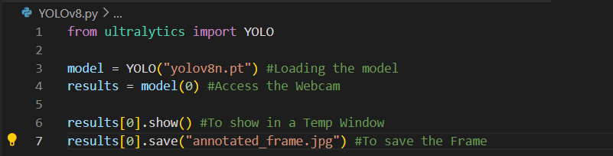
Deep Learning in Drones- YOLOv8
Exercise: Solution-

Slide 33
Deep Learning in Drones- YOLOv8
Ultralytics: Below are the functions that are used for getting the boxes and its coordinates for navigation.
results = model(0) → Running YOLO model on webcam and loading the results in the variable “results“.
boxes = results[0].boxes → gives all the detections found in that frame bounded by boxes.
results[0].boxes.xyxy → To get the coordinates of the boxes in the variable “coordinates“
[Ex: coordinates = results[0].boxes.xyxy → gives the coordinates in “coordinates“ variable]
results[0].boxes.conf → To get the confidence score of the boxes in the variable
[Ex: confidence = results[0].boxes.conf → gives the score in “confidence“ variable]
resultsxyz[0].show() → To show the annotated image or video after the analysis in a temporary window.
resultsxyz[0].save(“__/__.xyz") → To save the annotated image or video ( .JPG or .MP4 ) in an address.

Slide 34
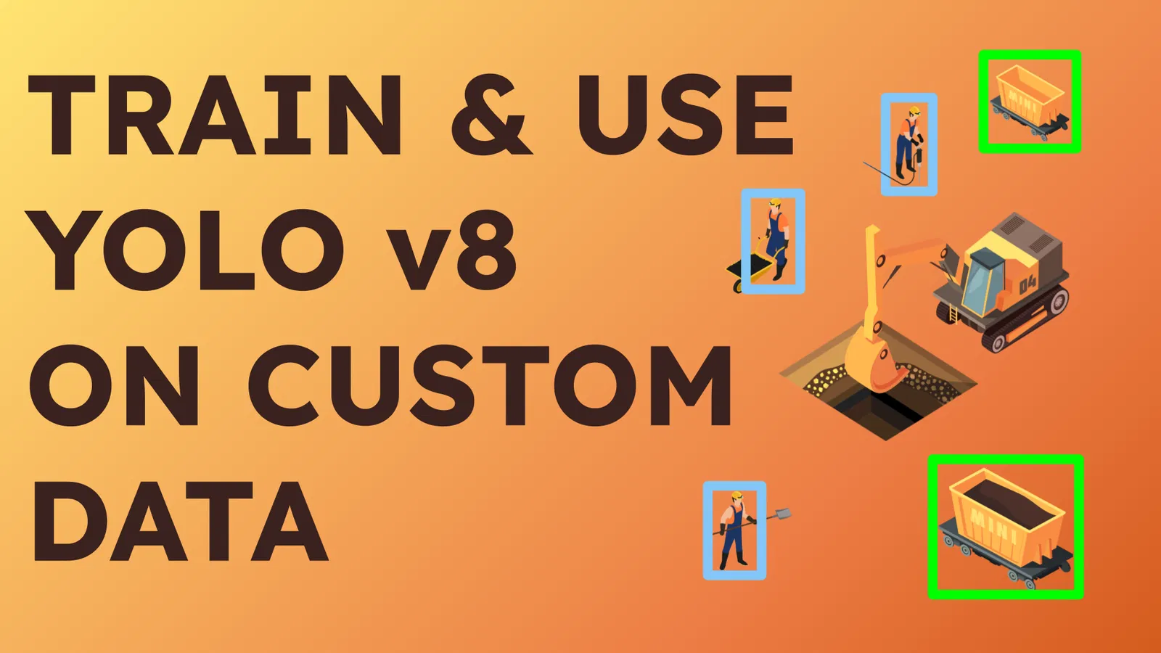
Deep Learning in Drones- YOLOv8
Training using your Data
YOLOv8 can only detect objects that it was trained for by default. But to make the drone detect Smiley balls or specific obstacles, we must train YOLOv8 with images of those objects. Pre-trained models are available online, but if there is a more specific dataset which is not available online, we need to make our own trained model
Steps-
Download all the programs needed
Collect images (20 – 200 images) of the data
Label (Annotating)
Setup Repository
Training the Model
Running the Model on Images & Live Video Feed

Slide 35


Deep Learning in Drones- YOLOv8
Training using your Data
YOLOv8 has many pre-trained models that are available online. Users have trained YOLOv8 on many different types of data, from airplanes to cars, musical instruments and many more. If we need a pre-trained model on Smiley Ball online, we can search for one on the Roboflow website. It gives free datasets uploaded by users. We can train using that in “Google Colab” and get the “best.pt”

Slide 36
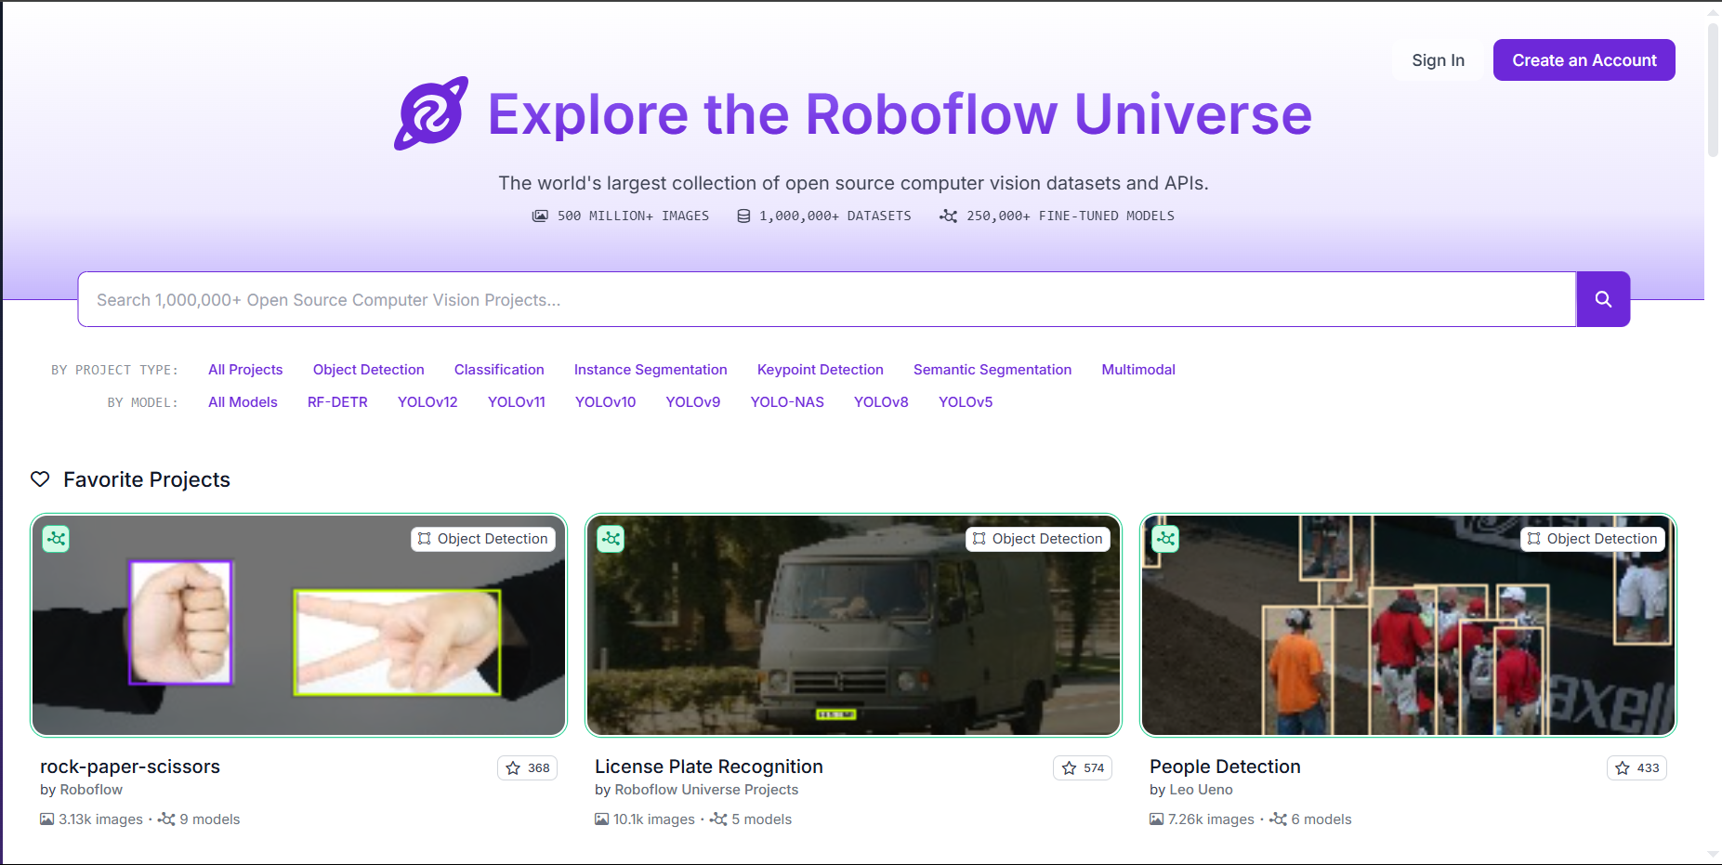
Deep Learning in Drones- YOLOv8
Training using your Data
Roboflow- You can explore thousands of publicly available datasets on Roboflow Universe, download them as YOLOv8 weights (best.pt), and use them directly for your own detection tasks. These are available in the Roboflow Universe. You can search up your desired dataset. Make sure you select YOLOv8 in the filters

Slide 37
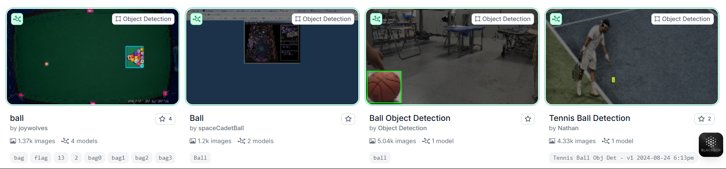
Deep Learning in Drones- YOLOv8
Training using your Data
Roboflow- Choose only the ones with the image count of upwards of 1,000. These datasets below are few examples.
More the Images, Better the Recognition

Slide 38
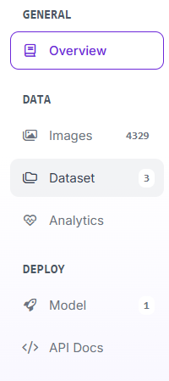
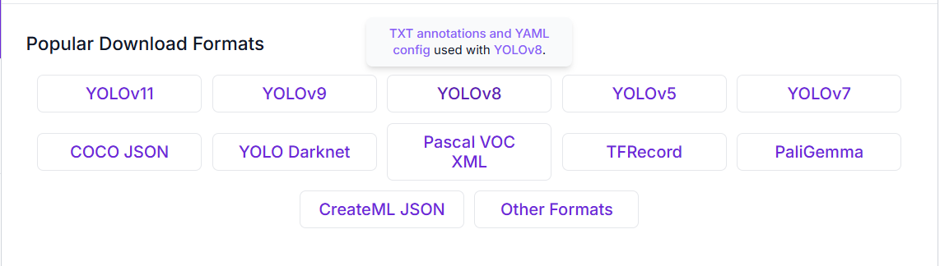
Deep Learning in Drones- YOLOv8
Training using your Data
Roboflow- Once you chose the one that you like, you can click on it and it will take you to the dataset profile, click on the “datasets” option in the left-hand side. Then chose the YOLOv8 option.

Slide 39
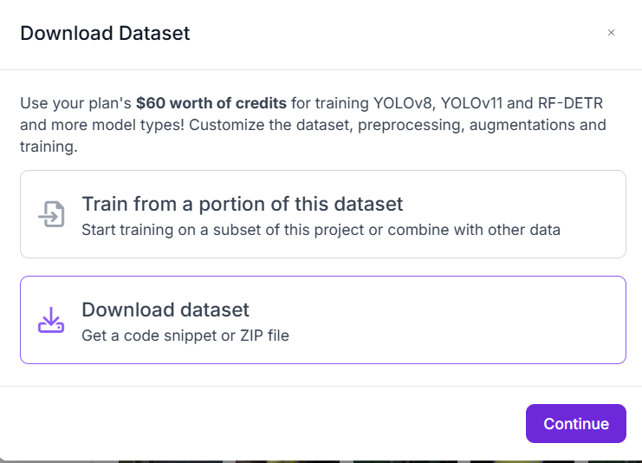
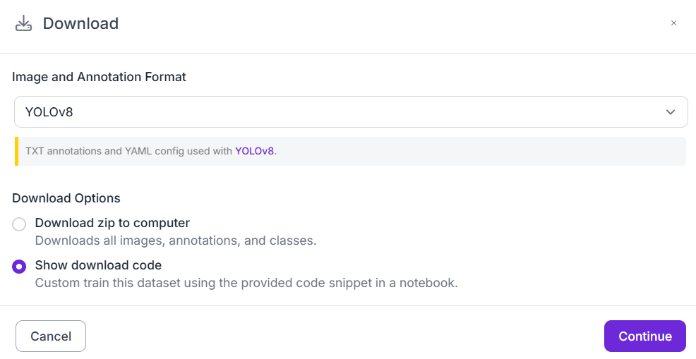
Deep Learning in Drones- YOLOv8
Training using your Data
Roboflow- Click on the “Download dataset” option, chose the “Show Download Code” option for the code with your own API key in it. By running this code in any IDE, you can download that dataset’s “data.yaml” file in the local IDE storage. Train the model using that “data.yaml” to get your own “best.pt”

Slide 40
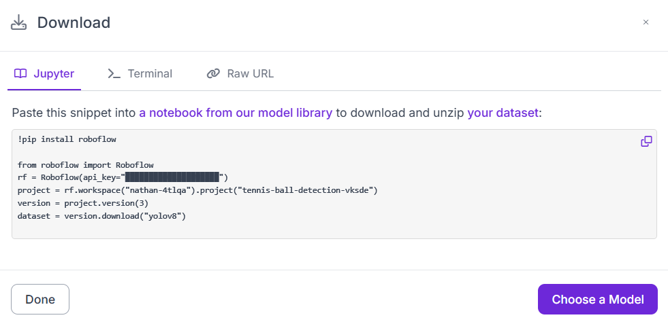
Deep Learning in Drones- YOLOv8
Training using your Data
Roboflow- By running this code in any IDE, you can download that dataset’s “data.yaml” file in the local IDE storage. Train the model using that “data.yaml” to get your own “best.pt”. Google Colab is a good option for training online. Free use of Graphics card with no computational power needed from your end. Online.

Slide 41

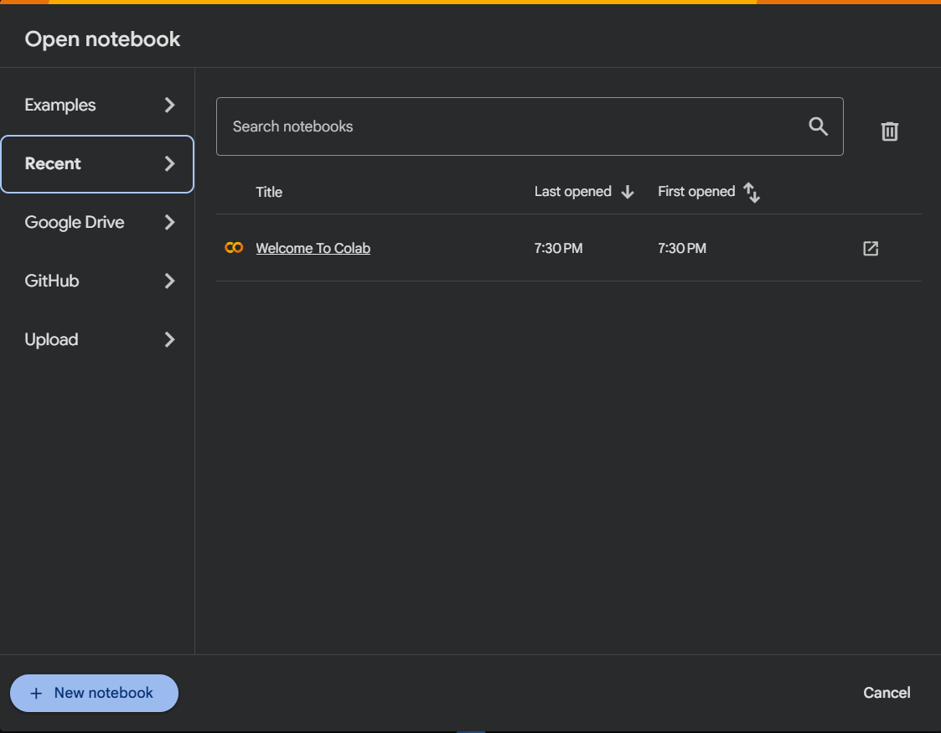
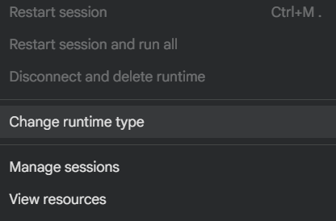
Deep Learning in Drones- YOLOv8
Training using your Data
Google Colab- This is a free IDE that allows users to run their code online on powerful GPUs for free. Log in to your Google Account and start a “New Notebook”. Change to GPU in “Change Runtime Type” options on the top, in the “Runtime” dropdown menu and get your training started.
To choose GPU

Slide 42
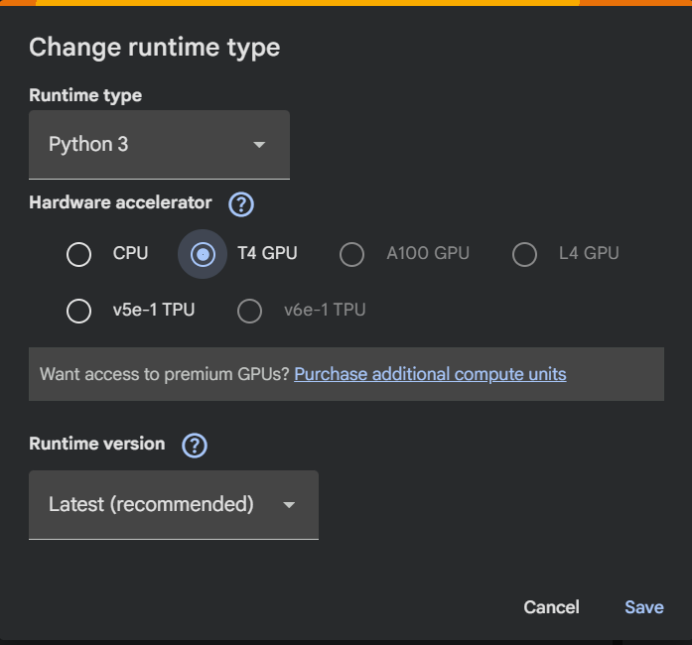
Deep Learning in Drones- YOLOv8
Training using your Data – Training the Model
Google Colab – Change the runtime type from CPU to GPU
Choose the GPU option
Save

Slide 43
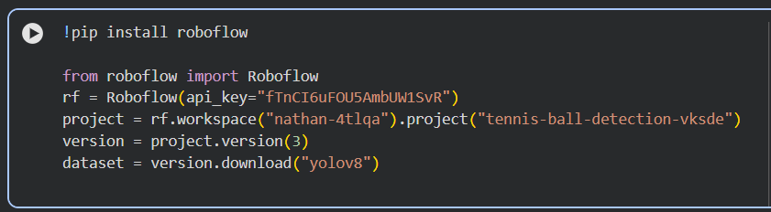
Deep Learning in Drones- YOLOv8
Training using your Data
Google Colab- Paste the code in the IDE and run the code.
Run the code

Slide 44

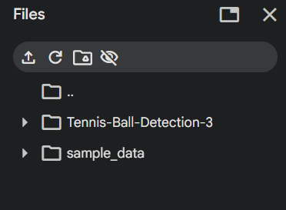
Deep Learning in Drones- YOLOv8
Training using your Data – Training the Model
Google Colab – Import the “dataset/” folder as a zip file to the Google Colab workspace. Click on the Folder Icon on the left toolbar, right click and click on “upload” option.
This is the Dataset which is now ready for training.

Slide 45
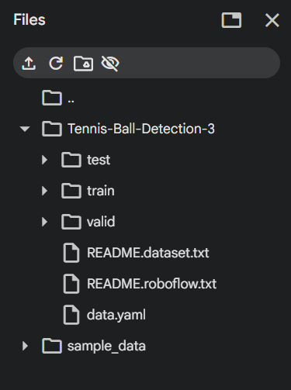
Deep Learning in Drones- YOLOv8
Training using your Data – Training the Model
Google Colab – Now we need the “data.yaml” file for training our YOLOv8 model. Confirm if the “data.yaml” file is in the folder.
This is the Dataset File that we are looking for.

Slide 46
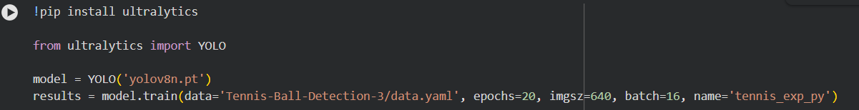
Deep Learning in Drones- YOLOv8
Training using your Data – Training the Model
Google Colab – Now train the YOLOv8 model with the dataset by providing the address of the “data.yaml” file from the Google Colab folder. Choose the YOLOv8 nano model to train.
Run the code
Epochs value as 20 is fine for even 10k images. (This would take some time. ~20 minutes)

Slide 47
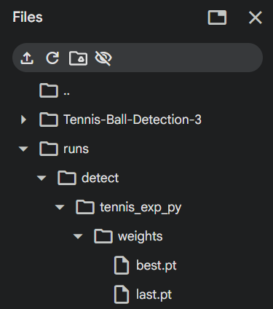
Deep Learning in Drones- YOLOv8
Training using your Data – Training the Model
Google Colab – The folder “Runs” will have the “best.pt” file for the chosen dataset. Export this file and use this for your drone. The training is complete!
This is the trained model for your dataset.

Slide 48
Deep Learning in Drones- YOLOv8
Training using your Data – (Custom Data)
YOLOv8 can only detect objects that it was trained for by default. But to make the drone detect hoops or specific obstacles, we must train YOLOv8 with custom datasets of those objects.
Steps- (For offline training)
Download all the programs needed
Collect images (2000+ images) of the data
Label (Annotating Offline or Online)
Setup Repository
Training the Model
Steps- (For complete online training)
Collect images (2000+ images) of the data
Label (Annotating completely online)
Online Repository
Training the Model (Google Colab)

Slide 49
Deep Learning in Drones- YOLOv8
Training using your Data – Downloading the Programs
(i) Necessary Programs- The programs needed for training the model, natively on your device, are-
Anaconda Prompt – Terminal for training (VS Code’s terminal is a better alternate)
LabelImg – Image annotator (Offline option)
Libraries – Python Libraries (Using “pip install”)

Slide 50
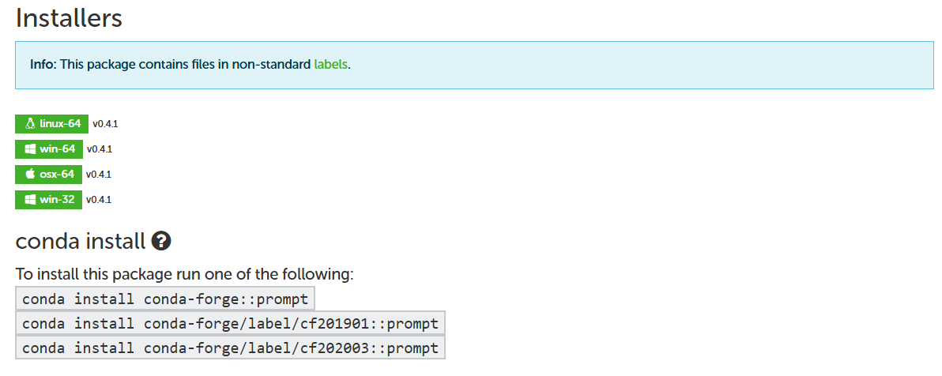
Deep Learning in Drones- YOLOv8
Training using your Data – Downloading the Programs
(i) Anaconda Prompt- This is the base for annotating and training the model on our custom data.
Install Anaconda prompt from its official website

Slide 51
Deep Learning in Drones- YOLOv8
Training using your Data – Downloading the Programs
(ii) Libraries- Open Anaconda prompt and change the directory to your preferred folder.
Use the “cd” command
Pip installs-
simple_image_download==0.4 → version 0.4 works with YOLOv8, higher versions aren’t compatable
labelImg → “I” is capital in “img”

Slide 52

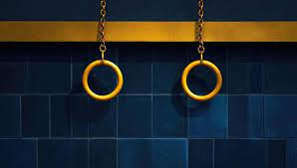
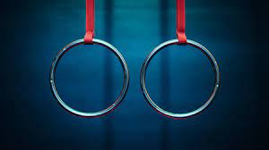
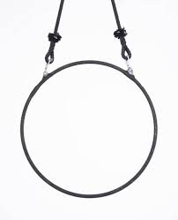
Deep Learning in Drones- YOLOv8
Training using your Data – Download the images
Simple_image_download – Using this library that we downloaded earlier to download up to 2000 images of the smiley ball.
It’s preferable if images are handpicked from the internet or taking photos yourself. But for bigger datasets, this library is useful.

Slide 53
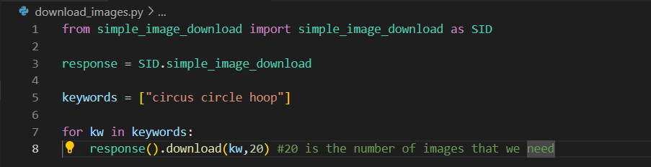
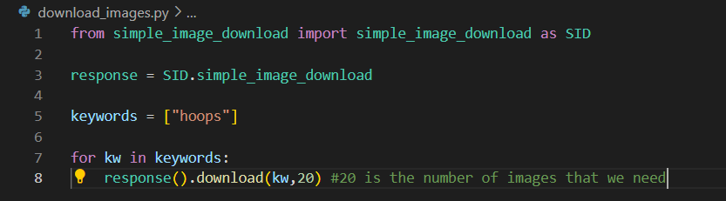
Deep Learning in Drones- YOLOv8
Training using your Data – Download the images
Simple_image_download – Using this library that we downloaded earlier to download up to 2000 images of the smiley ball.
It’s preferable if images are handpicked from the internet or taking photos yourself. But for bigger datasets, this library is useful. Run the code below and you’ll be getting a new folder in your directory named “simple_image“

Slide 54


Deep Learning in Drones- YOLOv8
Training using your Data – Labelling the images
labelImg – This is the OFFLINE tool that is used to annotate and make a dataset for our model. Open the tool using the command “labelImg“ (i is capital) in the Anaconda Prompt
This should open the Tool. Click on the “open dir” option on the toolbar and navigate to your images folder.

Slide 55
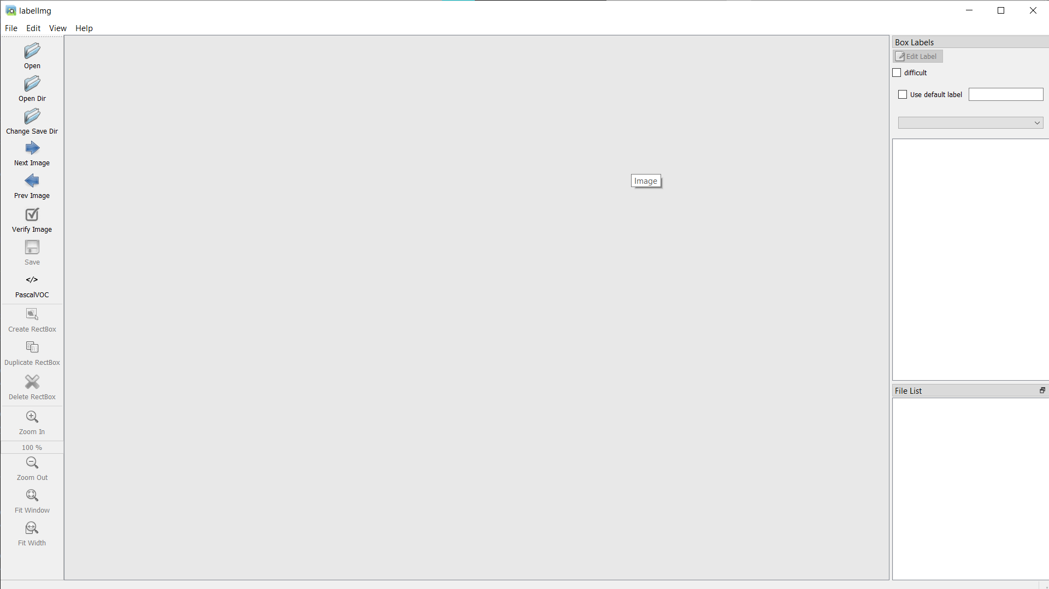
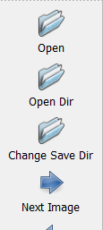
Deep Learning in Drones- YOLOv8
Training using your Data – Labelling the images
Open your images folder using the “open dir” option and open the folder where you want to save the annotated images using the “change save dir”

Slide 56
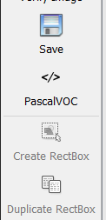
Deep Learning in Drones- YOLOv8
Training using your Data – Labelling the images
Make sure the mode is set to YOLO and not PascalVOC or CreateML
Click on the option to change it to YOLO

Slide 57
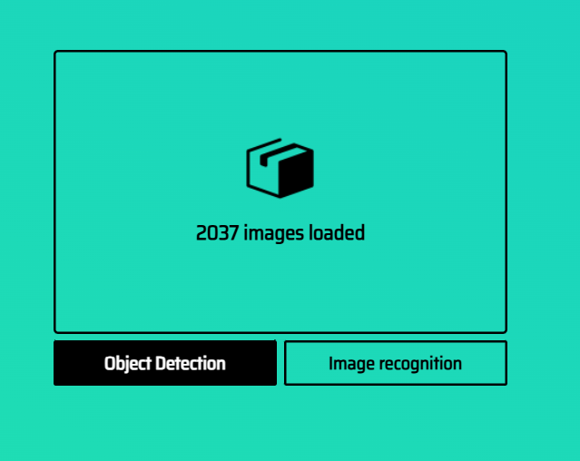
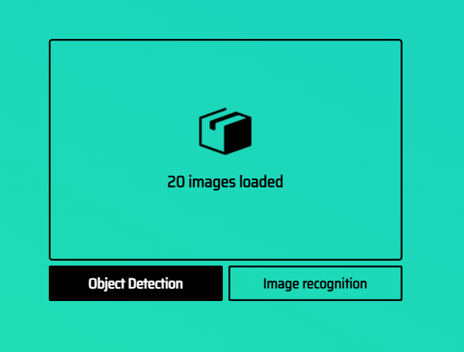
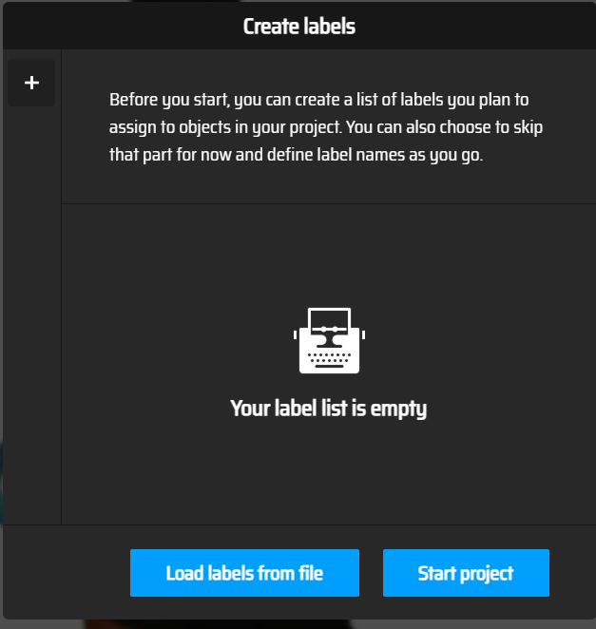
Deep Learning in Drones- YOLOv8
Training using your Data – Labelling the images
Makesense.ai – This is an ONLINE tool that is used to annotate and make a dataset for our model. Open the tool on your browser and import all the images that you want to annotate. Click on “Object detection”
Create a new label named “Smiley Ball”
Start after adding the label

Slide 58
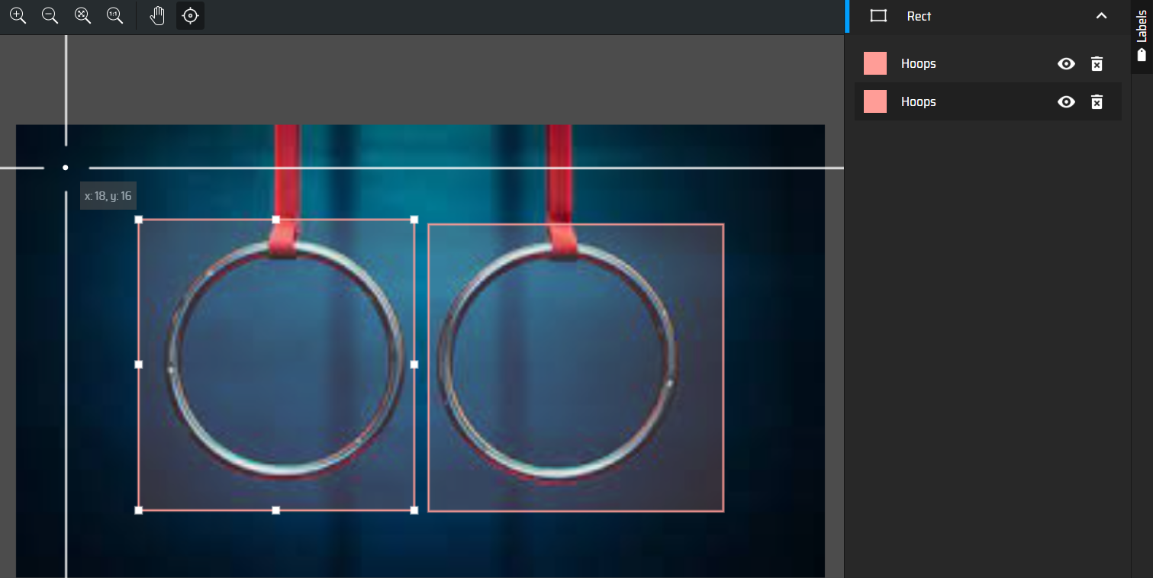
Deep Learning in Drones- YOLOv8
Training using your Data – Labelling the images
Makesense.ai – Now make boxes on the hoops using your cursor. Make sure you choose the “Hoops” label is chosen on the right-side, on the label’s toolbar.
Click on this option and choose the label from the drop-down menu

Slide 59

Deep Learning in Drones- YOLOv8
Training using your Data – Labelling the images
Makesense.ai – Repeat the process again on all the 20 images. Then click on the “Export Annotations” option in the “Actions” tab at the top. This will give zip folder with “.txt” files that contain all the annotations.
Click on this and export it to the repository that we will be working on

Slide 60


Deep Learning in Drones- YOLOv8
Training using your Data – Setting up the Folder
Your_directory
dataset
train
dataset
images
80% of the original
(random)
labels
80% of the annotated
(.txts of the images
In images/)
training.py
val
images
20% of the original
(remaining)
data.yaml
labels
20% of the annotated
(.txts of the images
In images/)

Slide 61

Deep Learning in Drones- YOLOv8
Training using your Data – Training the Model
data.yaml – Now in “data.yaml”, paste this code which will contain the information of where “train/” and “val/” folder is so that we can proceed with the training part.
By having this file, the training is much easier as we can use this file as the navigator and train our model using the “training.py” file.

Slide 62

Deep Learning in Drones- YOLOv8
Training using your Data – Training the Model Offline (Custom Dataset)
training.py – Now in “training.py”, paste this code which will contain the information of where “train/” and “val/” folder is so that we can proceed with the training part.
By running this code, the training of the model starts and it depends on the CPU and GPU power of the device.

Slide 63
Deep Learning in Drones- YOLOv8
Training using your Data – Training the Model Offline (Custom Dataset)
Trained model – Now in the directory, we can see a new folder made named “runs/” from which we will have to take the file named “best.pt”.
The path of “best.pt” is “runs/detect/train/weights/best.pt”
You can now use this path and run the trained model!

Slide 64

Deep Learning in Drones- YOLOv8
Training using your Data – Training the Model
Google Colab – You can also train your model in Google Colab, which provides free access to online GPUs for free. This allows faster training even if your laptop does not have a powerful GPU.
To choose GPU

Slide 65
Deep Learning in Drones- YOLOv8
Training using your Data – Training the Model
Google Colab – Change the runtime type from CPU to GPU
Choose the GPU option
Save

Slide 66

Deep Learning in Drones- YOLOv8
Training using your Data – Training the Model
Google Colab – Run “pip install ultralytics” in the coding window.
Run the line

Slide 67

Deep Learning in Drones- YOLOv8
Training using your Data – Training the Model
Google Colab – Import the “dataset/” folder as a zip file to the Google Colab workspace. Click on the Folder Icon on the left toolbar, right click and click on “upload” option.
Upload the .zip file

Slide 68

Deep Learning in Drones- YOLOv8
Training using your Data – Training the Model
Google Colab – Run “!unzip dataset.zip –d dataset” in the coding window. This will unzip the “dataset/” folder. Now the “train/” and “val/” folder will be available to us in Google Colab only for this session.
Run the line

Slide 69

Deep Learning in Drones- YOLOv8
Training using your Data – Training the Model
Google Colab – Run the code of data.yaml in the following way. This time with the “%%writefile data.yaml” at the top for Google colab to create a new “data.yaml”.
Run the line

Slide 70

Deep Learning in Drones- YOLOv8
Training using your Data – Training the Model
Google Colab – Run the code to start training the model. This time we don’t need to make a “training.py” file, Google Colab can run and train it using GPUs.
Run the line

Slide 71

Deep Learning in Drones- YOLOv8
Training using your Data – Training the Model Online (Custom Dataset)
Google Colab – The folder “Runs” will have the “best.pt” file for the chosen dataset. Export this file and use this for your drone. The training is complete!
This is the trained model for your dataset.

Slide 72

Drone Control & Autonomy – dronekit
Dronekit: DroneKit-Python is a high-level Python library used to control drones running ArduPilot or PX4. DroneKit is an open-source Python library that allows us to connect, control, and automate drones using high-level commands. It enables autonomous flight by letting our programs send movement instructions directly to the flight controller.
Uses MAVlink protocol to communicate with the drone. It lets the drone execute movements, navigate to positions, and respond to AI decisions in real time.
Uses –
• Execute autonomous takeoff, landing, and waypoint missions • Move the drone based on AI analysis (YOLO detection → movement) • Adjust drone’s velocity or orientation dynamically to center on objects • Integrate object detection with flight control for autonomous navigation

Slide 73
Drone Control & Autonomy – dronekit
Difference between ArduPilot and PX4
Dronekit-ArduPilot
Works with ArduPilot Firmware
Python library- “dronekit”
Connectivity- Serial/UDP/Telemetry
Full mission control & Velocity Commands
Easiest API for python control
Used in Beginner and Academic Drones
Dronekit-PX4 Python API
Works with PX4 Firmware
Python library- “mavsdk”
Connectivity- UDP/Mavlink
Full mission control & Offboard control
More modern API and safety features
Used in Industry-grade UAV systems

Slide 74
Drone Control & Autonomy - dronekit
Dronekit: This library has few functions that will be used heavily for drone control.
from dronekit import connect, VehicleMode, LocationGlobalRelative → importing syntaxes
connect(‘udp:UDP_address’, wait_ready=True)→ To select the drone by its UDP address.
[Ex: vehicle = connect(‘udp:xxx.x.x.x:xxxxx’, wait_ready=True) → assigned drone as “vehicle”]
VehicleMode(“GUIDED“)→ To set the drone in “GUIDED” mode (autopilot)
[Ex: vehicle.mode = VehicleMode(“GUIDED”)]
___.armed→ To arm the motors of the drone (Turn on at idle).
[Ex: vehicle.armed = True → Motors initialized and at idle power]
___.simple_takeoff(x)→ To takeoff to “x” altitude.
send_body_velocity(vx, vy, vz)→ To move the drone towards a position using the x, y and z velocity. (in m/s)

Slide 75
Drone Control & Autonomy - dronekit
Dronekit: This library has few functions that will be used heavily for drone control.
send_ned_velocity(vx,vy,vx,duration)→ Move the drone in specific velocity in NED frame (North, East, Down)
condition_yaw(x)→ To rotate the drone to “x” degrees in the clockwise direction.
VehicleMode(“LAND“) → To land the drone at the current position.
[Ex: vehicle.mode = VehicleMode(“LAND”)]
___.simple_goto(LocationGlobalRelative( lat , lon , alt ))→ To fly the drone to a GPS location.
[Ex: vehicle.simple_goto(LocationGlobalRelative(-35.363261, 149.165230, 2))]
___.location.global_frame → To get the GPS coordinates of the drone in latitude, longitude and altitude order.
[Ex: lat , lon , alt = vehicle.location.global_frame]
___.battery→ To get the drone’s power information.
[Ex output: Battery(voltage=11.4,current=0.5,level=87)]

Slide 76
Drone Control & Autonomy - dronekit
Dronekit: This library has few functions that will be used heavily for drone control.
___.attitude.xyz→ To get the attitude details of the drone (Roll, Pitch, Yaw)
[Ex: roll = vehicle.attitude.roll]
[Ex: pitch = vehicle.attitude.pitch]
[Ex: yaw = vehicle.attitude.yaw]

