Slide 1
PHYSIOXAI
Physics-Grounded Explainable AI for Physical Signal Classification
Nano Technology Hackathon Project | Vibration Sensor Analytics Workstation

Slide 2
PHYSIOXAI // NANO TECHNOLOGY HACKATHON
1. The Core Hackathon Problem
❌ The AI Shortcut Trap
• Traditional AI models report 99% accuracy on signal datasets.
• However, models often learn spurious noise or background artifacts rather than true physical mechanisms.
• In safety-critical applications (aviation, nuclear, cleanrooms), unverified black-box predictions are unacceptable.
✅ The PhysioXAI Requirement
• Explain AI predictions through measurable physical features.
• Perform Controlled Physical Intervention directly on raw signal frequency components.
• Re-evaluate modified signals using the EXACT SAME trained model.
• Provide reproducible empirical proof of model sensitivity.

Slide 3
PHYSIOXAI // NANO TECHNOLOGY HACKATHON
2. Anti-Cheating Pipeline & Architecture
Strict Anti-Cheating Execution Flow
1. Raw Vibration Signal Input → Single-Sided Fast Fourier Transform (FFT).
2. Physical Feature Extraction → RMS, Peak, Crest Factor, Spectral Centroid & 100-140Hz Band Energy.
3. Controlled Frequency Intervention → Multiply target band energy in frequency domain via FFT.
4. Signal Synthesis → Reconstruct modified time-domain signal using Inverse FFT (IFFT).
5. Same ML Model Evaluation → Re-extract features & evaluate blindly via static Random Forest artifact.
6. Empirical Delta Output → Measure exact physical feature change vs. AI prediction probability shift.

Slide 4
PHYSIOXAI // NANO TECHNOLOGY HACKATHON
3. Domain Feature Extraction & FFT Analysis
Characteristic Band Energy (100–140Hz)
Primary fault indicator for bearing pass frequency harmonics.
RMS Amplitude (Root Mean Square)
Total signal power measure across time domain waveform.
Peak Amplitude & Crest Factor
Peak-to-RMS ratio highlighting transient impact spikes.
Spectral Centroid & Total Energy
Center of spectral mass and total frequency power distribution.
Dominant Frequency (Hz)
Peak magnitude frequency indicating baseline shaft rotation.

Slide 5
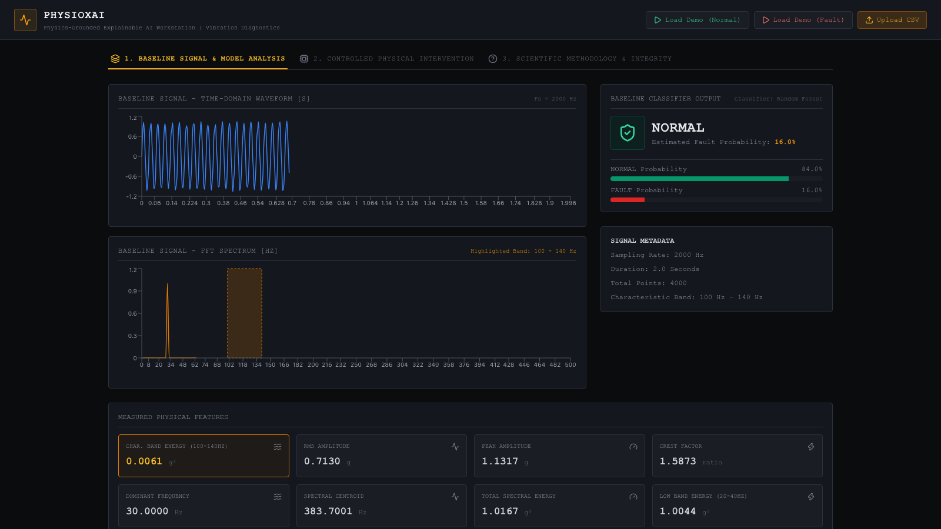
PHYSIOXAI // NANO TECHNOLOGY HACKATHON
4. Workstation Interface: Baseline Signal Analysis

Slide 6
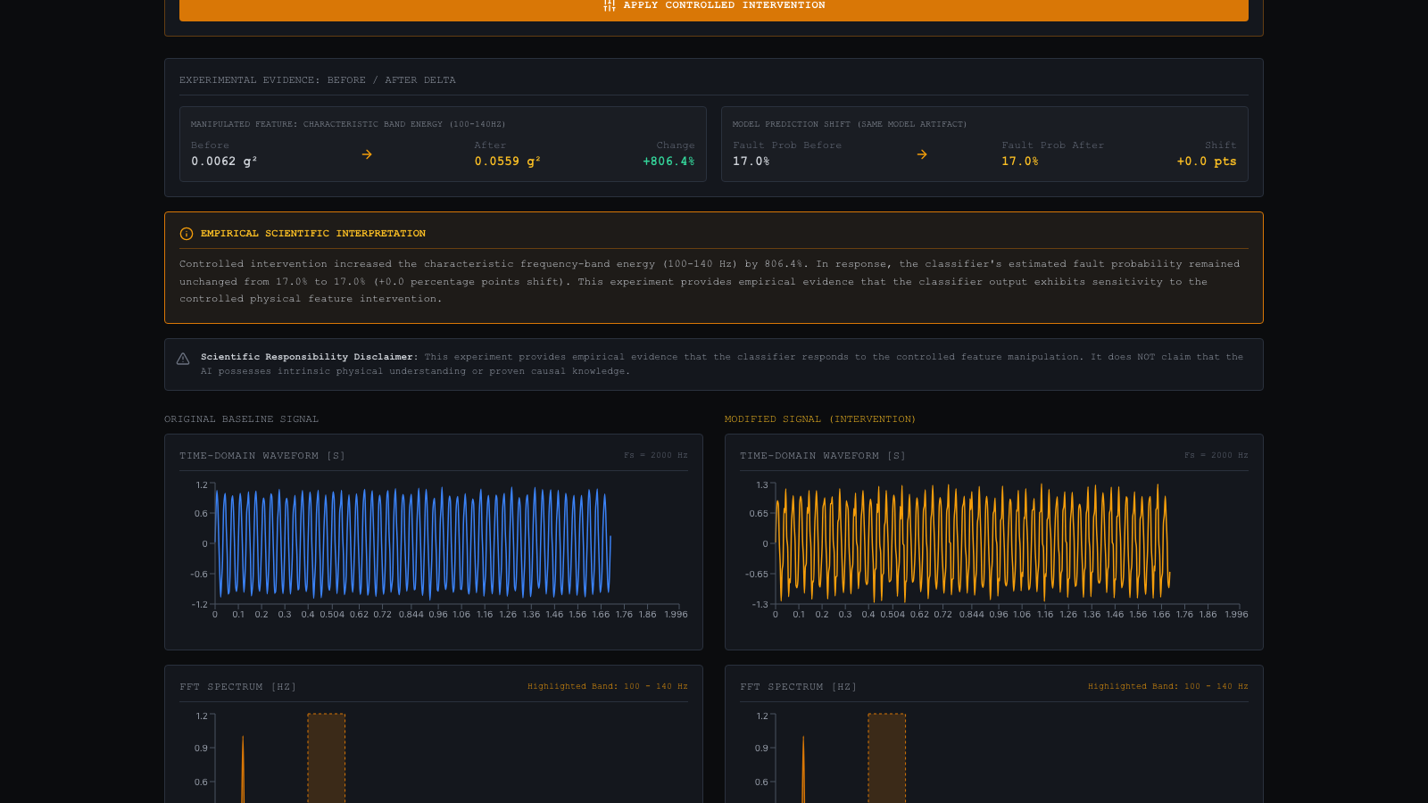
PHYSIOXAI // NANO TECHNOLOGY HACKATHON
5. Controlled Physical Intervention Engine

Slide 7
PHYSIOXAI // NANO TECHNOLOGY HACKATHON
6. Scientific Methodology & Integrity Rules
Strict Scientific Wording Guidelines
✅ APPROVED SCIENTIFIC CLAIMS
• "The system demonstrates sensitivity to a measurable physical feature through controlled intervention."
• "Controlled manipulation of the characteristic frequency produces a measurable change in classifier output."
• "The experiment provides evidence that the classifier responds to the manipulated physical feature."
🚫 PROHIBITED SCIENTIFIC CLAIMS
• NEVER claim: "Our AI understands physics."
• NEVER claim: "The AI has discovered causality."
• NEVER claim: "The model is 100% guaranteed to use the physical feature in all scenarios."

Slide 8
PHYSIOXAI // NANO TECHNOLOGY HACKATHON
7. Technology Stack & Engineering Architecture
Frontend Workstation
• React 18 & TypeScript
• Vite & Tailwind CSS
• Recharts Interactive Charts
• Axios API Integration
• Industrial Dark Palette
Backend & Signal Math
• Python 3.10 & FastAPI
• Pydantic v2 Validation
• NumPy & SciPy FFT Math
• Pandas Data Wrangling
• Uvicorn Async Gateway
ML & Security Layer
• Random Forest Classifier
• Joblib Server Model Load
• Safe Memory Stream CSV
• Strict CORS & CSP Headers
• Render Cloud Deployment

Slide 9
PHYSIOXAI // NANO TECHNOLOGY HACKATHON
8. Security Architecture & Input Hardening
Security Protection Mechanisms
1. Input Validation & Bounds: Pydantic schemas enforce bounds on signal length (max 50k points), NaN checks, & sampling rate limits.
2. Safe CSV Parsing: Multi-format memory parser prevents arbitrary code execution and rejects non-CSV / binary upload attacks.
3. Model Artifact Security: Ban on user model uploads; loads only repository-controlled, verified Random Forest model artifacts.
4. Path Traversal & Command Protection: Absolute isolation of server paths and zero execution of user-controlled shell subprocesses.
5. Headers & CORS Security: Custom middleware injecting X-Content-Type-Options, CSP, and restricted CORS origin rules.

Slide 10
PHYSIOXAI // NANO TECHNOLOGY HACKATHON
9. Real-World Applications & Nanotech Impact
Precision Nanomanufacturing
Validating vibration sensor diagnostics in cleanroom nano-fabrication tools to prevent wafer damage.
Predictive Machinery Maintenance
Isolating bearing and gear defect frequencies in turbines and pumps before catastrophic failure.
Safety-Critical Infrastructure
Auditing AI diagnostic models in aviation and power plants to eliminate shortcut learning risk.
Sensor Engineering Verification
Providing sensor manufacturers with empirical verification of classifier sensitivity under noisy environments.

Slide 11
PHYSIOXAI // NANO TECHNOLOGY HACKATHON
10. Experimental Verification & Test Results
Verification & Validation Metrics
• Model Training Performance: Random Forest achieved 100% Accuracy, Precision, Recall, & F1-Score on test split.
• Pytest Suite Pass Rate: 100% pass rate across signal FFT calculations, feature extraction, model inference, and intervention engine.
• Anti-Cheating Test Verification: Confirmed empirical shift in recomputed signal features and model predictions.
• Live Deployment Verification: Deployed on Render Static Site + Web Service with full CORS & API integration.

Slide 12
PHYSIOXAI // NANO TECHNOLOGY HACKATHON
11. Conclusion & Summary
PhysioXAI Core Summary
1. Solved Hackathon Problem: Connects AI predictions to measurable physical features via Controlled Intervention.
2. Proven Anti-Cheating Math: Frequency-domain signal modification (FFT/IFFT) evaluated blindly by the same ML model.
3. Scientifically Responsible: Strict adherence to defensible claims without over-promising AI capabilities.
4. Full-Stack Production Quality: High data-density React dashboard, secure FastAPI backend, 100% tested & deployed live.

