Slide 1

Real-Time Pest Detection with Automated Alerts
CSS 400 - MINOR PROJECT
Presented by
Chilukuri Hemanth Sai Nag - 226003030
Devireddy Deepak Reddy - 226003039
Gogula Sai Aasish - 226003050
GUIDE
Mr. Ramesh R
Srinivasa Ramanujan Centre
SASTRA Deemed to be University

Slide 2
AGENDA
Base Paper
Abstract
Problem Statement
Objective
Literature Review
Dataset Details
Proposed Method
Workplan
References

Slide 3
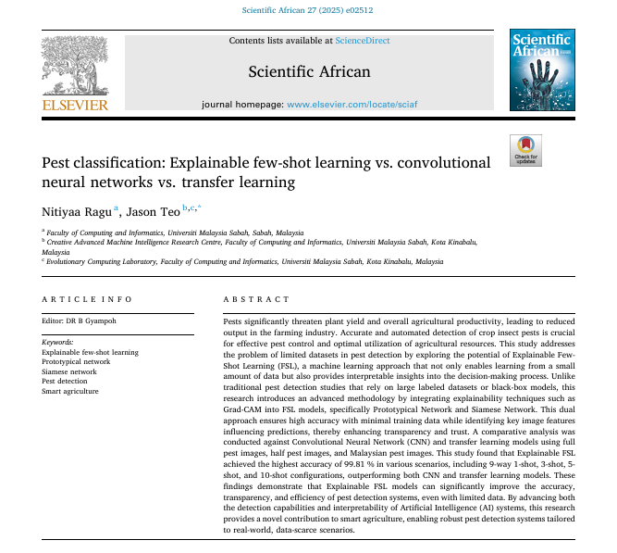
Base Paper
Indexing: SCIE

Slide 4
ABSTRACT
This problem is detecting pests in agriculture under minimal labeled data and real-time constraints. The hybrid approach integrating advanced machine learning and real-time processing tools will be developed to address this challenge. When the datasets are small, FSL or CapsNet will be applied for pest detection. For large datasets, Vision Transformers (ViT) will ensure high accuracy. Graph Neural Networks (GNNs) will train on pest relationships to improve detection, while Self-Supervised Learning will fine-tune performance with minimal labelled datasets. TensorFlow Lite will allow for optimized mobile inference and allow lightweight yet high performance pest detection. OpenCV will process real time video feeds, allowing immediate analysis. NumPy will aid in data handling for optimal computational performance. Integration with SMS notification is to ensure prompt action as this will notify the farmer about the activity of the pest. A scalable and self-sustaining solution to the problem of precision pest detection can be established for the purpose. The application combines machine learning with real-time processing, providing a very efficient and accurate method toward field-ready management of pests.

Slide 5
PROBLEM STATEMENT
Manual pest detection is slow, error-prone, and relies on expert knowledge, while existing AI models require large labeled datasets.
Conventional deep learning models struggle with accuracy in data-scarce environments and lack interpretability, making them difficult to trust.
Therefore leverages Explainable Few-Shot Learning (FSL) to enhance pest classification accuracy, reduce data dependency, and provide transparent, trustworthy AI decisions.

Slide 6
OBJECTIVE
➢Develop and evaluate an Explainable Few-Shot Learning (FSL)-based pest classification system to improve accuracy, efficiency, and transparency in smart agriculture.
➢Compare FSL models with traditional deep learning approaches to achieve high classification accuracy with minimal data while integrating explainability techniques like Grad-CAM for better interpretability and trust.

Slide 7
LITERATURE REVIEW
S.NO | TITLE | AUTHOR | YEAR | METHOD | JOURNAL | MERITS | DEMERITS
1. | Plant diseases and pests detection based on deep learning: a review | Jun Liu | 2021 | The study employs deep learning models, specifically Convolutional Neural Networks (CNNs), to classify mulberry ripeness stages based on image data. | Springer | The study highlights improved efficiency, reduced risks, fewer complications, and faster recovery with dual-modality endoscopy compared to traditional laparotomy. | Limitations include a single-center study design, small sample size, lack of prognosis analysis, and insufficient exploration of influencing factors.

Slide 8
LITERATURE REVIEW
S.NO | TITLE | AUTHOR | YEAR | METHOD | JOURNAL | MERITS | DEMERITS
2. | Machine Learning based Pest Identification in Paddy Plants. | Vivek Agnihotri | 2019 | The authors propose an OTA-C (Operational Transconductance | IEEE | The proposed design offers a flexible approach to implementing fractional-order filters. | The practical implementation of fractional-order capacitors can be challenging, and the performance may be affected by non-idealities in the OTA and other circuit components.
3. | Pest Detection and Recognition: An approach using Deep Learning Techniques | Niranjan C. Kundur | 2022 | Video Compression using Deep Neural Networks (CNN) | IEEE | The study demonstrates that deep neural networks can enhance video compression efficiency, potentially surpassing traditional H.264 standards in performance. | The study may face challenges in generalizing the model to diverse remote sensing datasets due to potential overfitting.

Slide 9
LITERATURE REVIEW
S.NO | TITLE | AUTHOR | YEAR | METHOD | JOURNAL | MERITS | DEMERITS
4. | Multi-Domain Few-Shot Learning and Dataset for Agricultural Applications | Sai Vidyaranya Nuthalapati | 2021 | Introduces a group-aware contrastive network using context graphs. | IEEE | One merit of this method could be its innovative approach to person re-identification using group-aware contrastive networks. | A potential demerit could be the complexity of implementing and fine-tuning such a specialized network.
5. | Insect Pest Detection and Identification Method Based on Deep Learning for Realizing a Pest Control System | Hiroaki Kuzuhara | 2020 | The authors propose a two-stage detection and identification method for small insect pests utilizing Convolutional Neural Networks (CNNs). | SCI-E | A significant advantage of this method is its ability to accurately detect and identify small insect pests, which are often challenging to recognize. | A potential drawback is that the two-stage process may result in increased computational complexity and longer processing times.

Slide 10
PROPOSED METHOD
A hybrid deep learning approach for precise pest detection using minimal labeled data. Few-Shot Learning (FSL) or Capsule Networks (CapsNet) will handle small datasets, while Vision Transformers (ViT) improve accuracy for larger datasets. Real-time processing with OpenCV and TensorFlow Lite ensures efficient mobile inference and instant detection. Graph Neural Networks (GNNs) and Self-Supervised Learning will enhance detection accuracy with minimal training data. NumPy optimizes data handling, and an SMS notification system will provide real-time alerts to farmers for timely pest control.

Slide 11
Dataset Details:
Dataset Link: Pest Classification Dataset
Pests are a huge threat! Farmers are hard at work however their productivity is reduced due to pests, so this dataset can be used to identify pests or maybe other use cases involving pest identification.
Dataset Description a. Type of dataset: Image Dataset b. No. of training images: 300 images per pest c. No. of testing images: 50 images per pest d. Data Source: Automatic script to scrape images of pest from Google through Selenium and Chrome Driver e. Pests: aphids, armyworm, beetle, bollworm, grasshopper, mites, mosquito, sawfly, stem borer.

Slide 12
pest/
│── train/
|-aphids
|- armyworm
|- beetle
|- bollworm
|- grasshopper
|- mites
|- mosquito
|- sawfly
|- stem_borer
│── test/
|-aphids
|- armyworm
|- beetle
|- bollworm
|- grasshopper
|- mites
|- mosquito
|- sawfly
|- stem_borer

Slide 13
WORKPLAN
Data Collection
Model Development
Testing and Validation
System Development

Slide 14
REFERENCES
S.H. Lee, C.S. Chan, S.J. Mayo, P. Remagnino, How deep learning extracts and learns leaf features for plant classification, Pattern Recognit 71 (2017) 1–13, https://doi.org/10.1016/j.patcog.2017.05.015.
J. Liu, X. Wang, Plant diseases and pests detection based on deep learning: a review, Plant Methods 17 (2021) 1–18, https://doi.org/10.1186/s13007-021- 00722-9.
S.H.M. Ashtiani, S. Javanmardi, M. Jahanbanifard, A. Martynenko, F.J. Verbeek, Detection of mulberry ripeness stages using deep learning models, IEEE Access 9 (2021) 100380–100394, https://doi.org/10.1109/ACCESS.2021.3096550.
H. Kuzuhara, H. Takimoto, Y. Sato, A. Kanagawa, Insect pest detection and identification method based on deep learning for realizing a pest control system, in: 2020 59th Annual Conference of the Society of Instrument and Control Engineers of Japan (SICE), IEEE, 2020, pp. 709–714.
L. Liu, R. Wang, C. Xie, P. Yang, F. Wang, S. Sudirman, et al., PestNet: an end-to-end deep learning approach for large-scale multi-class pest detection and classification, IEEE Access 7 (2019) 45301–45312, https://doi.org/10.1109/ACCESS.2019.2909522.
Y. Wang, Q. Yao, J.T. Kwok, L.M. Ni, Generalizing from a few examples: a survey on few-shot learning, ACM Comp. Surv. 53 (2020) 1–34, https://doi.org/ 10.1145/3386252.

Slide 15
THANK YOU

