Slide 1
TEAM A14
DOMAIN : DEEP LEARNING
VASAVI COLLEGE OF ENGINEERING
DEPARTMENT OF INFORMATION TECHNOLOGY
M.Akhil 1602-21-737-005
N.Hemantha Giri 1602-21-737-020
Project Guide : S.Rajyalaxmi
(Assistant Professor)

Slide 2
Title of the Project:
Enhancing Car Damage Analysis Through YOLOv8 - Based Detection and Localization
URL of the paper: https://ieeexplore.ieee.org/document/10337735

Slide 3
Table of contents
1.Abstract
2.Problem statement
3.Literature survey
4.Proposed Method and Architecture Diagram
5.Experimental setup description - Data set description
6.Evaluation Metrics
7.Results
8.Analysis
9.Conclusion and future scope
10.References
11.Publication status

Slide 4
1.Abstract
Traditional inspection techniques are slow and subjective
Introduced automated system using YOLOv8s for detection
Trained on a vehicle damage dataset
Detects and classifies various vehicle damage types
Real-time detection for quick and accurate results

Slide 5
2.Problem statement
Manual vehicle damage inspection is slow and subjective
Prone to human error in damage assessment
Need for automated, accurate vehicle damage detection
YOLOv8s enables real-time detection and localization
Aims to improve speed and consistency
Reduces human intervention and potential errors
Targeted for insurance claims and investigations

Slide 6
3. Literature survey
authors(s) | Proposed methodology | Performance | Gaps
Jihad Qaddour , Syeda Ayesha Siddiqa | Deep learning-based estimator for vehicle damage assessment | High detection accuracy | Lacks real-time evaluation on diverse datasets
R. Rudra, P. Sarker, F. H. Khan, A. Guha | Mask-RCNN-based instance seg- mentation for detecting vehicle damage | 85.3% mAP | Computationally expensive for real- time applications

Slide 7
3.Literature survey
author(s) | Approach | Performance | Gap
R. E. Van Ruitenbeek, S. Bhu- lai | CNN-based model for vehicle damage classification | 81.2% accuracy . | Limited dataset with few damage categories
N. Verma, P. S. Kumar, R. Ya- dav, V. Kumar | Combination of deep learning and computer vision techniques for damage assessment | 78.6% accuracy | Lacks robustness in vary- ing lighting conditions

Slide 8
4.Proposed Method
Proposed Model:
We use YOLOv8 (You Only Look Once – version 8), an advanced real-time object detection model developed by Ultralytics.
Detect and localize car damages using YOLOv8
Real-time object detection with high accuracy
Trained on labeled car damage image dataset

Slide 9
4.Proposed method
Workflow Overview:
Input: Image of a car with visible surface
Preprocessing: Resize, normalize
YOLOv8 model processes the image
Output: Bounding boxes around detected damages with confidence scores

Slide 10
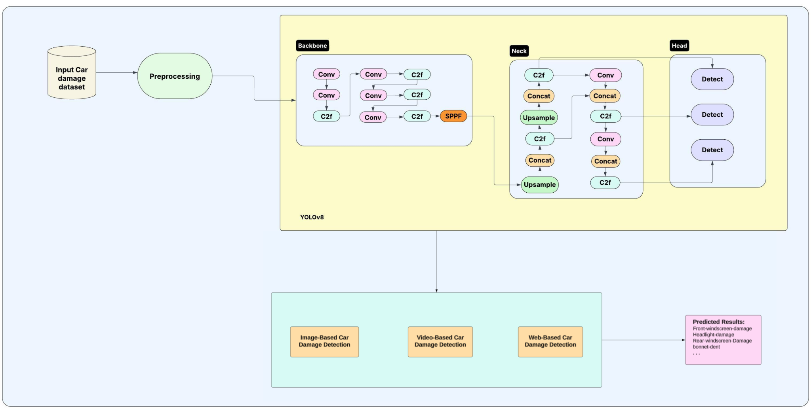
4.Architecture Diagram

Slide 11
5.Experimental setup description
Training done using Kaggle P100 GPU environment
Trained with Ultralytics YOLOv8 PyTorch framework
Epochs, batch size tuned for optimal performance
Evaluated based on precision, recall, F1-score, and Intersection over Union (IoU).

Slide 12
5.Dataset Description
Custom dataset of damaged car surface images
Included scratches, dents, cracks, and deformities
Images annotated with bounding boxes for damage
Collected from roboflow platform
Preprocessed with resizing and normalization techniques
Divided dataset into training, validation, testing sets

Slide 13
6.Evaluation Metrics
Precision: Correct detections / total detections
Recall: Correct detections / total actual damage instances
mAP (mean Average Precision): Measures both localization and classification accuracy
IoU (Intersection over Union): Evaluates overlap between predicted and ground truth bounding boxes

Slide 14
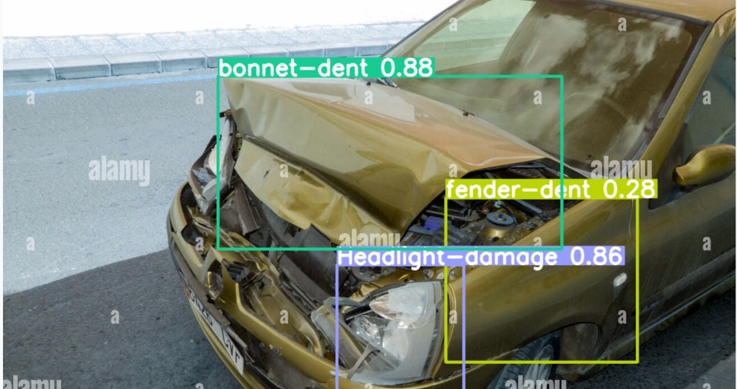
7.Results
Model Performance Metrics
The model achieves high precision (87.7%), indicating that most predicted damages are correct.
A recall of 74.8% shows it identifies a majority of actual damages.
mAP@0.5 of 83.1% confirms strong performance under standard IoU threshold.
mAP@0.5:0.95 of 63.9% reflects good localization and generalization across varying IoU thresholds.
output of an object detection
model applied to a damaged car

Slide 15
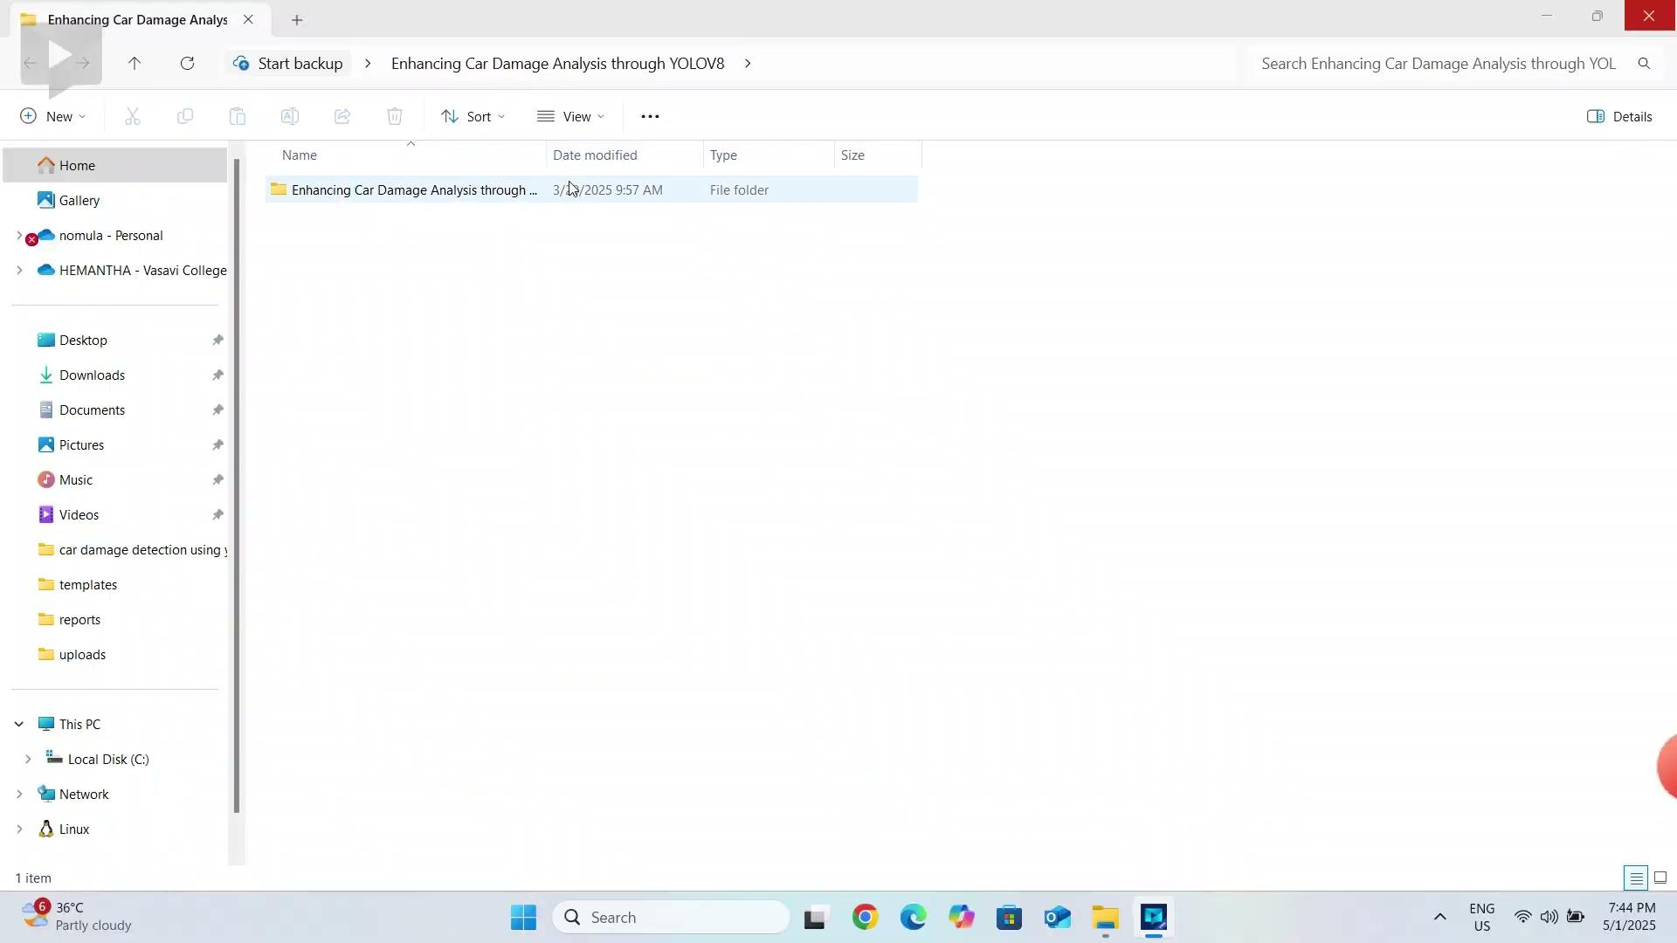
Execution Video
https://drive.google.com/file/d/1SDJkPx8UABmDS4_QunSWw49thGkmLNe1/view?usp=drive_link

Slide 16
8.Analysis
Model shows high accuracy in predictions
Most predicted damages are correctly localized
Some actual damages are occasionally missed
Few false positives due to reflections or shadows

Slide 17
9.Conclusion
This project successfully implemented an automated car damage detection system using YOLOv8, a state-of-the-art object detection model.
The model demonstrated high accuracy (mAP@0.5 ~83%) in identifying and localizing various types of car damages (scratches, dents, cracks).
It offers real-time performance, making it suitable for integration into mobile apps or insurance claim platforms.
The approach reduces manual inspection effort, increases objectivity, and speeds up damage assessment.

Slide 18
9.Future Scope
Larger Dataset and Fine-Tuning: Train on larger, real-world datasets for better generalization across car models, colors, and environments.
Mobile and Cloud Deployment: Integrate with mobile applications via REST APIs for end-user access and on-site car inspections.
Insurance Integration: Collaborate with insurance providers to automate the vehicle damage claim process.

Slide 19
10. References
[1] Qaddour, J., & Siddiqa, S. A. (2023). Automatic damaged vehicle estimator using enhanced deep learning algorithm. ScienceDirect. Retrieved from: https://www.sciencedirect.com/science/article/pii/S26673053230
00170
[2] R. Rudra, P. Sarker, F. H. Khan, A. Guha, Instance Segmentation for Car Damage Detection with Mask-RCNN, ResearchGate, 2023. Available:https://www.researchgate.net/publication/370134282 Instance Segmentation for Car Damage
Detection with Mask-RCNN.
[3] R. E. Van Ruitenbeek, S. Bhulai, Convolutional Neural Networks for Vehicle Damage Detection, ScienceDirect, 2022. Available: https://www.sciencedirect.com/science/article/pii/S2666827022000433
[4] N. Verma, P. S. Kumar, R. Yadav, V. Kumar, Car Damage Detection Analysis Using Deep Learning, Computer Vision Techniques, International Journal of Computer Applications, 2025. Available:
https://www.ijcaonline.org/proceedings/icaidsc2023/number1/car-damage-detection-analysis-using-deep-learning-computer-vision-techniques/.

Slide 20
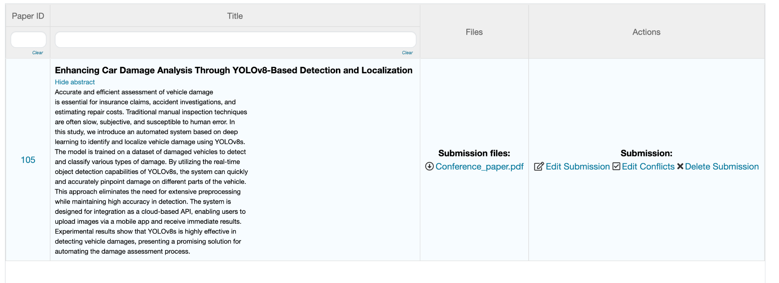
11.Publication status
Submitted paper in 8th International Conference on Intelligent Computing and Communication

