Slide 1

NATIONAL INSTITUTE OF TECHNOLOGY PUDUCHERRY
PROJECT NAME : SNAPCHAT FILTERS
PROJECT NUMBER : 15
TEAM MEMBERS : POSA HEMANTH KUMAR (CS21B1035)

Slide 2
OBJECTIVE :
The main objective is to design and develop a Snapchat filters which add fun and engaging visual effects to photos and videos shared on the platform by users.

Slide 3
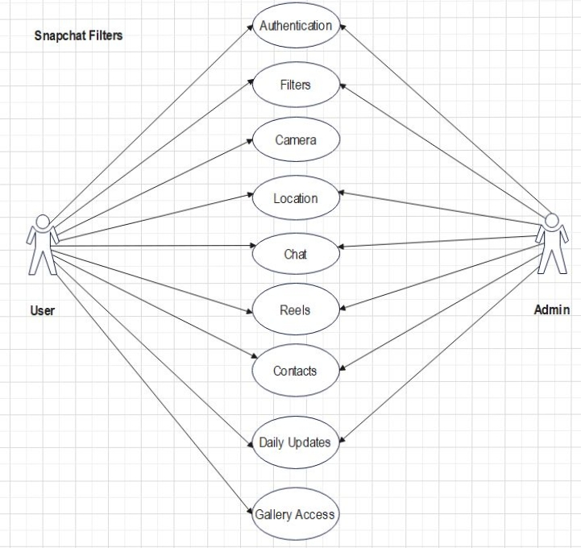
SYSTEM ARCHITECTURE:
(USE CASE DIAGRAM)

Slide 4
MOTIVATION :
To know and develop about Software Development Life Cycle (SDLC) and Software Testing Life Cycle (STLC) and how to apply various phases of Software Engineering in developing a project.

Slide 5
SCOPE OF PROJECT:
The Snapchat Filter Project can be a applicable for both mobile and desktop platforms. The project will allow users to apply filters to their photos and videos to make them more appealing and fun. The project will have a simple and user-friendly interface, which will allow users to easily navigate and apply filters. The project will include a wide range of filters, including face filters, location-based filters, and event-based filters.
Started on 20/12/2022 and ends by 11/4/2023 (approximately 113 days)

Slide 6
REQUIRMENTS:
Functional Requirements
Non-Functional Requirements
User requirements
User authentication
User profile
User interface
Camera access
Filter selection
Saving and sharing filters
Admin requirements
Admin interface
User management
Filter management
Reliability
Efficiency
Usability
Maintainability
Portability
Security

Slide 7
DATA FLOW DIAGRAMS:
Level 0: Snapchat Filters (Photo or video as input and filtered copy as output)
Level 1: User, Admin, Filters, User Management, Management Department
Level 2: Authentication, Live Camera, Import picture or video, Avatar, Security
Level 3: Details, Suggestions, Security, Daily Updates, Maintenance.

Slide 8
IMPLEMENTATION OF CODE:
Frontend :
Tkinter
Backend :
Python, SQL

Slide 9
TESTING:
INTERGRATION TESTING:
Login or signup successfully and opening new interface to use required filters.
After applying filters whether the copies are saving or not.
SYSTEM TESTING:
For given input such as photo/video desired output is formed or not.
ACCEPTENCE TESTING:
Alpha-testing:
Checking whether the code is user friendly or not.
Checking whether user can report problem or bugs successfully or not
Beta-testing:
Admin can able to add or remove filters successfully or not
Admin can able to security for every user or not
UNIT TESTING:
Module 1:
Login is done successfully or not
Sign up is successful if the credentials are valid
Module 2:
Camera is accessed successfully or not
Import file is image/video or not
Module 3:
Selected filter is particular or not
Have successfully engaging visual effects or not

Slide 10
TEST CASES:
Whether authentication is working as required or not
Whether our database accessing or not
Whether our application is working for different platforms like android and iOS
Checking for filters are working as required
Whether our filters working for different scenarios
After applying effect whether copy of image is saved or not
file:///C:/Users/posah/Desktop/TRESURE/Presentation2.pptx

Slide 11
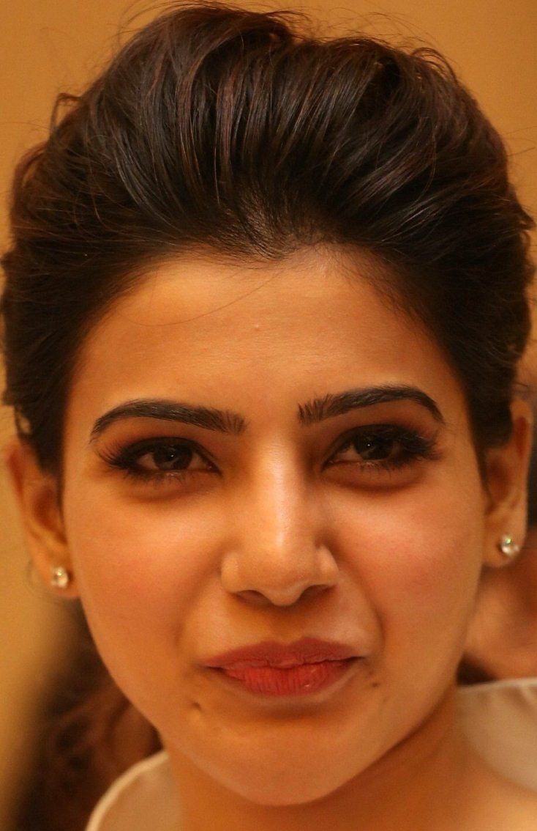
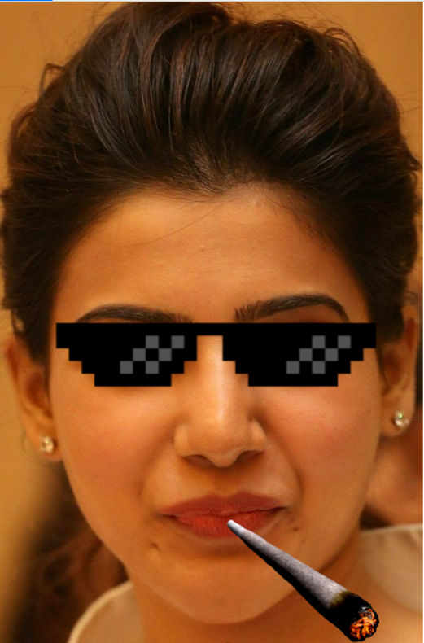
TEST CASES:

Slide 12
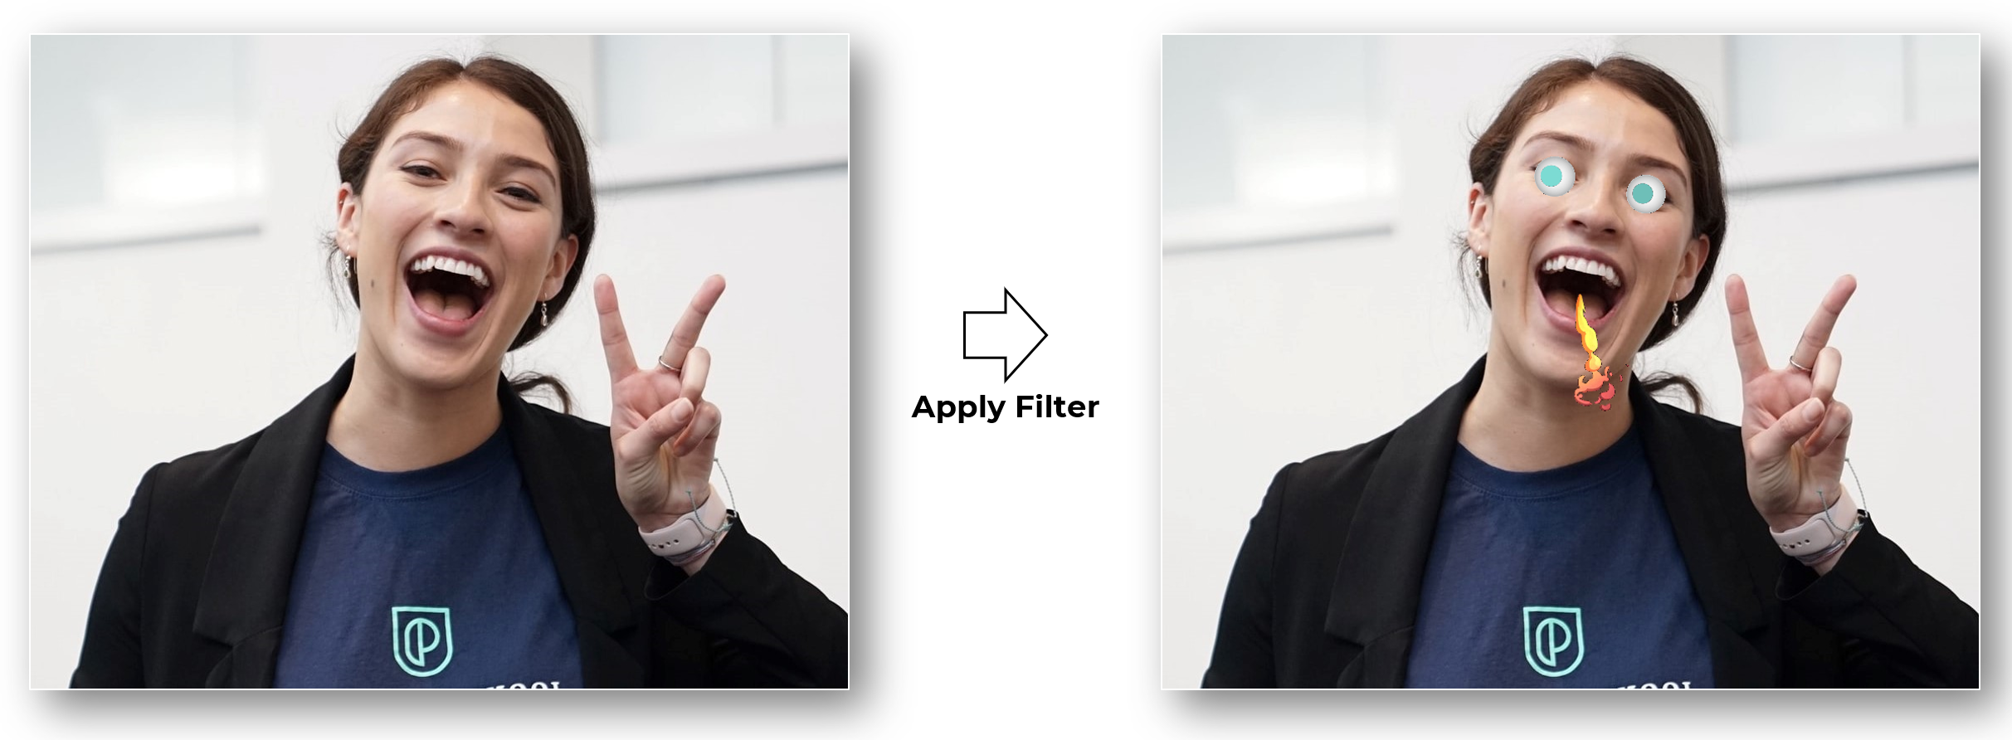

Slide 13
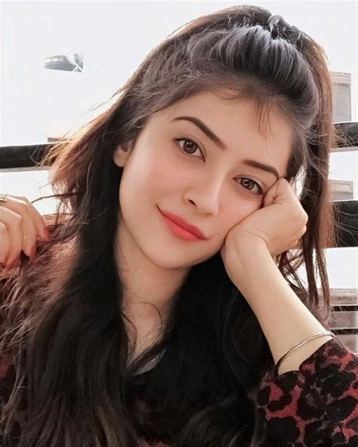


Slide 14


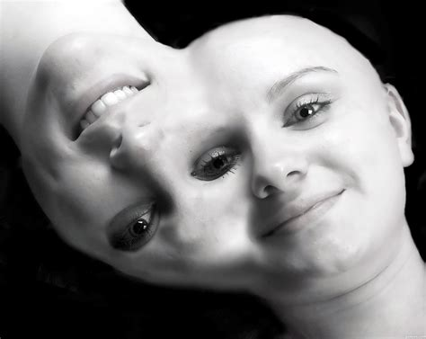

Slide 15
THANK YOU
Name : POSA HEMANTH KUMAR
Mobile number : 9949288461
Mail id : posahemanth@gmail.com
Github : https://github.com/Hemanth18052002
LinkedIn : https://www.linkedin.com/in/hemanth-kumar-posa-938b03237

