Slide 1

Student Academic Performance
Presented By
Student Name:JANJANAM HEMANTH KUMAR
College Name: R.V.R. & J.C.College of Engineering
Department: Computer Science and Business Systems
Email ID: hemanthkumarjanjanam@gmail.com
AICTE Student ID:STU65f9408cc01651710833804

Slide 2
OUTLINE
Problem Statement
Proposed System
System Development Approach
Algorithm & Deployment
Result
Conclusion
Future Scope
References

Slide 3
Problem Statement
Educational institutions often struggle to identify academically at-risk students. Most schools depend on traditional assessment methods that look only at test scores, without drawing on behavioral, demographic, or participation data. Thus, teachers do not have much information to identify and support students before they become disengaged. Thus, there is a significant need for the use of data for a system that can analyze historical data and behavioral data, recognize patterns, and assist in early academic interventions.

Slide 4
Proposed Solution
Classification Based on Machine Learning
Classifies students performance to three categories, that is; High (H), Medium (M) and Low (L).
Investigate both Historical and Behavioral Data
Uses students records based on academic engagement (e.g., raised hands, discussion) and behavioral factors (e.g., no shows).
Trains Multiple Classification Models
Trains various models including Decision Tree, Random Forest, Perceptron Neural Network, Logistic Regression and MLP Neural Network.
Visualize Performance
The graphs and charts compare the class-wise distribution of data in features (i.e. Gender, Grade level, stage, topic and absence days).
Test Predictions in Real Time
Allows users to input their custom values to 'simulate' and thus validate performance class predictions for new student data.
Engaging User Experience
A command line interface system that allows users to be guided step-by-step through the visualization and prediction to facilitate analysis.

Slide 5
System Approach
Programming Language: Python 3.9+
Libraries Utilized:
Pandas, NumPy: Data manipulation and processing
Matplotlib, Seaborn: Visualization
Scikit-learn: ML models and pre-processing
Time, Warnings: Run-time control
Dataset: AI-Data.csv
Features:
Demographics: Gender, Nationality, Place of Birth, Grade, Stage
Academic: Raised hands, resources visited, announcements, discussions
Engagement: Parent surveys, Satisfaction, Absences
Target: Class (H, M, L)
Visualizations Available For:
gender, nationality, grade, section, stage, topic, number of absent days, semester

Slide 6
Algorithm & Deployment
Preprocessing Steps
Removed unnecessary fields (e.g., Gender, Nationality)
Categorical data was encoded with LabelEncoder
GradeID (G-01 to G-12) → numerical
Features utilized: RaisedHands, VisitedResources, Discussion, Absences
Target: Class (H = 0, M = 1, L = 2)
Split: 70% Training / 30% Testing
Models Used
Decision Tree
Random Forest
Perceptron
Logistic Regression
MLP (Neural Network)
All models were evaluated for accuracy, precision, recall, and F1-score.
Custom Prediction Interface
User inputs values via terminal
All five models return class predictions on-the-fly

Slide 7
Result
Five machine learning algorithms were evaluated in the testing process.
Random Forest provided the highest estimated accuracy with an approximate accuracy of 83%.
MLP Classifier (neural network) produced the second best performance with an approximate accuracy of 80%.
Each model was assessed using statistical performance metrics: accuracy, precision, recall, and F1-score, as well as predicted scores for each student indicating high (H), medium (M), or low (L) academic performance.
The trained models assessed students' academic performance and created the potential for real-time testing where the model generates predicted scores with whatever input is provided for new student or previously unseen student data.
Algorithm | Accuracy (%)
Decision Tree | 78%
Random Forest | 83%
Perceptron | 70%
Logistic Regression | 75%
MLP (Neural Network) | 80%

Slide 8
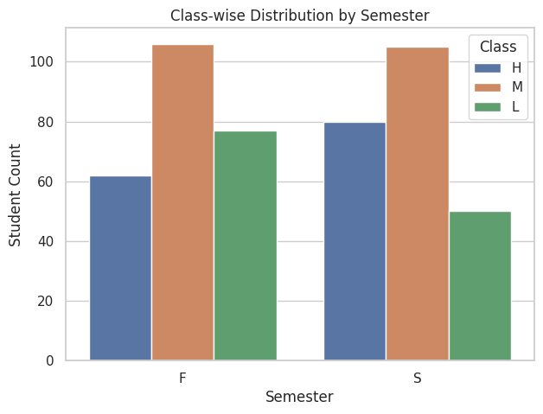
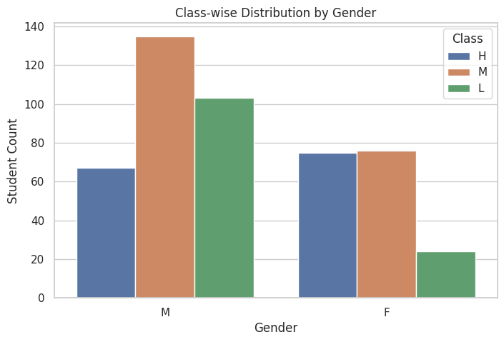
Result

Slide 9
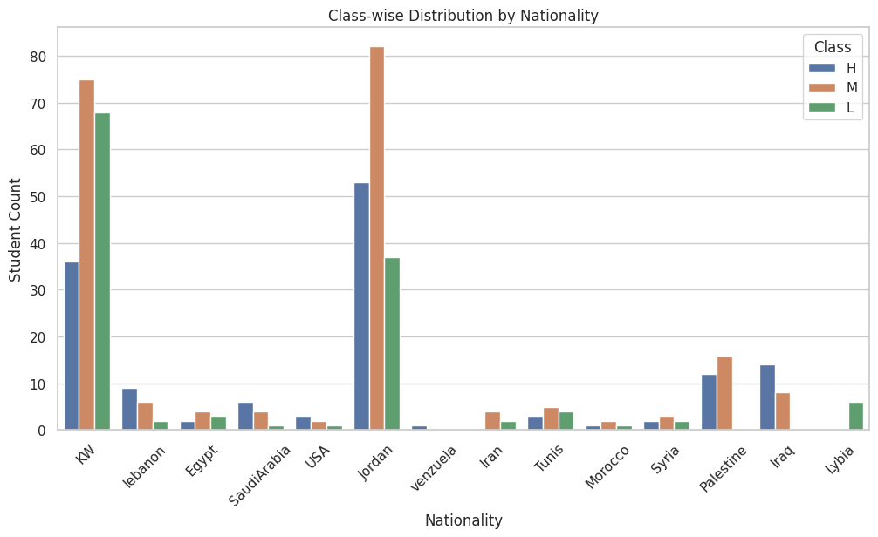
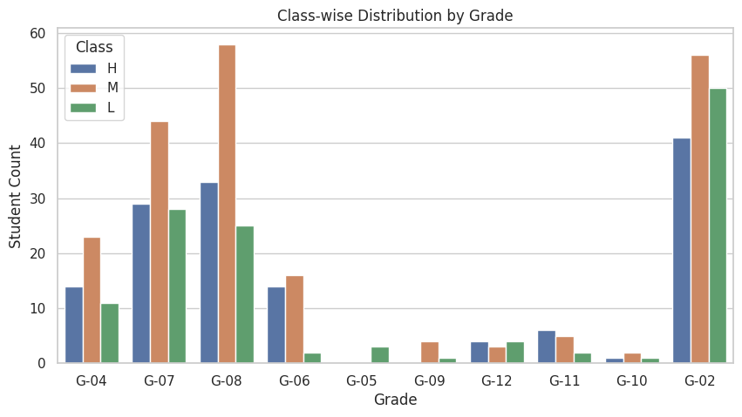
Result

Slide 10
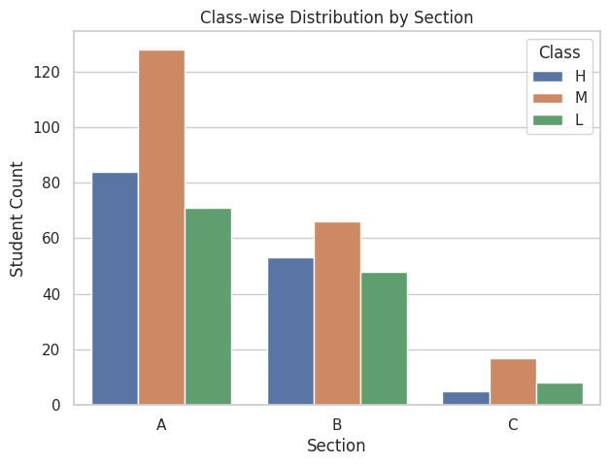
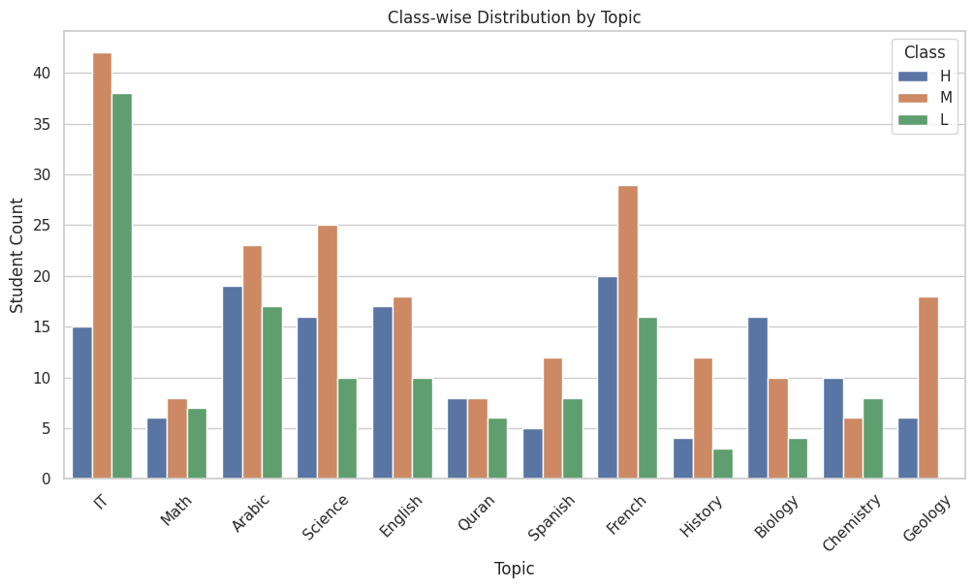
Result

Slide 11
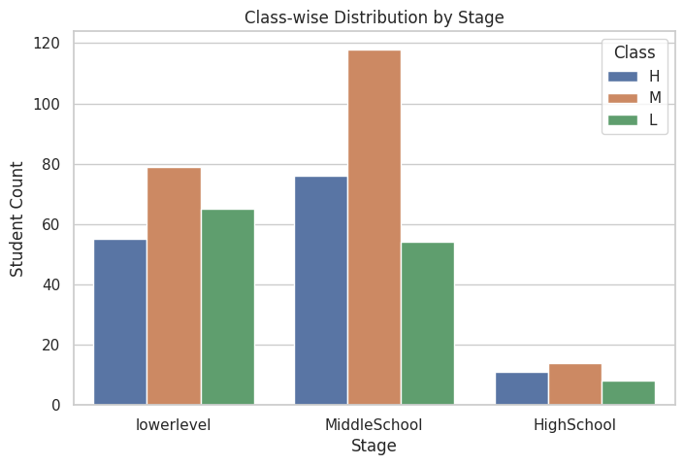
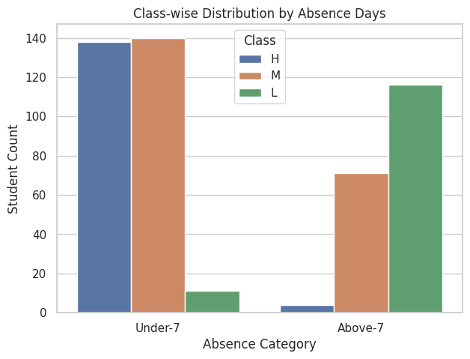
Result

Slide 12
Conclusion
This system demonstrates useful ways of applying machine learning to develop a useful and effective academic performance prediction system. Using historical and behavioral data the system is able to classify students into performance levels with good accuracy. Random Forest and MLP Neural Network models had the best accuracy and gave robustness among all classifiers we used. The interactive interface and graphical visualization enhance interpretability and validate our claims by demonstrating that the system is available to academic advisors and administrators to help them gain a broad assessment of student data.

Slide 13
Future scope
Connect for real-time streaming of data from school ERP systems
Incorporate web-based using Flask or Streamlit
A mobile application version for teachers and parents
Incorporate explainable AI using either SHAP or LIME to convey predictability for individual observations
More features such as emotional, psychological, or social scores
Longitudinal analysis using time-series data for visual trending analysis

Slide 14
References
The Scikit-learn documentation – https://scikit-learn.org/
Seaborn and Matplotlib – https://seaborn.pydata.org/ | https://matplotlib.org/
Dataset source: AI-Data.csv (from institution or prepared locally)
Géron, “Hands-On Machine Learning with Scikit-Learn, Keras & TensorFlow”
Educational Data Mining Surveys - IEEE & ACM Libraries
Git Hub: https://github.com/Hemanth181101/Student-Academic-Performance

Slide 15
Thank you

