Slide 1

Logistic Regression: Predicting Probabilities and Classifying Outcomes
Understanding how machines learn to make yes/no decisions from data
Notes:
1

Slide 2


What is Machine Learning?
Learning from Data
Pattern Recognition
Computer systems that improve performance through experience without explicit programming instructions
Algorithms identify patterns and relationships within datasets to make predictions or decisions
Adaptive Performance
Models continuously refine their accuracy as they process more training data
Notes:
2

Slide 3

What is Logistic Regression?
Statistical Classification
A powerful statistical model designed specifically for binary classification problems, predicting one of two possible outcomes.
Despite its name including "regression," it's fundamentally a classification algorithm that models the probability of a given event occurring.
Notes:
3

Slide 4
Logistic Regression vs. Linear Regression
Linear Regression
Logistic Regression
Purpose: Predicts continuous numerical values (e.g., house prices, temperature)
Purpose: Predicts probability of binary outcomes (e.g., yes/no, spam/not spam)
Output: Any real number from negative to positive infinity
Output: Probability between 0 and 1 representing class likelihood
Model: Uses a straight line to fit data
Model: Uses an S-shaped sigmoid curve for transformation
Notes:
4

Slide 5
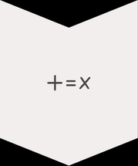



How Logistic Regression Works
Linear Combination
Creates a weighted sum of input features multiplied by their coefficients, similar to linear regression
Sigmoid Transformation
Passes the linear combination through the sigmoid function to transform outputs into probabilities
Probability Output
Generates a probability value between 0 and 1 representing the likelihood of the positive class
Classification Decision
Applies threshold (typically 0.5) to classify: if probability > 0.5 → Class 1, otherwise → Class 0
Notes:
5

Slide 6




Example: Medical Diagnosis Prediction
Problem Statement
Predict whether a patient has a specific condition based on various medical measurements.
Blood Test Results
Vital Signs
Analyzes biomarker levels, cholesterol, and glucose concentrations.
Evaluates blood pressure, heart rate, and oxygen saturation.
Patient History
Reviews clinical records, symptoms, and previous medical history.
Example: Model outputs probability of 0.87 → Classified as "Disease Present" since 0.87 > 0.5
Notes:
6

Slide 7




Decision Boundary
Separation Surface
Threshold Point
The line or hyperplane that separates different classes in feature space
Derived from where probability equals 0.5, creating the classification boundary
Dimensionality
Appears as a line in 2D, but becomes a hyperplane in higher-dimensional spaces
Notes:
7

Slide 8
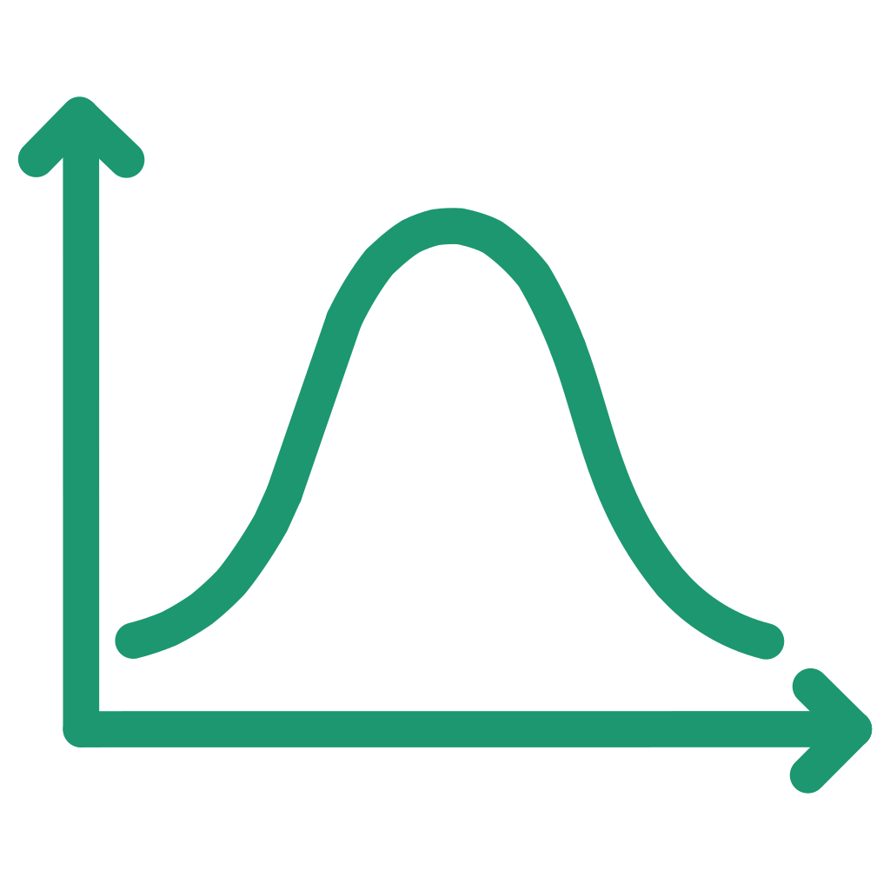



Key Features of Logistic Regression
Probabilistic Output
Interpretability
Provides interpretable probabilities for each prediction, not just binary classifications. This enables confidence assessment and threshold tuning.
Model coefficients reveal the direction and magnitude of each feature's influence on the outcome, making it highly transparent.
Computational Efficiency
Model Versatility
Fast training and prediction times with minimal computational resources required, making it ideal for large datasets.
Extensible to multinomial logistic regression for multi-class problems and ordinal variants for ordered categories.
Notes:
8

Slide 9
Applications & Limitations
Applications
Limitations
Medical diagnosis and disease prediction
Credit scoring and loan default prediction
Customer churn analysis
Email spam filtering
Fraud detection systems
Marketing campaign response prediction
Assumes linearity between features and log-odds
Struggles with complex non-linear relationships
Sensitive to outliers in training data
Prone to overfitting without regularization
Requires sufficient training data
Notes:
9

