Slide 1
SR
Smart Research Paper
Recommendation System
A DSA-driven research discovery and ranking system using string matching, information retrieval and graph algorithms.
Rabin-Karp
Levenshtein DP
TF-IDF + Cosine
PageRank
Bipartite Matching
PriorityQueue
REVIEW 4 • WORKING WEB DEMONSTRATION
Pure Java backend • CSV research dataset • Browser-based dashboard
Exact → Fuzzy → Vector Similarity → Graph Authority → Matching → Top-K

Slide 2
PROJECT OVERVIEW
Problem, Objective & Key Contributions
Problem
What makes the system different?
Researchers often need to search large collections using multiple topics. A keyword-only approach can miss fuzzy matches, term importance, and graph-based authority.
Exact + Fuzzy
Rabin-Karp and Levenshtein handle literal and typo-tolerant matching.
Information Retrieval
TF-IDF and cosine similarity capture term importance and vector similarity.
Objective
• Return relevant papers for one or multiple research topics.
• Combine multiple DSA techniques into one ranking pipeline.
• Provide explainable scores instead of a black-box recommendation.
• Assign distinct papers to topics using weighted bipartite matching.
Graph Intelligence
PageRank adds authority from the paper citation graph.
Optimization
DFS-based bipartite matching + PriorityQueue produces topic coverage and Top-K results.
Smart Research Paper Recommendation System
2

Slide 3
TECHNICAL APPROACH
System Architecture & Data Flow
1
User Query
2
Preprocessing
3
String Matching
4
Ranking
5
Matching
6
Top-K
Topics entered in browser
→
Normalize + tokenize
→
Rabin-Karp + Levenshtein
→
TF-IDF + Cosine + PageRank
→
Weighted DFS augmenting paths
→
PriorityQueue + dashboard
Implementation Stack
Frontend
HTML • CSS • JavaScript
Runtime Result
Server
Java HttpServer • REST-style /api/search
• Search endpoint scores every paper.
• Matching assigns distinct papers to topics.
• Top-K returns the strongest recommendations.
• Dashboard exposes every score component.
Core DSA
Algorithms.java
Data
research_papers.csv
Build
Maven • Java 21 target
Smart Research Paper Recommendation System
3

Slide 4
ALGORITHM 1 & 2
String Matching: Exact + Fuzzy Retrieval
Rabin-Karp
Levenshtein Dynamic Programming
Uses rolling hashes to locate exact topic occurrences efficiently.
Measures edit distance so near-matches and spelling variations are still considered.
CORE IMPLEMENTATION
CORE IMPLEMENTATION
long ph = 0, th = 0;
long h = 1;
for (int i = 0; i < m - 1; i++)
h = (h * BASE) % MOD;
for (int i = 0; i < m; i++) {
ph = (BASE * ph + pattern.charAt(i)) % MOD;
th = (BASE * th + text.charAt(i)) % MOD;
}
if (ph == th &&
text.regionMatches(i, pattern, 0, m))
return i;
int[][] dp = new int[a.length()+1][b.length()+1];
for (int i = 0; i <= a.length(); i++)
dp[i][0] = i;
for (int j = 0; j <= b.length(); j++)
dp[0][j] = j;
for (int i = 1; i <= a.length(); i++) {
for (int j = 1; j <= b.length(); j++) {
int cost = a.charAt(i-1) == b.charAt(j-1) ? 0 : 1;
dp[i][j] = Math.min(
Math.min(dp[i-1][j] + 1,
dp[i][j-1] + 1),
dp[i-1][j-1] + cost
);
}
}
Average: O(N + M) • Exact field-level matching
Complexity: O(MN) • Converted to fuzzy similarity
Smart Research Paper Recommendation System
4

Slide 5
ALGORITHM 3 & 4
Information Retrieval: TF-IDF + Cosine Similarity
TF-IDF
Cosine Similarity
Weights terms by local frequency and how rare they are across the paper collection.
Compares the angle between query and paper vectors.
CORE CALCULATION
CORE CALCULATION
double tf = (double) termCount / totalTerms;
double idf =
Math.log((N + 1.0) / (df + 1.0)) + 1.0;
double weight = tf * idf;
vector.put(term, weight);
double dot = 0.0;
double normA = 0.0;
double normB = 0.0;
for (String term : a.keySet()) {
double x = a.get(term);
double y = b.getOrDefault(term, 0.0);
dot += x * y;
normA += x * x;
normB += y * y;
}
return dot /
(Math.sqrt(normA) * Math.sqrt(normB));
The implementation builds TF-IDF vectors for all papers and a query vector for comparison.
Output: normalized similarity contribution used in the final recommendation score.
Smart Research Paper Recommendation System
5

Slide 6
ALGORITHM 5
Graph Authority: PageRank
PageRank implementation
Why PageRank helps
Each paper starts with an initial rank and repeatedly receives rank from linked papers.
• Rewards papers connected to influential papers.
• Adds graph structure beyond text similarity.
• Helps separate equally relevant textual matches.
• Makes the final ranking multi-dimensional.
CORE GRAPH RANKING LOGIC
Map<String,Double> rank = new HashMap<>();
for (Paper p : papers)
rank.put(p.id, 1.0 / papers.size());
for (int iter = 0; iter < 20; iter++) {
Map<String,Double> next = new HashMap<>();
for (Paper p : papers) {
double incoming = 0.0;
for (Paper q : papers) {
if (graph.getOrDefault(q.id, List.of())
.contains(p.id)) {
int out = Math.max(1,
graph.getOrDefault(q.id, List.of()).size());
incoming += rank.get(q.id) / out;
}
}
next.put(p.id,
(1.0 - DAMPING) / papers.size()
+ DAMPING * incoming);
}
rank = next;
}
Implementation note
The current demo uses a modeled/prototype citation graph derived from the dataset relationships.
Output: normalized authority score used as the 10% PageRank component.
Smart Research Paper Recommendation System
6

Slide 7
ALGORITHM 6 & 7
Optimization: Bipartite Matching + PriorityQueue
Weighted DFS / Augmenting Path
PriorityQueue Top-K
Topics form the left partition and papers form the right partition. Each topic seeks a strong distinct paper.
TOP-K RANKING CORE
PriorityQueue<Paper> pq =
new PriorityQueue<>(
Comparator.comparingDouble(
p -> p.score
)
);
for (Paper p : papers) {
pq.offer(p);
if (pq.size() > k)
pq.poll();
}
List<Paper> result = new ArrayList<>();
while (!pq.isEmpty())
result.add(pq.poll());
Collections.reverse(result);
AUGMENTING-PATH CORE
boolean dfs(int topic,
boolean[] seen,
int[] matchPaper) {
for (int p = 0; p < papers.size(); p++) {
if (relevance[topic][p] < threshold
|| seen[p])
continue;
seen[p] = true;
if (matchPaper[p] == -1 ||
dfs(matchPaper[p], seen, matchPaper)) {
matchPaper[p] = topic;
return true;
}
}
return false;
}
Keeps only the strongest K papers instead of sorting the entire result set.
Complexity: O(VE) for bipartite matching.
Complexity: O(N log K)
Smart Research Paper Recommendation System
7

Slide 8
FINAL RANKING
Composite Ranking Formula & Complexity
FINAL SCORE
0.45 × Exact + 0.20 × Fuzzy + 0.25 × TF-IDF/Cosine + 0.10 × PageRank
45%
Exact Match
20%
Fuzzy Match
25%
TF-IDF
10%
PageRank
Rabin-Karp
Levenshtein DP
Cosine Similarity
Citation Authority
Algorithm
Complexity
Role
Rabin-Karp
O(N + M) average
Exact pattern matching
Levenshtein
O(MN)
Fuzzy similarity
TF-IDF / Cosine
O(V) per vector
Term weighting + similarity
PageRank
O(I × E)
Graph authority
Bipartite Matching
O(VE)
Distinct topic-paper assignment
PriorityQueue
O(N log K)
Top-K recommendations
Smart Research Paper Recommendation System
8

Slide 9
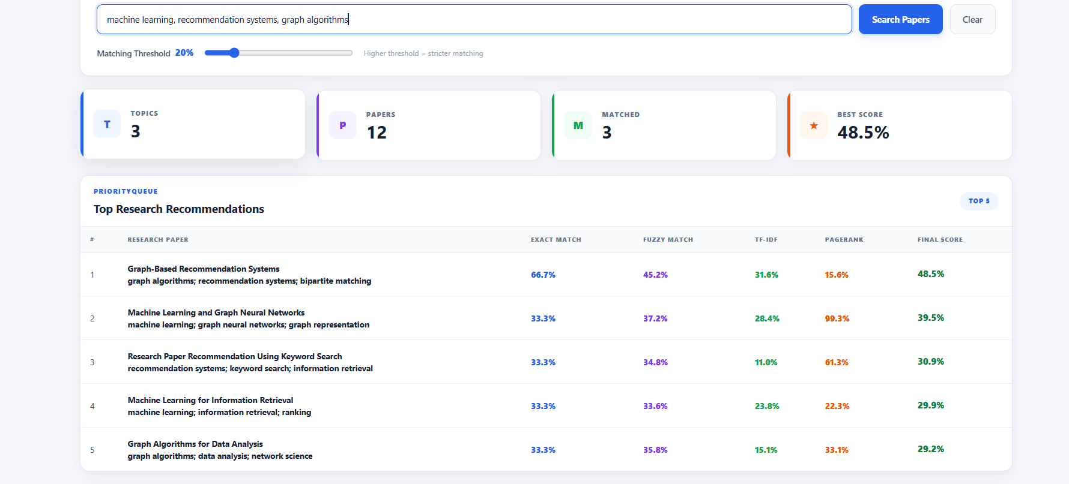
ACTUAL SYSTEM OUTPUT
Working Demonstration — Search Results
Demo query: "machine learning, recommendation systems, graph algorithms"
Smart Research Paper Recommendation System
9

Slide 10
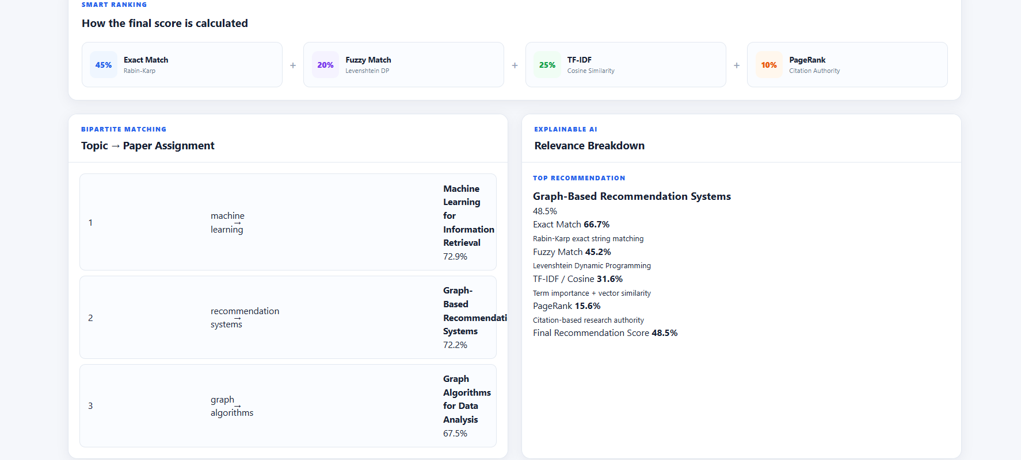
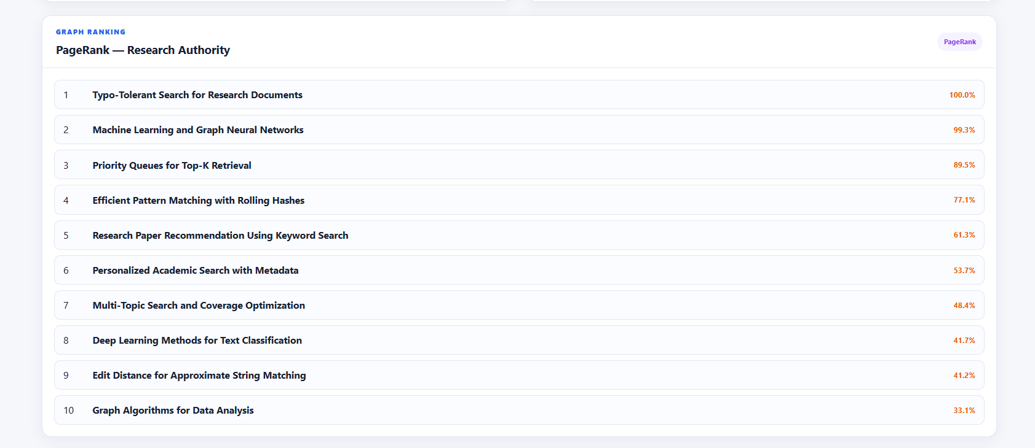
ACTUAL SYSTEM OUTPUT
Explainable Ranking & Research Authority
Relevance Breakdown + Topic Assignment
PageRank Output
Smart Research Paper Recommendation System
10

Slide 11
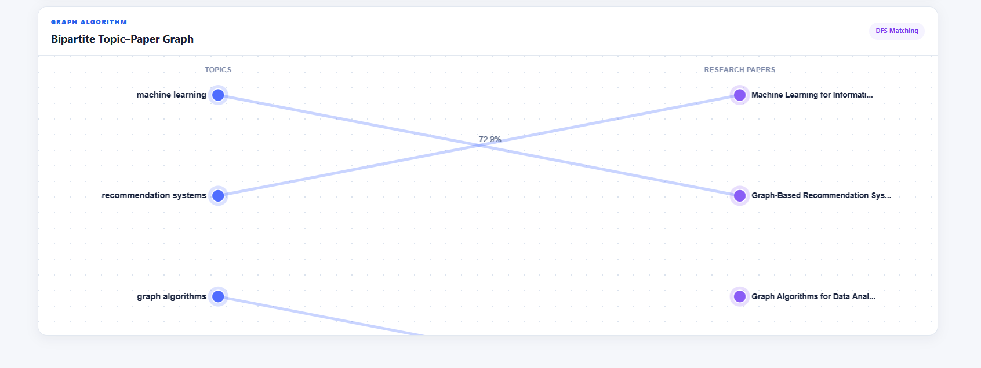
FINAL DEMONSTRATION
Graph Visualization & Review Takeaways
What to explain to the reviewer
• Rabin-Karp finds exact topic occurrences.
• Levenshtein handles approximate matches.
• TF-IDF + cosine measure term importance and vector similarity.
• PageRank adds graph-based authority.
• DFS matching assigns strong distinct papers to topics.
• PriorityQueue returns the Top-K recommendations.
Core message: multiple DSA techniques work together in one explainable pipeline.
DEMO FLOW → Query → Score → Match → Rank → Visualize
Smart Research Paper Recommendation System
11

