Slide 1

MINI PROJECT REPORT
HEMANTH K(ES19BTECH11003)
Submitted to -
Dr. Praveen Tammana,
Assistant Professor
Dept. of CSE, IIT Hyderabad

Slide 2
Initially I was assigned to search for the IoT devices which are available in India.
So I have been searching online resources and discussing with several organizations(Vigo, Borda IoT for Healthcare) as well.
But these organizations being international . Their services are not provided in India so we cannot continue with them.
Later,with the help of Praveen Sir, We got to know about Withings IoT smart scale device that can also be delivered in India.

Slide 3
So with the approval of sir we ordered
Withings smart scale(standard IoT device)
Amazon Echo (standard IoT device which is easily available online)
Door Sensor (Basic IoT device)
We continued to work on these three test devices first and later we thought of extending the list.
So when these devices arrived, we started the actual work of capturing packets from these IoT devices and building a MUDGEE profile from the PCAPs extracted from these devices.

Slide 4
Packet Capture on WI-FI Interface
OS used is Ubuntu and Wireshark is used for capturing the packets
Attempt-1:
Initially I tried to achieve this by putting the already present network interface down on ubuntu using terminal commands and changing its mode to monitor and again putting it up
But I am unable to capture packets on monitor mode as within a couple of seconds of setting it up into monitor mode it is again being changed into managed mode by default.

Slide 5
Attempt-2 → Using aircrack-ng (‘wlo1’ is the default interface)
“sudo airmon-ng start wlo1” →This puts the wireless interface in monitor mode, allowing us to capture all packets even if they are not destined for our computer.This command creates an another interface called ‘mon0’ that will be displayed when you run iwconfig
“sudo airodump-ng <options> mon0” →This starts capturing packets on mon0
Using this attempt only first few packets are being captured and then again it is again being changed into managed mode by default.

Slide 6
Attempt-3 →by creating a new interface
So I thought of creating a completely new interface by initialising it’s mode into monitor
And after creating the new interface I have deleted the present network interface so that finally there will be only one network interface present.
With this new interface being in monitor mode now I am able to capture the packets which are coming out and going towards the WI-FI access point.

Slide 7
Commands used to setup into monitor mode
iwconfig-- to know the network interface and it’s mode that is present in our laptop by default
sudo iw phy phy0 interface add mon0 type monitor → creating new network interface named mon0 in monitor mode
iw dev wlo1 del →deleting the default interface wlo1 (the wifi gets disconnected here)
iwconfig → verifying whether the default interface is deleted or not

Slide 8
ifconfig mon0 up → setting the newly created interface up
iwconfig mon0 channel 1 → adjusting the channel number based on the frequency of IoT device (In our case for Alexa the frequency is 2412 i.e; channel 1)
NOTE:
Initially we tried by setting up alexa to connect to 5GHz bandwidth wifi but while capturing we are able to see only the broadcast packets so we have shutdown the 5GHz bandwidth channel and turned on only the 2.4GHz channel and setting up the wifi to open without any authentication

Slide 9
wireshark & → to see whether the packets are being captured or not and after the start of capturing packets we have covered most of the applications that alexa can do and captured those packets using ip filter(extracting ip of alexa from TP-Link server website) on wireshark and saved the .pcap file.
Resetting the system into default mode:
iw dev mon0 del → deleting the newly created interface
sudo iw phy phy0 interface add wlo1 type managed → adding the old default interface and setting it into managed mode

Slide 10
SETTING UP ROUTER TRAFFIC MIRRORING TO WIRESHARK
For this initially we have to set the router into OpenWRT frame by downloading and installing it in router
Now, after installing the OpenWRT framework, IP address of the router changes from 192.168.0.1 (TP-Link) to 192.168.1.1 (OpenWRT)
Then we will SSH into Router using command ‘ssh root@192.168.1.1’ and entering the password which we have initially set up while installing the Open WRT in router.
Later we’ll check for the updates using the command ‘opkg update’

Slide 11
Then we should Install iptables-mod-tee package using command: ‘opkg install iptables-mod-tee’ as iptables-mod-tee is a kernel module it should be loaded before you are trying to get use of it.
Now we’ll check if package installed successfully: ‘opkg list-installed | grep "mod-tee"’

Slide 12
The port mirroring feature:
Use an external network analyzer to monitor network traffic..
Each incoming and outgoing packet is copied and sent to a designated port..
It can be used as a diagnostic tool, a debugging feature, or a defence mechanism against attackers.
All packets are copied to a specific designated port.
Allows inbound or outgoing packets to be replicated to the mirrored port after switching to their destination.

Slide 13
We will be doing port mirroring with iptables. It contains five tables:
NAT table – used for network address translation (e.g. port forwarding);
RAW table – used only for configuring packets so that they are exempt from connection tracking;
FILTER table – is the default table, and is where all the actions typically associated with a firewall take place;
SECURITY table – used for Mandatory Access Control networking rules;
MANGLE table – used for specialized packet alterations (e.g. cloning).

Slide 14
We need to alter MANGLE table because it permits modification of packets going through our router. To be more specific, we will be cloning packets.
Set traffic mirror rules to capture all traffic of ‘TEST_DEVICE_IP_ADDRESS’ to ‘MONITORING_WORKSTATION_IP_ADDRESS’.
Add iptables rules to mirror upstream and downstream traffic.
Note: Where TEST_DEVICE_IP_ADDRESS is Alexa’s IP and MONITORING_WORKSTATION_IP_ADDRESS is IP of the Laptop on which we are performing the activity.

Slide 15
Commands used
Command-I → ‘iptables -A PREROUTING -t mangle -i br-lan ! -d <TEST_DEVICE_IP_ADDRESS> -j TEE --gateway <MONITORING_WORKSTATION_IP_ADDRESS>’
Command-II → ‘iptables -A POSTROUTING -t mangle -o br-lan ! -s <TEST_DEVICE_IP_ADDRESS> -j TEE --gateway <MONITORING_WORKSTATION_IP_ADDRESS>’
Later using ‘Wireshark &’ we can check on ethernet interface and we’ll find the packets being mirrored and are visible to us.
Here also by using IP filter we will filter out the Alexa packets and store in a separate pcap file.

Slide 16
PCAP analysis from both the PCAP’s (wifi capture and ethernet mirror capture)
Capture Time : Around 4 mins(269216 packets)
After observing the PCAP’s we can observe there are mainly 6 protocol packets which are UDP(DNS,NTP),TCP,HTTP,TLSv1.3,ICMP and few other traces.
A sample packet is taken from each protocol and it is analysed in total four directions (forward-wifi,forward-ethernet,backward-wifi, backward-ethernet)
For detailed PCAP analysis of a packet of each protocol please refer to Link

Slide 17
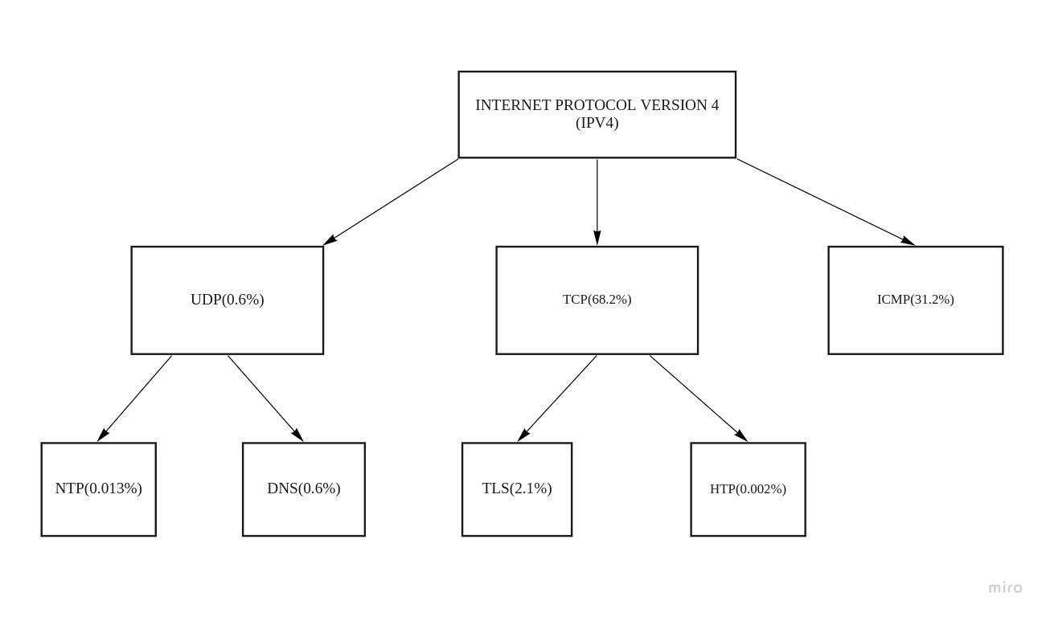
PCAP analysis from both the PCAP’s (wifi capture and ethernet mirror capture)

Slide 18
Conclusions drawn by observing a packet of each protocol in 4 directions
Analyzing the packets of each and every protocol mentioned in the tree diagram from bottom to top
NTP:
Alexa sends an NTP message to the time server (Amazon's IP), which analyses the packet, substitutes a few fields such as IP address, etc., and then sends the packet back.
In our case, packets are captured using the wifi interface and port mirroring through ethernet. The main difference between them is that the source MAC and destination MAC are different for the same packet, and all the remaining attributes are the same (IP, Port).
Note: These packets are only found in Alexa capturing but not in Withings smart scale capturing

Slide 19
DNS
The Domain Name System (DNS) is similar to the Internet's phone book. Domain names such as cricbuzz.com allow people to access content on the Internet. Internet Protocol (IP) addresses are used to communicate between web browsers. DNS converts domain names to IP addresses, allowing browsers to access resources on the Internet.
In our case, our device tries to access domain names such as api.amazon.com, prod.amcs-tachyoon.com(standard domain names under Amazon), etc. The only difference between the wifi DNS packet and an Ethernet DNS packet is the source MAC and destination MAC.

Slide 20
TLSv1.3
This TLS protocol adds a layer of security on top of the TCP/IP transport protocols, which are sent to/from the device and are intended to increase handshake performance and give better security.
In our case, these packets travel from Alexa's IP to Amazon's standard IP and return back to our device, providing an extra layer of security to our TCP packets. The only difference between the wifi TLS packet and Ethernet TLS packet is the source MAC and destination MAC.

Slide 21
HTTP
HTTP is a protocol for sending and receiving data over the Internet. Your browser sends a request to the associated web server when you visit a website, and the webserver answers with an HTTP status code. If the URL is legitimate and the connection is established, the server will transmit the webpage and relevant files to your browser.
In our case, only Alexa sends these HTTP packets to Amazon's IP requesting the associated webserver. These packets again reach back to the Alexa's IP from the source Amazon's IP, where the previous packet is sent along with two reassembled TCP segments sometimes. The only difference between the wifi HTTP packet and Ethernet HTTP packet is the source MAC and destination MAC.
Note: These packets are only found in Alexa capturing but not in Withings smart scale capturing

Slide 22
TCP
The internet standard for assuring the successful exchange of data packets between devices over a network is the transmission control protocol (TCP). The IP component is responsible for obtaining the address to which data is transmitted. Once an IP address has been found, TCP is in charge of data delivery.Many of the difficulties that emerge from packet-based messaging, such as missing packets, out-of-order packets, duplicate transmissions, and malformed packets, are addressed by TCP.
In our case, Nearly 70% of the packets that we captured from Alexa are TCP. Initially, our device(Alexa) sends these TCP packets to Amazon's IP, and later these packets are again resent to our device from the actual Amazon source IP where our initial packet is sent. The only difference between the wifi TCP packet and Ethernet TCP packet is the source MAC and destination MAC.

Slide 23
ICMP
When network difficulties hinder IP packet delivery, ICMP (Internet Control Message Protocol) is an error-reporting protocol used by network devices such as routers to generate error messages to the originating IP address.
In our case, nearly 31% of the packets that we captured from Alexa are ICMP only.
ICMP packets mostly appeared with info destination unreachable(port unreachable) or time to live exceeded.

Slide 24
Destination unreachable(port unreachable)
Destination unreachable(port unreachable) is because when the ping packet that the device(Alexa) sent was unsuccessful in reaching its intended destination and was dropped.
When Alexa pings a remote host, the ping packets are sent from this device to the target. Ping packets will reach the destination gateway, where they will be sent to the correct host by the remote router.
The response Destination Port Unreachable will be returned if the host is too busy or the device port does not handle the type of packets we transmit.

Slide 25
Time to live exceeded: So when a TCP packet is transmitted from Alexa, the TTL is set, indicating how many routers (hops) the packet can traverse through before being rejected. The TTL is decremented as the packet passes through a router until it hits zero, at which point the packet is destroyed, and an ICMP "time exceeded" message is returned.
Common Conclusion observed:
The source MAC and Destination MAC for the wifi captured packets from Alexa are mostly always the Alexa's MAC and the Router's MAC, whereas, in the ethernet Capture of Traffic using Mirroring of port, the source MAC and Destination MAC are always Router's MAC and laptop's MAC on which the ethernet capture is taking place.

Slide 26
Generating the MUDGEE profile from the extracted PCAP’s
So, now we are having 2 PCAP files for each device (one from wifi capture, another from ethernet capture)
Using the “ayoob’s github link” reference which is the only reference available to generate MUDGEE profile, we can extract a MUDGEE folder for each PCAP which contains the ipflows.csv file, Mud.json file and rule.csv file in it.
Hence we can get the MUDGEE profiles of each IoT device by using the PCAP files which are generated using these IoT devices.

Slide 27
Steps followed to extract MUDGEE profile from the PCAP’s
Initially we have to install Pcap Library(tcpdump) using the command “apt-get install tcpdump”
Now, we will git clone the mudgee,git file present in github of ayyoob using command “git clone https://github.com/ayyoob/mudgee.git”
So there will be a mudgee folder downloaded. Now we’ll enter into the mudgee using “cd mudgee” and here we call “mvn clean install”.Here we are calling the mvn executable, which means we need Maven installed on our machine and we are using the clean command, which will delete all previously compiled Java.

Slide 28
Steps followed to extract MUDGEE profile from the PCAP’s
Now, we have to edit the mud_config.json file which is present in the target folder of mudgee.
As this folder being locked. We cannot edit it physically so, we have to edit this file using the terminal by entering
“sudo nano /home/hemanth/mudgee/target/mud_config.json” the file will open in the terminal and we have to update the values at "deviceConfig":{ "device":"00:24:e4:20:28:c3", "deviceName": “Alexa" }
Here "device": MAC address of the device that we aim to generate the MUD profile for. "deviceName": name that appears in the output MUD profile.

Slide 29
Steps followed to extract MUDGEE profile from the PCAP’s
We should also update the “pcapLocation” to the correct address where our PCAP file is located on the system.
Example:"pcapLocation":"/home/hemanth/Desktop/alexa-packet-capture-ethernet.pcapng"
So in our case →"defaultGatewayConfig": {
"macAddress" : "5c:a6:e6:88:ee:6c",
"ipAddress": "192.168.1.1",
"ipv6Address": "fde7:321b:e113::1"
}
In order to capture communications between the device and servers on the Internet , our tool requires the default gateway(Router in our case) details. Therefore, MAC address and IP addresses of the default gateway(Router in our case) are needed to be declared in the config file.

Slide 30
Steps followed to extract MUDGEE profile from the PCAP’s
“java -jar target/mudgee-1.0.0-SNAPSHOT.jar target/mud_config.json”
After execution of the above command, this tool outputs the generated MUD profile into the results directory (i.e. /mudgee/result/)

Slide 31
LINKS
Alexa Trace files
Wifi Capture:Link
Ethernet Capture:Link
Withings smart scale Trace file
Wifi Capture:Link
Ethernet Capture:Link
MUDGEE profiles extracted from above trace files
Alexa::Link
Withings Smart Scale:Link
Folder Containing 5 different folders(for 5 protocols) where each folder contains 4 pcap files containing single packet in each pcap file analysed in all the 4 directions:Link
Github Link containing all the files mentioned in PPT:Github_Link

Slide 32
THANK YOU

