Slide 1
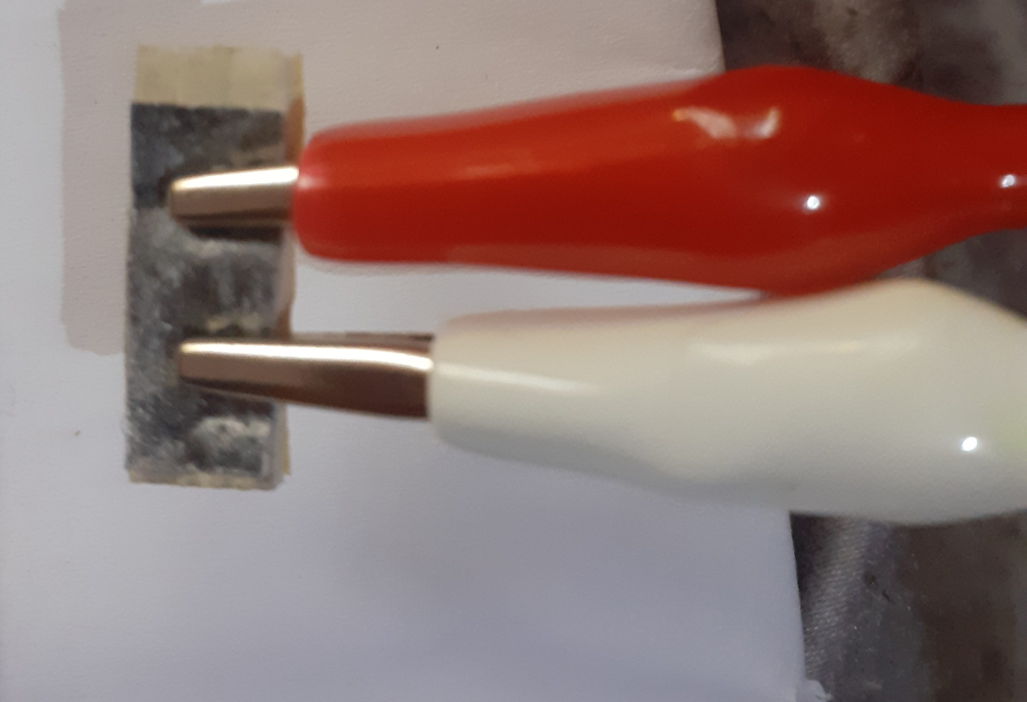
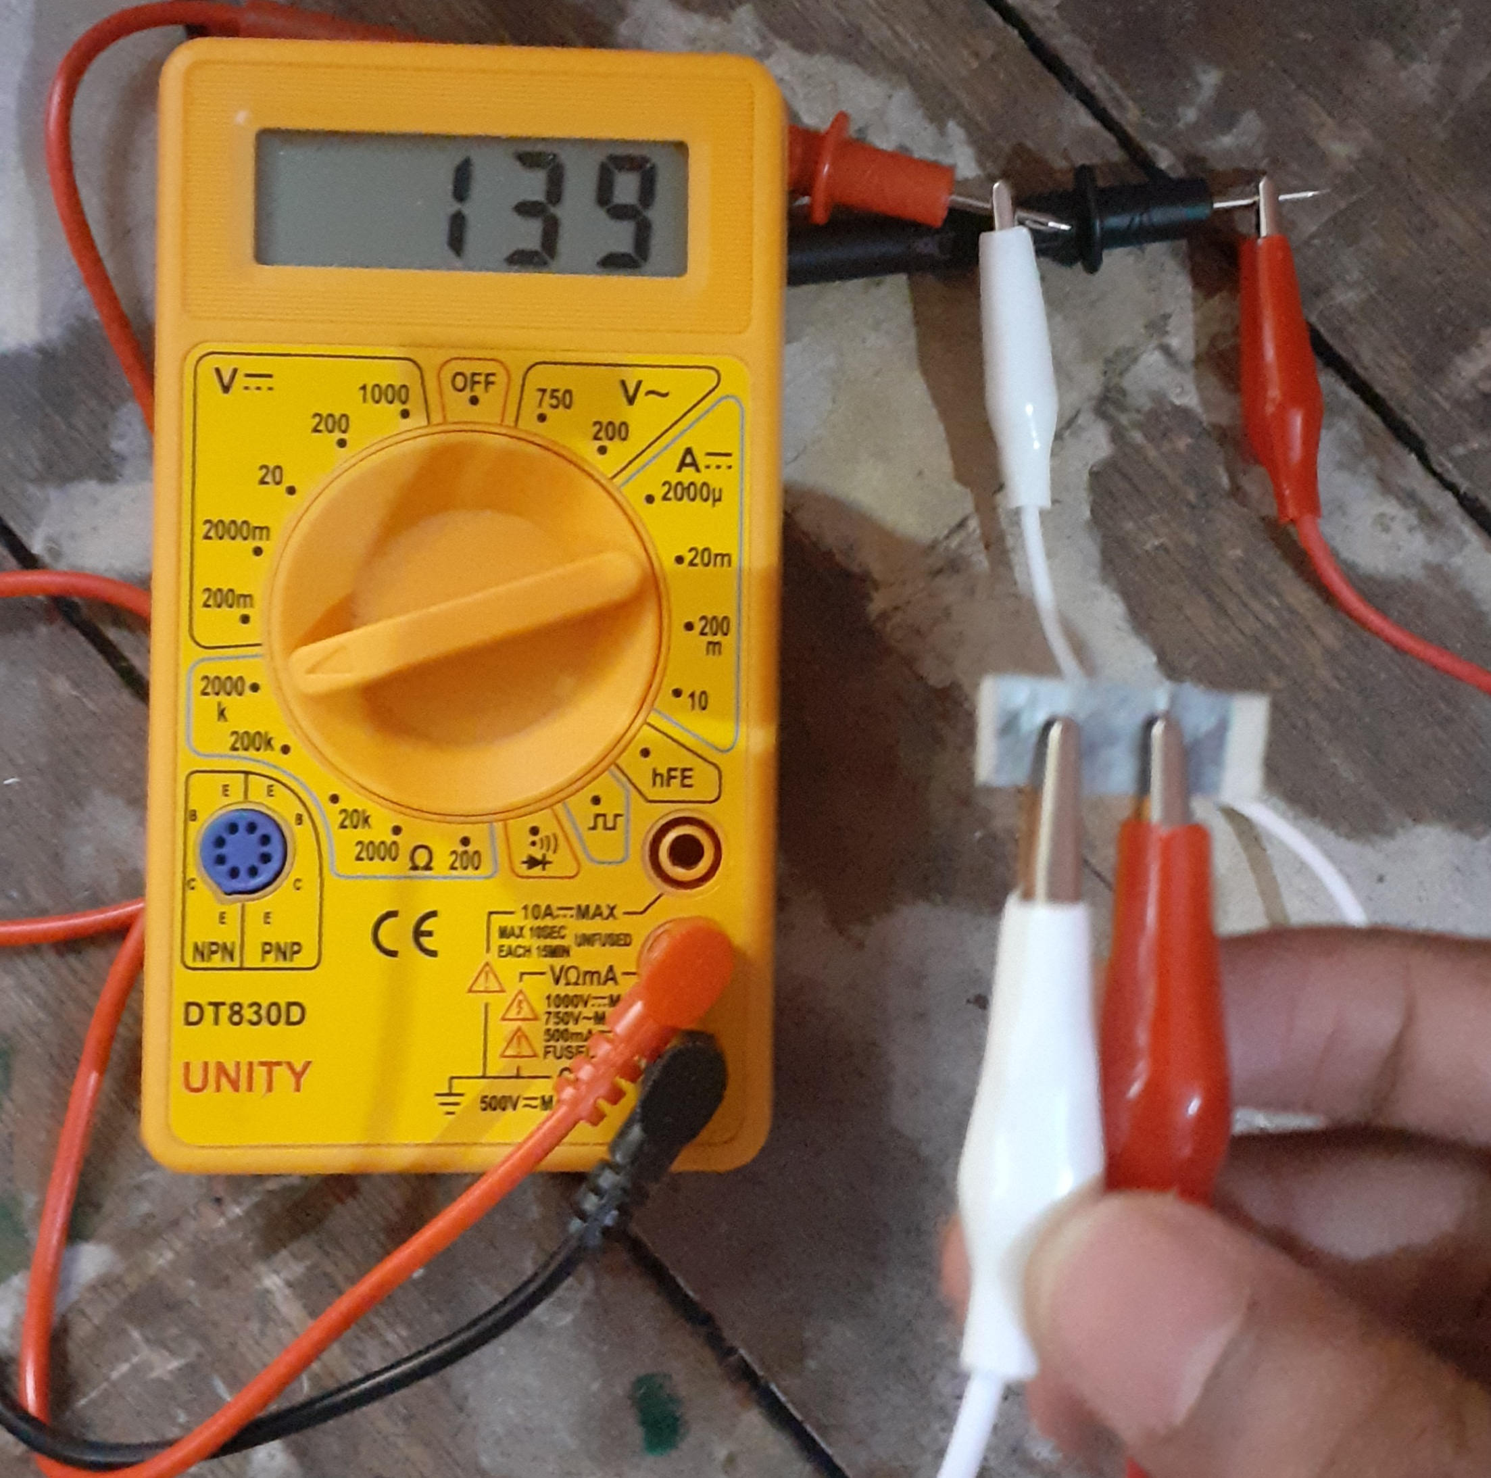
Update on the project :2
Experiment on the sensor during respiration
Sensor with clips
Sensor observation with multimeter

Slide 2
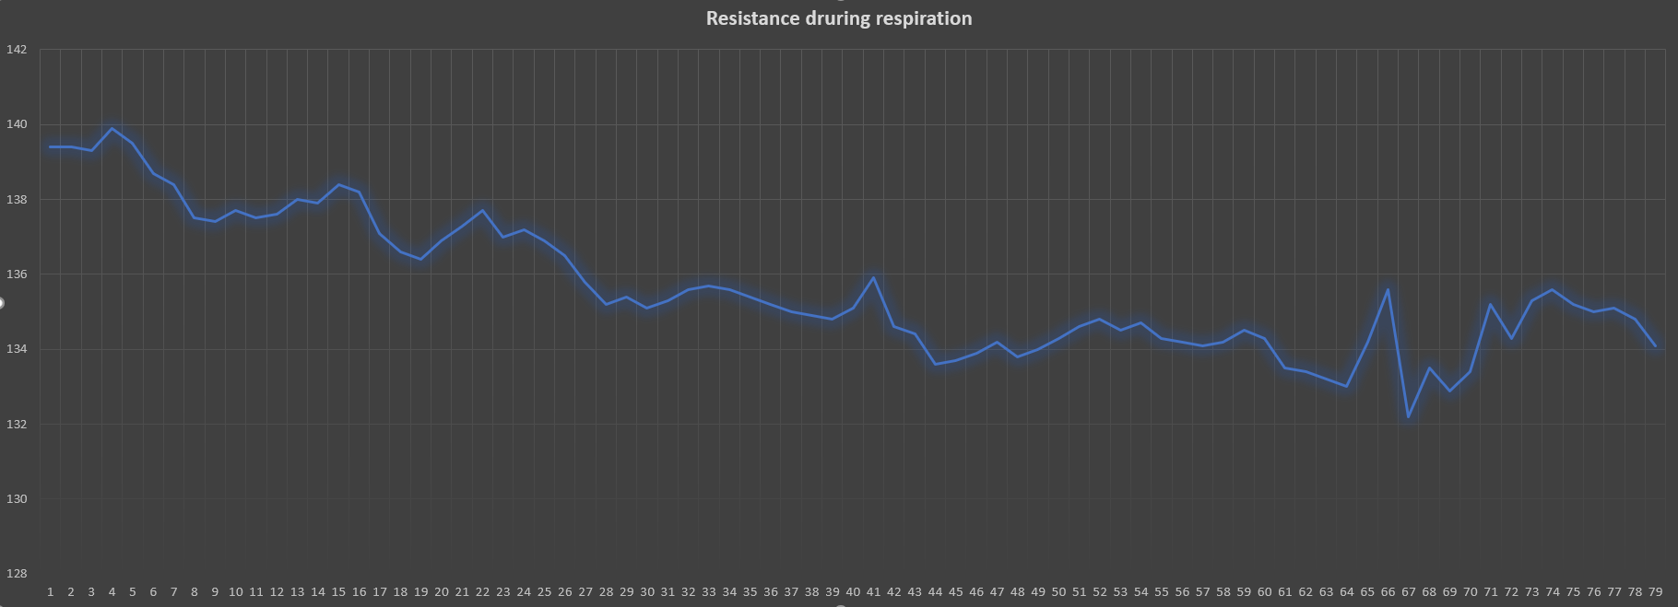
Observation:

Slide 3
Represents peak occurred during the exhalation due to increase in temperature
During Normal Respiration
During Deep breathing

Slide 4
Result:
As the temperature increases the resistance also increases.
During inhalation the inhaled air temperature is lower than exhaled air temperature.
So, we can find a peak in the graph during exhalation.
The resistance values during normal and deep breathing is observed and shown in the graph.

