Slide 1

VNR DESIGN-A-THON 2026
[Gender-Neutral Skill Assessment Engine]
Team Name : [Vision Vortex]
Team Members :
P Hemanth Kumar
Manjunath Karthikeyan
Mohammad Sameer

Slide 2
Agenda
Abstract
Introduction
Problem statement
Technical details
System Design
Conclusion
References

Slide 3
Abstract
The Gender-Neutral Skill Assessment Engine is a recruitment platform designed to reduce hiring bias by removing personal information from candidate profiles.
Candidates are evaluated through coding tests, aptitude tests, and technical assessments. An automated scoring system based on AI ranks candidates based on performance, while recruiters view only candidate IDs and test results.
This ensures fair, transparent, and merit-based hiring.

Slide 4
Introduction
What if hiring decisions were made without knowing the candidate’s name, gender, religion or background?
Hiring the right talent is essential for organizations, but traditional recruitment methods may introduce human bias.
To solve this problem, blind recruitment techniques can be used to hide personal identity details of the candidate during evaluation.
The Gender-Neutral Skill Assessment Engine implements this concept by anonymizing candidate profiles and evaluating them only through skill-based tests and automated scoring system.

Slide 5
Problem statement
Recruitment processes often suffer from unconscious bias, where candidates may be judged based on name, gender, religion, age or caste instead of their actual skills.
This can lead to unfair hiring decisions and talented candidates being rejected.
Therefore, there is a need for a fair recruitment system that evaluates candidates purely based on their skills and performance, without revealing personal information of the candidates
Especially women, minority and tribal communities are facing these problems.

Slide 6
Technical Details
The system is built as a web-based recruitment platform.
Technologies Needed:
Frontend: React / HTML / CSS / JavaScript
Backend: Python (Flask/Django) or Node.js
Superbase: MongoDB / MySQL
Additional Tools: AI-based fairness analysis Secure authentication Cloud deployment (AWS / Firebase)

Slide 7
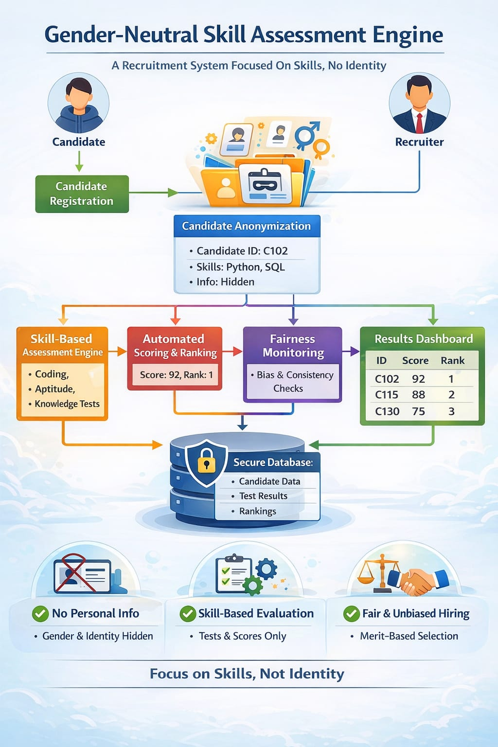
System Design
The platform consists of several modules:
Candidate Anonymization Module: It removes personal details and assigns a unique candidate ID.
Skill Assessment Engine: Evaluates candidates using coding, aptitude, and domain tests.
Automated Scoring System: Calculates scores and ranks candidates based on performance.
Fairness Monitoring System: Ensures consistent and unbiased evaluation.
Recruiter Dashboard: Displays candidate rankings and test results without revealing identity.

Slide 8
Business Prospect
The solution matches current HR market trends toward AI-driven hiring, diversity, and unbiased recruitment.
Bias during hiring causes talent loss and unfair decisions and solving it improves workplace equality, diversity, and hiring accuracy.
Beneficiaries include startups, enterprises, HR consultancies, and online recruitment platforms.
Revenue model can use SaaS subscriptions, enterprise licensing, and freemium plans as its income sources.
Unique Selling Point (USP): Candidate anonymization + automated skill scoring + fairness monitoring + dashboard system at a single platform.
Industries likely to adopt it: IT companies, banking, education, healthcare, consulting, and large recruitment firms.

Slide 9
Conclusion
The Gender-Neutral Skill Assessment Engine provides a fair recruitment process by hiding personal identity details and focusing only on candidate skills.
It reduces unconscious bias and improves transparency during hiring .
Organizations can select candidates based on merit, leading to better talent recognition.
This system benefits companies, HR agencies, recruitment platforms, and job seekers by making hiring more efficient and merit based.
It supports workplace diversity and equal opportunities in employment.
Future improvements can include AI-based interview analysis, proctoring, and predictive hiring analytics.
Overall, the solution contributes to modern, unbiased, and technology-driven recruitment practices.

Slide 10
References
Bertrand, Marianne and Sendhil Mullainathan. "Are Emily And Greg More Employable Than Lakisha And Jamal? A Field Experiment On Labor Market Discrimination," American Economic Review 94(4) (September 2004): 991-1013.
Black, Sandra E. and Elizabeth Brainerd. “Importing Equality? The Impact of Globalization on Gender Discrimination” Industrial and Labor Relations Review. July 2004; 57(4): 540-59
Darity, William A. Jr., and Patrick L. Mason. “Evidence on Discrimination in Employment: Codes of Color, Codes of Gender”. Journal of Economic Perspectives 12(2) (Spring 1998):63-90.

