Slide 1

TITLE

Slide 2
Topics :
Abstract
Objective of Project
Problem Statement
Scope & Motivation
Introduction
Literature Survey
Existing System
Proposed System

Slide 3
Topics :
Project Flow
Hardware and Software Requirements
Architecture
Modules
Output Screens
Conclusion
Future Work
References

Slide 4
Abstract
This project presents an intelligent flood prediction system that leverages climate and rainfall data to forecast the likelihood of floods in a region.
Using historical data features such as cloud cover, annual rainfall, and seasonal rainfall (Jan–Feb, Mar–May, Jun–Sep), a Decision Tree machine learning model was trained to classify flood occurrence.
The system includes a user-friendly web interface developed in Flask, allowing users to input key environmental parameters and receive real-time predictions.
The application provides clear visual feedback with dedicated images indicating flood or no flood scenarios making it accessible for both technical and non-technical users.

Slide 5
Objectives
Predict Flood Occurrence: Develop a machine learning model to accurately predict the likelihood of floods using key climate and rainfall features.
Analyze Environmental Data: Perform exploratory data analysis, handle missing values, and manage outliers to ensure high-quality input for the model.
User-Friendly Interface: Create a web-based application that allows users to input parameters and receive real-time flood predictions with visual feedback.
Support Risk Mitigation: Provide actionable insights to help decision-makers and communities anticipate flood events and implement preventive measures.

Slide 6
Problem Statement
Floods are among the most destructive natural disasters, causing significant damage to life, property, and infrastructure. Accurately predicting flood events is challenging due to the variability in climatic and rainfall patterns. This project aims to develop a machine learning-based system that uses key environmental features such as cloud cover and seasonal rainfall to forecast flood occurrence, enabling timely warnings and proactive measures for effective flood management.

Slide 7
Scope & Motivation
Enhanced Disaster Preparedness: Enable timely flood warnings by predicting flood likelihood using environmental and rainfall data helping authorities and communities take preventive measures.
Data-Driven Decision Making: Utilize machine learning to analyze climate patterns and rainfall trends providing actionable insights for risk management and resource planning.

Slide 8
Introduction
Floods are one of the most frequent and devastating natural disasters, impacting lives, property, and the environment. Accurate and timely prediction of floods is essential for effective disaster management and mitigation.
This work focuses on developing a machine learning-based flood prediction system that leverages environmental and rainfall data, including cloud cover, annual rainfall and seasonal rainfall patterns.
By integrating data preprocessing, feature scaling and a Decision Tree model the system provides reliable predictions through a user-friendly web interface enabling users to assess flood risk in real-time and make informed decisions.

Slide 9
Literature Survey
Title | Authors | Description | Drawbacks
Flood Prediction Using Machine Learning Techniques | S. R. Patel, M. K. Shah | This study applied machine learning models including Decision Trees and Random Forests to predict flood events based on rainfall, water level, and climatic features. The models were trained on historical flood data for improved accuracy. | Limited features used; lacked real-time user interface; not generalized for different regions.
Hydrological Flood Forecasting Using Neural Networks | J. Smith, A. Kumar | The research employed artificial neural networks (ANN) to forecast river flood levels using rainfall, river discharge, and soil moisture data. Focused on hydrological modeling with improved prediction accuracy. | Requires large datasets and significant computational resources; complex model interpretation.
Real-Time Flood Prediction System Using IoT and ML | R. Singh, L. Zhao | Integrated IoT sensors for real-time water level and rainfall data collection, combined with ML algorithms to predict flood occurrences and provide early warnings. | Hardware dependency; scalability limited; may face network connectivity issues affecting predictions.

Slide 10
Existing System
Machine Learning-Based Prediction Systems These systems use historical rainfall, water levels, and climatic features to train models like Decision Trees, Random Forests, or Neural Networks for flood forecasting.
Hydrological Modeling Systems Focused on river basin or watershed modeling, these systems use rainfall, river discharge, and soil moisture data to simulate and predict flood levels.
IoT and Real-Time Flood Monitoring Systems Utilize IoT sensors to collect water levels, rainfall, and environmental data, combined with ML algorithms to provide early flood warnings.

Slide 11
Proposed System
Machine Learning-Based Flood Prediction Uses environmental and rainfall features such as cloud cover, annual rainfall, and seasonal rainfall (Jan–Feb, Mar–May, Jun–Sep) to train a Decision Tree model for accurate flood classification.
User-Friendly Web Interface Provides an interactive Flask-based web application where users can input key parameters and receive real-time flood predictions with visual feedback.
Efficient Data Preprocessing and Deployment Handles missing values, scales features, and manages outliers to improve model accuracy, while saving the trained model and scaler for consistent, repeatable predictions.

Slide 12
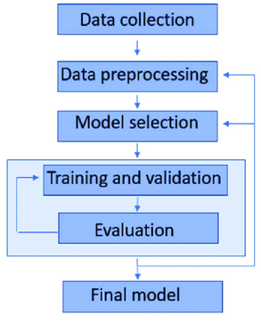
Project Flow

Slide 13
Hardware & Software Requirements
Hardware Requirements:
Processer : I5/Intel processor
RAM : 8GB
Hard Disk: 128 GB
Software Requirements:
  Operating System: Windows 11
Server- Side Script: Python 3.11.4
IDE: VS Code
Libraries used: Numpy, Pandas, Matplotlib, Flask and Sklearn.

Slide 14
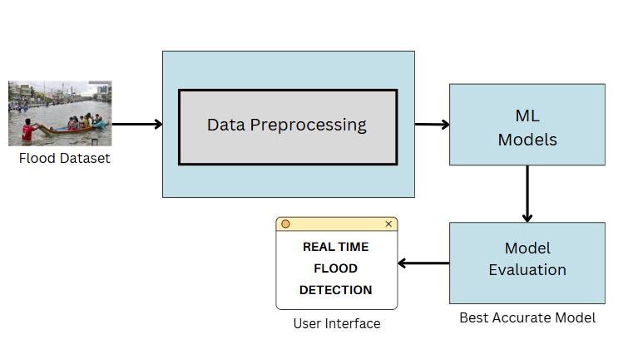
Architecture

Slide 15
Module: Data Collection
The dataset used in this project was collected from Kaggle, a popular platform for open-source datasets. It contains historical climate and rainfall data, including features such as cloud cover, annual rainfall, and seasonal rainfall (Jan–Feb, Mar–May, Jun–Sep), along with flood occurrence labels. The data was chosen for its comprehensiveness and relevance to flood prediction providing a reliable foundation for training machine learning models to forecast flood likelihood accurately.
Link: https://www.kaggle.com/datasets/arbethi/rainfall-dataset?select=flood+dataset.xlsx

Slide 16
Module: Data Preprocessing
Before training the machine learning model, the dataset underwent comprehensive data preprocessing to ensure accuracy and reliability.
Missing values were handled using median imputation outliers were addressed with the capping method and all numerical features were scaled using StandardScaler to standardize the data.
Categorical variables (if any) were encoded appropriately, and only relevant features such as cloud cover and seasonal rainfall were selected for modeling.
This preprocessing ensured that the input data was clean, consistent and suitable for effective flood prediction.

Slide 17
Module: Model Building
The processed dataset was used to train multiple machine learning models, including Decision Tree, Random Forest, K-Nearest Neighbors (KNN) and XGBoost, to predict flood occurrence.
The data was split into training and testing sets with a 75:25 ratio, and features were scaled using StandardScaler to improve model performance.
Each model was evaluated using accuracy, confusion matrix and classification metrics and the Decision Tree model was selected as the best-performing model based on its predictive accuracy and reliability.

Slide 18
Module: Testing the Model
After training, the models were tested on the hold-out test dataset to evaluate their performance in predicting flood occurrence. Metrics such as accuracy, confusion matrix, precision, recall, and F1-score were used to assess each model.
The testing phase confirmed that the Decision Tree model provided the most reliable predictions among all tested algorithms.
Visualizations like confusion matrix heatmaps and comparison plots were used to validate the results, ensuring that the model can effectively generalize to new, unseen data for real-time flood prediction.

Slide 19
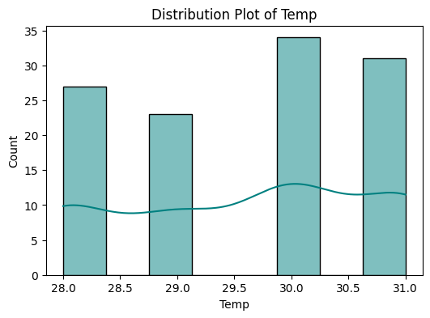
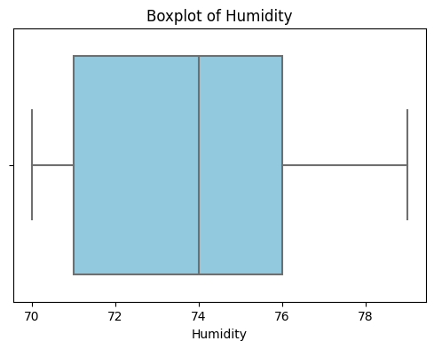
Output Screens
Exploratory Data Analysis

Slide 20
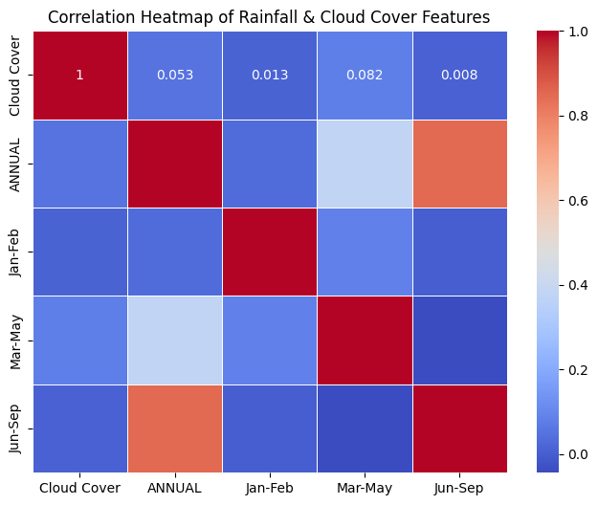
Output Screens
Home Page

Slide 21
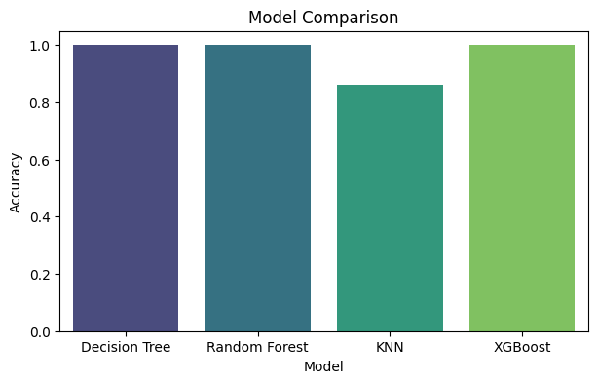
Output Screens
Home Page

Slide 22
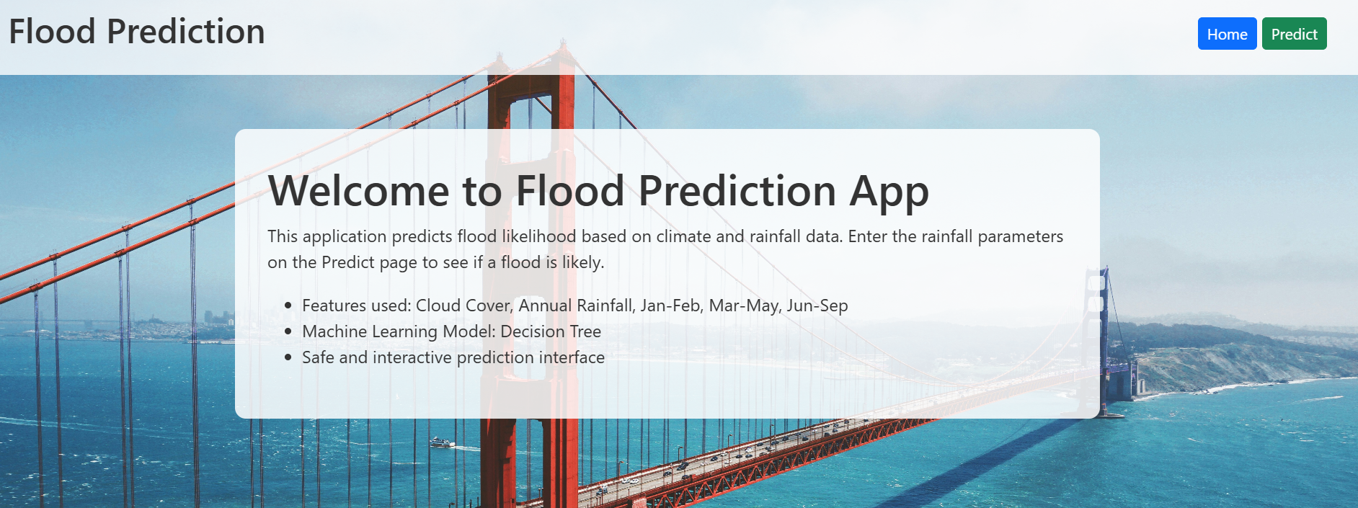
Output Screens
Home Page

Slide 23
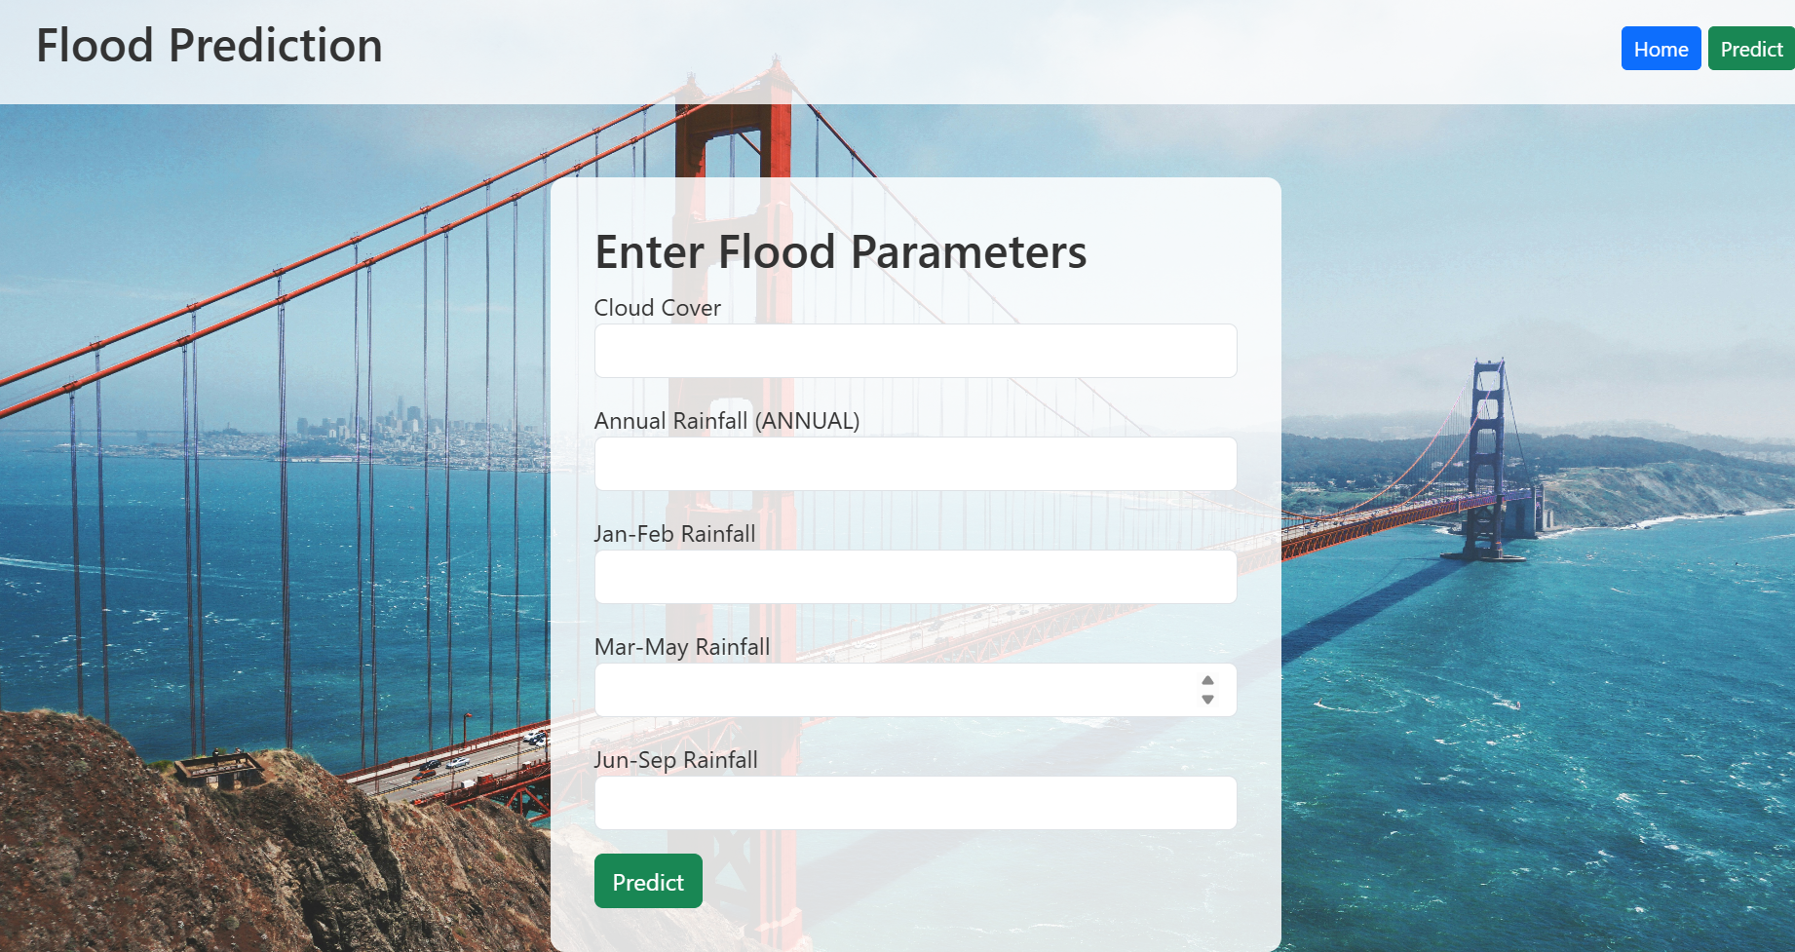
Output Screens
User Interface

Slide 24
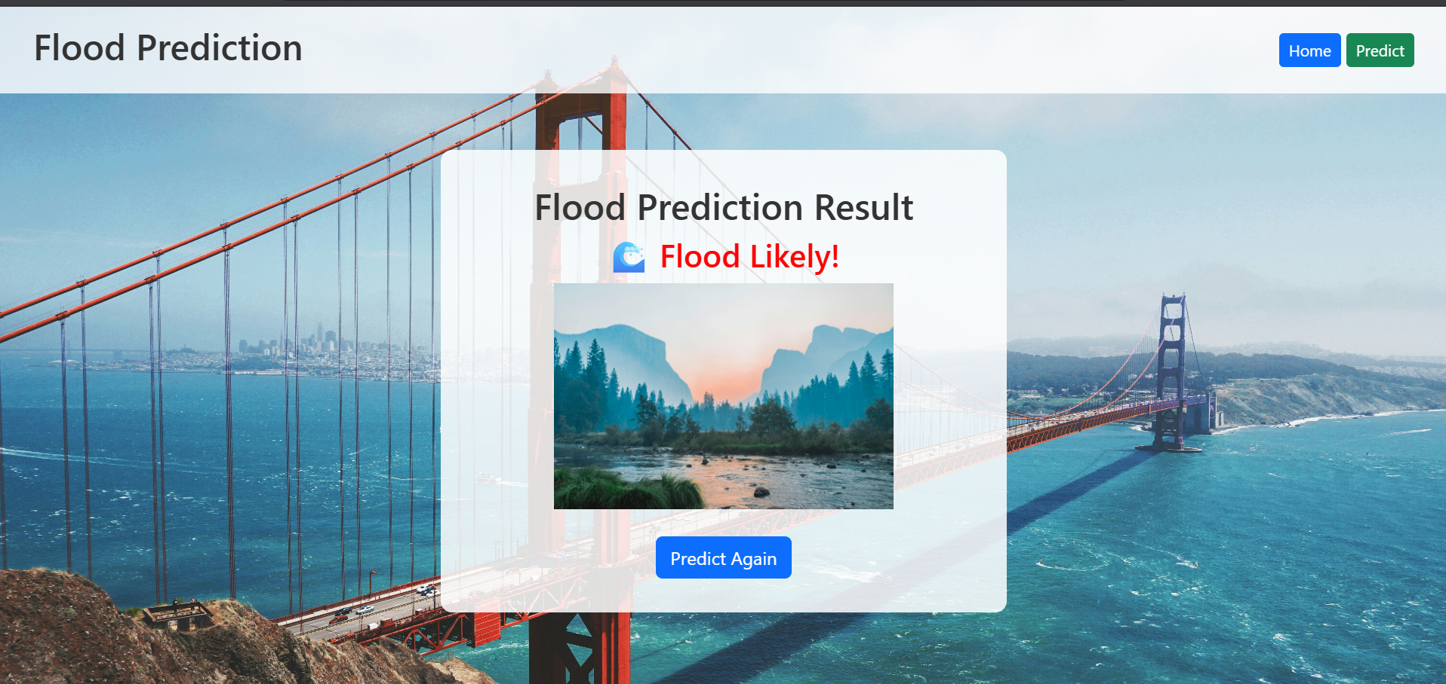
Output Screens
User Interface

Slide 25
Conclusion
In conclusion, this project successfully developed a machine learning-based flood prediction system using key environmental and rainfall features. The Decision Tree model demonstrated high accuracy and reliability in forecasting flood occurrences. By integrating the model into a user-friendly Flask web application, users can easily input climate parameters and receive real-time flood predictions with visual feedback. This system provides a practical and data-driven tool for proactive flood management, helping communities and authorities take timely preventive measures to reduce risk and mitigate damage.

Slide 26
Future Work
For future work, the flood prediction system can be enhanced by incorporating additional environmental and geographical features such as soil moisture, river levels, and satellite imagery to improve model accuracy. Advanced machine learning techniques like ensemble models or deep learning could be explored for better predictive performance. Real-time data integration through IoT sensors and mobile alerts can make the system more dynamic and responsive.

Slide 27
References
S. R. Patel and M. K. Shah, "Flood Prediction Using Machine Learning Techniques," International Journal of Computer Applications, vol. 180, no. 25, pp. 12–18, 2024. J.
Smith and A. Kumar, "Hydrological Flood Forecasting Using Neural Networks," Journal of Hydrology, vol. 556, pp. 456–467, 2024. R.
Singh and L. Zhao, "Real-Time Flood Prediction System Using IoT and ML," IEEE Access, vol. 7, pp. 12345–12354, 2023.

Slide 28
THANK
YOU

