Slide 1
Autonomous Drone Path Finder
Guide: Dr. Himanshu Sharma
Team (HS04):
Hemanth Vanam - S20170010172
Neelakanta Sriram Nandala - S20170010102
Hrithik Puppala - S20170010115

Slide 2
Outline
Objective
Previous Work Done
Present Work
Future Plan
Timeline
References

Slide 3
Objective
The main aim of our project is to train a group of autonomous UAV or drones to explore a given area and create a virtual map of the area based on the terrain information in the simulation.

Slide 4
Review on existing researches
Most of the drone mapping of topology researches involve cameras and manually controlled to capture the terrain photos.
Advanced CNN methods are used to reconstruct the topology information.
Disadvantages:
Drones need to be at high altitude to avoid collision and can’t be automated based on the topology information as that topology information can’t be retrieved in real time from photos.
They need high resolution cameras for accurate images.

Slide 5
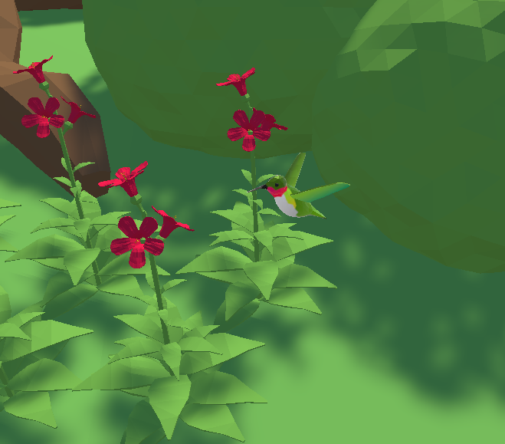
Previous Work done
Implemented PPO Algorithm with a simple environment .
Made a hummingbird model which collects the nectar from the nearest flower and once nectar of that flower is exhausted move to the next nearest flower.

Slide 6
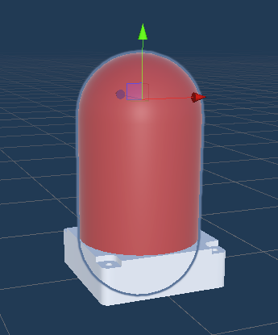
Raycast Lidar
A virtual lidar to generate data from the environment using raycasts.
A real world lidar(Velodyne HDL-64E) is considered.
The collected data will be stored in a dictionary with time at each lap as key and corresponding point coordinates as values.
Model of Lidar Sensor

Slide 7
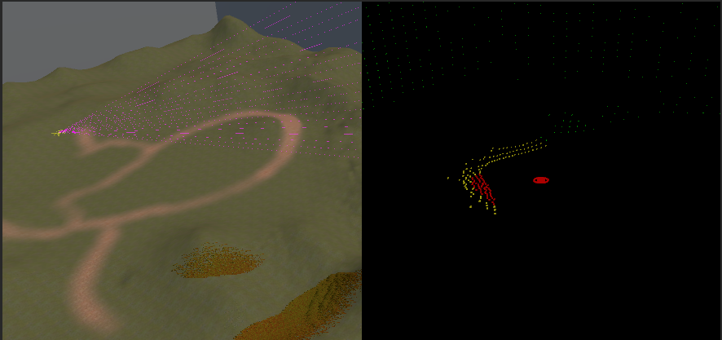
In real time simulation the cloud points are displayed using Particle System, in Unity, in a blank space.
These cloud points will be used for detecting elements in the surrounding environment.

Slide 8
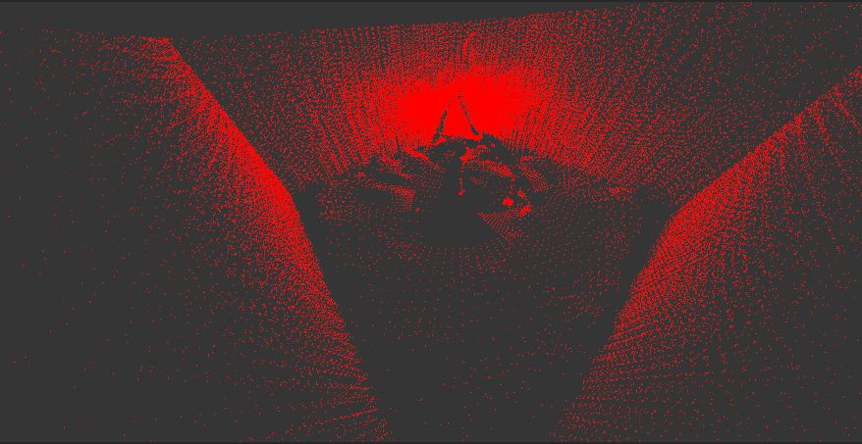
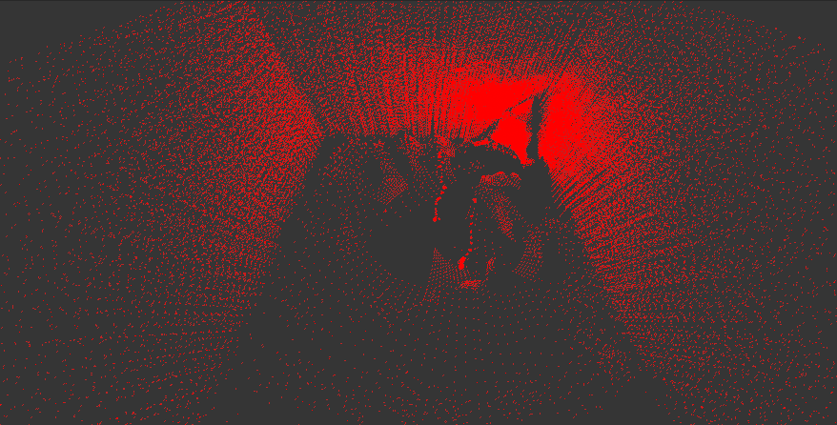
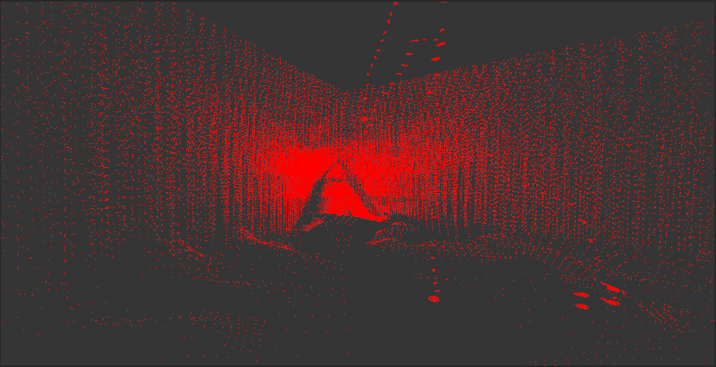
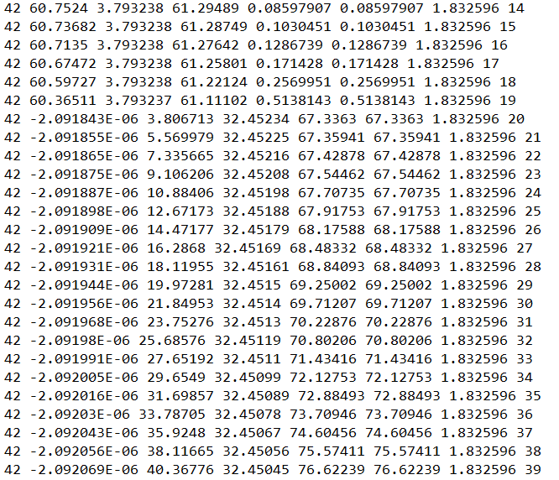
Snippet of simulated data

Slide 9
Parameters considered from Velodyne HDL-64E Lidar:
Number of lasers (64)
Laser range (120m)
Rotation speed of the lidar sensor (1Hz)
Rotation angle between scans (0.9deg)
Vertical offset between sets of lasers (2.85cm)
Vertical field of view for the top set (10.5deg)
Vertical field of view for the bottom set (16.0deg)
Angle from horizontal plane to normal of top set (3.3deg)
Angle from horizontal plane to normal of bottom set (16.9deg)
Source: https://velodynelidar.com/wp-content/uploads/2019/09/86-0104-REV-A-OUTLINE-DRAWING-HDL-64E-S3.pdf

Slide 10
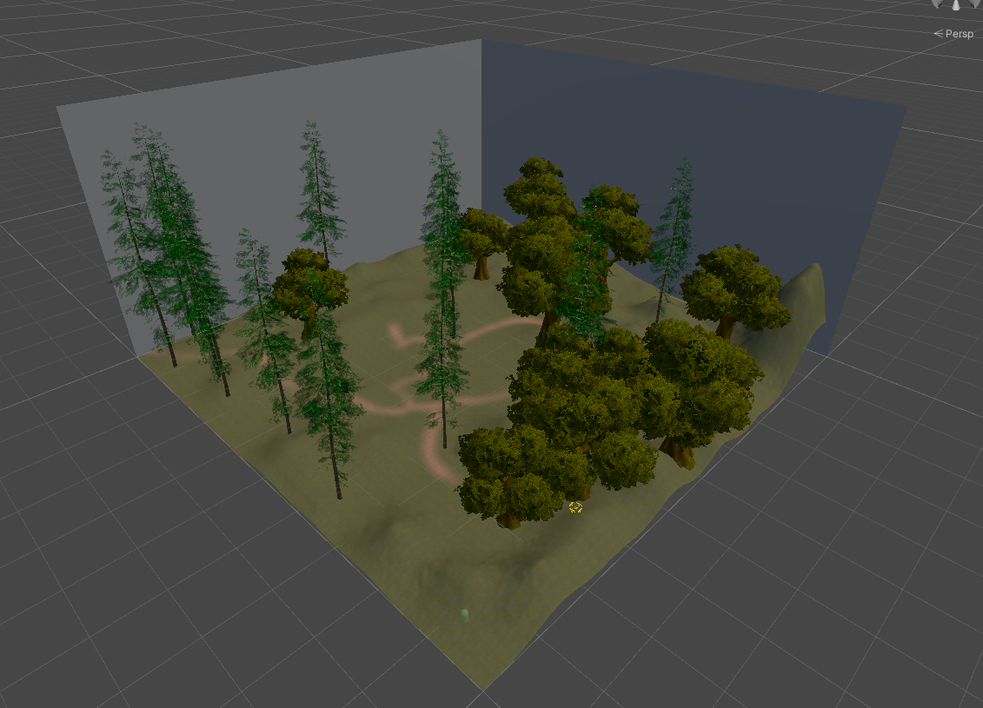
Training Environment
The environment consists of a custom created terrain of 100x100 square meters with grass and trees.
Walls of 50 meters height on all sides and roof with collider component.
Training Environment

Slide 11
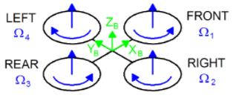
Drone Mechanism
To change yaw of drone diagonal propellers speeds are changed which creates unbalanced torque on the drone.
To roll two propellers on same side are increased while other side are decreased.
To change altitude all propeller’s speeds are varied.

Slide 12
OnEpisode begin
Drone’s mass, drag, angular drag, scale, local position, local rotation, velocity, angular velocity are all reset to the values specified in the trainer_config.yaml file (environment parameters) and a new random safe position is calculated on the terrain and spawned at that position.
Gravity in the unity physics is set to -9.81 in vertical direction.
Time scale is set to 20x.
Physics update frequency is set to every 0.02 seconds.
Resets the propeller rotation direction based on the left_diagonal_clockwise environment parameter.
Spawns the goal to a new random safe position in the terrain or spawns safely to a position which is of at most of “nearSpawnMaxRadius” distance from the drone position with a chance of 50%.

Slide 13
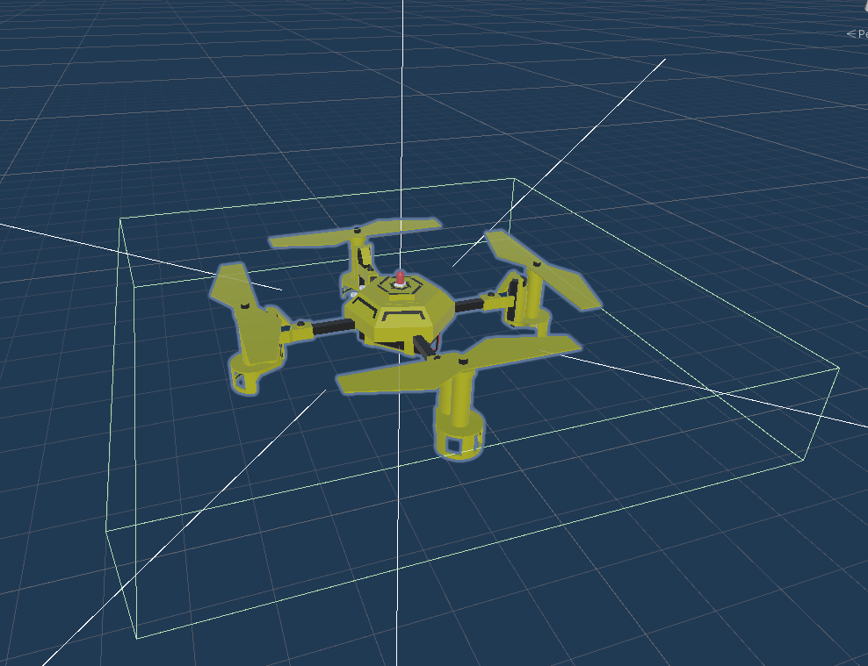
Parameters of Drone:
Max Viewing Distance of drone sensor: 10
Altitude Rate: 5
Roll Rate: 50
Pitch Rate: 50
Yaw Rate: 50
Max. Drone Spawn Height: 15.5
nearSpawnMaxRadius: 1
Drone model with ray perceptions and lidar sensor

Slide 14
Inputs to the Neural Network
The direction of the target with respect to that of the drone normalised (+3 float values).
Drone’s local rotation normalised (+4 float values).
Dot product of the “toGoal” direction and drone’s forward direction (+1 float value)(value: +1 if drone directly pointing towards the goal , -1 if directed away).
Minimum of distance of the target from the drone and maximum view distance normalised (+1 float value).
6 ray perception sensors in 6 directions of drone (12 float values).

Slide 15
Actions of Drone
Based on the input parameters of the sensor , the 21 observations are collected and transferred to Neural Networks. The output of the neural network consists of a float vector of length 4.
Index 0 : Altitude of the Drone (+1 for Altitude Gain , -1 for Altitude Loss)
Index 1: Yaw of the Drone (+1 for turning left , -1 for turning right)
Index 2: Pitch of the Drone ( +1 for tilting forward , -1 to tilting backward)
Index 3: Roll of the Drone (+1 for rolling left , -1 for tilting right)
Based on the outputs above , the drone moves accordingly towards the goal. If the Drone finds the goal then after 3 seconds the goal game object resets it position.

Slide 16
Rewards System
When the drone is inside the target game object, the reward is calculated based on the exact distance from the goal center to the drone plus a small consistent reward of (+0.01).
If the drone collides with any other object, the negative reward (-0.5) is given and the episode stops.
If the drone travelled below the terrain or above the roof, a negative reward (-0.5) is given and the episode ends.

Slide 17
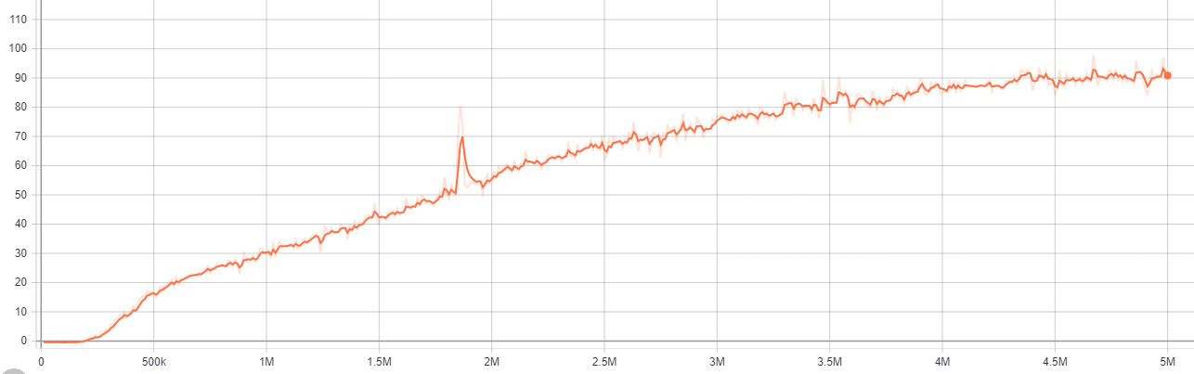
Results (Cumulative Reward of drone)

Slide 18
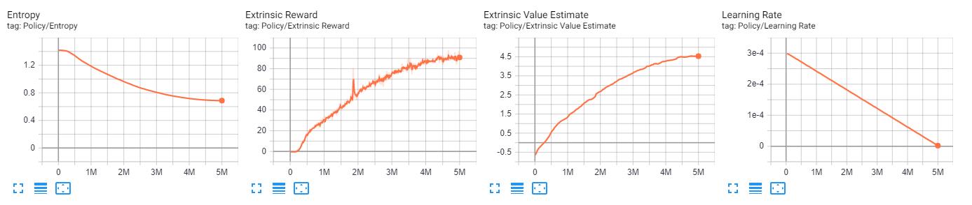
Results

Slide 19
Future Plan
By the Final Evaluation : Create a model which deploys a group of drones and get the terrain information from the drones and generates the virtual map of the area.

Slide 20
Timeline
Eval-1
Eval-2
Eval-3
Eval-4
Literature Survey
Drone training in simple Environment
Create Map and navigate drones based on current map data.
Drone movement training and LIDAR Cloud point Sensora
.

Slide 21
References
Design, control and application of quadcopter. International Journal of Industrial Engineering and Management. 6. 43-48. Ostojic, Gordana & Stankovski, Stevan & Tejic, Branislav & Đukić, Nikola & Tegeltija, Srdjan. (2015).
Using DJI phantom 4 rtk drone for topographic mapping of coastal areas, Y.Taddia, F. Stecchi, A. Pellegrinelli, Remote Sensing and Spatial Information Sciences, Volume XLII-2/W13, 2019 ISPRS Geospatial Week 2019, 10–14 June 2019, International Archives of the Photogrammetry.
Convolutional network architectures for super-resolution/sub-pixel mapping of drone-derived images, Pattathal V. Aruna, Ittai Herrmannb, Krishna M.Budhirajua, Arnon Karnielic, Pattern Recognition, Volume 88, 2019, Pages 431-446, ISSN 0031-3203.

Slide 22
References
A UAV Search and Rescue Scenario with Human Body Detection and Geolocalization. AI 2007: Doherty, P., & Rudol, P. (n.d.), Advances in Artificial Intelligence doi:10.1007/978-3-540-76928-6_1.
Towards Automated Drone Surveillance in Railways International conference on ACIVS 2016, Flammini, F., Naddei, R., Pragliola, C., & Smarra, G. (2016). doi:10.1007/978-3-319-48680-2_30

Slide 23
Thank You !

