Slide 1
INTRODUCTION TO HTML AND CSS
LEARNING THE LANGUAGE OF THE WEB

Slide 2
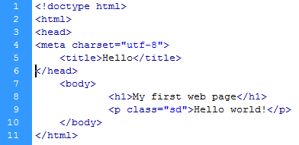
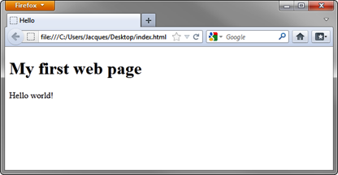
What is HTML?
HTML stands for:
    Hypertext
    Markup
    Language
A markup language, HTML elements are the building blocks of web pages.
HTML elements use tags to structure content.

Slide 3
Tags
HTML elements consist of tags.
Tags are enclosed by angle brackets, like this: <html>
Tags usually come in pairs, like this: <title> and </title>
Tags have a start (or opening) and end (or closing).
Tags are not displayed in a web browser.
Tags interpret how to display content between the tags.
<html>
<head>
<title></title>
</head>
<body>
<h1></h1> <p></p>
</body>
</html>

Slide 4
Tags
<html></html> describes the web page.
<head></head> describes the header.
<body></body> describes visible page content.
Common formatting tags:
  <h1></h1> displays a heading, ranging from size 1 (biggest) to 6 (smallest).
  <p></p> formats text as a paragraph.
  <strong></strong> bolds text.
  <em></em> emphasizes text, displays as italics.
  <br> creates a line break.
Links:
  <a href="http://www.example.com"></a> creates a link to a web page.

Slide 5
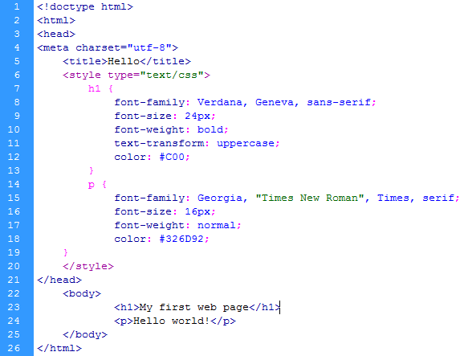
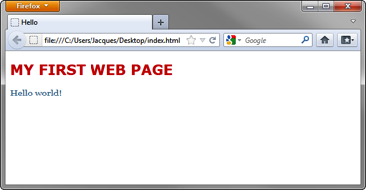
CSS
CSS stands for:
    Cascading
    Style
    Sheets
Describes the “look and feel” of HTML elements on a web page.
Helps separate document content (HTML) from document presentation (CSS).
Structures presentation elements such as layout, colors, and fonts.

Slide 6
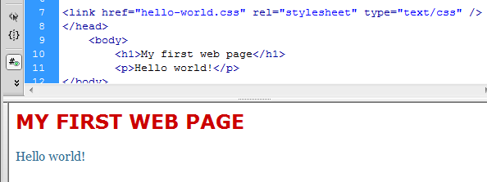
CSS
A style sheet contains a list of rules about how elements appear on a page.
Consists of a selector and a declaration block:
  Selectors tell which markup elements the style applies to.
  A declaration block is a list of property and value pairs that define the style.
Can be embedded inside the HTML or linked as a separate document.
h1 {
font-family: Verdana, Geneva, sans-serif;
font-size: 24px;
font-weight: bold;
text-transform: uppercase;
color: #C00;
}

Slide 7

Evolution of HTML and CSS
HTML and CSS are a collection of web standards.
HTML and CSS are a set of best practices for building websites.
HTML and CSS are constantly evolving:
  HTML5 is the fifth iteration of HTML and adds tags to support multimedia elements and dynamic graphics in modern web browsers.
  CSS3 defines a new set of modular rules for how HTML content will be presented within the web browser.

Slide 8
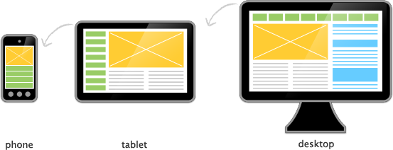
HTML5 best practices
Use HTML5 <!doctype html> to tell a browser how to translate.
Use <meta charset="utf-8"> to tell a browser the character-set.
Use semantic markup tags <article>, <section>, <header>, <nav>, and others to bring a higher level of structural meaning to documents.
Design and test content across a range of browsers and devices that support HTML5 capabilities.

