Slide 1

Process Mining Virtual Internship
by
T. Hemanth kumar
Roll No. 224G5A3207
Department of Computer Science and Engineering (Data Science)
Srinivasa Ramanujan Institute of Technology
(Affiliated to JNTUA & Approved by AICTE) (Accredited by NAAC with ‘A’ Grade & Accredited by NBA (EEE, ECE & CSE)
Rotarypuram Village, B K Samudram Mandal, Ananthapuramu – 515701.
2023 - 2024

Slide 2

Contents
Course Objective
Introduction
Technology
Applications
Modules
Real Time applications
Learning outcomes
GitHub Link
Queries

Slide 3
Course Objective
The primary objective of the course is to ensure that students gain a solid understanding of the fundamental concepts, principles, and methodologies of process mining.
The second main objective is to enable students to apply their acquired knowledge to real-world scenarios and datasets.

Slide 4
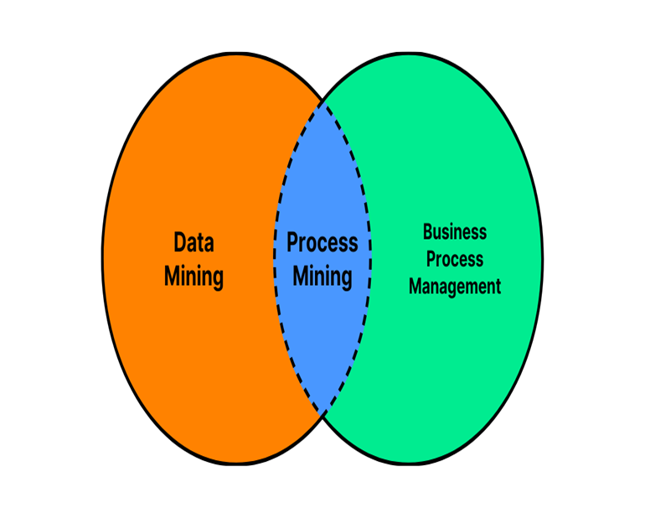
INTRODUCTION
WHAT IS PROCESS MINING?
Process mining sits at the intersection of business process
management (BPM) and data mining
Process mining is a data-driven approach that aims to
discover, analyze, and improve real business processes
using information extracted from event logs.
It involves the extraction of insights and knowledge
about how processes are actually executed within an
organization.

Slide 5
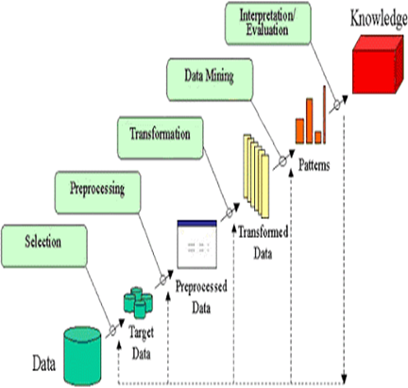
TECHNOLOGY
Data collection
Collect data from event logs, databases and other sources.
Data pre-processing
Clean, filter, and enrich data for analysis.
Process Discovery
Visualize and model process flows from event logs.

Slide 6
APPLICATIONS
Process Discovery: Process discovery is one of the fundamental applications of process mining. It involves analyzing event logs and automatically generating visual representations of how processes are executed in reality.
Conformance Checking: Conformance checking is a crucial application of process mining that involves comparing the actual execution of processes with the intended or expected behavior of those processes.

Slide 7
MODULES
Data collection: It involves gathering event data from various sources within an organization's information systems, databases.
Data understanding: Data understanding in process mining refers to the process of gaining a comprehensive understanding of the data that will be used for analysis.
Data preparation: It is a crucial step in the process mining workflow. It involves transforming and structuring the raw event data into a suitable format for analysis.
Data modeling: Data modeling in process mining refers to the creation of graphical representations or mathematical models that capture the behavior, structure, and characteristics of business processes using the event data collected.
Data evaluating: In the context of process mining, data evaluation involves asses sing the quality, relevance, and appropriateness of the data before and during the analysis.

Slide 8
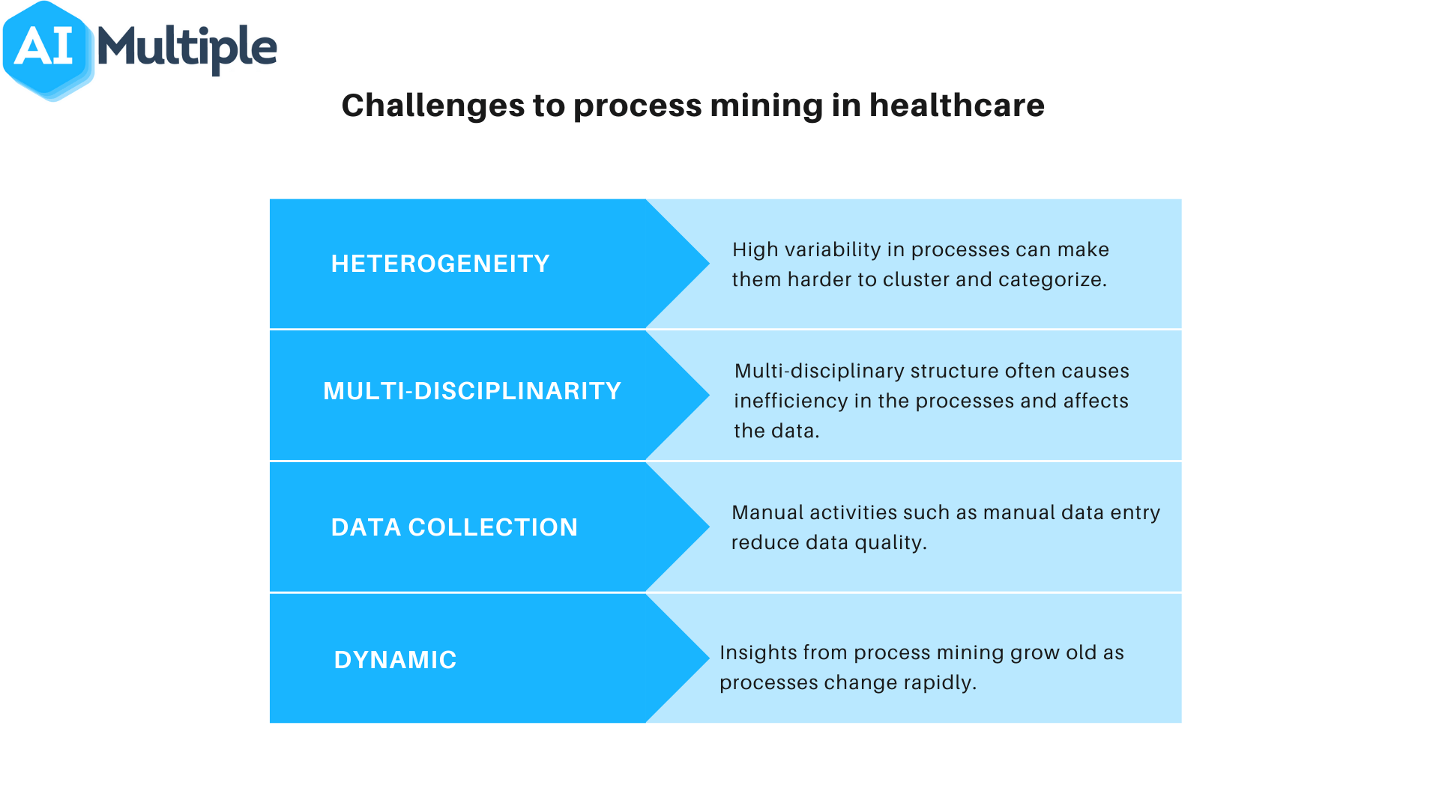
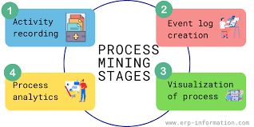

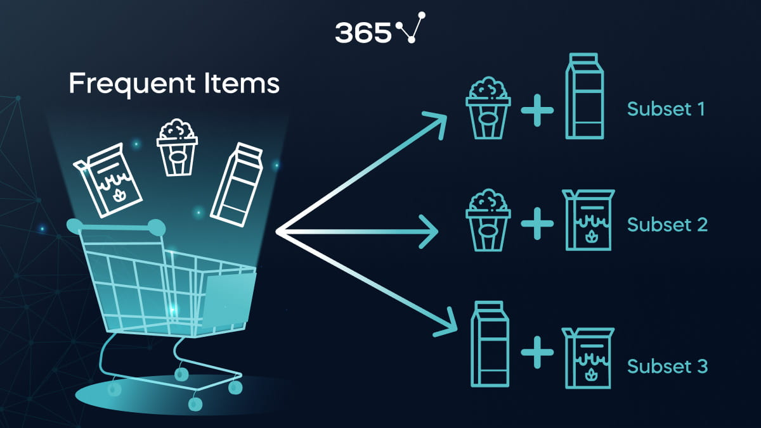
Real Time Applications
Healthcare
Improve patient care and optimize hospital processes.
Finance
Optimize financial processes,reduce froud and improve customer experience.
Customer survice
Reduce response times,improve service quality and increase customer satisfaction.
Market Basket Analysis
By predicting customers purchase behaviours, It helps to uncover patterns and relationships between products or items that are frequently purchased together.

Slide 9
LEARNING OUTCOMES
It improve problem soving skills of students
It is a technique used to analyze and visualize processes based on event data recorded in information systems.
It put our theoritical knowledge of process mining into practice.

Slide 10
Conclusion
Process mining is a powerful tool that can help organizations to identify , optimize processes, reduce costs and increase efficiency. It requires careful implementation to overcome challenges and realize its potential..
By this I learnt about the event log and also how to increase the service cost, how to process the data.
Learnt about PQL queries.

Slide 11
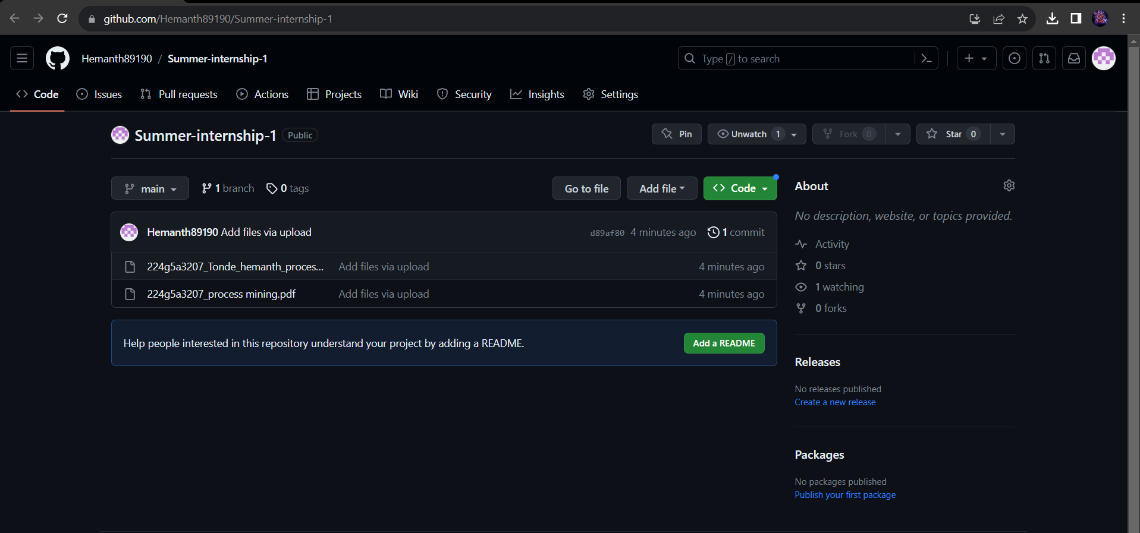
Git Hub Dashboard
Github link:https://github.com/Hemanth89190/Summer-internship-1

Slide 12
Any Queries?

Slide 13
Thank You!!!

