Slide 1




Analyzing Feature Selection Techniques for Machine Learning Based Anomaly Detection in IOT System

Slide 2
ABSTRACT
To identify the DDoS attack, ML algorithms are utilized.
The administered machine learning calculations like K-nearest neighbors (KNN), logistic regression, Naïve Bayes, Decision tree, and random forest are utilized for recognition and alleviation of attack.
There are six stages: Data gathering, Pre-processing, feature engineering, data splitting, feature selection, and feature extraction to find the best features in the given dataset (CICIDS-2017) with better accuracy.
It requires the most effective model to distinguish malicious activities as quickly as could really be expected and accurate.

Slide 3
INTRODUCTION
Distributed denial of service (DDoS) is a special sort of denial-of-service attack. Models can learn patterns from network traffic and trace network attack activities.
The results demonstrate the much better performance of the model compared with conventional machine learning ways. DDoS attacks still increase with frequency and intensity.
Recently, machine learning (ML) and data processing techniques are playing an important role in detection and therefore the classification of intrusion attacks.
There are many issues that can influence machine learning performance, such as the feature selection methods, the dataset used etc.

Slide 4
DATACOLLECTION & PREPROCESSING
We have collected the DDOS dataset named CICIDS-2017 dataset from UNB website. This study uses Machine Learning CVE data consists of eight (8) traffic monitoring sessions; each is in the form of a comma separated value (CSV) file. CICIDS-2017 has more complex types of attacks. Only 40% of Machine Learning CSV data from the CICIDS-2017 dataset are used in this project. Since the dataset has redundant features, it is needed to remove the redundant ones. Then relabeling process is performed. The 40% of Machine Learning CVE data are then split into 70% for training data and 30% for testing data.
We have collected the DDOS dataset named NSL-KDD dataset from UNB website. The raw dataset contains total attacks in the training set is 4.8M and the testing set has 311K attacks. We transformed the raw dataset into a much cleaner dataset by adding the column names.

Slide 5
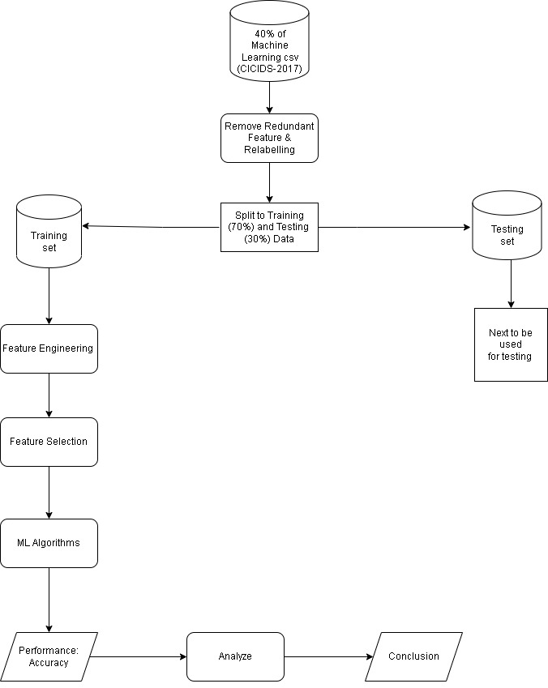

Slide 6
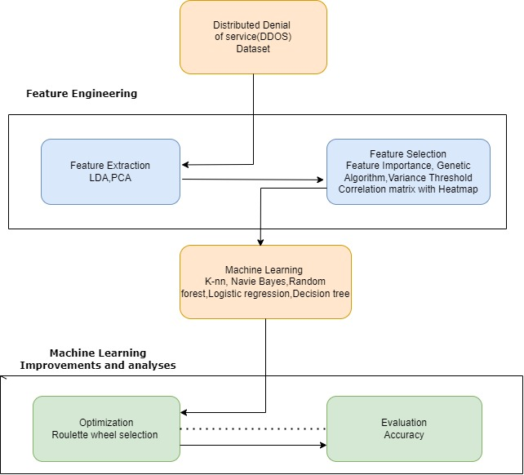

Slide 7
FEATURE SELECTION
Feature Importance
Variance Threshold
Co-relation Matrix with heat map
Principal Component Analysis(PCA)
Linear Discriminant Analysis(LDA)
Roulette Wheel Selection

Slide 8
ML ALGORITHMS
Logistic regression
Naive Bayes
K-Nearest Neighbors(KNN)
Decision Tree
Random Forest

Slide 9
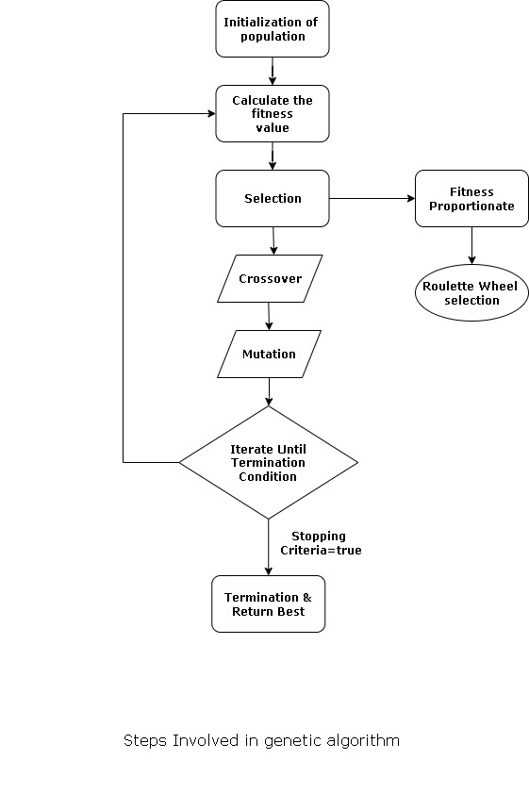

Slide 10

OPERATIONS
The main idea of improving detection efficiency is a way to effectively reduce the dimension of features without reducing the flexibility of information expression to boost the efficiency of knowledge analysis, which consists of two main steps: Feature selection and Feature extraction. It suggests that logistic regression, naive Bayes, KNN (K Nearest Neighbours), Decision tree, and random forest models have shown smart performance for solutions to classification issues. In addition, although feature selection methods are widely used and achieve good results, the redundancy caused by the correlation between features has not been taken into consideration, So feature extraction methods are introduced. A more efficient method called Principal Component Analysis (PCA) can reduce measurements by eliminating correlation. The accuracy of the genetic algorithm can be predicted using logistic regression and decision trees. we used roulette wheel selection to find the best features in the dataset. Then we calculate the accuracy of the selected features.

Slide 11
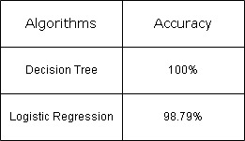
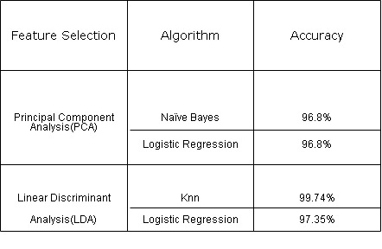
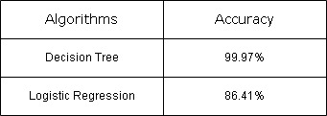
SIMULATION OF RESULT

Slide 12
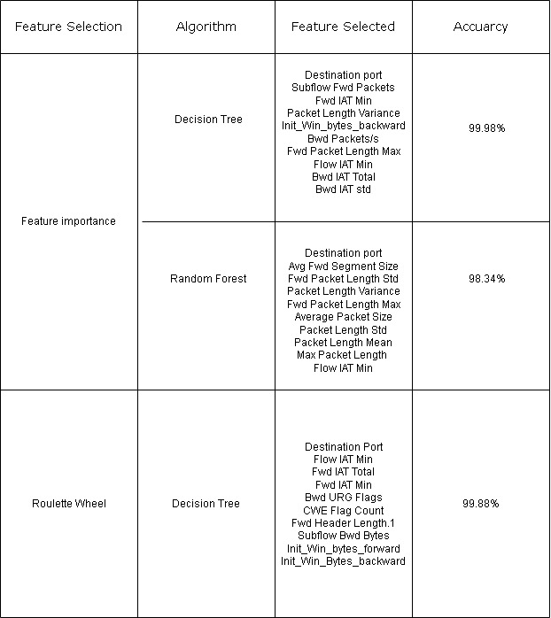
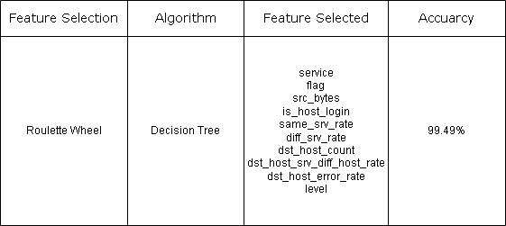
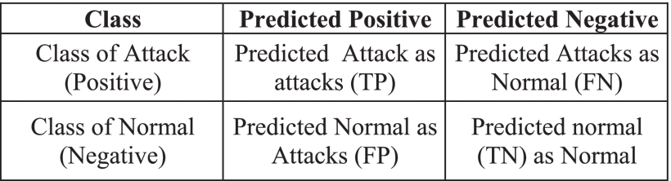

Slide 13
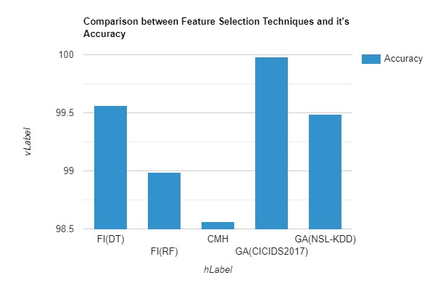
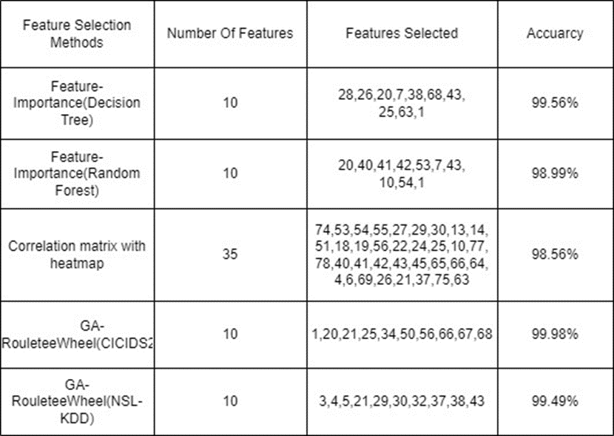
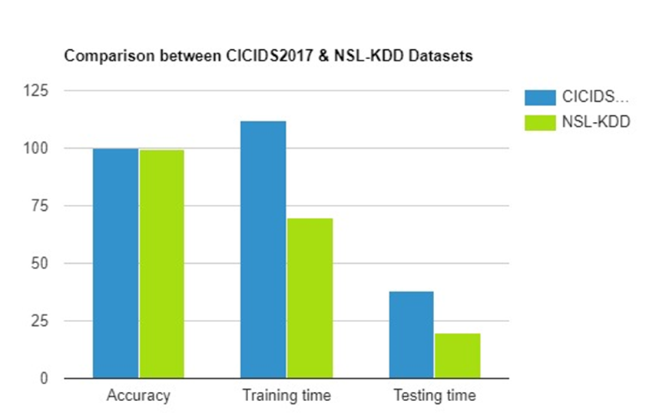

Slide 14
CONCLUSION
According to the testing results, Decision tree is giving better accuracy with feature importance.
Both Logistic regression and Naïve Bayes is giving same accuracy with principal component analysis.
KNN is giving better accuracy with linear discriminant analysis.
By Using Roulette Wheel Selection We have drawn top 10 Features among 79 Features and these features gives 99.88 % accuracy of CICIDS2017 Dataset
By Using Roulette Wheel Selection We have drawn top 10 Features among 43 Features and these features gives 99.49 % accuracy of NSL-KDD Dataset

Slide 15
FUTURE WORK
In future work we have to use the Well Optimization Technique for feature reduction. We have to take the features from the research papers as the reference and then make a comparison by using other DDoS Datasets such as SDN, Caida, etc. Accordingly, we can show some comparison graphs based on the accuracy.
Changes in Optimization Techniques like Ant Colony Optimization Algorithm, PSO (Particle swarm optimization), etc. make more experiments in genetic algorithms, Compare with different datasets like Caida, SDN, etc. Change the selection process and test with different data like changing the number of generations
Our future research will focus on approaches to increase the pace of discovery. We aim to make the inquiry process easier by combining the efforts of researchers.

Slide 16

THANK YOU
B . Krishna Murari
M . Hemanth
K . Sai Akhil

