Slide 1
DETECTION OF DDOS ATTACK BY COMPARITIVE ANALYSIS
Presented By:
M. Hemanth
K. Laharish
K. Shiva Chaitanya
M. Shashank

Slide 2
CONTENT
ABSTARCT
INTRODUCTION
DATA COLLECTION & PREPROCESSING
CLASSIFIERS
OPERATIONS
SIMULATION RESULTS
CONCLUSION
FUTURE SCOPE

Slide 3
ABSTRACT
To identify the DDoS attack, ML algorithms are utilized. The administered machine learning calculations like k-nearest neighbours (k-NN), logistic regression and random forest are utilized for recognition and alleviation of attack. There are three stages: data gathering, Pre-processing and feature extraction in the grouping calculation for recognition of "Normal or DDoS" attack utilizing the NSL-KDD dataset.it required the most effective model to distinguish malicious activities as quick as could really be expected and accurate.

Slide 4
INTRODUCTION
Distributed denial of service (DDoS) may be a special sort of denial-of-service attack. Models can learn patterns from network traffic and trace network attack activities. The results demonstrate the much better performance of the model compared with conventional machine learning ways. DDoS attacks still increase with frequency and intensity. Recently, machine learning (ML) and data processing techniques are playing an important role within the detection and therefore the classification of intrusion attacks. There are many issues that can influence machine learning performance, such as the feature selection methods, the dataset used etc.

Slide 5
DATA COLLECTION & PREPROCESSING
We have collected the DDOS dataset named NSL-KKD dataset from UNB website. The raw dataset contains total attacks in the training set is 4.8M and testing set has 311K attack. We transformed raw dataset to much more clean dataset by adding the column names. We dropped the non-numeric columns to get the confusion matrix. We changed the attack feature to numeric feature because its main feature to find the confusion matrix. We created a confusion matrix from that we manually selected the features which has the attack value more than 0.6 and we introduced this features for training and testing the dataset.
We made one hot encoding for other non-numeric features to convert into numeric features.

Slide 6
CLASSIFIERS
K-Nearest Neighbors(KNN) :-It is a learning algorithm that stores all instances corresponding to training data in n – dimensional space. It is a lazy learning algorithm as it does not focus on constructing a general internal model instead. It works on storing instances of training data.
Random Forest :-Random decision trees or random forest are an ensemble learning method for classification etc. it operates by constructing a multitude of decision trees at training time and outputs the class that is the mode of the classes or classification of the individual trees.
Logistic regression : It predicts binary outcomes for given dataset independent variables. The dependent variables outcome is discrete. It is categorical dependent variable. It is used in classification problems, cybersecurity, image processing.

Slide 7
OPERATIONS
We have features from feature selection and added a few features from other researchers, those are used as main features for testing and training of dataset. After that we joined the non-numeric features and numeric features. Then we split the data for training and testing. We implemented a model that calculate the accuracy and cross validation technique for
K-Nearest Neighbour, Random Forest and Logistic Regression. We found that logistic regression has less accuracy compared to other. We implemented a ROC curve for logistic regression with parameters of true positive rate and false positive rate and implemented the Xgboosting technique to get the better accuracy for logistic regression.

Slide 8
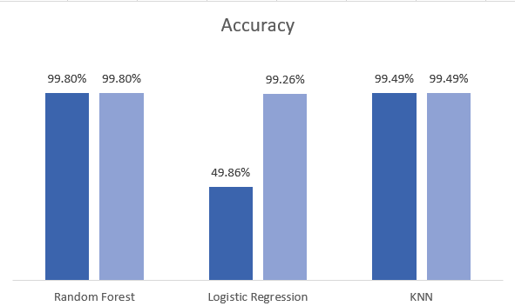
SIMULATION OF RESULT
From the cross validation model we got the accuracies of Random Forest, K- Nearest Neighbour and Logistic Regression. Those are represented in dark blue colour in bar graph. The light blue colour representation in bar graph is accuracies after using Xgboost technique.

Slide 9
CONCLUSION
We selected the features from confusion matrix by feature selection to train and test the dataset. We observed the result and concluded that Random Forest will give better accuracy compared to other techniques used. The Logistic Regression accuracy is low compared to other, so we applied Xgboosting technique for Logistic Regression to get better accuracy.

Slide 10
FUTURE SCOPE
We will also supply this database with malwares source codes, if available, as well as with exploits that they misuse to infect victims. We also aim to make this database open to other research teams, in order to collect and organize all the useful data. These kinds of information are usually scattered around the web and it takes a lot of time to sort them out. Therefore, we hope to simplify the investigation process by joining researcher’s efforts.

Slide 11

THANK YOU

