Slide 1
Business Intelligence Dashboard
Business Performance Analysis & Strategic Insights
Generated on December 03, 2025 | Data Period: Jan 2024

Slide 2
Executive Summary
Comprehensive analysis of 7 key performance indicators reveals significant business insights with both growth opportunities and operational challenges. Strategic focus on high-performing areas combined with targeted improvement initiatives for underperforming segments will drive enhanced business results.

Slide 3
Key Performance Indicators
Totalal Rainfal...
44
Row Count
30
Column Count
5
Data Completeness
100.0
Average Rainfal...
1.5

Slide 4
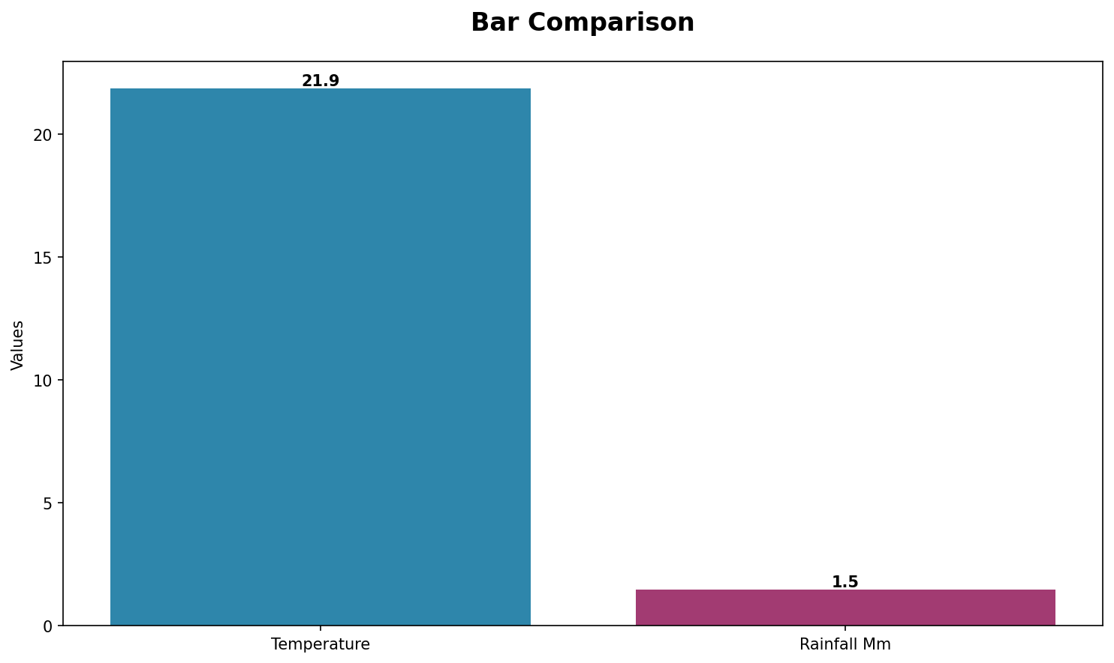
Performance Trends Analysis
Trend analysis showing performance patterns over time with key inflection points highlighted.

Slide 5
Key Insights & Recommendations
Key Business Insights:
• Current total rainfall mm stands at 44, representing a significant business metric that impacts overall performance.
Strategic Recommendations:
• Implement comprehensive performance monitoring systems to track key business indicators in real-time.
• Develop targeted strategies to capitalize on high-performing areas while addressing underperforming segments.
• Establish regular review cycles to assess progress against business objectives and adjust tactics accordingly.

Slide 6
Next Steps & Action Items
Key Action Items for Next Quarter:
• Implement comprehensive performance monitoring systems to track key business indicators in real-time.
• Develop targeted strategies to capitalize on high-performing areas while addressing underperforming segments.
• Establish regular review cycles to assess progress against business objectives and adjust tactics accordingly.

