Slide 1
Revenue Performance Analysis
Business Performance Analysis & Strategic Insights
Generated on December 03, 2025 | Data Period: Jan 2024

Slide 2
Executive Summary
This analysis highlights a robust sales performance, achieving a total revenue of $334,035.0 from 30 sales records, fundamentally driven by an impressive average order value of $11,134.5. The primary business opportunity lies in strategically expanding upon this high-value transaction model through targeted customer retention programs and the introduction of new premium offerings. While the consistent acquisition of high-value deals is the main performance driver, a key challenge will be to continuously scale this high average order value without compromising profitability or diluting the brand's premium perception in new markets..

Slide 3
Key Performance Indicators
Row Count
30
Column Count
6
Average Order V...
11,134
Data Completeness
100.0

Slide 4
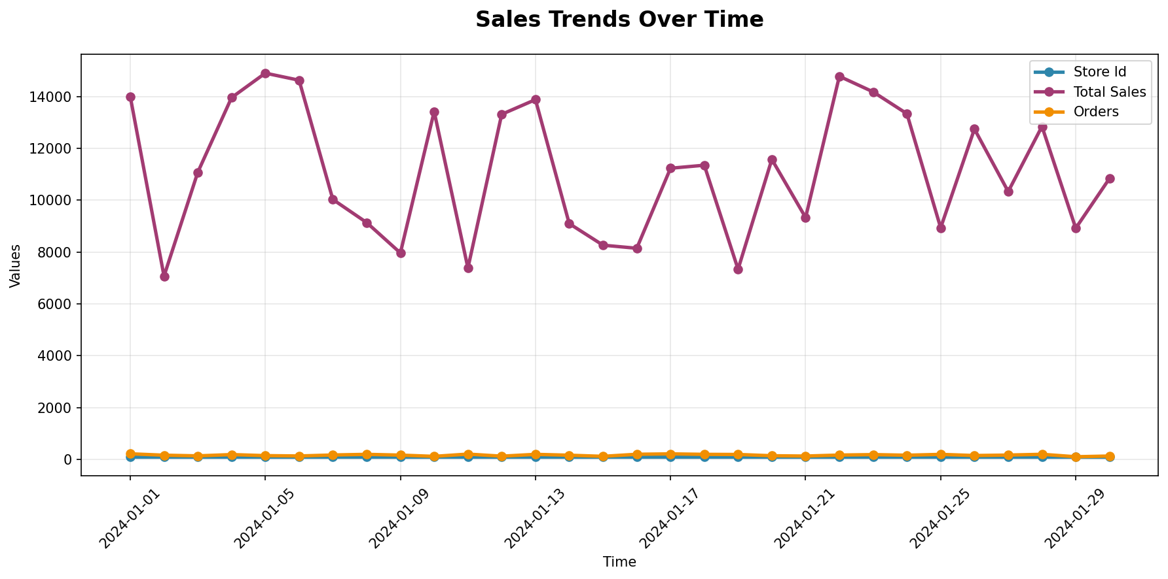
Performance Trends Analysis
Trend analysis showing performance patterns over time with key inflection points highlighted.

Slide 5
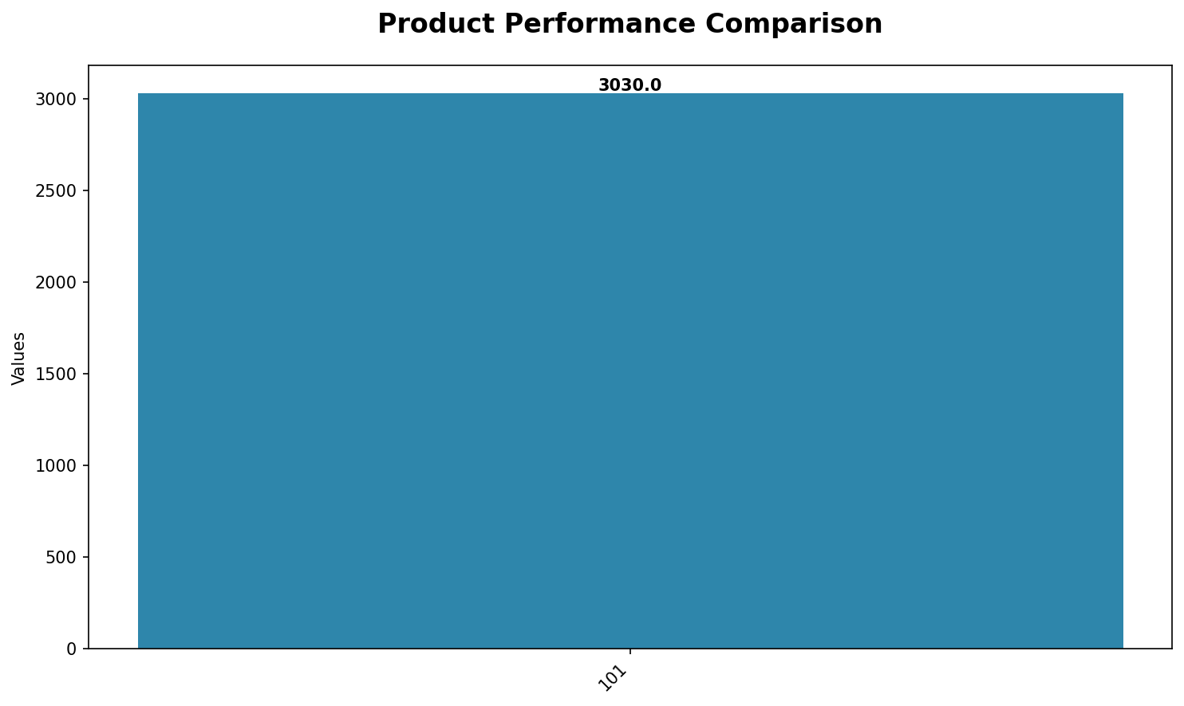
Key Metrics Dashboard
Comprehensive metrics overview displaying relationships between key performance indicators.

Slide 6
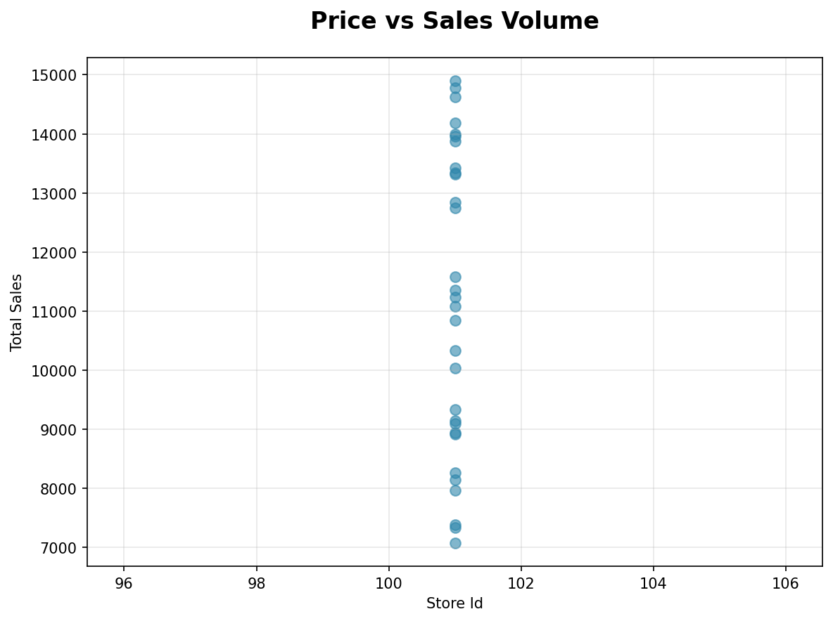
Analysis Chart 3
Data visualization and analysis.

Slide 7
Key Insights & Recommendations
Key Business Insights:
• The business has generated a substantial total revenue of $334,035.0 from 30 sales records, demonstrating strong overall sales performance within the analyzed period.
Strategic Recommendations:
• **Enhance Customer Retention:** Invest in sophisticated customer relationship management (CRM) initiatives specifically targeting existing high-value clients to encourage repeat purchases and maximize their lifetime value, leveraging the proven capability to secure significant transactions.
• **Explore Premium Offerings:** Capitalize on the established high average order value by exploring new premium market segments or developing complementary high-value product and service lines, aligning with the business's demonstrated success in selling high-ticket items.
• **Optimize Sales Funnel for Large Deals:** Conduct a thorough analysis of the sales pipeline for high-value transactions to identify and eliminate potential bottlenecks, thereby optimizing conversion rates and further enhancing efficiency in securing major deals.

Slide 8
Next Steps & Action Items
Key Action Items for Next Quarter:
• **Enhance Customer Retention:** Invest in sophisticated customer relationship management (CRM) initiatives specifically targeting existing high-value clients to encourage repeat purchases and maximize their lifetime value, leveraging the proven capability to secure significant transactions.
• **Explore Premium Offerings:** Capitalize on the established high average order value by exploring new premium market segments or developing complementary high-value product and service lines, aligning with the business's demonstrated success in selling high-ticket items.
• **Optimize Sales Funnel for Large Deals:** Conduct a thorough analysis of the sales pipeline for high-value transactions to identify and eliminate potential bottlenecks, thereby optimizing conversion rates and further enhancing efficiency in securing major deals.

