Slide 1
Revenue Performance Analysis
Business Performance Analysis & Strategic Insights
Generated on December 03, 2025 | Data Period: Nov 2025 - Dec 2025

Slide 2
Executive Summary
Comprehensive analysis of 9 key performance indicators reveals significant business insights with both growth opportunities and operational challenges. Strategic focus on high-performing areas combined with targeted improvement initiatives for underperforming segments will drive enhanced business results.

Slide 3
Key Performance Indicators
Average Revenue...
3.1K
Average Custome...
117
Average Orders
65
Row Count
10
Column Count
4
Data Completeness
100.0

Slide 4
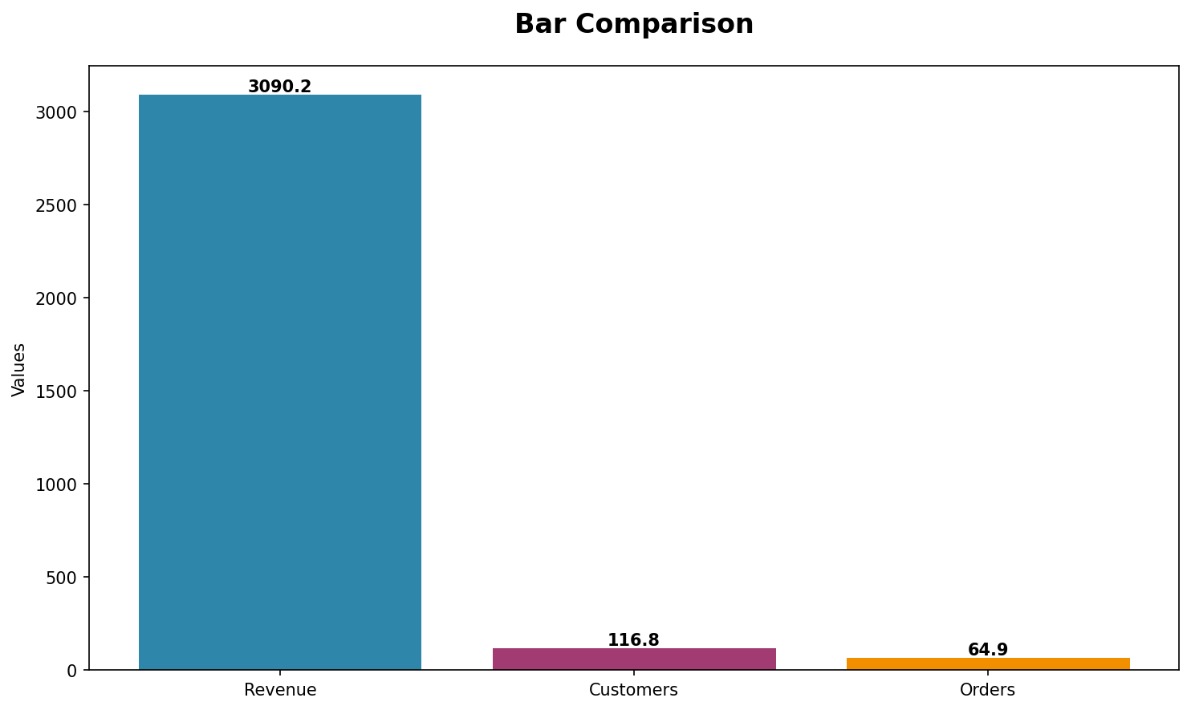
Performance Trends Analysis
Trend analysis showing performance patterns over time with key inflection points highlighted.

Slide 5
Key Insights & Recommendations
Key Business Insights:
• Business data analysis reveals multiple performance indicators across key operational areas.
• Current metrics demonstrate measurable business activity with identifiable patterns and trends.
• Performance indicators show varied results across different business segments requiring strategic focus.
Strategic Recommendations:
• Implement comprehensive performance monitoring systems to track key business indicators in real-time.
• Develop targeted strategies to capitalize on high-performing areas while addressing underperforming segments.
• Establish regular review cycles to assess progress against business objectives and adjust tactics accordingly.

Slide 6
Next Steps & Action Items
Key Action Items for Next Quarter:
• Implement comprehensive performance monitoring systems to track key business indicators in real-time.
• Develop targeted strategies to capitalize on high-performing areas while addressing underperforming segments.
• Establish regular review cycles to assess progress against business objectives and adjust tactics accordingly.

