Slide 1
Footfall & Traffic Analysis
Business Performance Analysis & Strategic Insights
Generated on December 03, 2025 | Data Period: Jan 2024

Slide 2
Executive Summary
Here are the key business insights derived from the operations metrics: Overall, our operations exhibit a healthy average daily footfall of 641 visitors, with a significant proportion, 506.07, being unique visitors. This indicates strong daily reach to distinct customers. The average visit duration across all operations is approximately 13.2 minutes, suggesting that visitors are spending some time engaged within our stores.

Slide 3
Key Performance Indicators
Totalal Footfall
641
Totalal Unique ...
506
Overall Average...
13.2
Average Daily F...
371.0
Row Count
30
Column Count
6

Slide 4
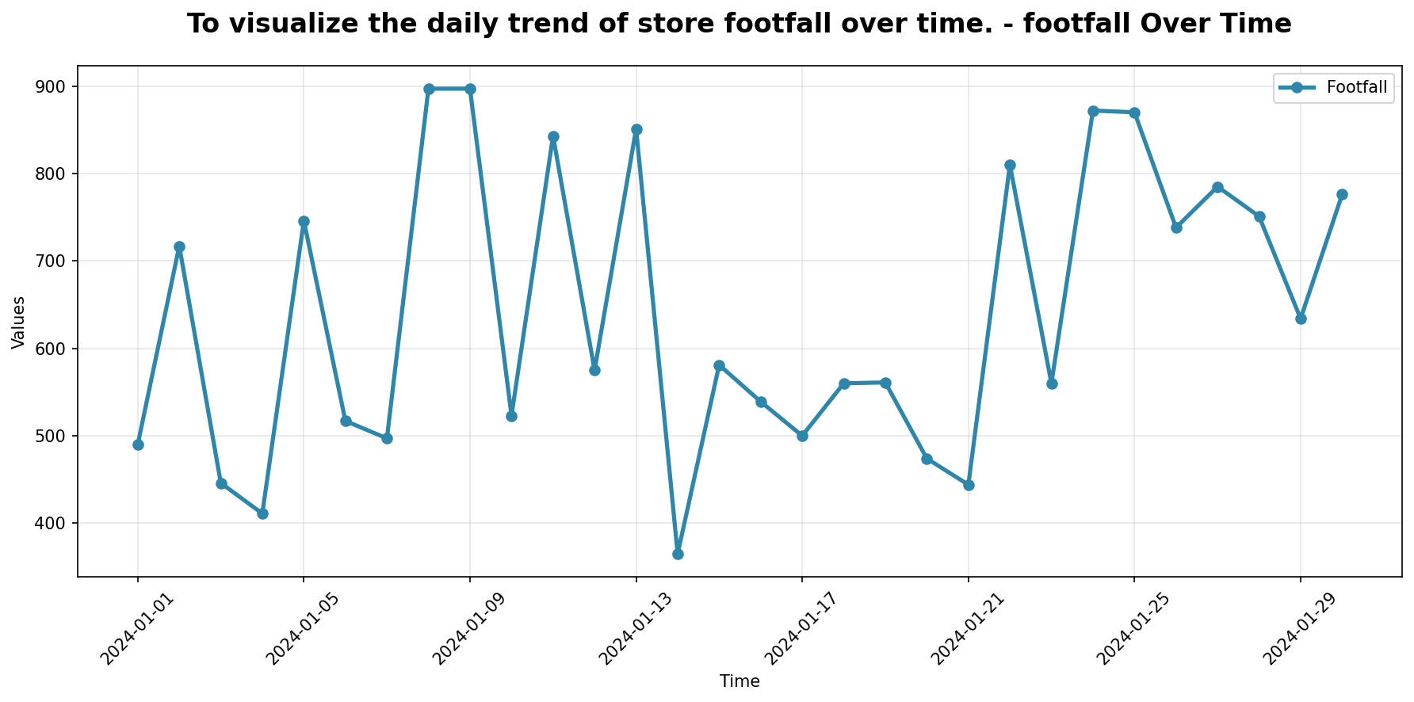
Performance Trends Analysis
Trend analysis showing performance patterns over time with key inflection points highlighted.

Slide 5

Key Metrics Dashboard
Comprehensive metrics overview displaying relationships between key performance indicators.

Slide 6
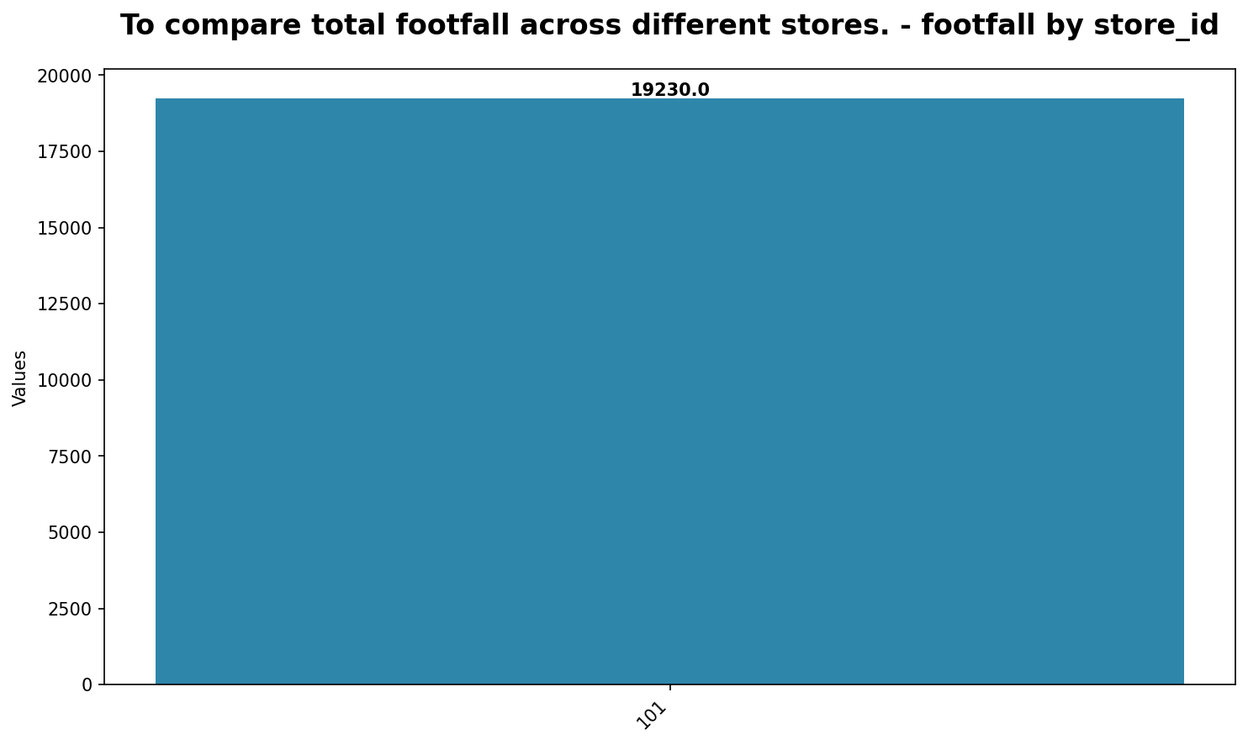
Analysis Chart 3
Data visualization and analysis.

Slide 7
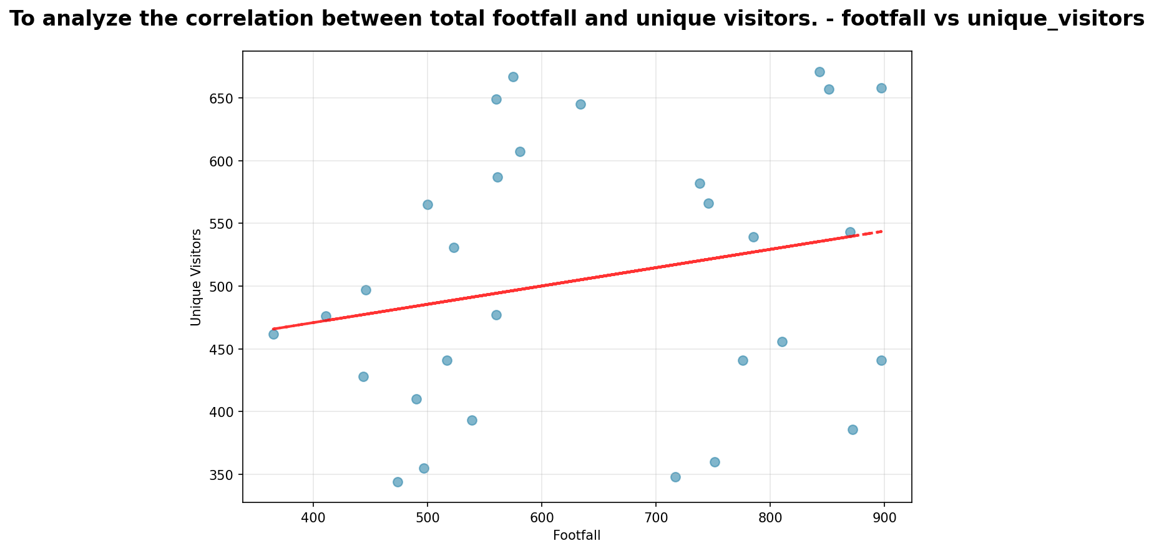
Analysis Chart 4
Data visualization and analysis.

Slide 8
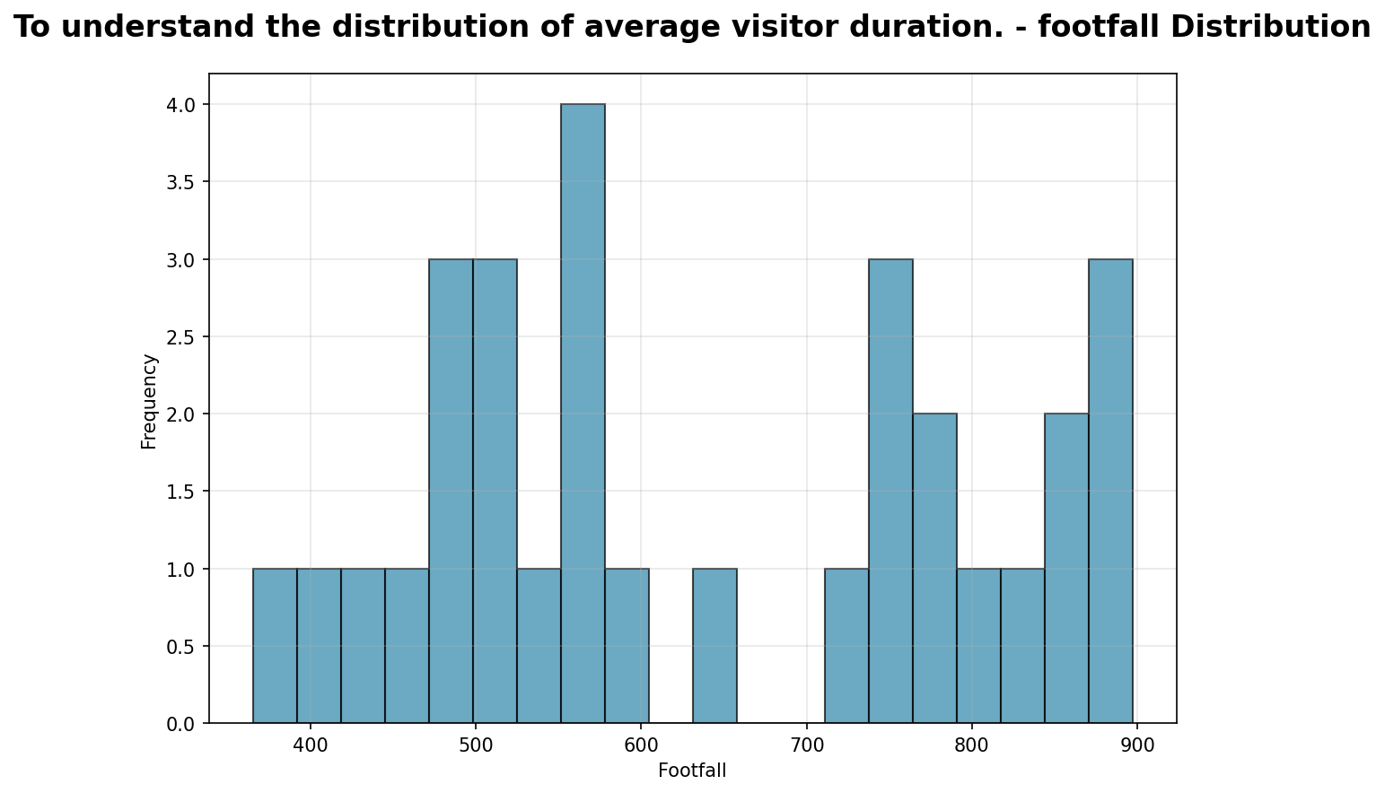
Analysis Chart 5
Data visualization and analysis.

Slide 9
Key Insights & Recommendations
Key Business Insights:
• Here are the key business insights derived from the operations metrics:
• Overall, our operations exhibit a healthy average daily footfall of 641 visitors, with a significant proportion, 506.07, being unique visitors.
• However, a critical anomaly requires immediate attention: the "Unique Visitor Ratio" is reported as 573.53.
Strategic Recommendations:
• Here are the key business insights derived from the operations metrics:
• Overall, our operations exhibit a healthy average daily footfall of 641 visitors, with a significant proportion, 506.07, being unique visitors.
• However, a critical anomaly requires immediate attention: the "Unique Visitor Ratio" is reported as 573.53.

Slide 10
Next Steps & Action Items
Key Action Items for Next Quarter:
• Here are the key business insights derived from the operations metrics:
• Overall, our operations exhibit a healthy average daily footfall of 641 visitors, with a significant proportion, 506.07, being unique visitors.
• However, a critical anomaly requires immediate attention: the "Unique Visitor Ratio" is reported as 573.53.

