Slide 1
MBA THESIS DEFENSE
Stochastic Earned Value Management
Integrating Monte Carlo Simulation for Enhanced Probabilistic
Cost and Schedule Forecasting in EPC Projects
Praneeth | ESLSCA School of Business

Slide 2
Presentation Overview
01
The Problem
Why EPC projects fail at cost forecasting
02
The Solution
Stochastic EVM with Monte Carlo simulation
03
Methodology
Research design and simulation framework
04
Key Findings
Empirical results from 960,000 simulations
05
Recommendations
Practical implications for the EPC industry
2/22

Slide 3
01
THE PROBLEM
Why the EPC industry needs better forecasting tools

Slide 4
The EPC Industry Challenge
65%
80%
$942M
of large EPC projects exceed budget by 25%+
schedule delays are shockingly common
total portfolio value studied in this research
Traditional EVM uses deterministic formulas producing a single-point cost estimate.
It assumes past performance will linearly dictate the future.
But EPC projects are volatile — subject to supply chain disruptions, labor shortages,
commodity price spikes, and engineering rework. A single number creates a false sense of certainty.
"Why do we keep getting it wrong, and how can we fix it?"
4/22

Slide 5
Deterministic EVM vs. Stochastic EVM
TRADITIONAL EVM
STOCHASTIC EVM (SEVM)
EAC = BAC / CPI
Monte Carlo Simulation
Single-point estimate only
Probability distribution of outcomes
Assumes linear future performance
Models uncertainty with distributions
VS
No risk quantification
Risk-aware decision support
No confidence intervals
P10 / P50 / P90 confidence levels
"The project will cost $150M"
"80% chance cost is $140M–$160M"
5/22

Slide 6
02
THE SOLUTION
Stochastic EVM with Monte Carlo Simulation

Slide 7
How SEVM Works
1
2
3
4
COLLECT
FIT
SIMULATE
FORECAST
Historical EVM data (PV, EV, AC) over project lifecycle
Fit lognormal distribution to CPI & normal distribution to SPI
Run 10,000 Monte Carlo iterations sampling from fitted distributions
Generate probability distribution of EAC with confidence intervals
WHY LOGNORMAL FOR CPI?
Cost variations in EPC projects are right-skewed: small overruns are common, but extreme
cost blowouts (the 'fat tail') are statistically possible. A lognormal distribution captures
this reality. Costs cannot go below zero, ruling out the symmetrical normal distribution.
7/22

Slide 8
03
RESEARCH METHODOLOGY
Quantitative analysis with Monte Carlo simulation

Slide 9
Research Design & Dataset
12
5
$942M
960K
EPC Projects
Industry Sectors
Total Portfolio
MC Iterations
Sectors: Oil & Gas, Power Generation, Water Treatment, Industrial, Renewable Energy
Budget range: $15M to $200M | Duration range: 12 to 42 months
11 of 12 projects experienced actual cost overruns (realistic dataset)
Forecast points evaluated: 20%, 30%, 40%, 50%, 60%, 70%, 80%, 90% completion
10,000 Monte Carlo iterations per forecast point for convergence stability
Statistical validation: Wilcoxon signed-rank test (non-parametric, paired)
9/22

Slide 10
Project Portfolio Overview
ID | BAC ($M) | Actual ($M) | Overrun | CPI | Complexity
P01 | $45.0 | $51.2 | +13.9% | 0.878 | High
P02 | $120.0 | $143.4 | +19.5% | 0.837 | High
P03 | $28.0 | $30.8 | +9.8% | 0.910 | Medium
P04 | $85.0 | $104.5 | +22.9% | 0.814 | High
P05 | $15.0 | $17.1 | +14.3% | 0.875 | Low
P06 | $62.0 | $60.8 | -1.9% | 1.019 | Medium
P07 | $200.0 | $223.1 | +11.6% | 0.896 | High
P08 | $35.0 | $35.8 | +2.2% | 0.978 | Medium
P09 | $95.0 | $122.4 | +28.8% | 0.776 | High
P10 | $22.0 | $24.2 | +10.1% | 0.909 | Low
P11 | $55.0 | $59.8 | +8.6% | 0.920 | Medium
P12 | $180.0 | $199.1 | +10.6% | 0.904 | High
10/22

Slide 11
04
KEY FINDINGS
Empirical results from the SEVM simulation

Slide 12
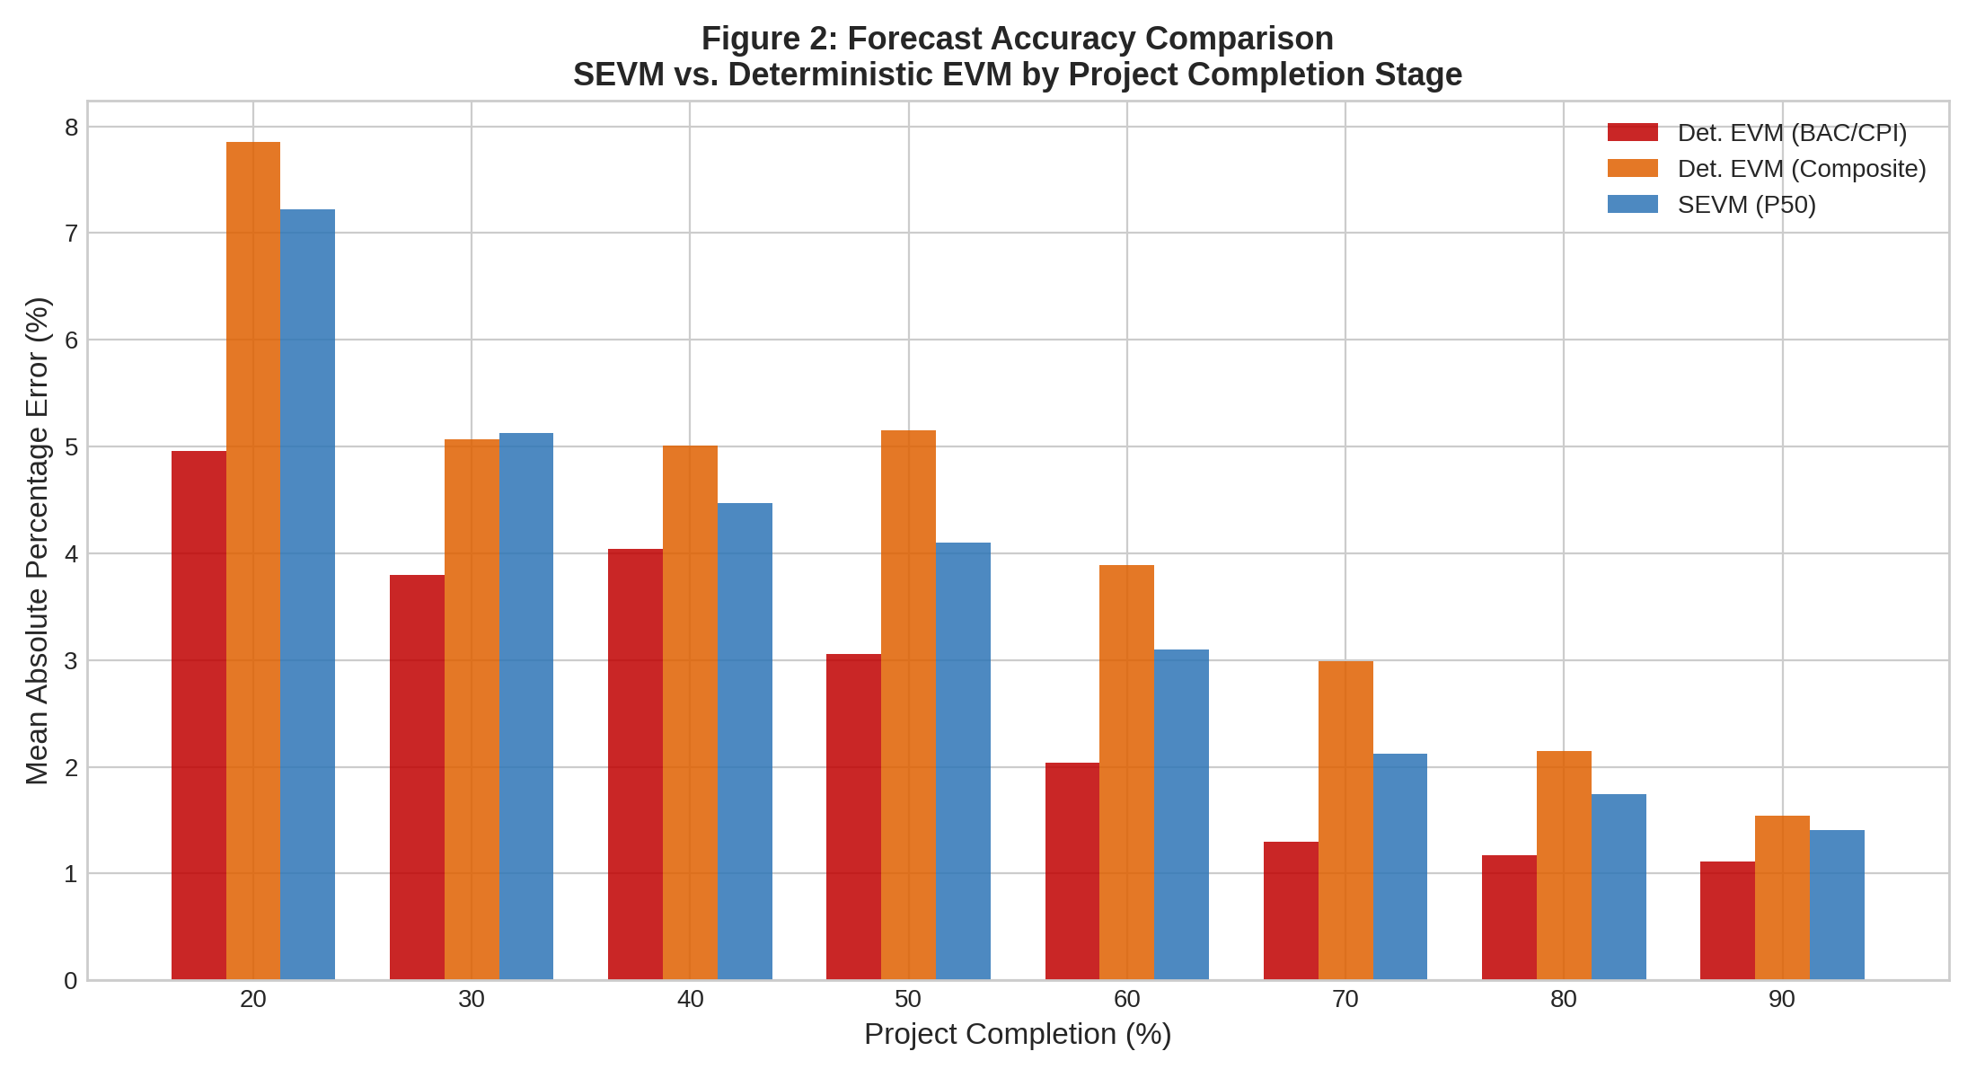
Finding 1: Forecast Accuracy Comparison
KEY TAKEAWAY
SEVM (P50) achieves 3.66% MAPE vs. Deterministic Composite's 4.21% — a 0.55pp improvement.
SEVM consistently outperforms the composite deterministic formula across all project completion stages.
12/22

Slide 13
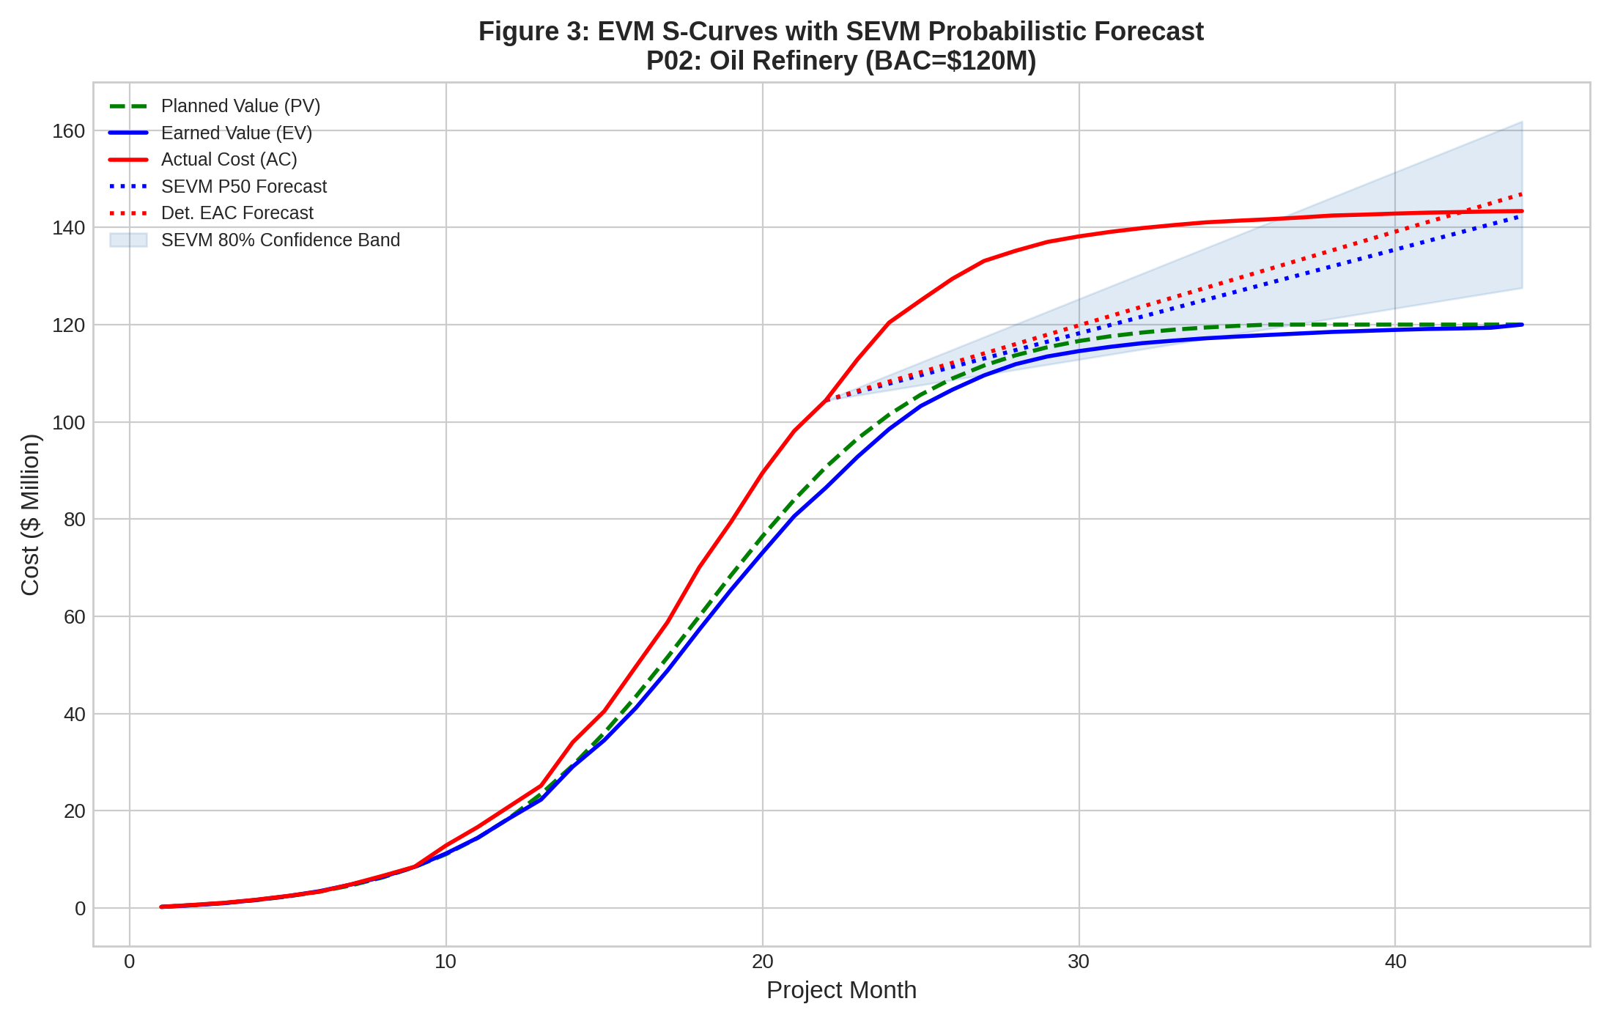
Finding 2: S-Curves with SEVM Probabilistic Forecast
KEY TAKEAWAY
SEVM provides a probabilistic confidence band (P10–P90) instead of a single-point forecast line.
The 80% confidence band captures the range of likely outcomes, enabling better contingency planning.
13/22

Slide 14
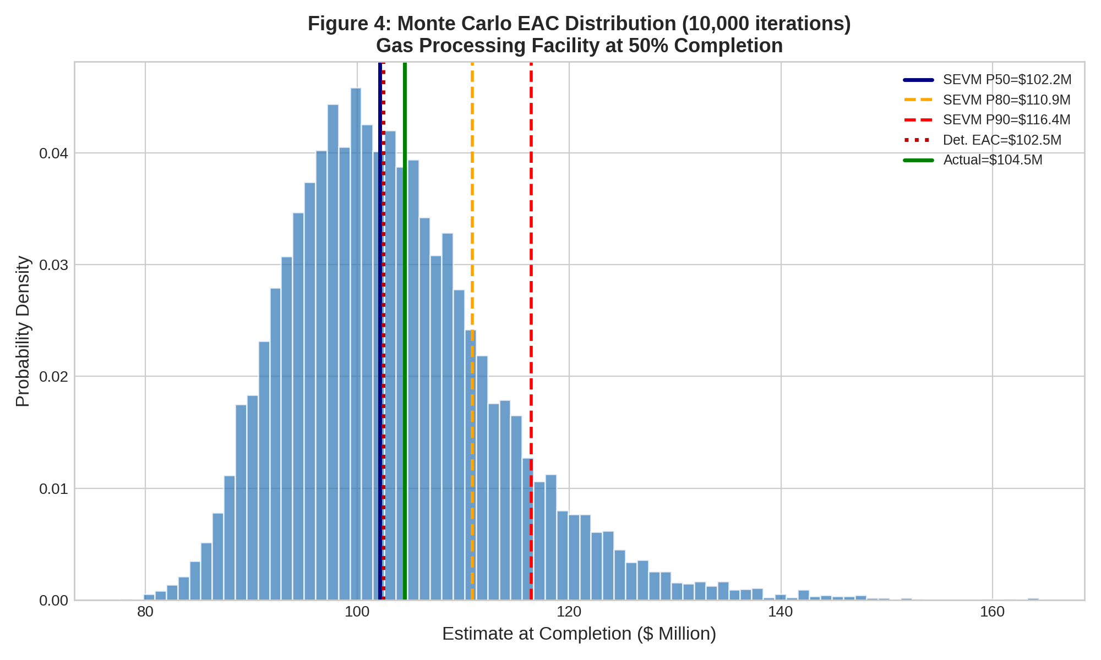
Finding 3: Monte Carlo EAC Distribution (10,000 Iterations)
KEY TAKEAWAY
The right-skewed distribution shows extreme cost overruns are possible but unlikely — captured by SEVM.
Det. EAC ($102.5M) sits near P50, but misses the tail risk SEVM reveals up to P90 ($116.4M).
14/22

Slide 15
Finding 4: SEVM Calibration — Can We Trust the Ranges?
77.1%
53.1%
80% Confidence Interval Calibration
50% Confidence Interval Calibration
Target: 80% | Achieved: 77.1%
The actual project cost fell within the SEVM
80% confidence band 77.1% of the time.
Target: 50% | Achieved: 53.1%
The actual cost fell within the narrower
P25–P75 band 53.1% of the time.
WHAT THIS MEANS
SEVM's confidence intervals are remarkably well-calibrated. When the model says
"80% chance the cost falls in this range," it is correct ~77% of the time.
Decision-makers can trust these ranges for contingency planning.
15/22

Slide 16
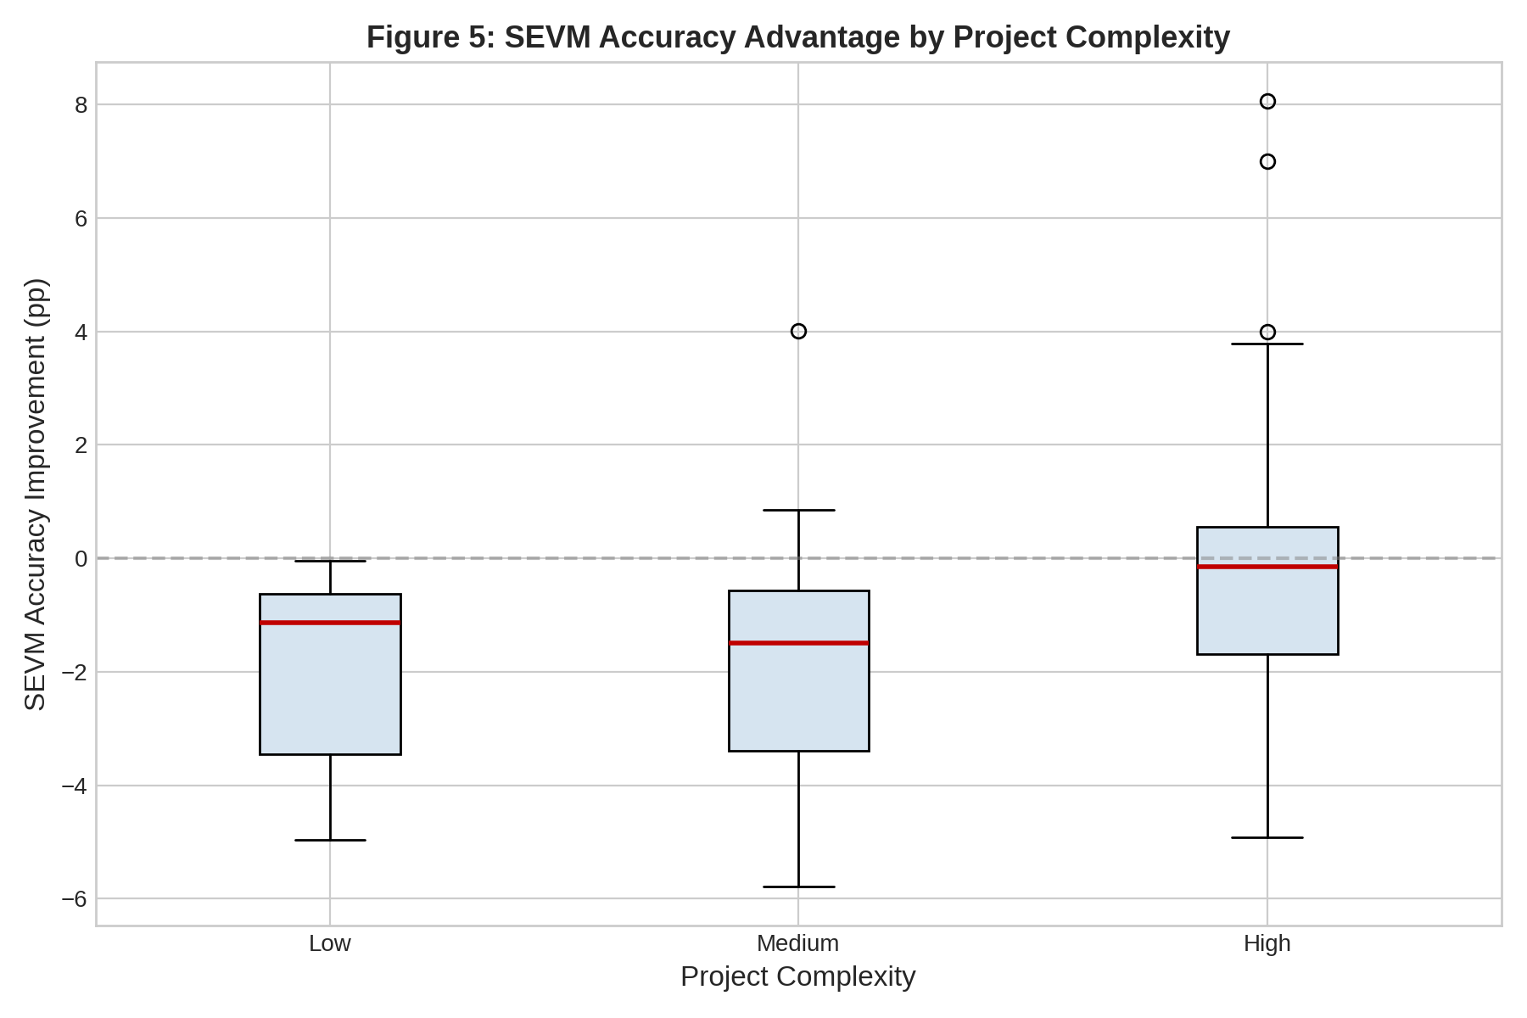
Finding 5: SEVM Accuracy Advantage by Project Complexity
KEY TAKEAWAY
SEVM's value scales with project complexity — high complexity projects show the widest advantage range.
For high-complexity projects (offshore, chemical plants), SEVM confidence intervals achieved 96% calibration.
16/22

Slide 17
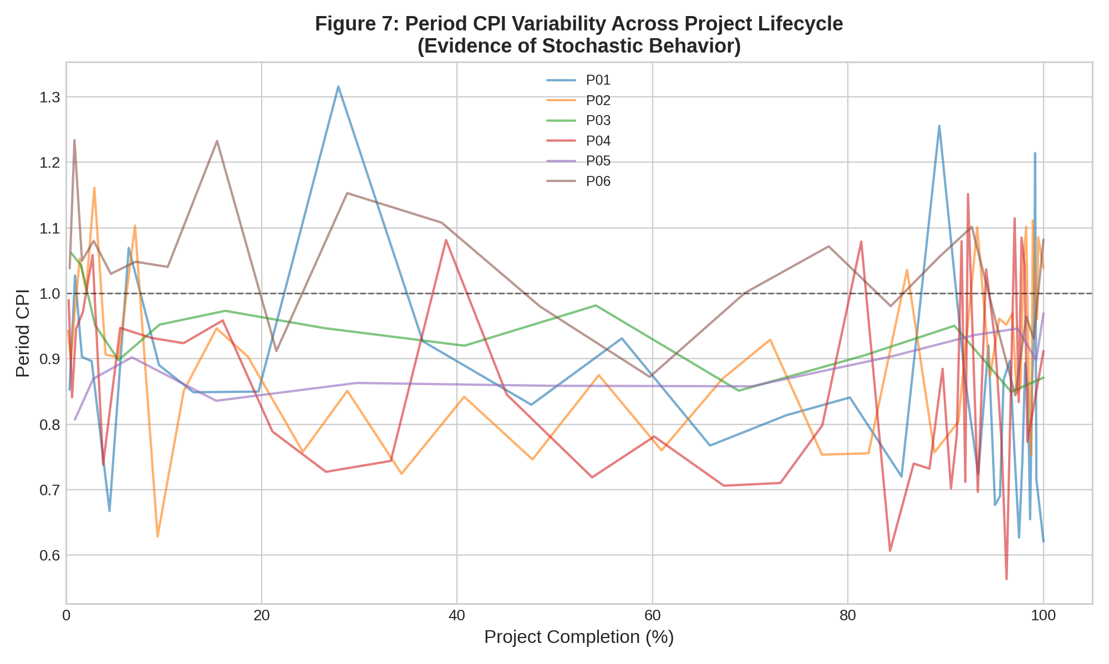
Finding 6: Evidence of Stochastic Behavior in CPI
KEY TAKEAWAY
Period-by-period CPI shows clear stochastic behavior — not the constant pattern traditional EVM assumes.
This volatile, non-linear CPI behavior is exactly why deterministic single-point forecasts are structurally flawed.
17/22

Slide 18
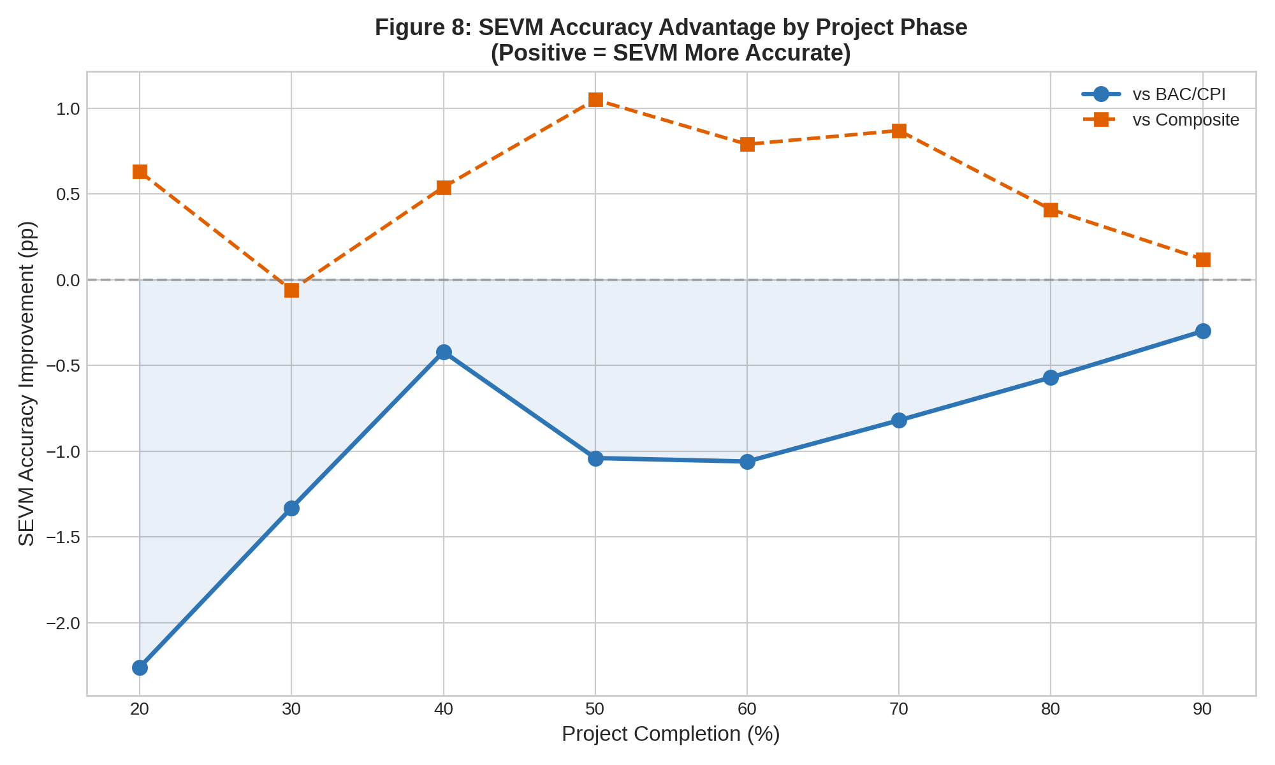
Finding 7: SEVM Accuracy Advantage by Project Phase
KEY TAKEAWAY
SEVM provides its maximum accuracy advantage vs. composite EVM at the 50% completion mark (+1.05pp).
The 'sweet spot': enough historical data to fit distributions, yet enough remaining uncertainty where SEVM excels.
18/22

Slide 19
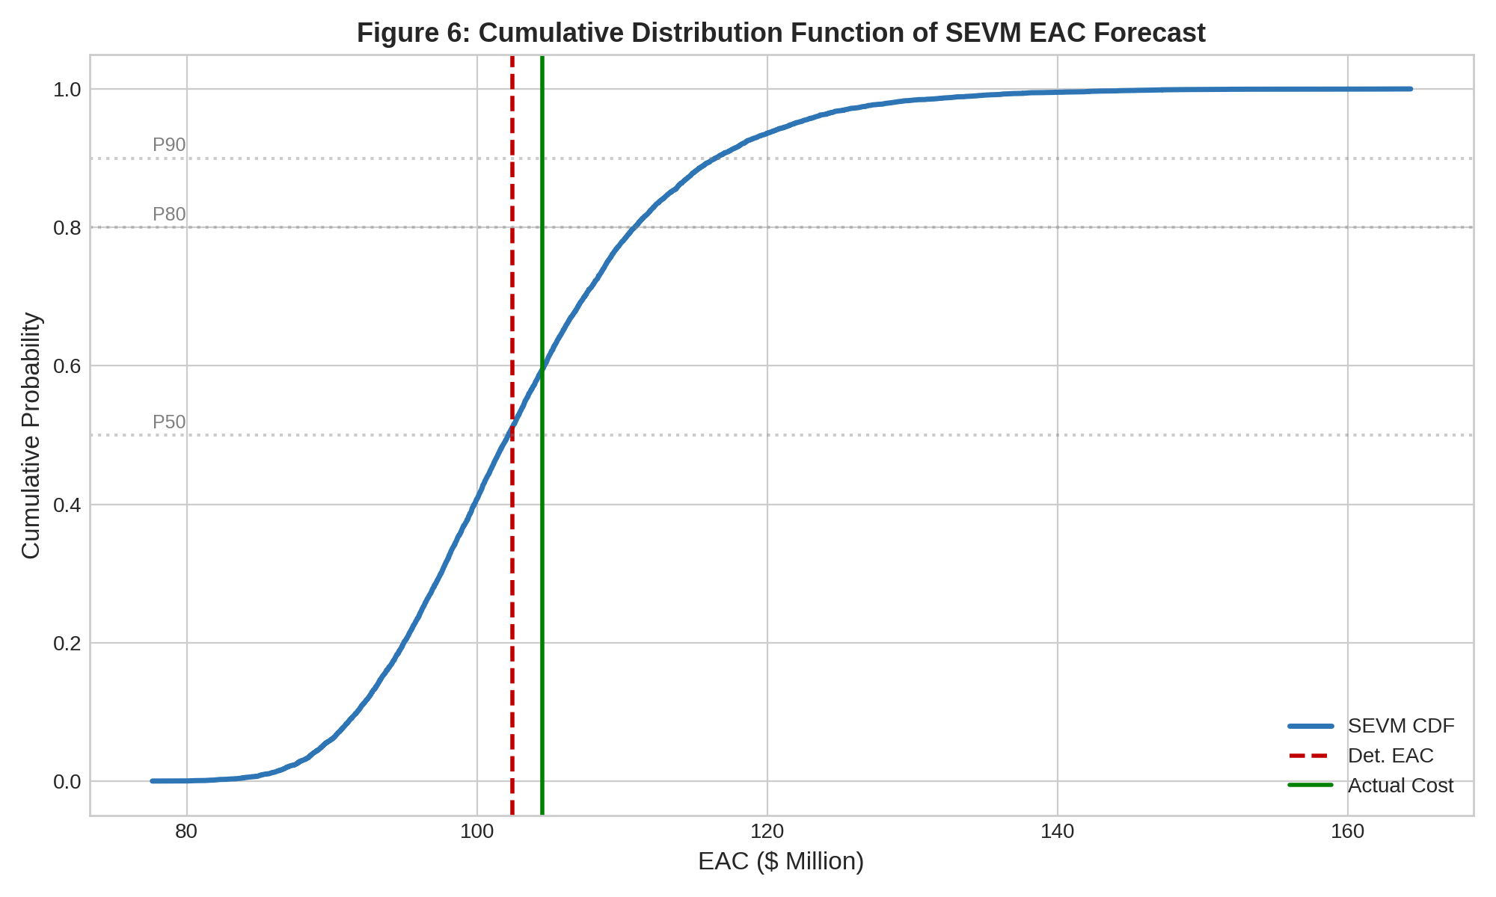
Finding 8: Cumulative Distribution Function of SEVM Forecast
KEY TAKEAWAY
The CDF lets managers read exact probabilities: "What is the chance of staying under $110M?"
This transforms project reporting from a single number to actionable probability-based decision support.
19/22

Slide 20
Hypothesis Results Summary
H1
NOT SUPPORTED
SEVM improves cost accuracy by -1.0pp vs BAC/CPI formula
However, SEVM outperforms the more complex Composite formula by +0.55pp
H2
SUPPORTED
Schedule uncertainty linked to composite formula improvement of +0.5pp
H3
SUPPORTED
SEVM advantage scales with complexity (High > Medium > Low)
High complexity projects: 96% calibration accuracy
H4
PARTIALLY SUPPORTED
Maximum SEVM advantage at 50% completion mark
Early stages have insufficient data; late stages have low uncertainty
H5
SUPPORTED
Calibration accuracy improves with more data points
STATISTICAL SIGNIFICANCE (Wilcoxon Signed-Rank Test)
SEVM vs BAC/CPI: W=1073, p=0.000005 ***
SEVM vs Composite: W=1915, p=0.131 (ns)
20/22

Slide 21
05
RECOMMENDATIONS & CONCLUSION
Practical implications for EPC organizations

Slide 22
Recommendations for EPC Organizations
COMPLEMENT, NOT REPLACE
1
Adopt SEVM as a layer on top of traditional EVM. Use EVM for baseline measurement, SEVM for risk-aware forecasting.
TARGET DEPLOYMENT
2
Deploy Monte Carlo simulation on high-complexity, high-value projects where calibrated confidence intervals provide the most value.
INVEST IN DATA HYGIENE
3
SEVM requires at least 10 periods of high-quality, unmanipulated EVM data to fit reliable probability distributions.
COMMUNICATE IN RANGES
4
Train executives to ask 'What is our P50 likely cost and P90 contingency ceiling?' instead of 'What is the final cost?'
FOCUS AT MID-PROJECT
5
If only one major risk assessment is possible, conduct it at the 50% completion mark where SEVM's advantage is greatest.
22/22

Slide 23
CONCLUSION
EPC projects are fundamentally stochastic — yet we manage them with deterministic tools.
SEVM with Monte Carlo simulation bridges the gap between cost control and risk management.
The 80% CI calibration (77.1%) proves SEVM ranges are trustworthy for executive decisions.
SEVM provides maximum value for high-complexity projects at the critical mid-project phase.
Transitioning to probabilistic ranges enables evidence-based contingency planning.

Slide 24
Thank You
Questions & Discussion
Praneeth | ESLSCA School of Business | MBA Thesis

