Slide 1
Enhancing Risk Management Effectiveness in
Hybrid Projects through AI-Driven
Strategic Governance
A Structural Equation Modelling Study
Based on primary data from 384 project professionals
Analysis: Structural Equation Modelling (SEM) | SPSS & AMOS

Slide 2
Introduction & Research Context
The Problem
Hybrid Complexity
The AI Opportunity
Traditional risk management relies on static registers, periodic assessments, and subjective expert judgment — insufficient for today's complex, data-intensive projects.
Agile + Waterfall coexistence creates fragmented governance, inconsistent risk documentation, and ambiguous escalation authority.
AI enables predictive analytics, real-time monitoring, continuous learning, and data-driven decision support for risk governance.
Research Gap: No integrated SEM model testing AI capability alongside governance mechanisms in hybrid project risk management
2/14

Slide 3
Research Objectives & Hypotheses
H1
Risk Process Alignment → Risk Management Effectiveness
H2
Risk Visibility Integration → Risk Management Effectiveness
H3
Timely Risk Escalation → Risk Management Effectiveness
H4
Governance Consistency → Risk Management Effectiveness
H5
AI-Driven Risk Analytics Capability → Risk Management Effectiveness
All hypotheses posit a significant positive impact on Risk Management Effectiveness in Hybrid Project Environments.
3/14

Slide 4
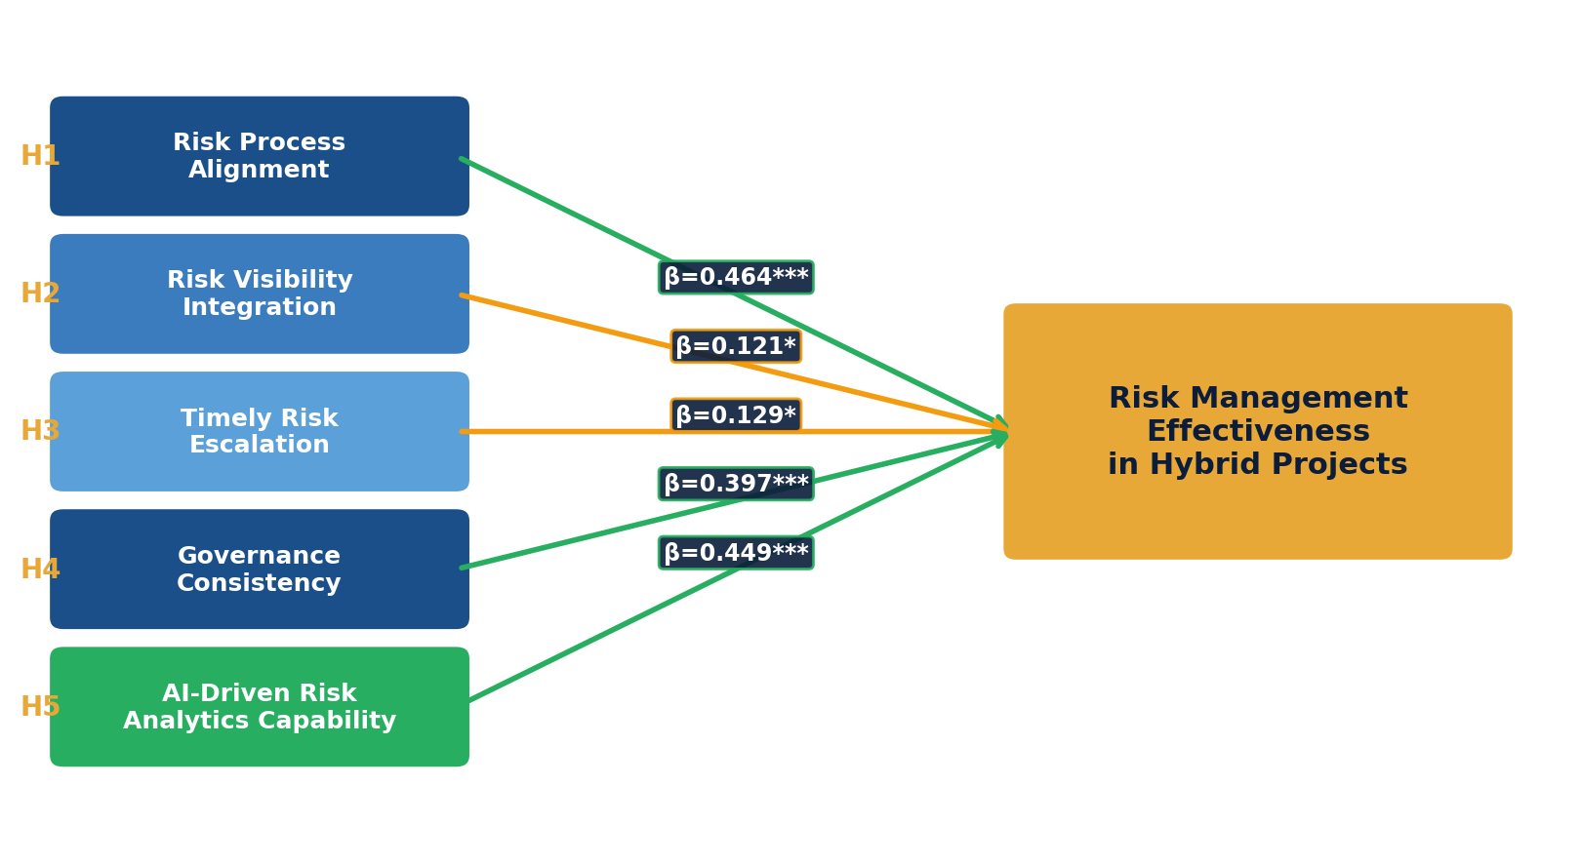
Conceptual Framework
Integrated Model of AI-Driven Strategic Risk Management
4/14

Slide 5
Research Methodology
Quantitative Research Design
384 Professionals Surveyed
SPSS + AMOS Analysis Tools
Rigorous Validation
Cross-sectional survey with 5-point Likert scale
Project managers, risk managers, PMO, analysts, scrum masters
CFA for measurement model SEM for hypothesis testing
KMO = 0.927 | All AVE > 0.5 All CR > 0.7 | Fornell-Larcker
Statistical Techniques
• Confirmatory Factor Analysis (CFA) for measurement model validation
• Structural Equation Modelling (SEM) for testing causal relationships
• Discriminant Validity via Fornell-Larcker Criterion | Cronbach's Alpha for reliability
5/14

Slide 6
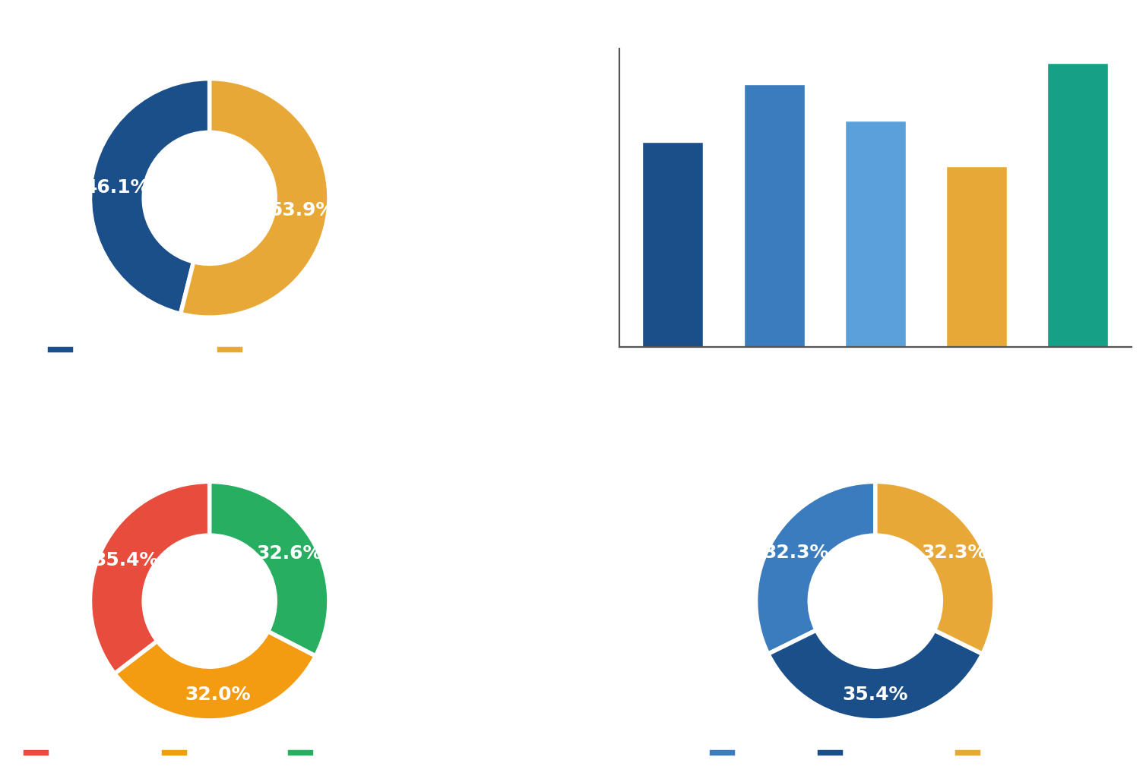
Sample Demographics
N = 384 Project Professionals across Diverse Industries
77%+
Over 5 years experience
53.9%
Female respondents
27.6%
Hold professional certifications
32.3%
Hybrid project experience
6/14

Slide 7
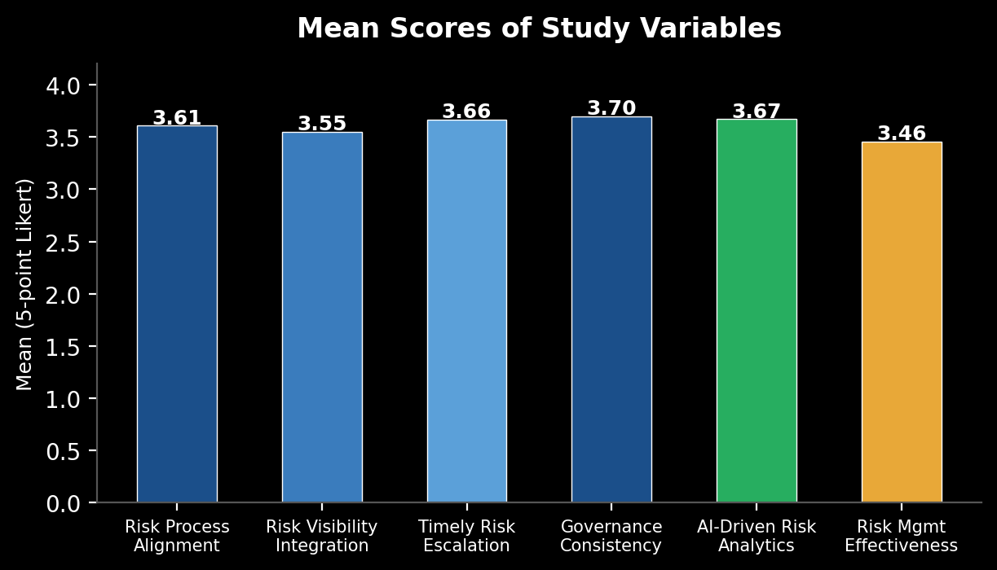
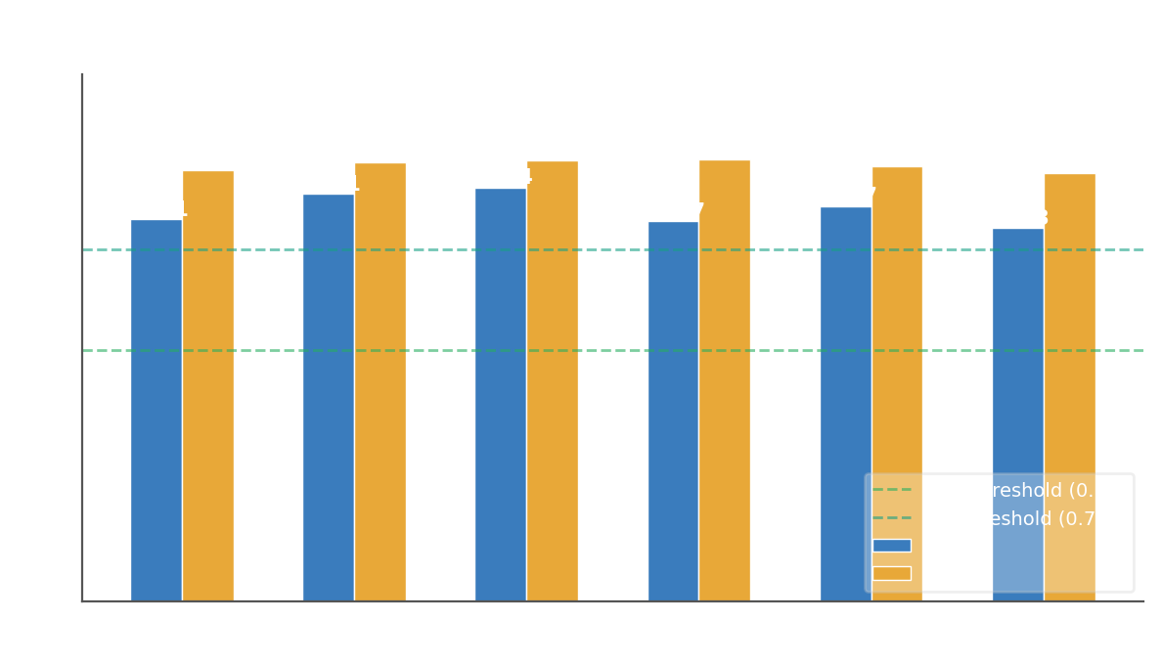
Measurement Model & Validity
Measurement Validation Summary
KMO = 0.927
Excellent sampling adequacy
All AVE > 0.50
Convergent validity confirmed
All CR > 0.70
Internal consistency established
Fornell-Larcker Criterion Met
Discriminant validity verified
Bartlett's Test: p < 0.001
χ² = 7618.445, df = 465
All factor loadings > 0.60
Indicator reliability confirmed
7/14

Slide 8
Hypothesis Results: H1 & H2
H1: Risk Process Alignment → RME
H2: Risk Visibility Integration → RME
✅ SUPPORTED
β = 0.464 | C.R. = 7.346 | p < 0.001
Model Fit:
CMIN/DF = 2.366 | GFI = 0.958 | CFI = 0.976
RMSEA = 0.060
Interpretation:
Moderate-to-strong positive effect. Aligning risk identification, assessment, and monitoring across Agile & Waterfall components significantly enhances coordination and reduces ambiguity.
Process alignment functions as a foundational enabler of effective risk management.
⚠️ SUPPORTED (Marginal Effect)
β = 0.121 | C.R. = 2.116 | p = 0.034
Model Fit:
CMIN/DF = 1.376 | CFI = 0.994
RMSEA = 0.031
Interpretation:
Statistically significant but modest effect. Visibility alone is insufficient — it functions as a supportive mechanism rather than an independent driver.
Without strong governance and interpretive capacity, information availability does not translate into better outcomes.
8/14

Slide 9
Hypothesis Results: H3 & H4
H3: Timely Risk Escalation → RME
H4: Governance Consistency → RME
⚠️ SUPPORTED (Modest Effect)
β = 0.129 | C.R. = 2.283 | p = 0.022
Model Fit:
CMIN/DF = 1.326 | CFI = 0.995
RMSEA = 0.029
Interpretation:
Positive but modest direct effect. In hybrid settings, Agile teams manage risks locally, reducing the need for frequent formal escalation.
Escalation effectiveness depends on appropriateness and quality rather than on speed alone.
✅ SUPPORTED
β = 0.397 | C.R. = 6.869 | p < 0.001
Model Fit:
CMIN/DF = 1.716 | CFI = 0.985
RMSEA = 0.043
Interpretation:
Governance Consistency is the structural backbone that stabilizes risk management across diverse execution approaches.
Uniform application of policies, decision rights, and accountability mechanisms reduces ambiguity and enhances coordination.
9/14

Slide 10
Hypothesis 5 – Key Finding
AI-Driven Risk Analytics Capability → Risk Management Effectiveness
✅ H5 STRONGLY SUPPORTED
Strongest Predictor Among All 5 Variables
β = 0.449 | C.R. = 7.697 | p < 0.001
Model Fit:
CMIN/DF = 1.995 | NFI = 0.965 | CFI = 0.982 | RMSEA = 0.051
Key Insight:
AI-Driven Risk Analytics is one of the STRONGEST predictors of Risk Management Effectiveness among all variables tested.
AI functions as an organizational capability that enhances predictive foresight, anomaly detection, real-time monitoring, and automated risk prioritization.
It complements and amplifies governance structures rather than replacing them.
Strategic Capability Not Just a Tech Tool
Amplifies Governance & Decision Quality
10/14

Slide 11
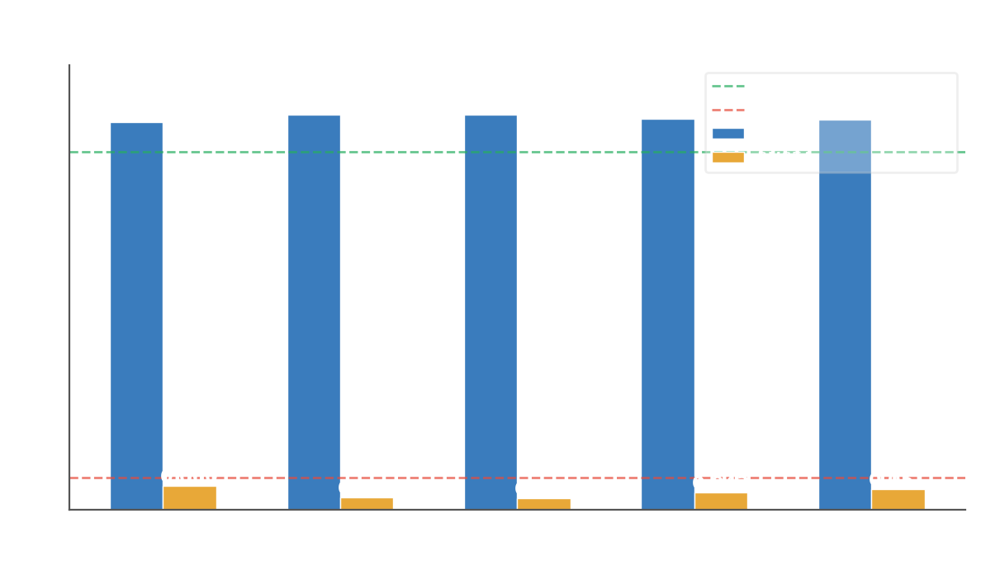
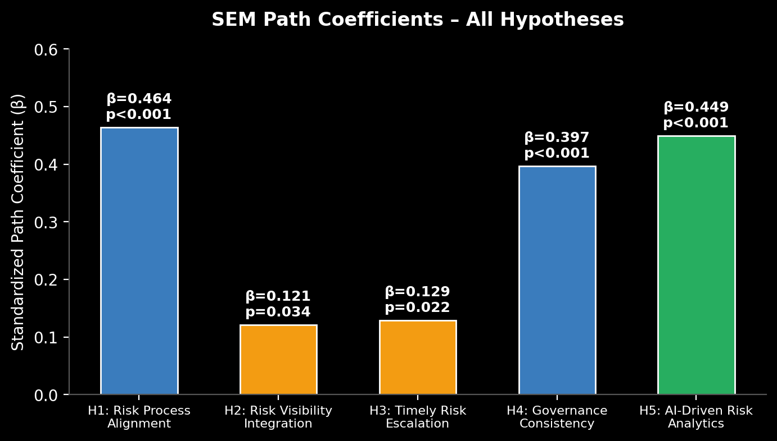
All 5 models exceed fit thresholds ✓ CFI > 0.90 ✓ RMSEA < 0.08 ✓ CMIN/DF < 3.0
Summary of All Hypothesis Results
Outcome Summary
H
Path
β
Result
H1
RPA → RME
0.464
✅ Supported
H2
RVI → RME
0.121
⚠ Marginal
H3
TRE → RME
0.129
⚠ Modest
H4
GC → RME
0.397
✅ Supported
H5
ADRAC → RME
0.449
✅ Supported
Rank: H5 (AI) > H1 (RPA) > H4 (GC) >> H3 > H2
11/14

Slide 12
Discussion & Key Insights
Structural Coherence Drives Effectiveness
AI as a Strategic Organizational Capability
Visibility & Speed Are Necessary but Insufficient
Governance Consistency and Risk Process Alignment are foundational enablers. Risk management effectiveness requires deliberate integration across Agile and Waterfall governance — not parallel or fragmented systems.
AI analytics is not merely a technical tool but an organizational capability that enhances predictive foresight and decision quality. It amplifies governance structures and reduces cognitive limitations in complex environments.
Risk visibility and timely escalation are supportive but not dominant drivers. Without governance clarity and interpretive capacity, information availability alone does not improve risk outcomes. Quality of decisions matters more than speed.
12/14

Slide 13
Theoretical & Practical Implications
Theoretical Contributions
Practical Recommendations
• Positions AI as a structural determinant of risk management effectiveness, not just a peripheral tool
•
• Advances hybrid project management research through integrated SEM-based empirical validation
•
• Bridges governance theory and dynamic capability theory in the hybrid project domain
•
• Demonstrates AI capability as complementary to governance structures, not a replacement for them
• Prioritize harmonizing risk processes across Agile and Waterfall components
•
• Establish consistent governance: clear decision rights, accountability, and escalation pathways
•
• Invest in AI analytics embedded within governance frameworks — not deployed in isolation
•
• Train managers to interpret and act on AI-generated insights for strategic decisions
13/14

Slide 14
Conclusion, Limitations & Future Research
Effective risk management in hybrid projects requires integrated structural alignment, governance stability, and AI-driven analytical intelligence — not isolated practices or technologies.
①
②
③
Governance + Process Alignment
AI as Strategic Enabler
Beyond Visibility & Speed
Structural coherence is the foundation for effective risk governance.
Strongest predictor — enhances foresight and amplifies governance.
Decision quality and governance clarity matter more than information volume.
Limitations
Future Research
• Cross-sectional design limits causal inference
• India-focused sample — may limit generalizability
• Self-reported data — potential response bias
• Longitudinal studies across project phases
• Cross-cultural replication in other regions
• Mediating roles of culture & project complexity
Thank You — Questions & Discussion Welcome
14/14

