Slide 1
Enhancing Risk Management Effectiveness in
Hybrid Projects through AI-Driven
Strategic Governance
A Structural Equation Modelling Study
Based on primary data from 384 project professionals
Methodology: Structural Equation Modelling (SEM) | SPSS & AMOS

Slide 2
Presentation Outline
01
Introduction & Background
02
Research Objectives & Questions
03
Conceptual Framework & Hypotheses
04
Methodology
05
Demographics & Sample Profile
06
Measurement Model & Validity
07
SEM Results (H1 – H5)
08
Discussion & Implications
09
Conclusion & Future Research
2/22

Slide 3
Introduction & Background
The Problem
Traditional risk management relies on static registers,
periodic assessments, and subjective expert judgment.
Hybrid Project Complexity
Agile + Waterfall integration creates fragmented governance,
inconsistent risk documentation, and ambiguous escalation.
The AI Opportunity
AI enables predictive analytics, real-time monitoring,
and data-driven decision support for risk governance.
Most IT projects fail to meet original objectives (Standish Group, 2020)
Traditional methods struggle with dynamic, data-intensive environments
AI: Machine Learning + NLP + Deep Learning enable continuous risk sensing
3/22

Slide 4
Research Objectives & Questions
RO1
Examine the impact of Risk Process Alignment on Risk Management Effectiveness
RO2
Analyze the influence of Risk Visibility Integration on Risk Management Effectiveness
RO3
Assess the effect of Timely Risk Escalation on Risk Management Effectiveness
RO4
Evaluate the role of Governance Consistency in enhancing Risk Management Effectiveness
RO5
Examine the impact of AI-Driven Risk Analytics Capability on Risk Management Effectiveness
4/22

Slide 5
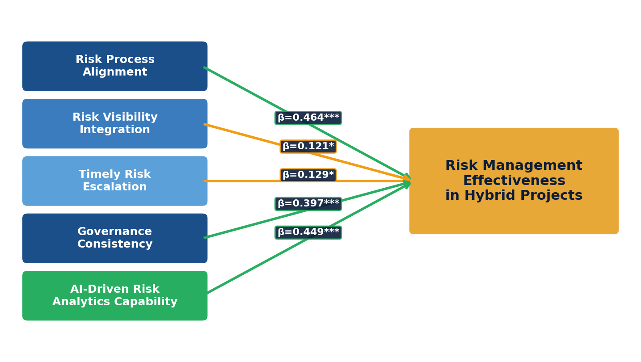
Conceptual Framework
Integrated Model of AI-Driven Strategic Risk Management
5/22

Slide 6
Research Hypotheses
H1
Risk Process Alignment has a significant positive impact on Risk Management Effectiveness in Hybrid Project Environments.
H2
Risk Visibility Integration has a significant positive impact on Risk Management Effectiveness in Hybrid Project Environments.
H3
Timely Risk Escalation has a significant positive impact on Risk Management Effectiveness in Hybrid Project Environments.
H4
Governance Consistency has a significant positive impact on Risk Management Effectiveness in Hybrid Project Environments.
H5
AI-Driven Risk Analytics Capability has a significant positive impact on Risk Management Effectiveness in Hybrid Project Environments.
6/22

Slide 7
Research Methodology
Research Design
Sample Size
Data Collection
Analysis Tools
Quantitative, cross-sectional survey design
384 project professionals across industries
Structured questionnaire (5-point Likert)
SPSS + AMOS for CFA and SEM analysis
Statistical Techniques Applied
• Confirmatory Factor Analysis (CFA) for measurement model validation
• Structural Equation Modelling (SEM) for hypothesis testing
• Cronbach's Alpha, AVE, and Composite Reliability for construct validity
• KMO and Bartlett's Test for sampling adequacy (KMO = 0.927)
• Discriminant Validity via Fornell-Larcker Criterion
7/22

Slide 8
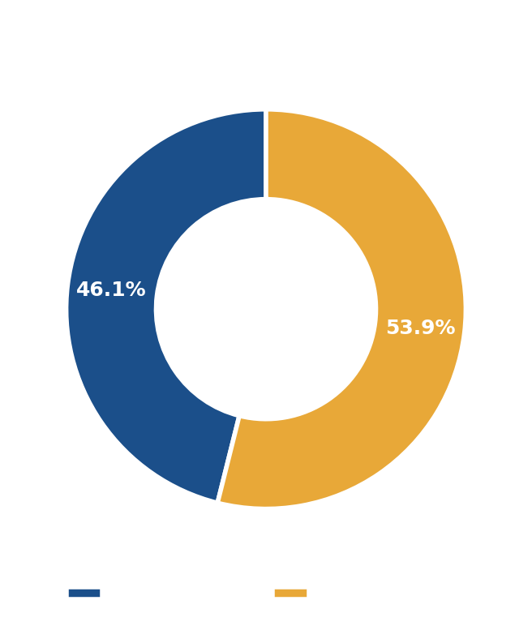
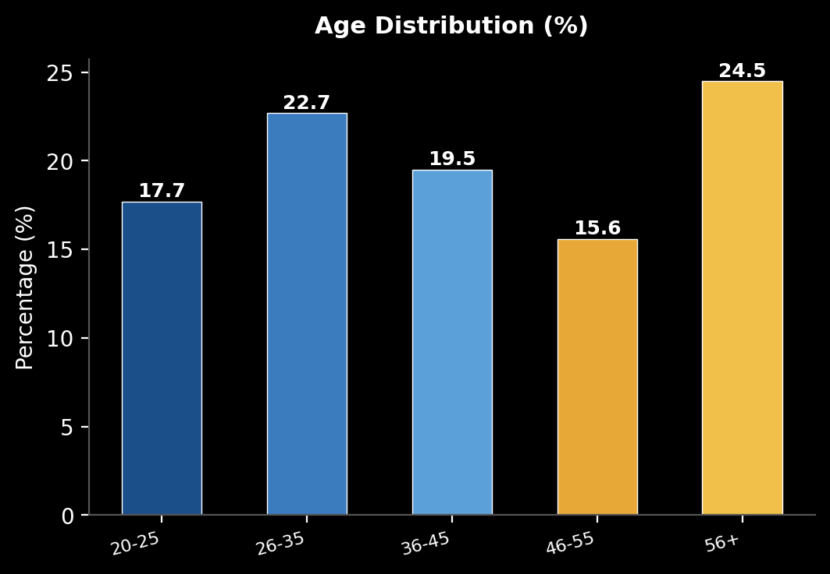
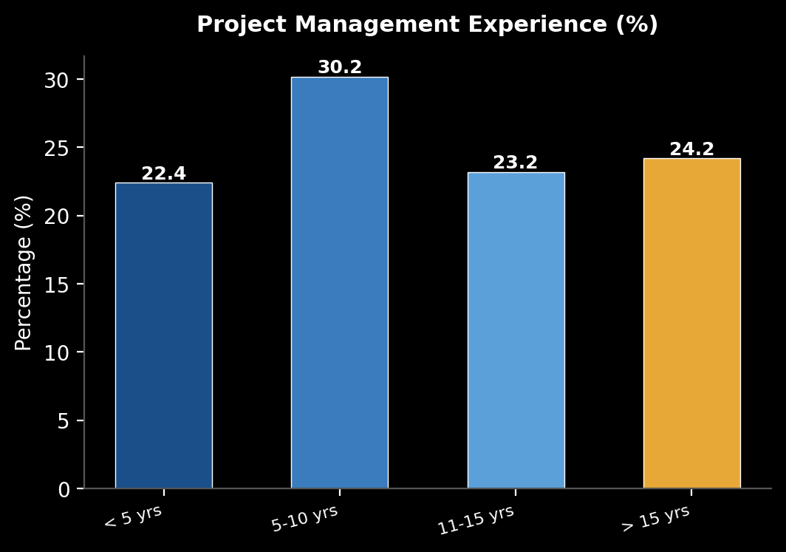
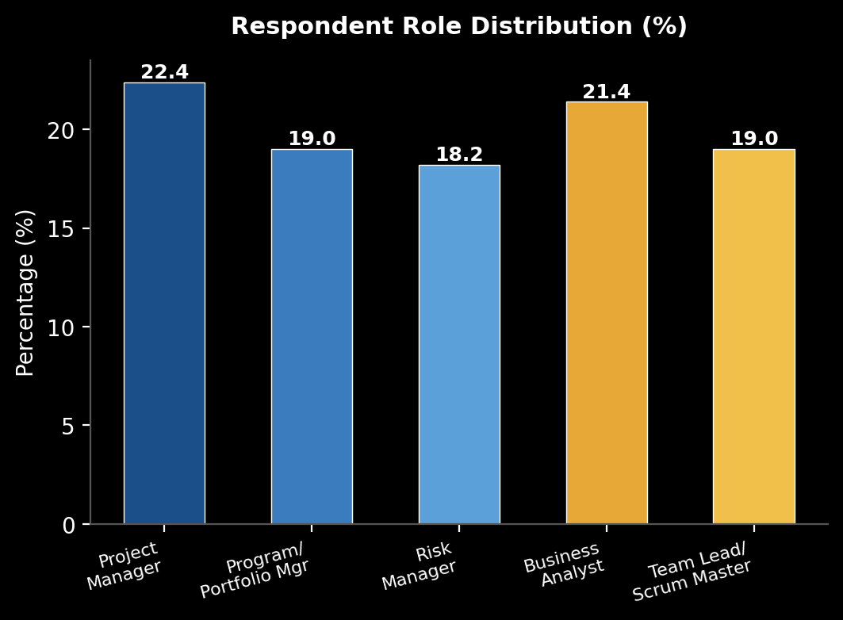
Sample Demographics
N = 384 Project Professionals
77%+ have over 5 years experience
53.9% Female 46.1% Male
27.6% Hold Professional Certifications
Balanced role distribution
8/22

Slide 9
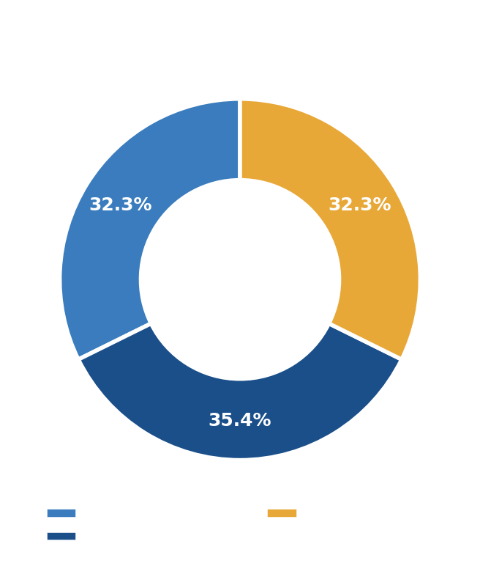
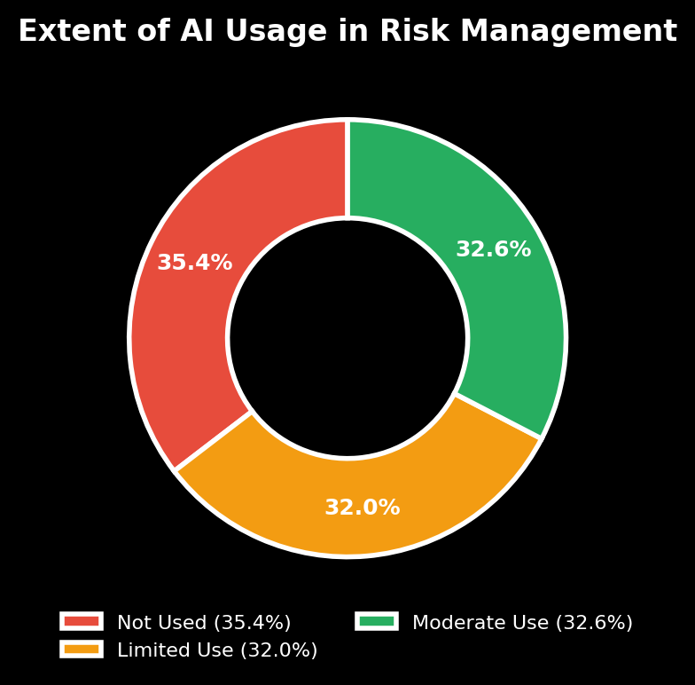
Methodology & AI Adoption Profile
Even distribution across methodologies ensures balanced insights | AI adoption is progressing but not yet universal
9/22

Slide 10
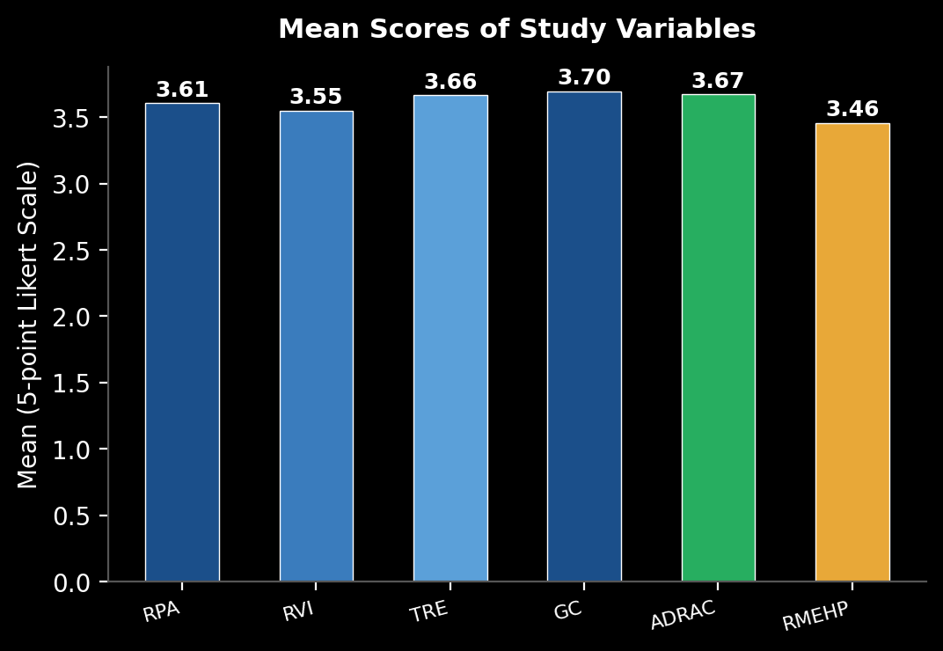
Descriptive Statistics
Mean Scores on 5-point Likert Scale
Key Observations
Governance Consistency and AI-Driven Risk Analytics score highest (3.70, 3.67)
Risk Management Effectiveness has the lowest mean (3.46), suggesting uneven translation of practices into outcomes
All skewness values within ±2 and kurtosis within ±3 → data is suitable for SEM
All constructs show moderately high agreement
10/22

Slide 11
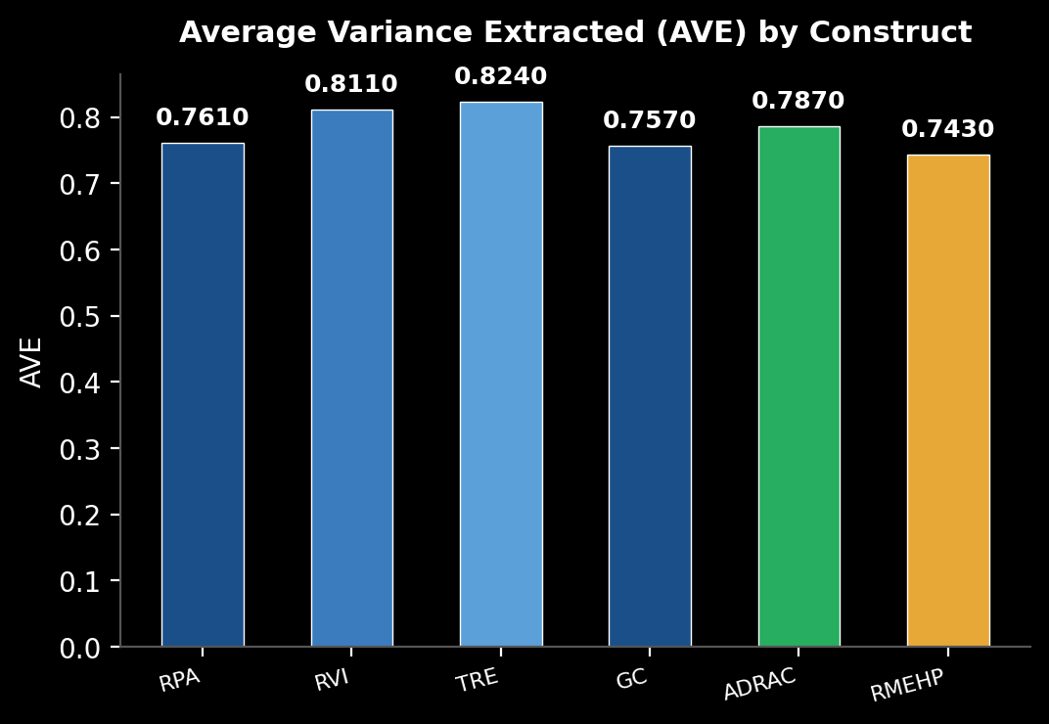
Measurement Model & Validity
Convergent Validity
Construct
AVE
CR
Risk Process Alignment
0.761
0.858
Risk Visibility Integration
0.811
0.873
Timely Risk Escalation
0.824
0.877
Governance Consistency
0.757
0.880
AI-Driven Risk Analytics
0.787
0.866
Risk Mgmt Effectiveness
0.743
0.852
KMO = 0.927 (Excellent Sampling Adequacy) Bartlett's Test: χ² = 7618.445, p < 0.001
All AVE > 0.5 and CR > 0.7 confirm convergent validity
11/22

Slide 12
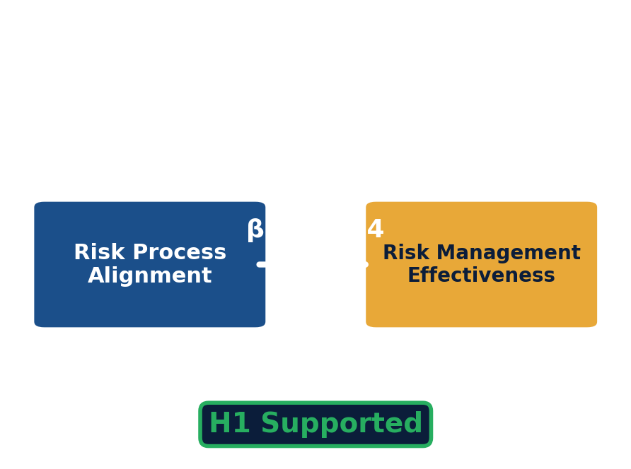
Hypothesis 1 – Result
Risk Process Alignment → Risk Management Effectiveness
Result: H1 Supported
β = 0.464 | C.R. = 7.346 | p < 0.001
Model Fit:
CMIN/DF = 2.366 | GFI = 0.958
CFI = 0.976 | RMSEA = 0.060
Interpretation:
Risk Process Alignment shows a moderate and meaningful positive relationship with RME.
When risk processes are aligned across Agile & Waterfall, organizations experience improved coordination and reduced ambiguity.
12/22

Slide 13
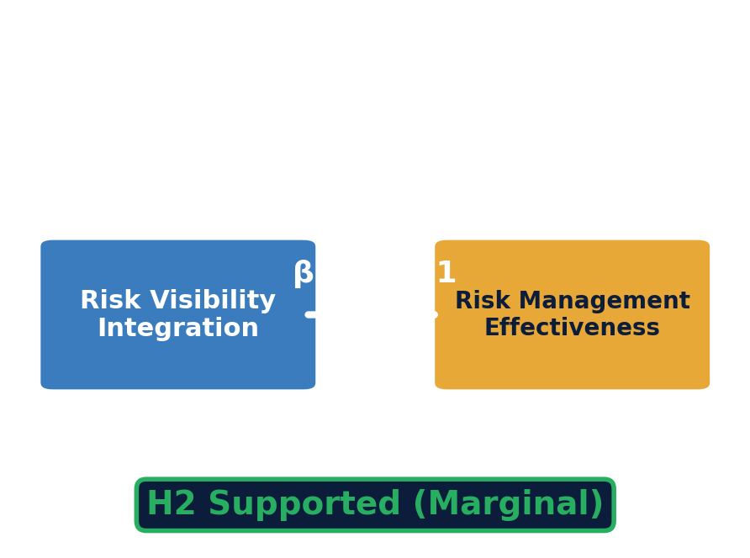
Hypothesis 2 – Result
Risk Visibility Integration → Risk Management Effectiveness
Result: H2 Supported (Marginal Effect)
β = 0.121 | C.R. = 2.116 | p = 0.034
Model Fit:
CMIN/DF = 1.376 | CFI = 0.994
RMSEA = 0.031
Interpretation:
While statistically significant, the effect size is modest.
Risk visibility alone is insufficient — it functions as a supportive mechanism rather than a dominant driver when governance structures are weak.
13/22

Slide 14
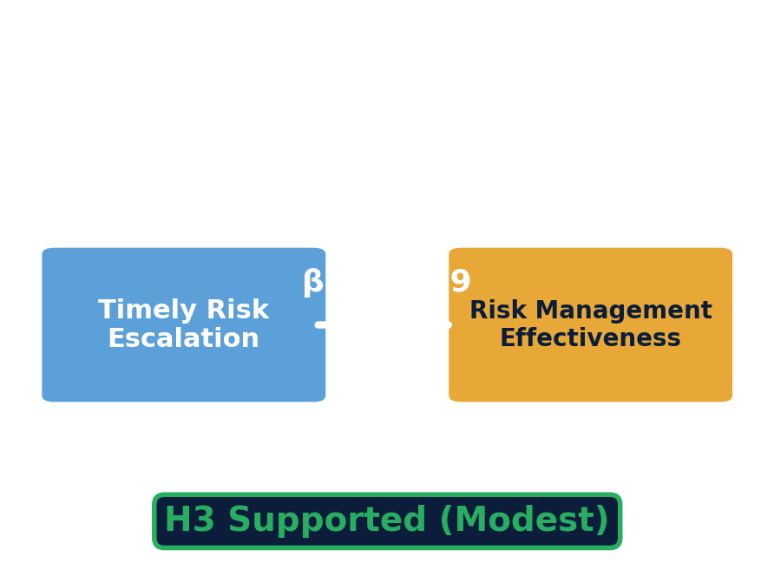
Hypothesis 3 – Result
Timely Risk Escalation → Risk Management Effectiveness
Result: H3 Supported (Modest Effect)
β = 0.129 | C.R. = 2.283 | p = 0.022
Model Fit:
CMIN/DF = 1.326 | CFI = 0.995
RMSEA = 0.029
Interpretation:
Statistically significant but modest direct effect.
Agile teams manage risks locally, reducing the need for frequent formal escalation. Effectiveness depends on appropriateness, not speed.
14/22

Slide 15

Hypothesis 4 – Result
Governance Consistency → Risk Management Effectiveness
Result: H4 Supported
β = 0.397 | C.R. = 6.869 | p < 0.001
Model Fit:
CMIN/DF = 1.716 | CFI = 0.985
RMSEA = 0.043
Interpretation:
Governance Consistency is a structural backbone that stabilizes risk management across diverse execution approaches.
Uniform governance reduces ambiguity in authority, accountability, and decision-making in hybrid settings.
15/22

Slide 16
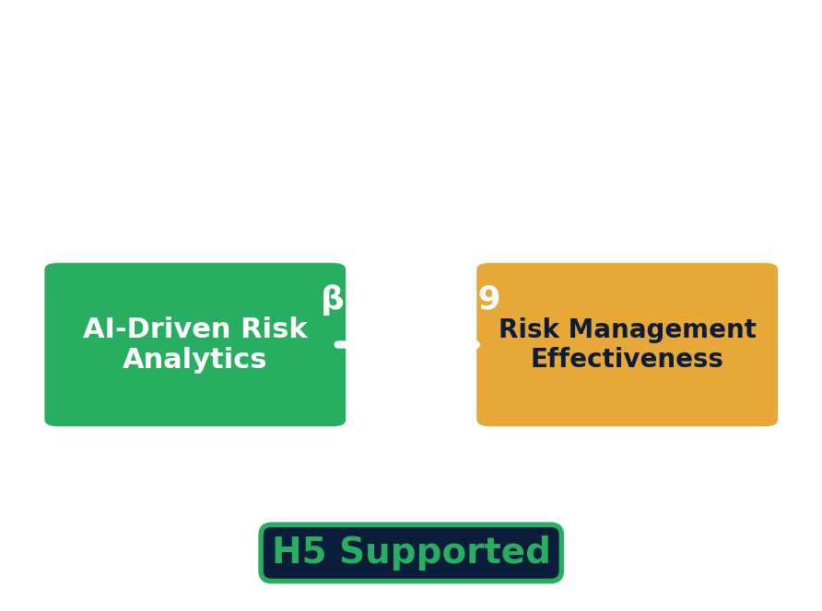
Hypothesis 5 – Result
AI-Driven Risk Analytics Capability → Risk Management Effectiveness
Result: H5 Supported
β = 0.449 | C.R. = 7.697 | p < 0.001
Model Fit:
CMIN/DF = 1.995 | CFI = 0.982
RMSEA = 0.051
Interpretation:
AI-Driven Risk Analytics is one of the STRONGEST predictors of RME.
AI enhances predictive foresight, anomaly detection, real-time monitoring, and automated risk prioritization in hybrid environments.
16/22

Slide 17
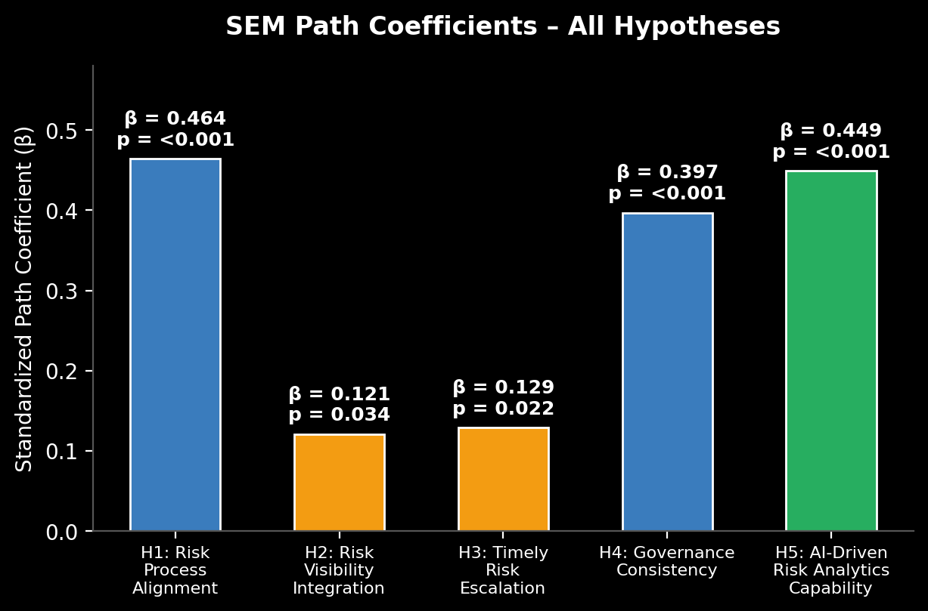
Summary of Hypothesis Testing Results
Hypothesis Outcomes
H1
RPA → RME
β=0.464
Supported
H2
RVI → RME
β=0.121
Marginal
H3
TRE → RME
β=0.129
Modest
H4
GC → RME
β=0.397
Supported
H5
ADRAC → RME
β=0.449
Supported
Strongest: H5 (AI) > H1 (RPA) > H4 (GC)
17/22

Slide 18
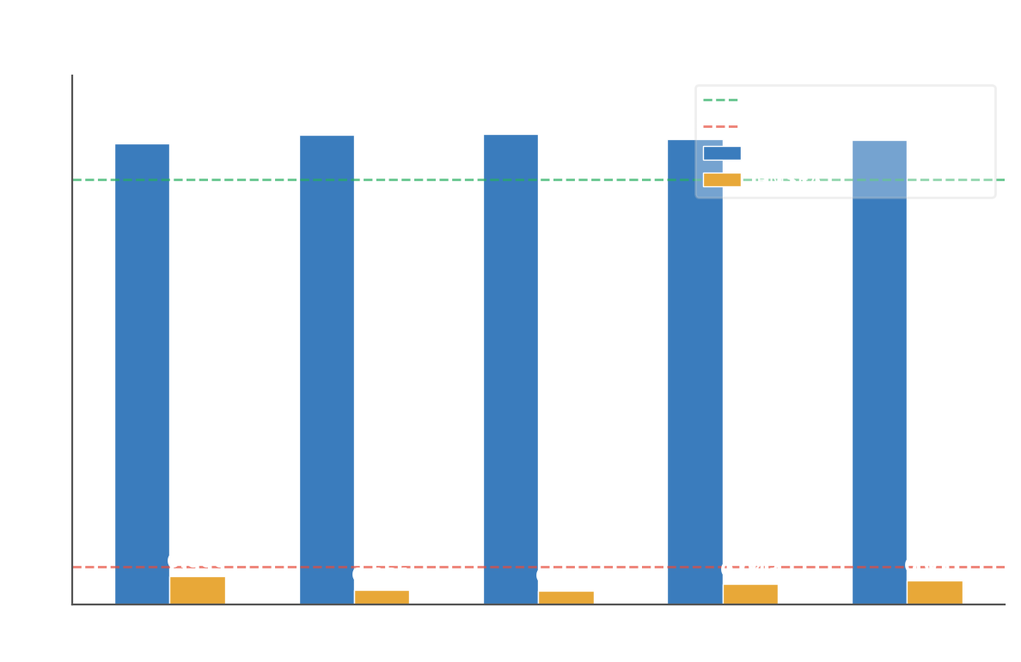
Model Fit Indices
All models demonstrate good-to-excellent fit
Acceptance Criteria
✓ CMIN/DF < 3.00
✓ GFI ≥ 0.90
✓ NFI ≥ 0.90
✓ CFI ≥ 0.90
✓ IFI ≥ 0.90
✓ RMSEA ≤ 0.08
✓ RMR ≤ 0.05
All models meet or exceed all thresholds
18/22

Slide 19
Discussion & Key Insights
Structural Coherence Matters Most
AI as Strategic Capability
Visibility & Speed Are Insufficient Alone
Governance Consistency and Risk Process Alignment are foundational. Effective risk management requires deliberate integration across Agile and Waterfall governance systems.
AI analytics is not merely a technical tool but an organizational capability that enhances predictive foresight and decision quality. It complements and amplifies governance structures.
Risk visibility and timely escalation are supportive but not dominant drivers. Without strong governance and interpretive capacity, information availability does not improve outcomes.
19/22

Slide 20
Theoretical & Practical Implications
Theoretical Contributions
Practical Recommendations
• Extends project risk management theory by positioning AI as a structural determinant, not just a tool
• Advances hybrid project management research through SEM-based empirical validation
• Bridges governance theory and dynamic capability theory in hybrid project domain
• Demonstrates AI capability as complementary to governance, not a replacement
• Prioritize harmonizing risk processes across Agile and Waterfall components
• Establish consistent governance standards: accountability, decision rights, and escalation pathways
• Invest in AI analytics embedded within governance frameworks, not standalone
• Train managers to interpret and act on AI-generated insights for strategic decisions
20/22

Slide 21
Conclusion
Effective risk management in hybrid projects requires integrated structural alignment, governance stability, and AI-driven analytical intelligence — not isolated practices.
1
2
3
Governance + Process Alignment
AI as Strategic Enabler
Beyond Visibility & Speed
Structural coherence is the foundation — consistent governance and aligned risk processes drive effectiveness.
AI capability is one of the strongest predictors — it enhances predictive foresight and amplifies governance.
Organizations must focus on decision quality and governance clarity, not just information availability.
21/22

Slide 22
Limitations & Future Research
Limitations
Future Research Directions
• Cross-sectional design limits causal inference
• Sample drawn from India may limit generalizability
• Self-reported perceptions may introduce response bias
• Focuses on direct relationships only (no mediation/moderation)
• Longitudinal studies across project phases
• Cross-cultural replication in different regions
• Explore mediating roles of organizational culture and project complexity
• Examine AI interaction with specific Agile practices (sprints, retrospectives)
Thank You
Questions & Discussion Welcome
22/22

