Slide 1

Hemanth Krishna Software Engineer Intern at Blue Yonder – Product Development Graduate Student at The University of Texas at Dallas Ex-Software Engineer at Amagi

Slide 2





Technologies Used at Blue Yonder
HTML
CSS
JavaScript
ReactJS
Redux Toolkit
MaterialUI
TanStack
Java

Slide 3
Cognitive Assortment
The Cognitive Assortment Solution is a sophisticated, visually driven, and user-friendly platform designed to create consumer-centric product assortments.
It offers extensive configurability to meet diverse business needs while ensuring seamless interoperability across cross-functional workflows.
This solution empowers businesses to optimize their assortments effectively, enhancing decision-making and aligning with consumer preferences.

Slide 4
Add Products Dialog in Cognitive Assortment
I have developed the Add Products Dialog as part of the Cognitive Assortment feature. This dialog is activated when the user clicks the "Add Products" button. Below is a detailed breakdown of the dialog's structure and functionality:
Dialog Activation & Transition:
Upon clicking the "Add Products" button, the dialog is displayed with a smooth transition effect.
The dialog features a header that includes a close icon. Clicking the close icon will exit the dialog.
Toolbar & Method Selection:
The dialog includes a dynamic toolbar where users can choose from three distinct methods for adding products:
Add Products from History
Add Products from Assortment
Add Products from Catalog
Each method presents unique input fields and user interfaces based on the selected option.
After entering the necessary inputs and clicking the "Show Products" button, the available products are fetched from the Backend API and displayed in the "Available Products" section.

Slide 5
Add Products Dialog in Cognitive Assortment continue…
Main Dialog Body Structure:
The main body of the dialog is divided into three key sections:
Vertical Filter
This section allows users to filter the available products based on various criteria like Attributes or type of products, ensuring they can quickly find the products they need.
Available Products
Displays all the products retrieved from the Backend API. Users can browse through the entire list of available products in this section.
Selected Products
Here, users can drag and drop the products they wish to add to the assortment. This section provides an intuitive way for users to build their desired product assortment.
Dialog Footer:
This section consists of a “cancel” button and an “Add To Line” button allowing users to either cancel adding the products to the assortment or add the products to the assortment which are in selected products.

Slide 6
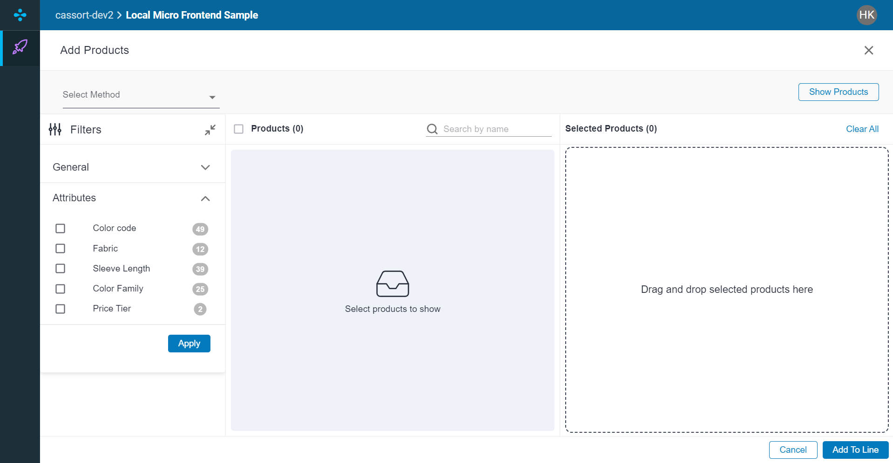

Slide 7
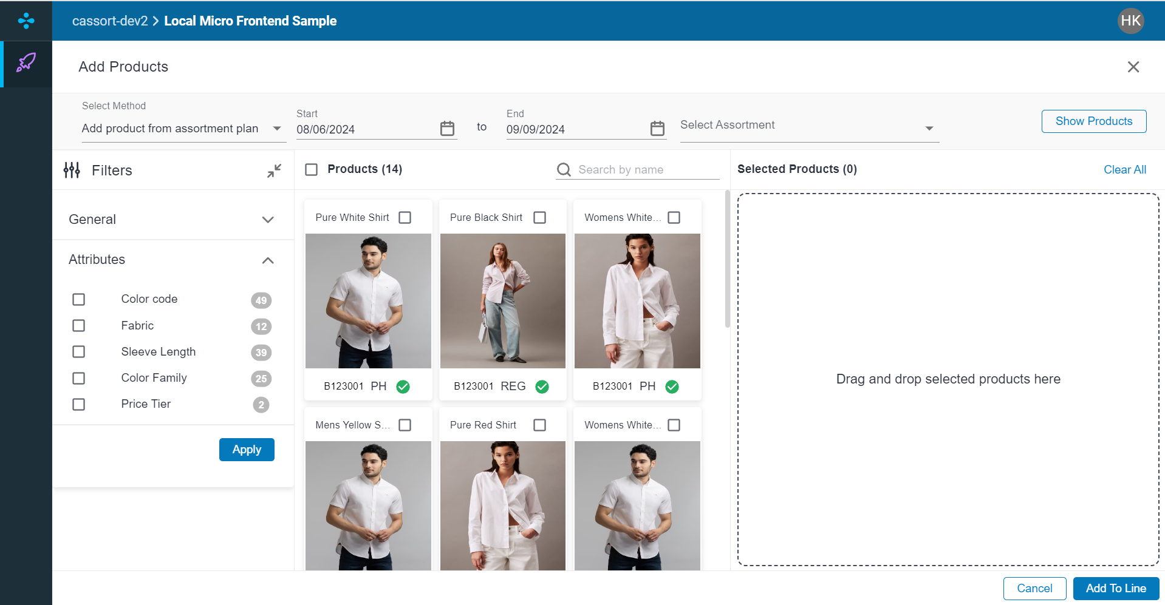

Slide 8
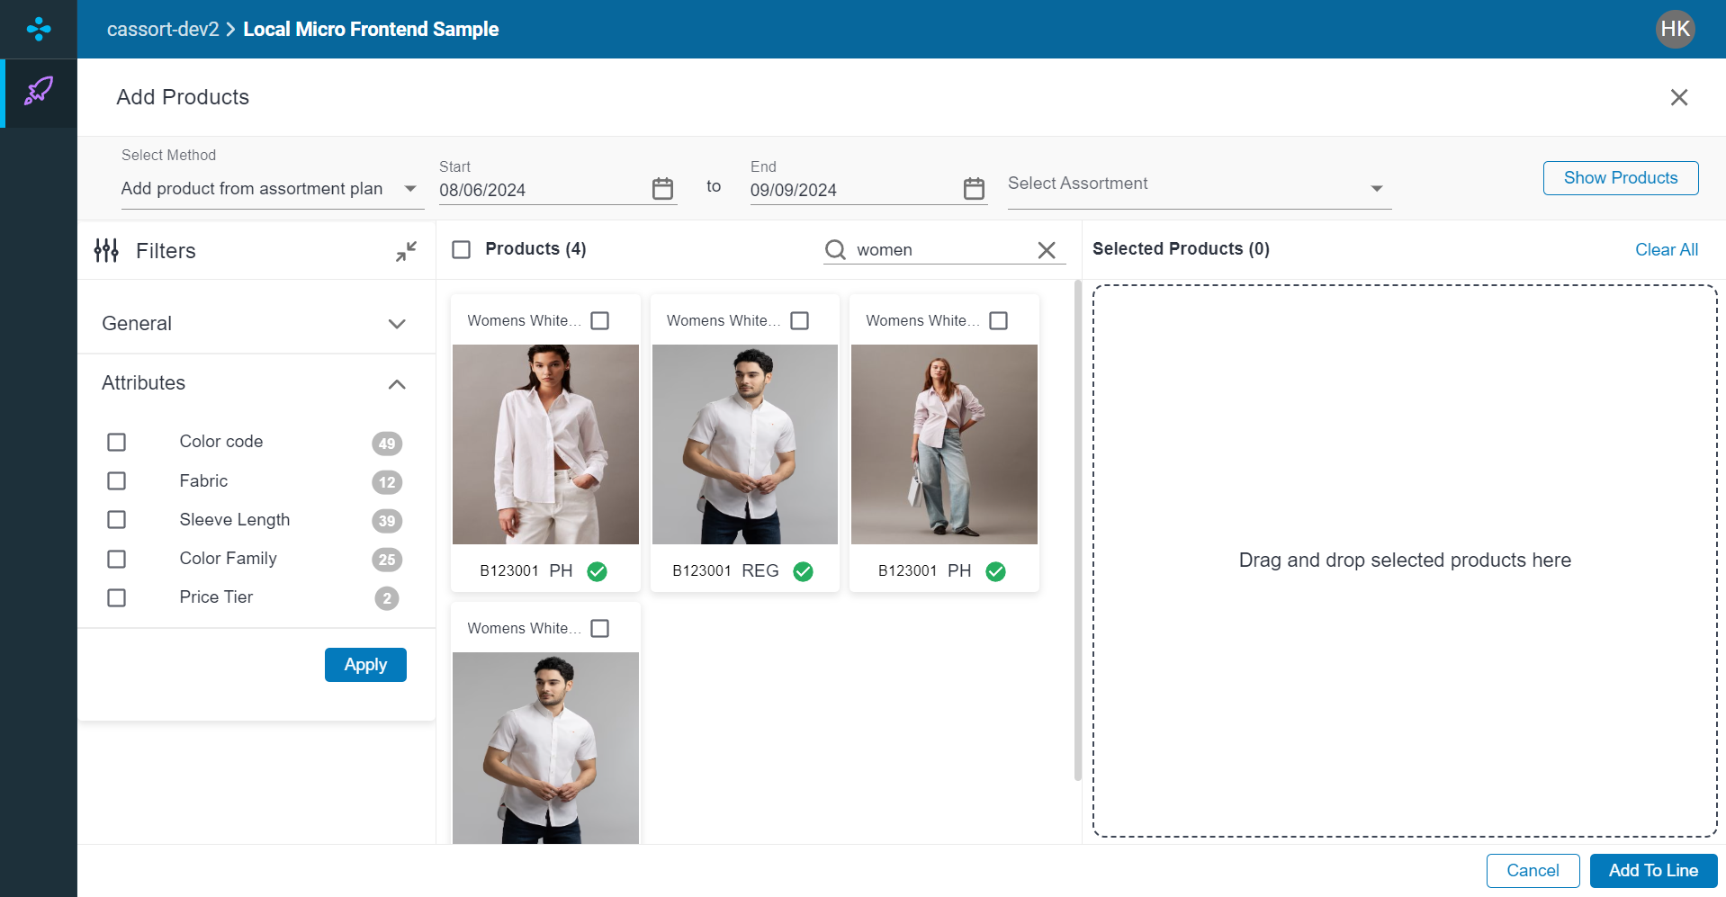

Slide 9
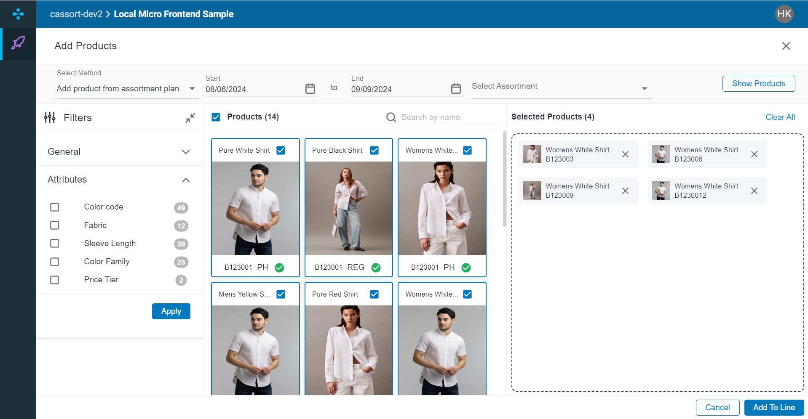

Slide 10
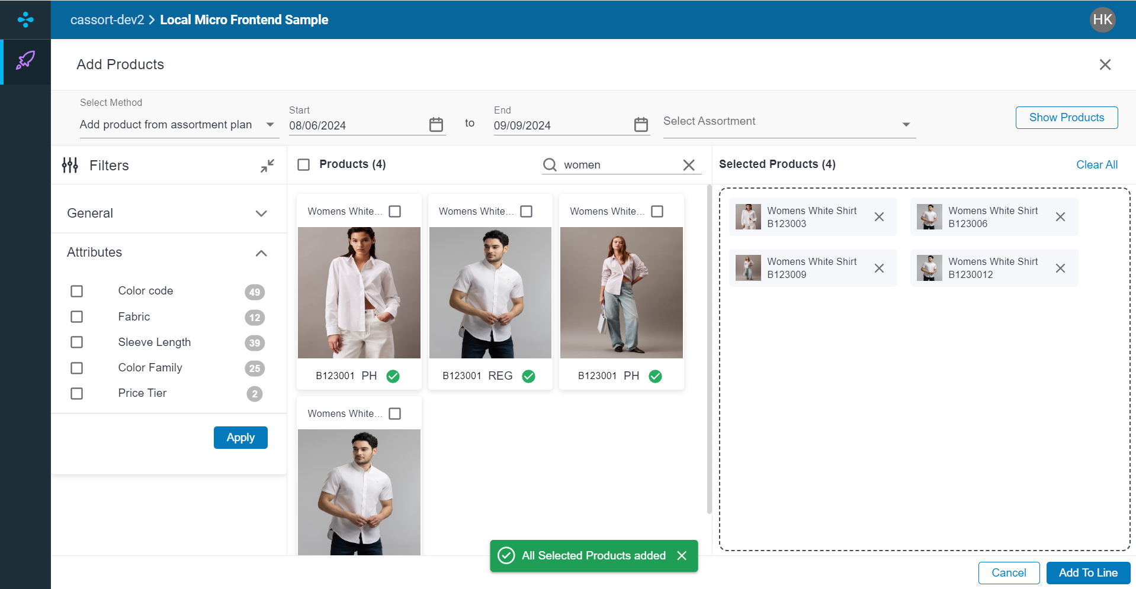

Slide 11
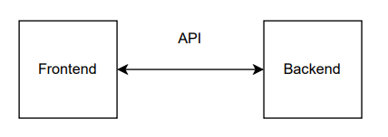
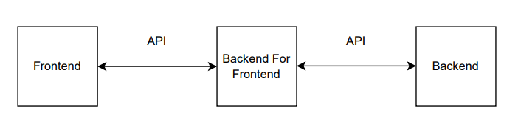
Difference between UI directly calling the Backend API vs UI calling the BFF which in turn calls the Backend API

Slide 12
Let’s try to understand the workflow of BFF with Add Products from Catalog API that I have implemented
User Interaction:
The process begins when the user selects "Add Products from Catalog" and clicks on the "Show Products" button.
API Calls via Custom Hooks:
Upon clicking the button, the UI triggers specific API calls using custom hooks implemented with TanStack Query, specifically useSelectFromCatalogAPI.
This custom hook is responsible for managing data submission, handling errors, and efficiently managing the API call lifecycle.
Handling Query Success:
Once the API query is successful, the workflow shifts to the Redux Toolkit. An action is dispatched with a payload, which, in this case, is an object containing the number of weeks.
This action communicates with the Backend for Frontend (BFF) service.

Slide 13
Let’s try to understand the workflow of BFF with Add Products from Catalog API that I have implemented continue…
Backend for Frontend (BFF) Processing:
Instead of directly interacting with the backend API, the UI communicates with the BFF.
The BFF takes the incoming request body, modifies necessary parameters such as query parameters (e.g., limit, offset), and restructures the request body to meet the backend API’s requirements.
The BFF then forwards the adjusted request to the actual backend API.
Backend API Interaction:
The backend API processes the request and sends a response back to the BFF.
The BFF returns this response to the Micro Frontend (MFE) component.

Slide 14
Let’s try to understand the workflow of BFF with Add Products from Catalog API that I have implemented continue…
State Management and UI Update:
Upon receiving the JSON response without errors, the Redux store's state is updated accordingly.
Specifically, the item details are updated with 14 products, which are then rendered on the UI as per the updated state.
Final UI Rendering:
The UI reflects the new state, displaying the updated list of products to the user, thereby completing the workflow.

Slide 15
Total Components Developed
PLAN-CASSORT-MFE
PLAN-CASSORT-BFF
AvailableProductsInfo
AvailableProducts
ProductsAddBody
RegisteredProducts
SelectHistoryMethod
SelectAssortmentMethod
SelectCatalogMethod
SelectHistoryMethod
ProductsAddHeader
ProductsAddHeader
styledComponents
AddProductsDroppedProduct
getProductsFromCatalogController
getProductsFromHistoryController
All components are developed in strict accordance with Blue Yonder standards, ensuring that the codebase is fully scalable and readily adaptable to accommodate future expansion and evolving requirements.

Slide 16
Learnings:
UI/UX Design Integration:
Developed a dynamic and user-friendly "Add Products Dialog" with smooth transitions, enhancing the overall user experience.
Backend Integration:
Gained experience in integrating frontend components with Backend APIs to fetch and display data based on user inputs.
Dynamic Component Management:
Successfully implemented a flexible dialog with multiple product addition methods, showcasing the ability to manage different UI components dynamically.
End-to-End Feature Development:
Learned the process of taking a feature from conceptualization through to implementation, including UI design, backend interaction, and final integration into the larger application.

Slide 17




To everyone at Blue Yonder: It's always an adventure around here because of you!. I thank you so much for making things interesting! Special thanks to the below for playing an important role in my journey at Blue Yonder.
Mr. Prakash Acharya
Ms. Bethany LeClair
Mr. Ravi Sajja
Mr. Rameshbabu
Pallapati

