Slide 1
Major Project Phase - 2 Review - 1
Federated Learning For Privacy Protected Cyber Threat Detection Across Distributed Systems.
Harsha Jain H J : 4AD22CI017
Hemanth Kumar C S : 4AD22CI018
Mohith D L : 4AD22CI030
Shreyash Umrao : 4AD22CI049
Under the guidance of
Prof Khateeja Ambareen
Assistant Professor
Dept. of CSE-AI & ML
ATMECE, Mysuru

Slide 2
Contents
Introduction (overview)
Existing System
Problem Statement
Literature survey
Objectives
Proposed system
System requirements and specification
Implementation
Results
References

Slide 3
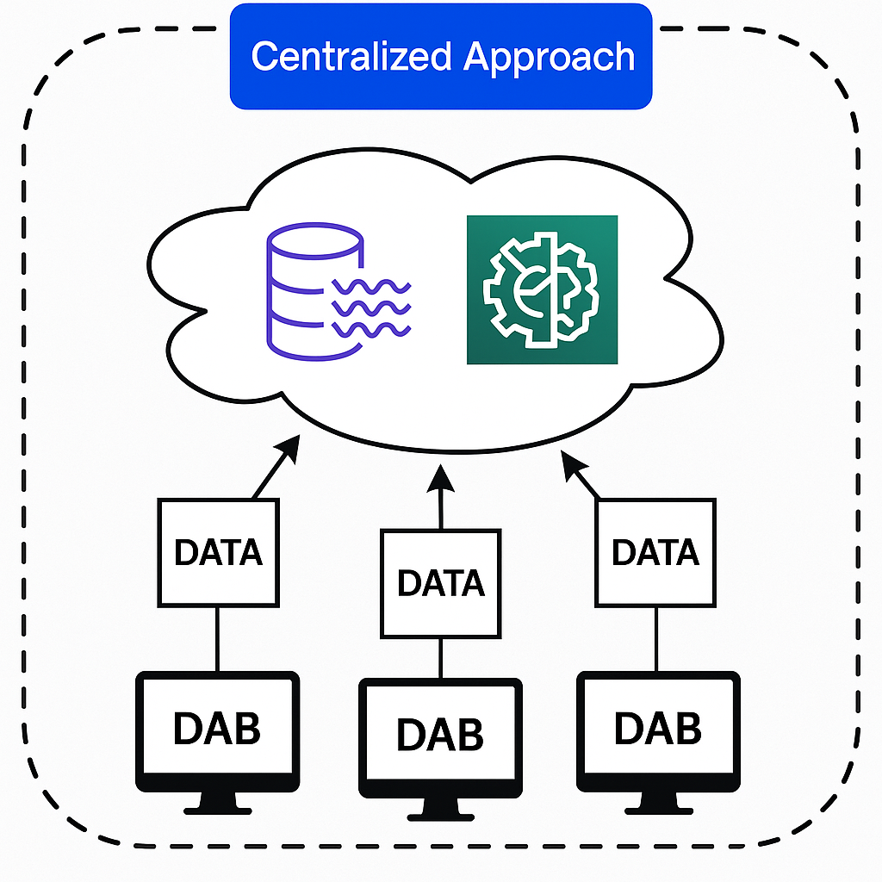
Introduction
What are DDoS Attacks?
Distributed Denial of Service attacks are among the most dangerous types of network-based attacks
Overwhelming target systems with traffic
Multiple compromised computer systems
Renders services unavailable to legitimate users
Traditional Detection Models
Centralized machine learning approaches:
Data collected and processed at a central location
Single model trained on aggregated network data
Requires raw data transmission across network
Limitations-
High privacy risks
Increased latency
Scaling difficulties
Communication overhead
Fig 1. a centralized approach to cyber threat detection

Slide 4
Problem Statement
Federated learning for privacy protected cyber threat detection across distributed systems.
DDoS attacks pose ongoing threats to the security and stability of distributed systems. Traditional centralized detection methods struggle with issues related to privacy, scalability, and resilience. While Federated Learning offers a decentralized approach, existing FL-based DDoS detection systems often lack lightweight and high-performance architectures like CNNs, making them less suitable for distributed environments. Additionally, they remain highly susceptible to data poisoning attacks, where malicious clients compromise model integrity by feeding in corrupted data.

Slide 5
Literature Survey
[1] Federated Learning for Decentralized DDoS Attack Detection in IoT Networks
Alhasawi, Y., & Alghamdi, S. (2024). Federated Learning for Decentralized DDoS
Attack Detection in IoT Networks. IEEE Access, 12, Article 3378727.
This paper addresses the growing threat of (DDoS) attacks in Internet of Things (IoT) networks by proposing a decentralized detection framework based on Federated Learning.
It Proposes a decentralized FL framework to detect DDoS attacks in IoT without sharing raw data.
Uses CNNs trained locally on IoT devices with the CICIDS2017 dataset to maintain data privacy.
Applies homomorphic encryption and differential privacy for secure model updates.
Achieves 98.72% accuracy, with low communication overhead and strong scalability.
Tackles challenges of non-IID data and device heterogeneity while ensuring consistent performance.

Slide 6
[2] An Efficient Federated Learning System for Network Intrusion Detection
Li, J., Tong, X., Liu, J., & Cheng, L. (2023). An Efficient Federated Learning System for Network Intrusion Detection. IEEE Systems Journal, 17(2), 2455–2464.
This paper introduces a dynamic weighted aggregation federated learning (DAFL) system aimed at enhancing network intrusion detection while preserving data privacy across distributed environments.
Proposes DAFL, a Federated Learning system with dynamic filtering and adaptive weighting of local models.
Enhances intrusion detection by prioritizing reliable updates for global model aggregation.
Achieves high detection accuracy with reduced communication overhead.
Ensures data privacy in distributed environments without compromising performance.
Proven to be scalable and practical for real-world cybersecurity applications through experimental validation.

Slide 7
[3] Federated Deep Learning for Cyber Security in the Internet of Things: Concepts, Applications, and Experimental Analysis
Ferrag, M. A., Friha, O., Maglaras, L., Janicke, H., & Shu, L. (2021). Federated Deep Learning for Cyber Security in the Internet of Things: Concepts, Applications, and Experimental Analysis. IEEE Access, 9, 138509–138542.
This study explores the integration of Federated Deep Learning techniques into Internet of Things (IoT) environments to enhance cybersecurity while preserving data privacy.
Introduces Federated Deep Learning to secure IoT networks while preserving data privacy.
Enables collaborative learning on local IoT data using RNN, CNN, and DNN models.
Shows superior performance over traditional centralized ML in detecting cyber threats.
Explores integration with blockchain and intrusion/malware detection systems.
Demonstrates strong potential for privacy-aware, scalable, and adaptive IoT security.

Slide 8
[4] DDoS Attack Detection Based on CNN and Federated Learning Xia, L., Liu, Y., & Duan, C. (2022).
DDoS Attack Detection Based on CNN and Federated Learning. Procedia Computer Science, 199, 470–477.
This paper presents a novel approach to Distributed Denial-of-Service (DDoS) attack detection by integrating Convolutional Neural Networks (CNN) with Federated Learning (FL) to enhance detection accuracy while preserving data privacy.
Proposes a CNN-based model integrated with Federated Learning to detect DDoS attacks.
Eliminates centralized data sharing, ensuring privacy-preserving detection.
Uses the CICDDoS2019 dataset to validate the model’s effectiveness.
Achieves high accuracy, low communication overhead, and strong system adaptability.
Demonstrates a scalable and secure solution for modern network infrastructures.

Slide 9
[5] Recent Advances on Federated Learning for Cybersecurity and Cybersecurity for Federated Learning for Internet of Things
Ghimire, B. and Rawat, D.B., 2022 .Recent Advances on Federated Learning for Cybersecurity and Cybersecurity for Federated Learning for Internet of Things. IEEE Internet of Things Journal, 10(10), 8617–8637.
This comprehensive survey delves into the dual role of Federated Learning (FL) in enhancing cybersecurity and being secured itself within Internet of Things (IoT) environments.
A comprehensive survey on using Federated Learning (FL) both to enhance cybersecurity and secure FL systems in IoT.
Covers FL applications in malware detection, anomaly detection, and intrusion prevention.
Identifies FL vulnerabilities like poisoning and inference attacks, and proposes defense mechanisms (e.g., secure aggregation, differential privacy, adversarial training).
Provides a threat taxonomy and explores challenges like data heterogeneity, communication efficiency, and device trust.
Acts as a research roadmap for building secure, scalable FL-based IoT cybersecurity systems.

Slide 10
Objectives
From the conduction of the literature survey, we have defined the following core objectives:
1.To implement a CNN-based Federated Learning Model for DDoS Detection
Based on: Xia et al. (2022), Alhasawi& Alghamdi (2024) - To design and evaluate a lightweight CNN model in a Federated Learning environment using the CICDDoS2019 dataset for binary and multi-class DDoS detection.
2. To Detect and Mitigate Data Poisoning in Federated DDoS Detection
Based on: Ferrag et al. (2021), Elhoseny et al. (2023), Xia et al. (2022) - To simulate a basic data poisoning attack scenario in a Federated Learning setup for DDoS detection and implement a basic outlier detection or validation mechanism to reduce its impact on the global model
3. To Build a Privacy-Preserving DDoS Detection Model Using Federated Learning
Based on: Alhasawi & Alghamdi (2024), Mothukuri et al. (2021) To implement a Federated Learning-based DDoS detection model that ensures data privacy by training locally on each client node without sharing raw data, and compare its performance to a centralized model.

Slide 11
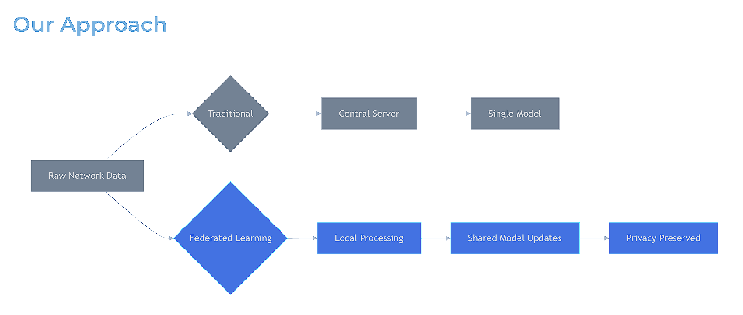
Proposed system
A Decentralized FL framework for detecting DDoS attacks in distributed systems using Docker/Kubernetes-based node simulation.
Each node will train a local CNN model on its own traffic data, only model weights will be shared, ensuring data privacy.
Federated Averaging (FedAvg) + Multi-krum will be used to update the global model collaboratively without raw data exchange.
Enables scalable, privacy-preserving DDoS detection with realistic simulations, no physical IoT devices required.
Fig 2. CL v/s FL

Slide 12
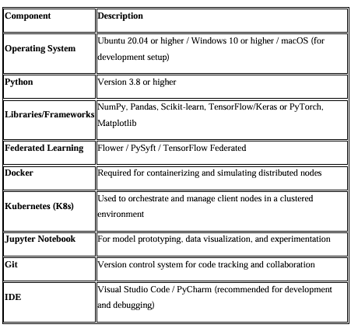
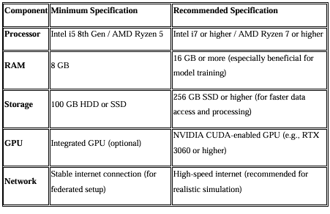
System Requirements
1. Software Requirements
2. Hardware Requirements

Slide 13
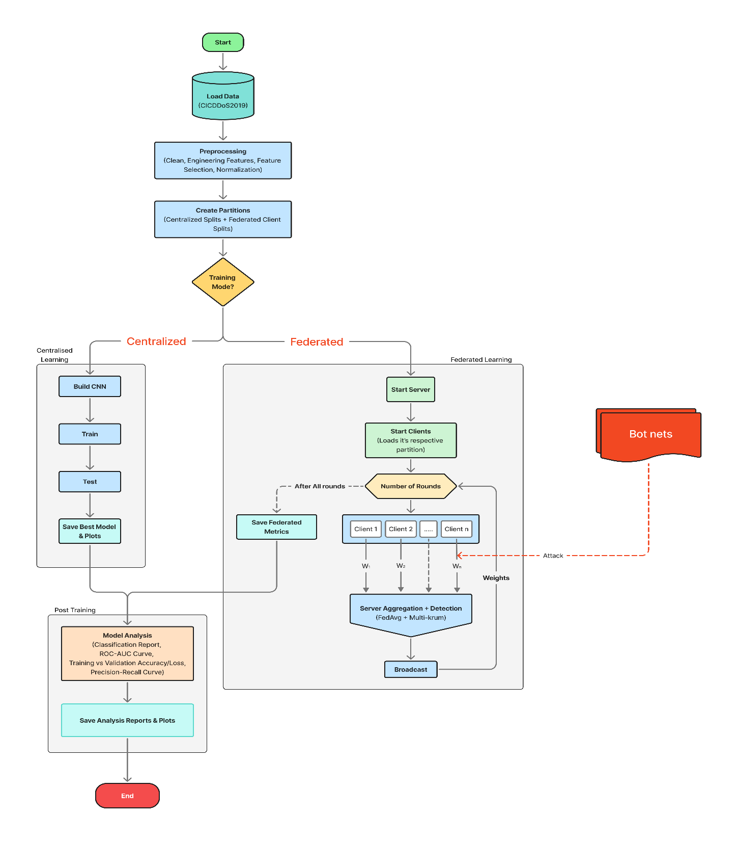
Implementation
Model architecture

Slide 14
Dataset overview:
Source: CICDDOS2019 – [Canadian Institute of Cybersecurity (CIC)]
Original Samples: 50,006,249 [file size: 23.9GB]
Features: 88 network flow features.
Classes: 11 different attack types [format: CSV]
Original dataset (23.9GB)
Sampled Dataset (2.24gb – 50K records
Reduced features (88 → 30 +2 features)
Balanced Dataset (25k benign + 25k attack
Training-ready Dataset
Sample Selection: DrDoS_DNS, SYN flood attacks, TFTP attacks, UDP lag attacks.

Slide 15
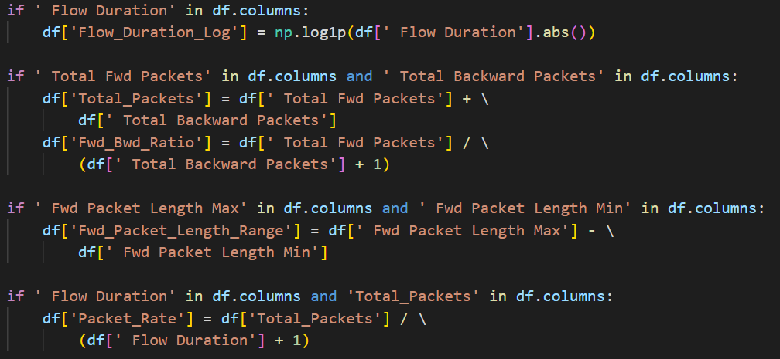
Cleaning and Feature engineering
Dropped fully empty rows,
Dropped infinities,
Dropped duplicate rows,
Dropped non-numerical rows.
Feature Engineering:
Flow duration values can be very large and skewed, log transformations reduces the variance.
DDoS has highly skewed traffic
i.e more fwd than bwd packets,
The ratios capture this imbalance.
Measures variablilty in fwd packet size, attack traffic is uniform, but normal traffic has more variation.
Packet rate is used to measure how many packets per unit of time.

Slide 16
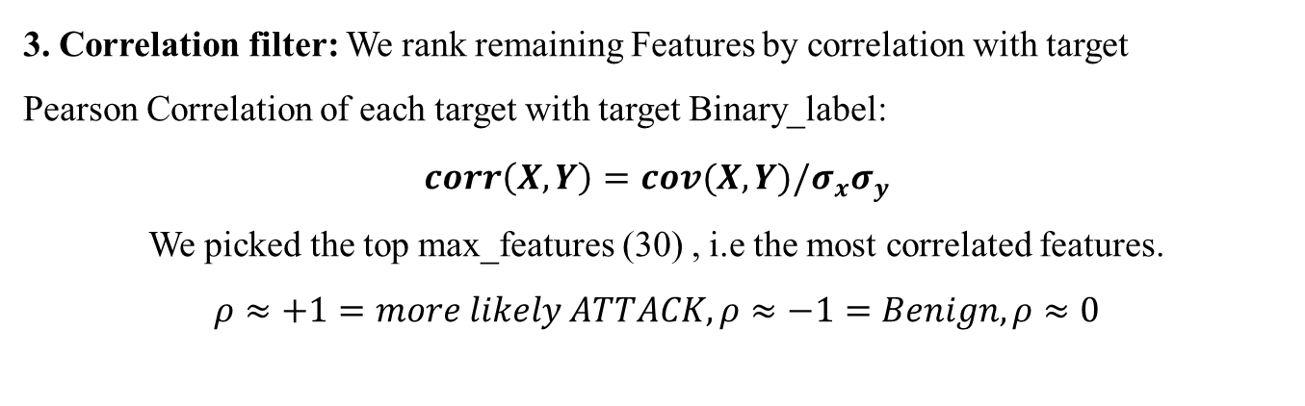
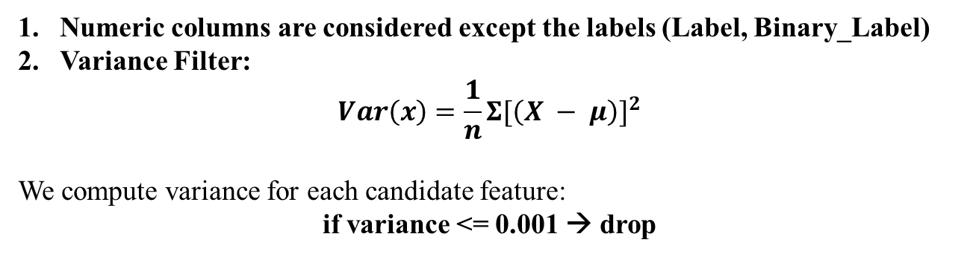
Feature Selection
Numeric columns are considered except the labels (Label, Binary_Label)
Variance Filter:
$$Var\left(x\right)=\frac{1}{n}Σ{[\left(X − μ\right)]}^{2}$$
We compute variance for each candidate feature:
if variance <= 0.001 → drop
Low variance = feature does not change across samples (almost constant)
Such features wont help the model separate normal v/s attack traffic hence we drop it.
3. Correlation filter: We rank remaining Features by correlation with target
Pearson Correlation of each target with target Binary_label:
$$corr\left(X,Y\right)=cov(X,Y)/σ_{x}σ_{y}$$
We picked the top max_features (30) , i.e the most correlated features.
$$ρ≈+1=more likely ATTACK,ρ≈−1=Benign,ρ≈0$$
4. Reattaching labels: We add back the labels(Label, Binary_Label) and save the features.

Slide 17
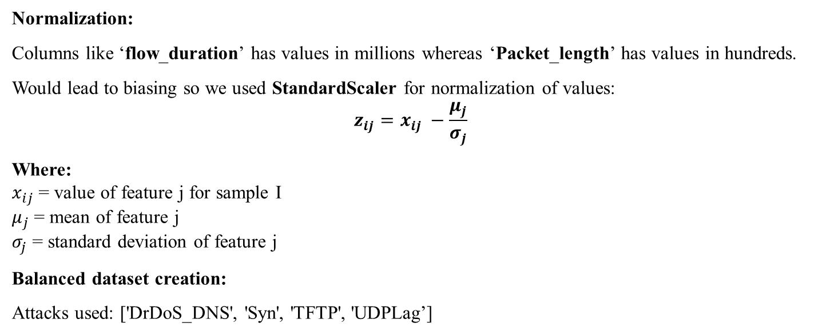
Normalization And Balanced Dataset Creation
Normalization:
Columns like ‘flow_duration’ has values in millions whereas ‘Packet_length’ has values in hundreds.
Would lead to biasing so we used StandardScaler for normalization of values:
$$z_{ij}=x_{ij} −\frac{μ_{j}}{σ_{j}}$$
Where:
$x_{ij}$= value of feature j for sample I
$μ_{j}$= mean of feature j
$σ_{j}$ = standard deviation of feature j
Balanced dataset creation:
Attacks used: ['DrDoS_DNS', 'Syn', 'TFTP', 'UDPLag’]
Each attack | 6250 rows
Total attack rows | 25000
Benign Rows | 25000
Dataset | 25k+25k = ~50k
Target features | 30
Number of clients | 4
Client 0 | 12500 samples
Client 1 | 12500 samples
Client 2 | 12500 samples
Client 3 | 12500 samples
Test set | 10000 samples

Slide 18
Benign Collection
First the benign data is spread across multiple files hence,
Chunks of 10,000 rows consider to avoid memory issues,
in each chunk → columns are stripped of whitespace
in rows → Label = ‘Benign’
We collect until there are 5000 rows per file or till 25,000 target is hit.
New column → Binary_label = 0
Result = ~25,000 benign rows collected from different sources.
Attack Sampling
First, we remove accidental benign rows
if rows > 6250 then we randomly select 6250 with random_state = 42
New column → Binary_label = 1
Result = ~25,000 attack rows total.
Combining:
Concatenate Benign + Attack Dataframes

Slide 19
Sequential Model:
Input data: csv(CICDDoS2019 dataset)
Each Row: one network flow.
Example: Row 1 → [f1, f2, f3, ..., fN] → Label = Attack/Benign
. .
. .
We are using CNN for DDoS detection as they are very good at detecting local patterns in a row of features
Since we have 30 + 2 = 32 features, original row: shape = (30, )
CNN input: shape = (30, 1) here 1 defines our 1D CNN
A Kernel Size of 3 is considered.
[f1,f2,f3] → o1=v1… output row = [v1,v2,v3,v4….vn]

Slide 20
Layers | Output Shape | Parameters
Conv1D | (28,64) | 256
Batch normalization | (28,64) | 256
Activation | (28,64) | 0
Conv1D_1 | (26,128) | 24704
Batch Normalization_1 | (26,128) | 512
Activation_1 | (26,128) | 0
Max Pooling1D | (13,128) | 0
Conv1D_2 | (11,256) | 98560
Batch Normalization_2 | (11,256) | 1024
Activation_2 | (11,256) | 0
Global Average Pooling1D | (256) | 0
Dropout | (256) | 0
Dense | (128) | 32896
Batch Normalization_3 | (128) | 512
Activation_3 | (128) | 0
Dropout_1 | (128) | 0
Dense_1 | (1) | 129
Total parameters: 158
Trainable parameters: 157,697
Non-Trainable parameters: 1,152

Slide 21
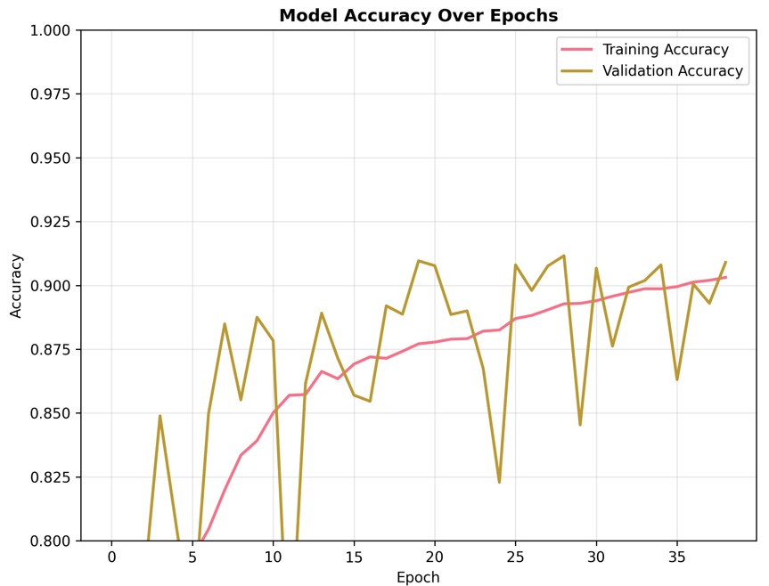
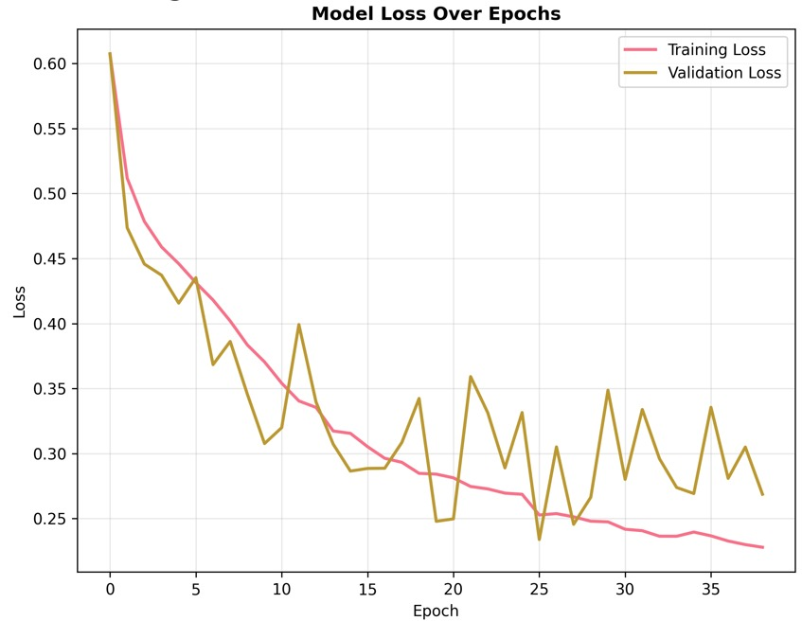
Results:

Slide 22
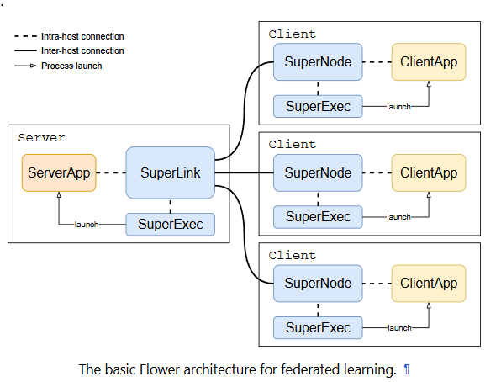
Global server- Aggregation
The Flower Server coordinates with the training rounds and aggregates client updates using Fed-Avg with Multi-Krum for data-poisoning prevention.
Flower architecture
Source: flower framework

Slide 23
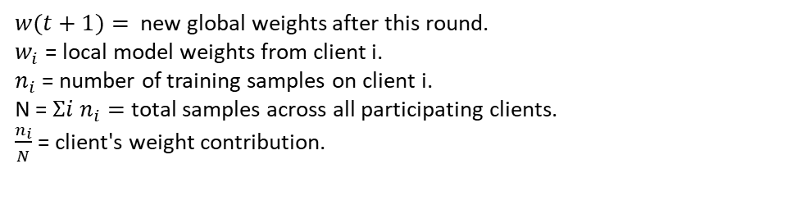
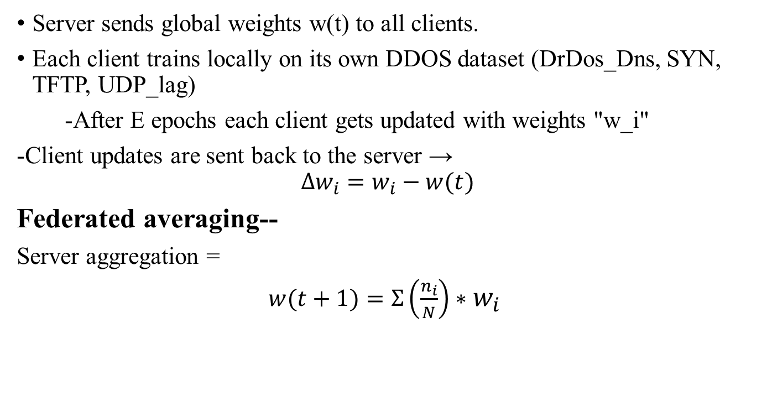
Aggregation – FedAvg and Multi-Krum
Server sends global weights w(t) to all clients.
Each client trains locally on its own DDOS dataset (DrDos_Dns, SYN, TFTP, UDP_lag)
-After E epochs each client gets updated with weights "w_i"
-Client updates are sent back to the server →
$$Δw_{i}=w_{i}−w(t)$$
Federated averaging--
Server aggregation =
$w(t+1)=Σ\left(\frac{n_{i}}{N}\right)∗$ $w_{i}$
$w(t+1)=$new global weights after this round.
$w_{i}$= local model weights from client i.
$n_{i}$= number of training samples on client i.
N = $Σi n_{i}=$ total samples across all participating clients.
$\frac{n_{i}}{N}$= client's weight contribution.

Slide 24
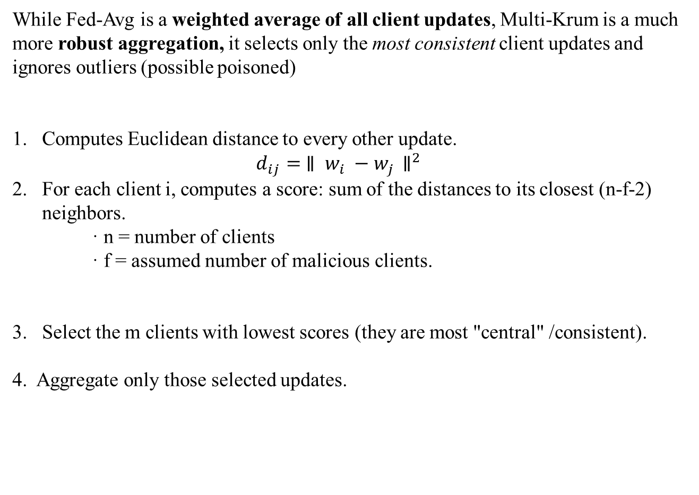
Multi-Krum
While Fed-Avg is a weighted average of all client updates, Multi-Krum is a much more robust aggregation, it selects only the most consistent client updates and ignores outliers (possible poisoned)
Computes Euclidean distance to every other update.
$d_{ij}= {∥ w_{i} −w_{j }∥}^{2}$
For each client i, computes a score: sum of the distances to its closest (n-f-2) neighbors.
· n = number of clients
· f = assumed number of malicious clients.
Select the m clients with lowest scores (they are most "central" /consistent).
4. Aggregate only those selected updates.

Slide 25
Work to be done:
1.Integrate the pre-trained federated learning model into victim containers for real-time DDoS detection.
2.Run attacker and victim containers across multiple machines to simulate a decentralized network.
3.Test simultaneous multi-vector attacks on the same or multiple victims.
4.Automate traffic logging and feature extraction for analysis.
5.Create a dashboard to monitor attacks, CPU/memory usage, and detection results.

Slide 26
References
1. Alhasawi, Y. and Alghamdi, S., 2024. Federated learning for decentralized DDoS attack detection
in IoT networks. IEEE Access, 12, pp.42357-42368. DOI: 10.1109/ACCESS.2024.3378727
2. Li, J., Tong, X., Liu, J. and Cheng, L., 2023. An efficient federated learning system for network
intrusion detection. IEEE Systems Journal, 17(2), pp.2455-2464. DOI: 10.1109/JSYST.2023.3236995
3. Ferrag, M.A., Friha, O., Maglaras, L., Janicke, H. and Shu, L., 2021. Federated deep learning for
cyber security in the internet of things: Concepts, applications, and experimental analysis. IEEe
Access, 9, pp.138509-138542. DOI: 10.1109/ACCESS.2021.3118642
4. Lv, D., Cheng, X., Zhang, J., Zhang, W., Zhao, W. and Xu, H., 2022, March. Ddos attack detection
based on cnn and federated learning. In 2021 Ninth International Conference on Advanced Cloud and Big Data (CBD) (pp. 236-241). IEEE. DOI: 10.1109/CBD54617.2021.00048
5. Ghimire, B. and Rawat, D.B., 2022. Recent advances on federated learning for cybersecurity and
cybersecurity for federated learning for internet of things. IEEE Internet of Things Journal, 9(11),
pp.8229-8249. DOI: 10.1109/JIOT.2022.3150363

Slide 27
Thank You

