Slide 1
Fourier Descriptors
in Deformable Curves
Computer Vision — Advanced Seminar for Ph.D. Scholars
Fourier Transforms
Shape Descriptors
Wavelet Analysis
Active Contours
Level Sets
Comparative Study
From Fundamentals to Cutting-Edge Applications

Slide 2
Seminar Roadmap
1
Signals & Fourier Transform Fundamentals
2
Discrete Fourier Transform (DFT) & Complex Representation
3
Fourier Descriptors for 2D Shape Analysis
4
Wavelet Descriptors & Multi-Resolution Analysis
5
Deformable Curves: Active Contours & Snakes
6
Level Set Methods for Implicit Curve Evolution
7
Comparative Analysis: FD vs AC vs LS vs Wavelets
8
Real-World Applications & Research Frontiers

Slide 3
Part 1: Fourier Transform — The Foundation
Section 1.1 — What is a Signal?
🎵 Sound Wave
Core Insight: Fourier's Claim
Pressure variation over time — each note is a pure frequency sine wave
"Any periodic signal can be expressed as a sum of sines and cosines of different frequencies."
📷 Image Row
f(t) = a₀/2 + Σ [aₙcos(nωt) + bₙsin(nωt)]
Where:
aₙ = (2/T)∫f(t)cos(nωt)dt
bₙ = (2/T)∫f(t)sin(nωt)dt
Pixel intensities along a scan line — spatial frequency encodes edges & texture
📐 Shape Boundary
x(t), y(t) coordinates along a curve — periodic, closed contour
Fourier Transform decomposes complexity into simple oscillations.

Slide 4
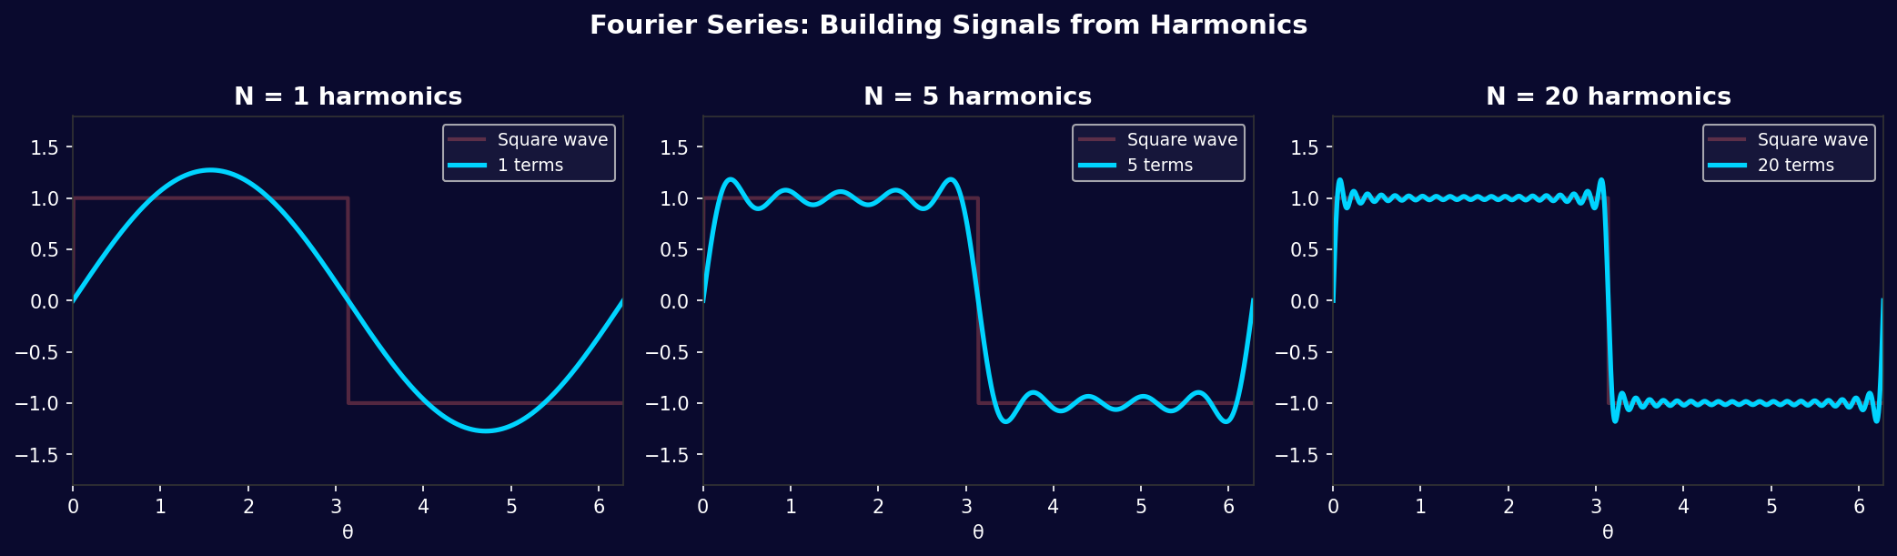
Fourier Series: Adding Harmonics
N=1: Fundamental
N=5: Adding Harmonics
N=20: Convergence
Only the base frequency — a sine wave. Rough approximation.
Higher-order terms sharpen edges. Signal gets closer to square.
Many harmonics → nearly perfect. Gibbs phenomenon near jumps.

Slide 5
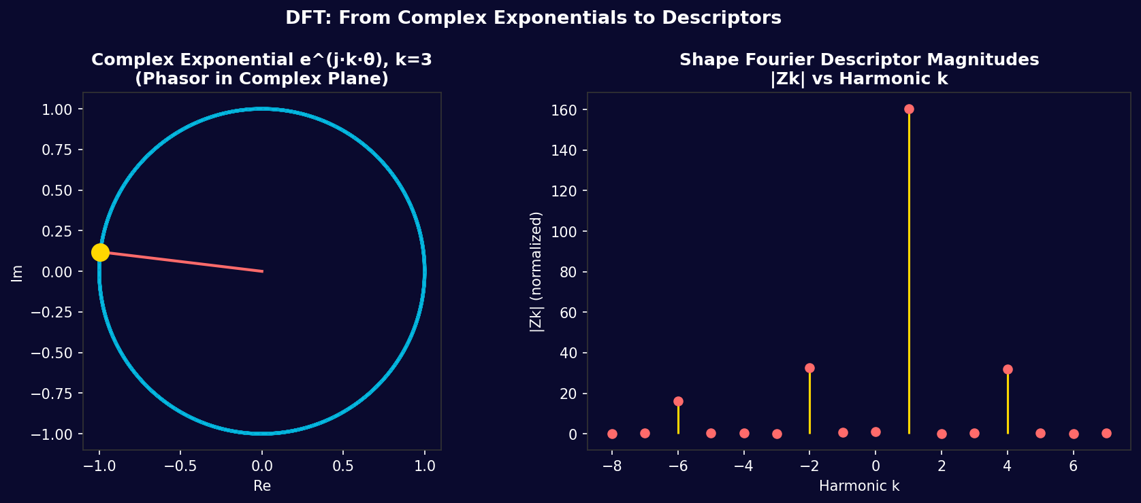
Part 2: Discrete Fourier Transform (DFT)
DFT Formula
Phasor & Spectrum Visualization
Forward DFT:
Z[k] = Σₙ z[n] · e^(−j2πkn/N)
Inverse DFT:
z[n] = (1/N) Σₖ Z[k] · e^(+j2πkn/N)
k = frequency index (0 to N−1)
n = sample index (time/space)
N = total number of samples
Z[k] = complex Fourier coefficient
e^(−j2πk/N) = N-th root of unity (phasor)

Slide 6
Part 3: Fourier Descriptors for Shape Analysis
Encoding a 2D shape boundary as a frequency signature
STEP 1
STEP 2
STEP 3
STEP 4
Sample Boundary
Complex Encoding
Apply DFT
Normalize
Extract N evenly-spaced boundary points: (x₀,y₀)...(xₙ₋₁,yₙ₋₁)
Encode as complex: z[n] = x[n] + j·y[n]
(Boundary → complex sequence)
Z[k] = Σₙ z[n]·e^(−j2πkn/N)
Fourier coefficients = descriptors
Divide by |Z[1]| for scale invariance
Phase-shift for rotation invariance
⭐ Key Invariance Properties of Fourier Descriptors:
Translation: Z[0]=0 Scale: Normalize by |Z[1]| Rotation: Use |Z[k]| magnitudes Start Point: Normalize by phase of Z[1]

Slide 7
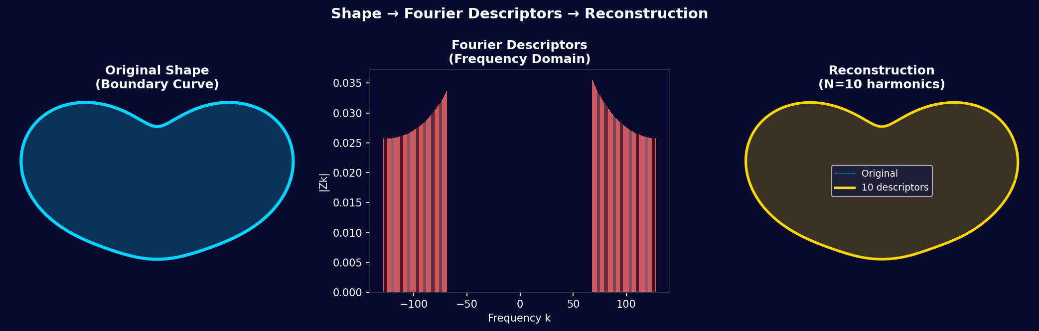
FD Pipeline: Shape → Descriptors → Reconstruction
Original Shape
Frequency Domain
Reconstruction
Arbitrary closed 2D boundary sampled as complex coordinates
Each |Z[k]| encodes a specific spatial frequency component
Only N descriptors needed for perceptually accurate shape

Slide 8
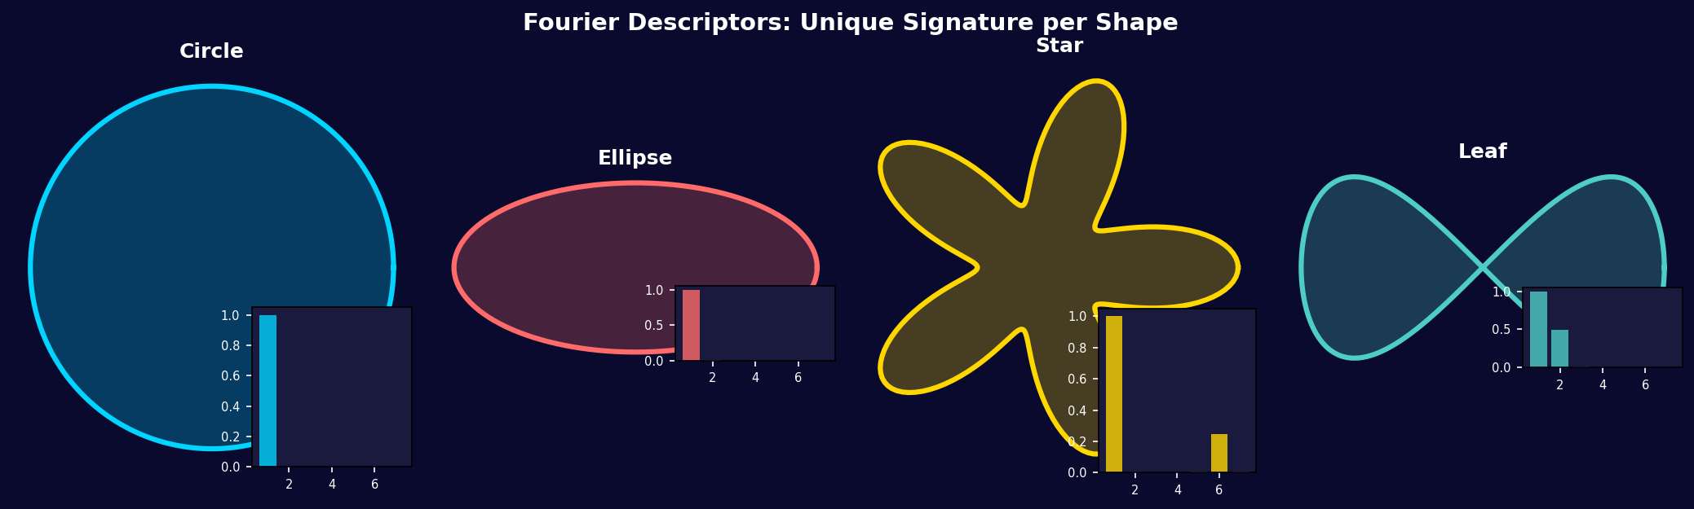
FD as Shape Fingerprints
Each shape has a unique Fourier Descriptor signature — enabling robust classification
Shape Recognition Algorithm: 1) Compute FD of query shape 2) Compare |Z[k]| vectors using Euclidean or χ² distance 3) Nearest match in database = recognized class

Slide 9
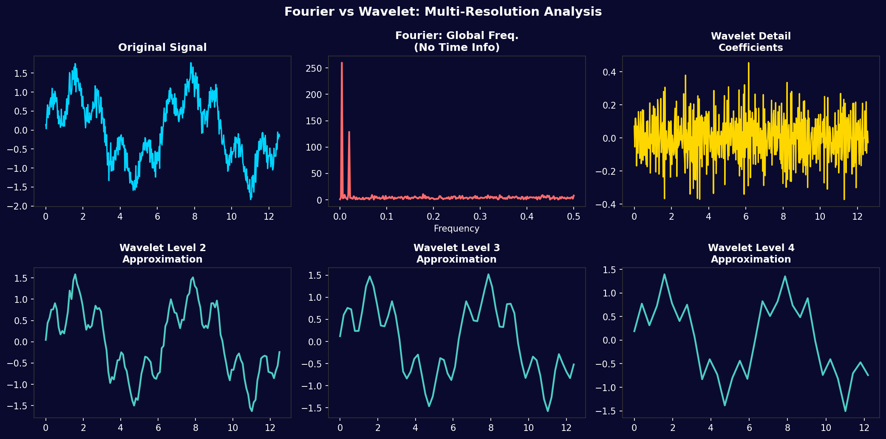
Part 4: Wavelet Descriptors — Multi-Resolution Analysis
Why Wavelets?
⚡ Time-Frequency Localization
Fourier: knows WHAT frequencies, not WHERE. Wavelets know BOTH — essential for local shape features.
📐 Multi-Scale Representation
Analyze shape at coarse (global) and fine (local) scales simultaneously using MRA.
🔬 Wavelet Transform
WT{z}(a,b) = (1/√a)∫z(t)·ψ*((t−b)/a)dt
Scale a, position b, mother wavelet ψ
🏷️ Discrete Wavelet (DWT)
dyadic subband coding: successive low-pass + high-pass filtering with downsampling.

Slide 10
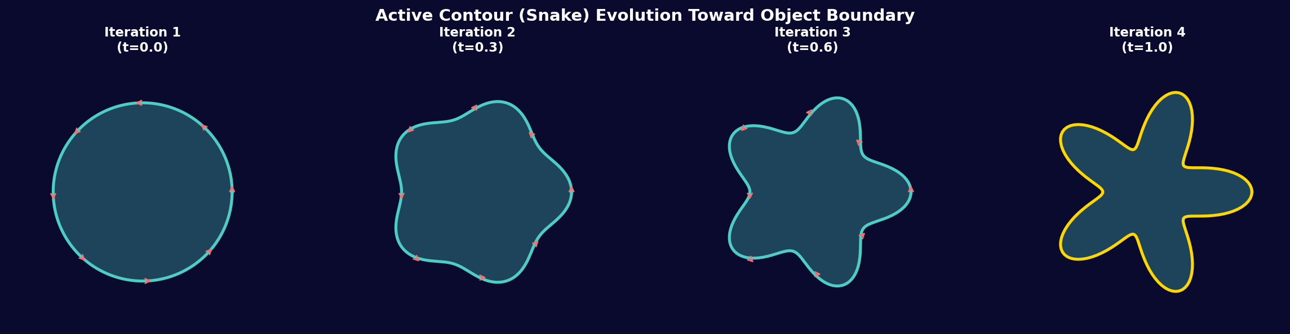
Part 5: Deformable Curves — Active Contours (Snakes)
Origin: Kass, Witkin, Terzopoulos (1988) — "Snakes: Active Contour Models" — IJCV
Snake Energy Functional
Snake Evolution Sequence
E_snake = ∫₀¹ [E_int + E_ext] ds
Internal Energy (smoothness):
E_int = α|v'(s)|² + β|v″(s)|²
External Energy (image force):
E_ext = −|∇I(v(s))|² (edge potential)
α = elasticity β = rigidity ∇I = image gradient

Slide 11
Active Contour Euler-Lagrange Equations
Variational Minimization
−d/ds[α v'(s)] + d²/ds²[β v″(s)] + ∇E_ext = 0
Minimizing E_snake via calculus of variations gives the Euler-Lagrange PDE:
Force Balance Interpretation
F_int(elasticity) + F_int(bending) + F_ext(image) = 0
The snake is a particle system in equilibrium of forces:
Gradient Descent Solution
vₜ = α v_ss − β v_ssss − ∇E_ext(v)
Add artificial time t to evolve the curve iteratively:
Discrete Update (Matrix Form)
(A + γI) vⁿ⁺¹ = γvⁿ − ∇E_ext(vⁿ)
Discretize with N control points. Matrix A encodes internal forces:

Slide 12
Fourier Descriptors + Deformable Curves: Unified Framework
Parametric Shape
Prior
Low-Dimensional
Deformation
FD coefficients define the mean shape learned from training data
Fourier
Deformable
Model
Deform only the first K Fourier modes — K≪N parameters vs N boundary points
Constrained
Optimization
Shape Grammar
Minimze snake energy in Fourier coefficient space: E(Z[1]...Z[K])
Legal deformations defined by PCA on FD space — morphologically valid shapes
Key Advantage: Fourier parameterization dramatically reduces search space for deformable model fitting (K<<N).

Slide 13
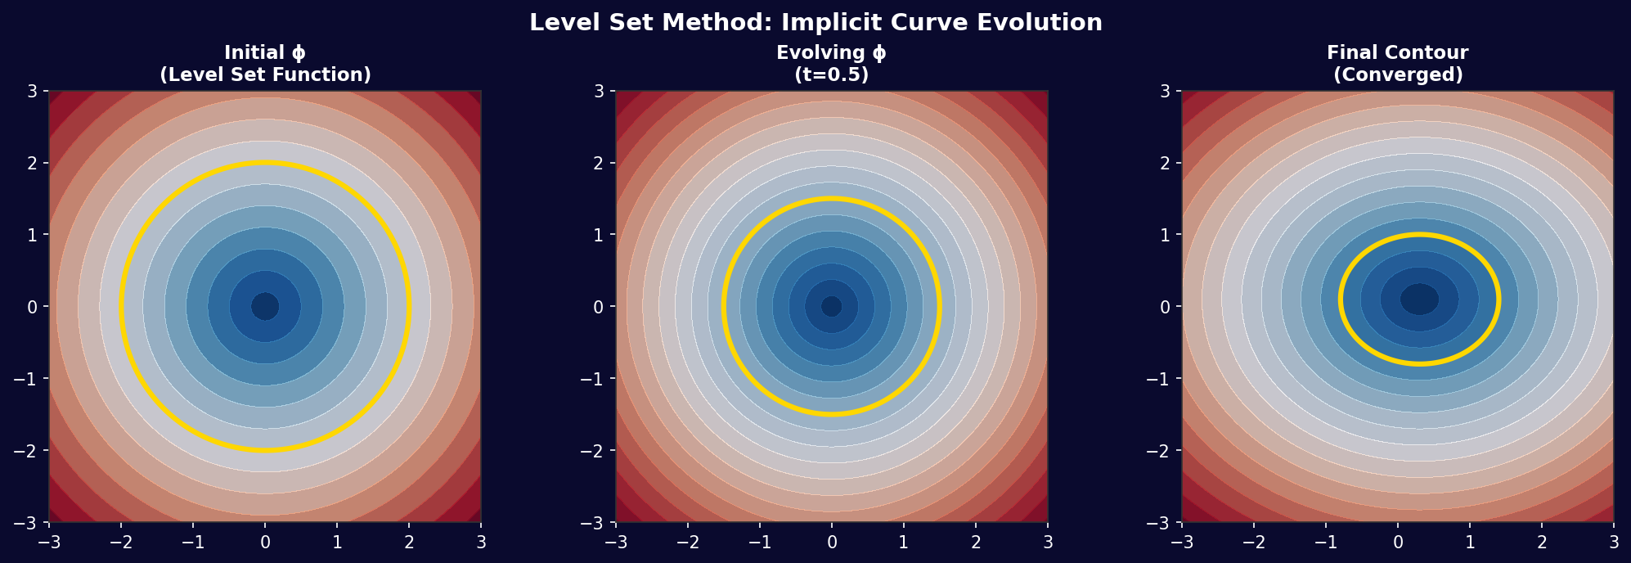
Part 6: Level Set Methods — Implicit Curve Evolution
Implicit Representation
Level Set Function Visualization
Level Set Function ϕ
Embed curve C as the zero-level set of ϕ(x,y,t):
C(t) = {(x,y) : ϕ(x,y,t) = 0}
Inside: ϕ < 0 | Outside: ϕ > 0
Evolution Equation (PDE)
dϕ/dt + F|∇ϕ| = 0
F = speed function driven by image features
Chan-Vese Energy Model
E = μ·L(C) + λ₁∫_in(I−c₁)² dA + λ₂∫_out(I−c₂)² dA
Region-based: no need for edge gradient!
Topology Change
Implicit → automatic merging/splitting of curves. No re-parameterization needed!

Slide 14
Part 7: Comparative Analysis of Techniques
Criterion
Fourier Desc.
Active Contour
Level Sets
Wavelet Desc.
Representation
Global frequency
Parametric curve
Implicit function
Multi-scale freq.
Topology Change
✗ Fixed topology
✗ Manual handling
✓ Automatic
✗ Fixed topology
Initialization
Easy (from contour)
Sensitive
Moderate
Easy
Noise Robustness
High (low-pass)
Moderate
High
Very High
Computational Cost
O(N log N)
O(N²) per iter
O(N²) grid
O(N log N)
Interpretability
Very High
High
Low
High
Local Features
Poor
Good
Good
Excellent
Best For
Recognition, indexing
Object tracking
Medical imaging
Texture+shape

Slide 15
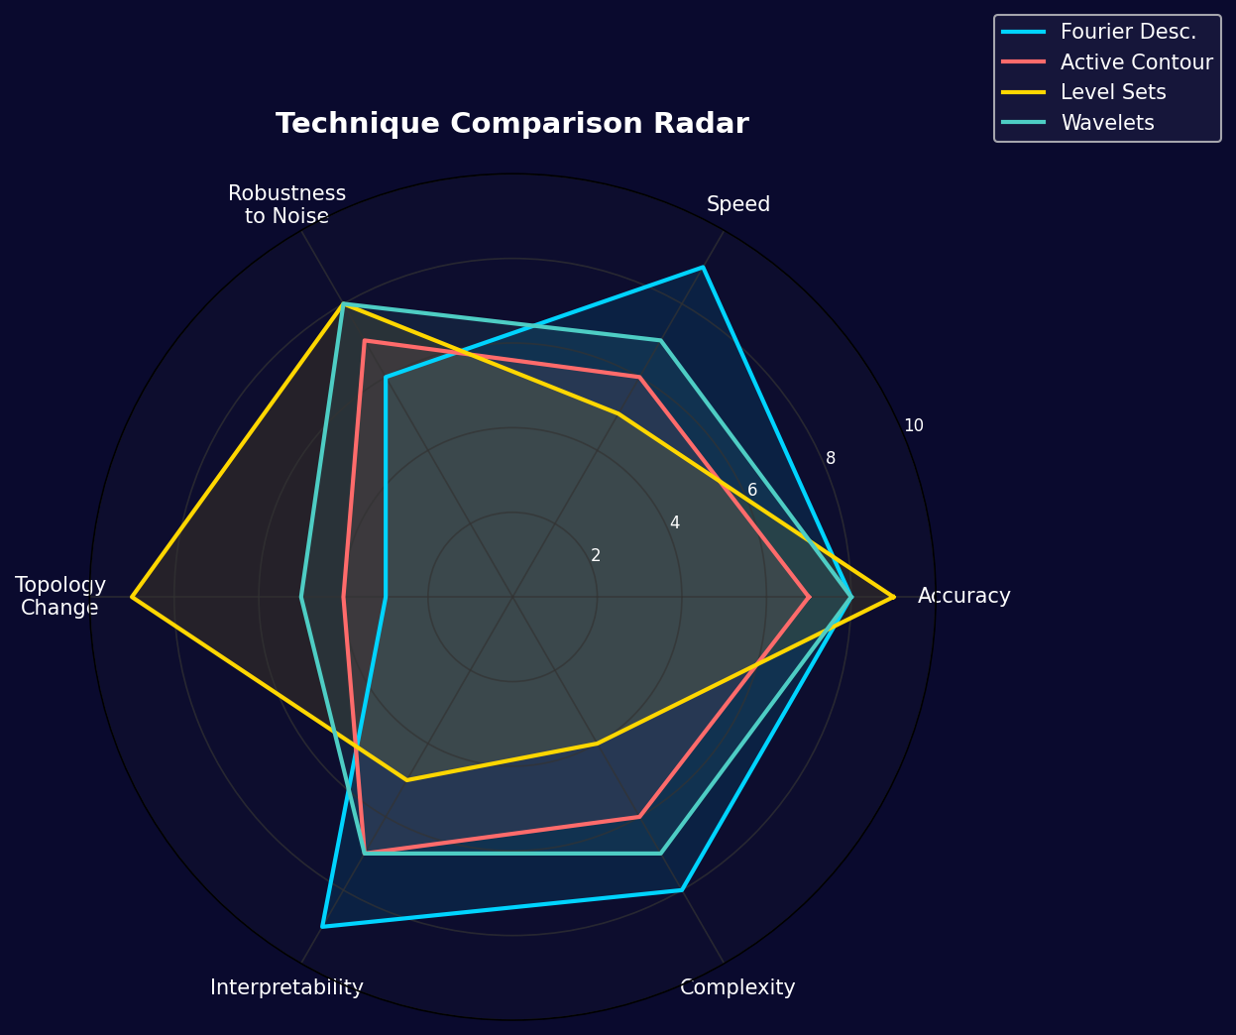
Multi-Dimensional Performance Comparison
Key Insights
Fourier Desc.
Best interpretability + speed. Weak on topology and local detail.
Active Contour
Balanced performer. Requires careful initialization and parameter tuning.
Level Sets
Tops accuracy + topology. High compute cost; hard to interpret.
Wavelets
Best local feature capture. High robustness to noise. Multi-scale.

Slide 16
Part 8: Real-World Applications
🏥 Medical Imaging
🚗 Autonomous Vehicles
🔬 Biometrics
Cardiac MRI segmentation (active contours)
Brain tumor boundary delineation (level sets)
Organ shape analysis & atlas building
Cell morphology classification via FD
Pedestrian silhouette recognition (FD-based)
Lane marking detection (snakes)
Road sign shape classification
Obstacle boundary tracking
Fingerprint ridge pattern analysis (wavelet FD)
Iris shape encoding for authentication
Gait analysis from body silhouettes
Hand geometry biometrics
🏭 Industrial Inspection
🎨 Computer Graphics
🛰️ Remote Sensing
PCB component shape verification
Defect detection on manufactured parts
Particle shape analysis in materials
Weld bead profile monitoring
Shape interpolation & morphing
Font outline recognition (FD)
Character pose estimation
Sketch-based retrieval systems
Geographic feature extraction
Building footprint delineation
Shoreline change monitoring
Agricultural field boundary detection

Slide 17
Advanced Topics & Research Frontiers
Deep Learning + FD
Graph Neural Network Snakes
CNNs learn implicit Fourier-like filters. FD-CNN hybrids for shape recognition outperform pure DL on limited data. ShapeNet FD embeddings.
Model boundary control points as a graph. GNN propagates energy across nodes — learns data-driven internal energy. ICCV 2021 Deep Snake.
Fourier Neural Operators (FNO)
Morphing & Interpolation
Leroux et al. 2021: learn PDEs in Fourier space. Direct extension to shape evolution PDEs — infinite-dimensional functional learning.
FD space supports linear interpolation between shapes with guaranteed smoothness. Shape blending for data augmentation in medical imaging.
Statistical Shape Models (SSM)
Topological Data Analysis
PCA on FD space → Active Shape Models (ASM). Cootes et al. constrain snake deformation to statistically plausible shapes.
Persistent homology + FD: capture multi-scale topological features. Combines with level set handles for topological shape analysis.

Slide 18
Complete Mathematical Reference
Continuous Fourier Transform:
F(ω) = ∫_{-∞}^{∞} f(t) · e^{−jωt} dt
Discrete Fourier Transform (DFT):
Z[k] = Σ_{n=0}^{N−1} z[n] · e^{−j2πkn/N}, k=0,...,N−1
Shape Fourier Descriptor (Normalized):
FD[k] = Z[k]/Z[1], for k=2,...,K (K<<N)
Wavelet Transform:
W(a,b) = (1/√a) ∫ z(t) · ψ*((t−b)/a) dt
Snake Energy Minimization:
E = ∫₀¹[α|v'|² + β|v″|² − λ|∇I(v)|²] ds → min
Level Set PDE:
ϕ_t = F · |∇ϕ| + ε·κ·|∇ϕ|, κ = div(∇ϕ/|∇ϕ|)
Chan-Vese Functional:
E(ϕ,c₁,c₂) = μ∫|∇H(ϕ)|dA + ∫[(I−c₁)²H(ϕ) + (I−c₂)²(1−H(ϕ))]dA
FD Shape Distance Metric:
d(S₁,S₂) = √[Σₖ (|FD₁[k]| − |FD₂[k]|)²]

Slide 19
Open Research Questions & Ph.D. Opportunities
Q1
How many Fourier descriptors are sufficient for a given shape class?
Information-theoretic bounds on shape complexity?
Q2
Can we learn optimal basis functions (beyond Fourier/wavelet) for a specific shape corpus using deep metric learning?
Q3
How to incorporate FD-based shape priors into neural implicit representations (NeRF, SDF) for 3D?
Q4
Real-time level set computation on GPU: what algorithmic shortcuts preserve accuracy?
Q5
Extending FD to 3D surface meshes: spherical harmonics, spectral graph theory connection?
Q6
Uncertainty quantification in deformable model segmentation — Bayesian snakes?

Slide 20
Key Takeaways
Fourier Descriptors
Deformable Curves
Transform the shape boundary into a compact, invariant frequency signature. Ideal for recognition, retrieval, and comparison.
Active Contours and Level Sets minimize energy to fit boundaries. Bridges signal processing and geometry.
Unified Framework
Multi-Resolution
Fourier parameterization of deformable models combines compactness + physical constraints. The best of both worlds.
Wavelets extend FD to capture local features at multiple scales — critical for complex shapes.
"Shape is the DNA of visual understanding — Fourier gives us the language to read it."

