Slide 1

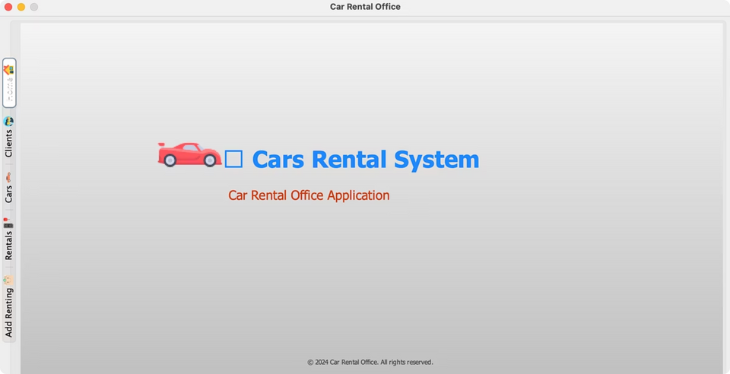
Car Rental Management System
CSCI 6991 Data Engineering Capstone Project
Advisor: Dr. Robert Gilliland
Student: Hemanth Kumar Machani - Y00886464
Youngstown State University

Slide 2
Project Overview
What We Built
Technology Foundation
A comprehensive, standalone Car Rental Management System designed to streamline vehicle rental operations for both customers and administrators.
  Backend: Java 17 with Spring Boot framework
  Frontend: JavaFX for rich desktop UI
  Database: MySQL with optimized schema design
The platform automates critical workflows including real-time vehicle availability searches, seamless booking processes, automated billing calculations, and comprehensive vehicle fleet management.
  Architecture: MVC pattern with REST services

Slide 3
Background & Motivation
Manual Limitations
Time & Error Costs
Digital Transformation
Traditional car rental services rely heavily on manual record-keeping, leading to inefficiencies and operational bottlenecks.
Manual processes increase processing time, introduce human errors, and create significant challenges when scaling operations.
Software-based automation dramatically improves operational efficiency, data accuracy, and overall user experience.
Modern car rental platforms like Enterprise and Turo demonstrate the power of digital transformation in the rental industry, inspiring our system architecture and feature set.

Slide 4
The Problem We're Solving
Disorganized Operations
Limited Visibility
Without digitization, car rental procedures become chaotic and difficult to manage effectively, leading to customer dissatisfaction and lost revenue.
Customers struggle to check real-time vehicle availability, often resulting in frustrating phone calls and wasted time for both parties.
Administrative Burden
Our Solution
Administrators manually manage extensive datasets including vehicle inventories, booking records, return schedules, and complex billing calculations.
A centralized, automated management system that eliminates inefficiencies and creates a seamless experience for all stakeholders.

Slide 5
System Architecture & Methodology
Technology Stack
Development Process
  Java 17 for robust backend logic
01
02
  Spring Boot for rapid development
Requirements & Planning
Design Phase
  JavaFX for rich desktop UI
Analyzed needs and defined system specifications
Created UI mockups and database schema
  MySQL for reliable data storage
  MVC Architecture with REST services
  GitHub for version control
03
04
Feature Implementation
Validation & Testing
Built modules incrementally with testing
Comprehensive quality assurance procedures
05
Deployment Packaging
Final optimization and distribution

Slide 6





Implementation & Testing Strategy
Module Development
CRUD Validation
Each core module was built independently with isolated unit testing to ensure reliability and maintainability.
Comprehensive validation of Create, Read, Update, and Delete operations across users, vehicles, and bookings.
End-to-End Workflow Testing
Search Availability
Real-time query
Book Vehicle
Reservation creation
Rent Process
Contract initiation
Return Vehicle
Check-in workflow
Generate Bill
Payment calculation
Stress Testing: System validated with high-volume sample data entries to ensure scalability and performance under load.
Integration Testing: Frontend-backend communication verified for optimal request/response latency and error handling.

Slide 7
Results & Performance Analysis
100%
60%
95%
Workflow Automation
Time Reduction
Error Reduction
Complete rental process digitized
Estimated decrease in processing time
Fewer mistakes vs. manual operations
Key Achievements
  Real-time rental workflow handling with instant updates
  Modular architecture enabling easy feature additions
  Intuitive UI design for both administrators and customers
  Scalable foundation ready for SaaS transformation
  Stable performance with efficient database queries
  Comprehensive data management capabilities

Slide 8


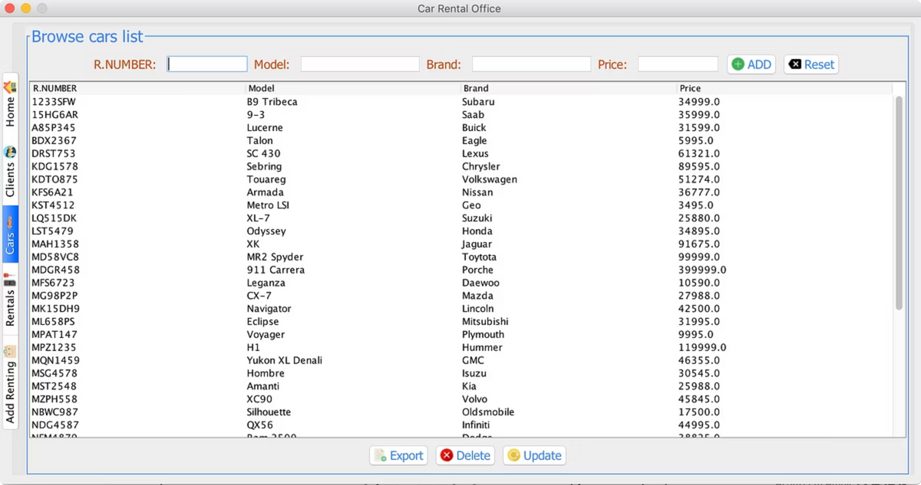



Project Outcomes & Impact
Fully Operational System
A complete, working standalone rental management platform successfully built and demonstrated with all core features functioning seamlessly.
Operational Automation
The application automates rental operations end-to-end, significantly reducing manual effort and eliminating repetitive administrative tasks.
Scalable Architecture
Modular design allows for continuous improvements, feature additions, and seamless scaling to accommodate business growth.
Learning Objectives Met
The project successfully fulfills all expected learning outcomes for CSCI 6991 Data Engineering Capstone course requirements.

Slide 9
Future Enhancements & Roadmap
Analytics Dashboard
1
Rental statistics, revenue trends, and business intelligence reporting
2
Communication Features
Email notifications, automated invoice generation, and customer alerts
Cloud Deployment
3
Containerization with Docker and cloud hosting infrastructure
4
Enhanced Security
Advanced role-based access control and permission management
Multi-Platform UI
5
Web and mobile application extensions for broader accessibility
These time-permitting enhancements represent the natural evolution path for transforming the system into a comprehensive, enterprise-grade solution.

Slide 10








Project Contribution
Solo Development
System Design
Core Implementation
Architecture, backend, frontend, and database schema development
Booking workflow, billing system, and all feature modules
Documentation
Quality Assurance
Technical documentation, reports, and presentation materials
Testing, debugging, and performance optimization
All project work completed by: Hemanth Kumar Machani

Slide 11
Thank You!

