Slide 1
Luggage Tracker
Luggage Tracking Simplified!

Slide 2

Design
Background Image
We selected a background image that depicts a typical traveller to set the idea for this app.
Title
Very simple and self-explanatory title.
Caption
Luggage Tracking Simplified!
Notify Me Button
This was intended to be the first thing that attracts the visitor’s eye. We chose a bright colour for that reason. The button redirects to a signup page, keeping the landing page clean.
Feature Cards
Small cards which highlight our key features in a direct and concise way.
What we do
The picture we chose depicts a person who has just lost their luggage. This sets a picture for the audience to put themselves in those shoes and think about how our product is the solution.

Slide 3
Key Benefits for a Customer
Our product will not only reduce the chances of being misplaced, but it will add speed, precision and increase the overall performance to track your baggage
Location via SMS, In-app GPS and Email as soon as you check your luggage in and on every checkpoint throughout your journey
QR codes in the tag offers Owners information and address to quicken the process of lost baggage return, once tagged owner will be instantly alerted of the location.
Easy Integration with iOS and Android and a free application with decent prices.

Slide 4
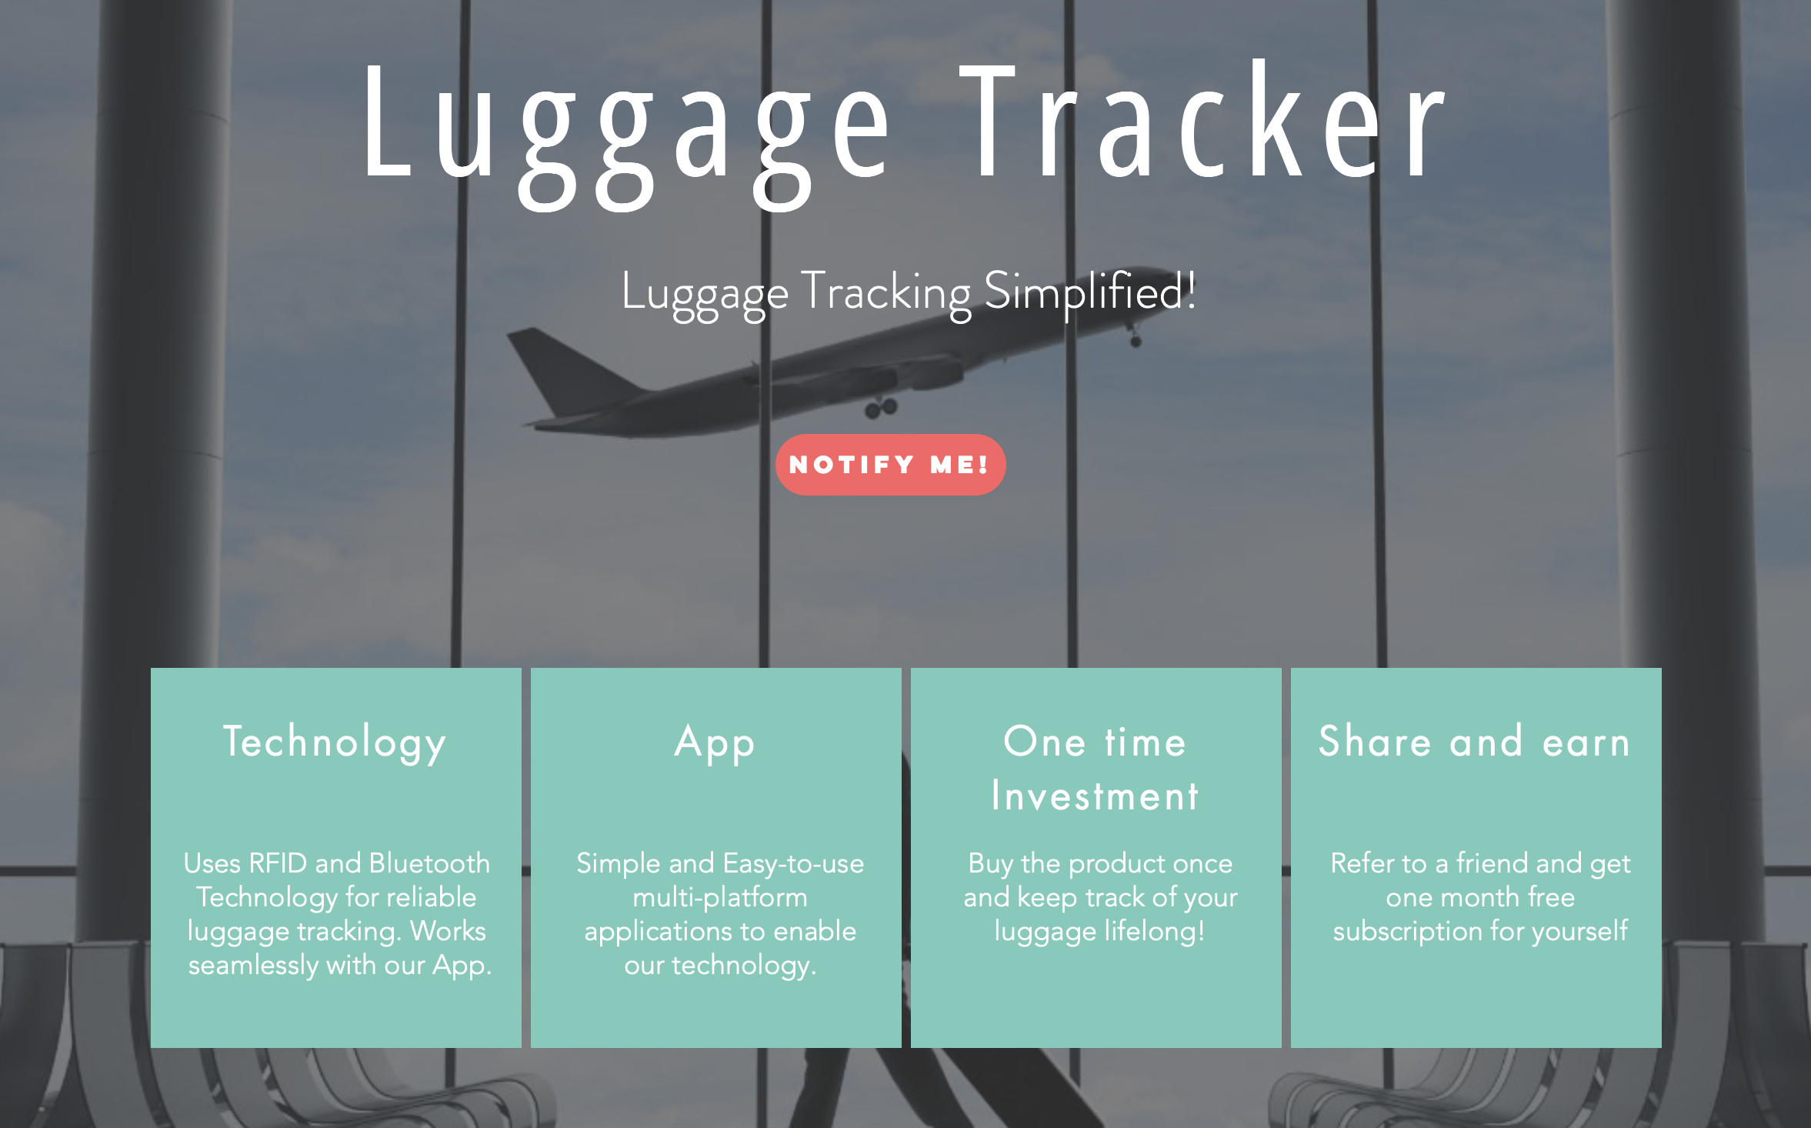

Slide 5


