Slide 1
CSE7302 - INTERNSHIP Review-3 Presentation MLFF
Student Details
Name | Hemanth Nagaraj
Roll No | 20221CSE0527
Section | 8CSE09
Under the Supervision of,
Dr Sudha P
Associate Professor
Presidency School of CSE
Presidency University
Name of the Program: Computer Science and Engineering
Name of the HoD: Dr.Asif Mohammad
Name of the Program Internship Coordinator: Dr.Balakrishnan
Name of the School Internship Coordinator: Dr. Md Ziaur Rahman

Slide 2
Content
About Company or Organization
Working domain or the technology
Challenges Faced in Internship
Objectives of the work

Slide 3
About Company or Organization
ViaPlus is a global mobility company in the Intelligent Transportation Systems (ITS) market, specializing in revenue and services management solutions for the transportation industry.
Their applications include:
Electronic Toll Collection
Latitude Road User Charging
Beacon EV Charging
Mobility Ecosystems

Slide 4
Working domain or the technology
Assigned Domain: MLFF
Focus: Mobility Back Office (MBO) & Financial Transaction Processing.
Core Function: Converting from old technology (ASP.Net and .Net 4) to new using the latest tech stack(Angular and .Net8)
Ecosystem: Moving from legacy toll plazas to Free-Flow (Open Road) Tolling.
Key Technology Stack: MBO Architecture, Computer Vision (AI/ML), IoT Integration, Cloud Infrastructure

Slide 5
Challenges Faced in Internship
The challanges faced during the internship are:
Adapting to new technology
The "Zero-Error" Mindset - Unlike college assignments, code here handles real money. The pressure to write production-grade code with strict error handling and logging standards was high.

Slide 6
Objectives of the work
To gain hands-on experience in the Intelligent Transportation Systems (ITS) domain by contributing to the development and optimization
To understand the end-to-end lifecycle of an Electronic Toll Collection (ETC) transaction
To adapt to the corporate Agile/Scrum methodology, actively participating in sprints, stand-ups, and cross-functional team reviews.

Slide 7
Problem Statement
Update User Details Page
Pan Verification for customers
Bulk upload data

Slide 8
Advantages of Proposed System/Work
Users could edit their details online without the support of customer care executive
The agents could verify Pan with a click of a button
The back office system will not have to enter each data one by one, now the system handles it and can be uploaded in bulk

Slide 9
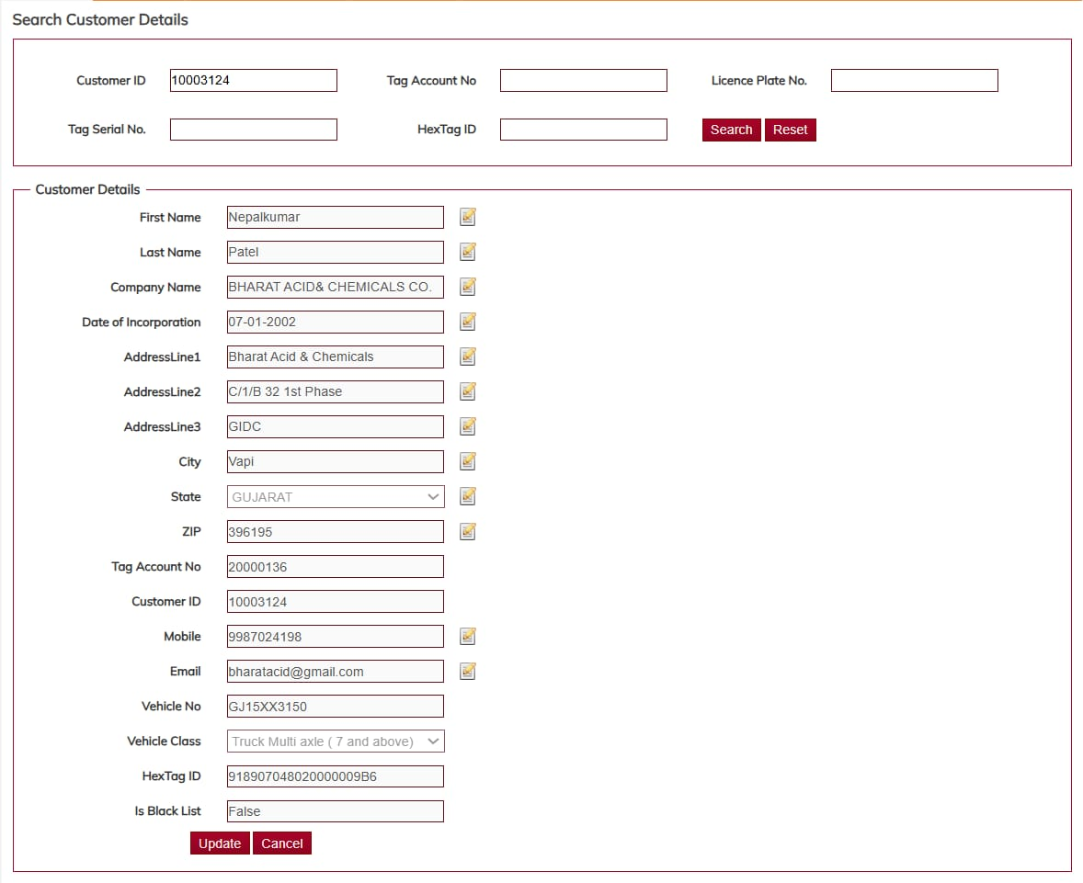
System Design

Slide 10
Q&A

Slide 11
Thank you !!

