Slide 1
INDIAN RESTAURANTS IN NEW YORK
Locate a neighborhood with best Indian Restaurants for tourists
Locate the best neighborhood for an entrepreneur to start his business

Slide 2
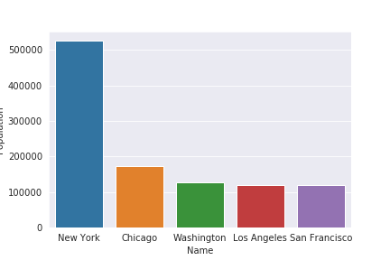
Business Problem :
An entrepreneur wants to start a new Multi Cuisine Indian restaurant in NEW YORK CITY.Since he believes that New York is one of the most densely populated Indian immigrant states in US. So He approaches a Data Scientist for a suggestion where to start his business. (Source from Wikipedia).

Slide 3
Role of a Data Scientist :
Since being a Data Scientist we need to solve his problem and recommend the best neighborhood of New York to start his business.
Roles involves :
.
Finding all the Neighborhoods with INDIAN Restaurants.
Finding all the Neighborhood with out single INDIAN Restaurants.
Finding the best place and most visited INDIAN Restaurant.
Suggest best Neighborhood for starting business.

Slide 4
Approach followed :
We consider some metrics to solve this problem
Number of INDIAN restaurants in neighborhood
Distance of neighborhood from the center of the city
Is there any tourist places to visit
The optimal place to start business is a location where there are less INDIAN restaurants, Minimum distance from the center of city and there are some popular tourist places to visit.

Slide 5
Data Gathering
For this project we need following data :
❏ First we need all the neighborhoods of New York along with their latitude and longitude coordinates.
➔ Data Source : https://cocl.us/new_york_dataset
➔ Description : cocl.us has a list of Neighborhood of New York, we scrap it using python libraries and get its location coordinates using geopy.geocoder library in python.
❏ Indian restaurants in each Neighborhood of New York
➔ Data Source : FourSquare API
➔ Description : By using this API we will get all the venues in each neighborhood. We can filter this venues to grab only INDIAN restaurants

Slide 6
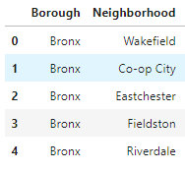
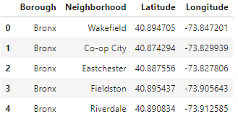
Modeling :
Data from cocl.us
Location coordinates from Geopy library

Slide 7
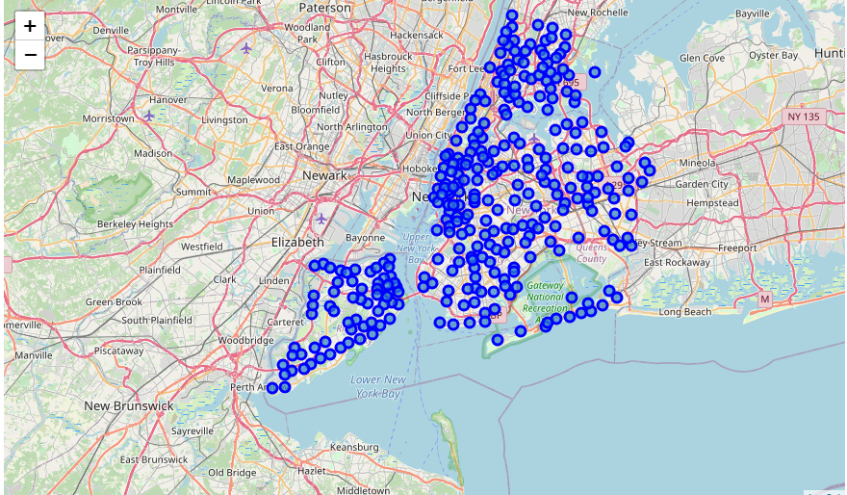
Visualizing the Neighborhoods of New York

Slide 8
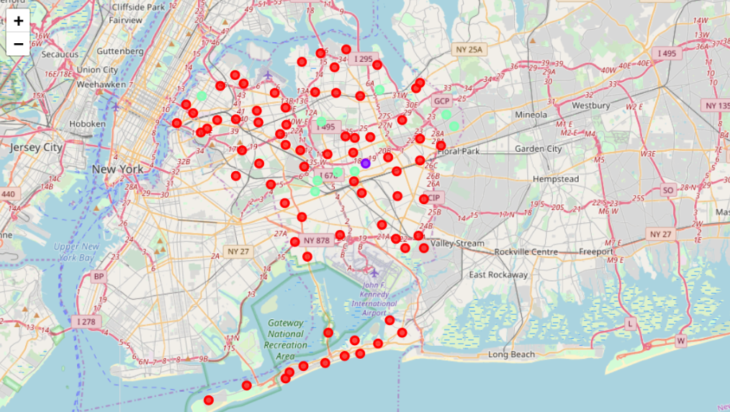
Visualization of INDIAN restaurants

Slide 9
Conclusion
Best place in NEW YORK to find INDIAN restaurant : Prospect Leffert Gardens.
Best restaurant in Prospect Leffert Gardens to have dinner : Gandhi Fine Indian Cuisine Restaurent (it has got 8.6 ratings and 82 likes)

