Slide 1
Problem Statement:
We have to cluster the countries by the factors of income, GDPP and child_mort rate.
Datasets -> Country-data.csv
-> data-dictionary+.csv

Slide 2
Steps followed:
Read the data and understand the data.
Clean the data if any null values and incorrect data are present.
Preparing the data for modelling( rescaling).
Modelling
Final Analysis
Analysis:
->Understand the data
->The dataset has no null values, so we can proceed to data modelling
->But to find the exact number of clusters, we can use elbow method and silhouette score.

Slide 3
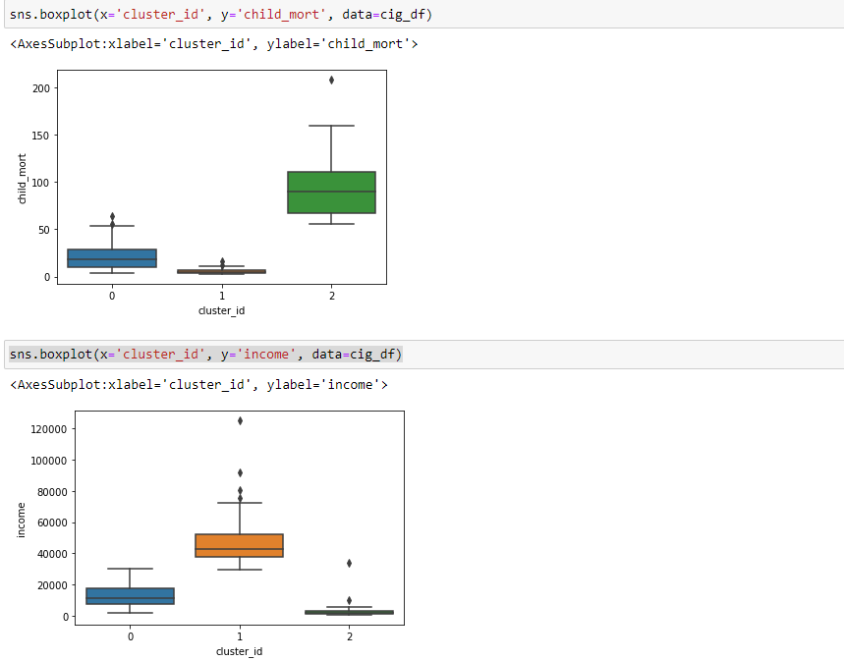
Boxplot of scaled data.
We can see that cluster 2 has high child_mort and low income comparatively.

Slide 4
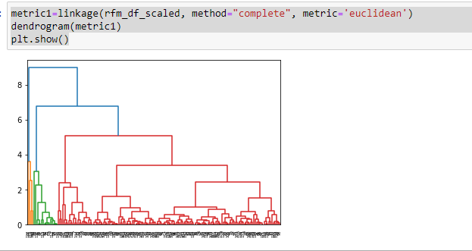
Hierarchical clustering :
No need to predefine K value. Useful for small datasets because it has a time complexity of O(N³)

Slide 5
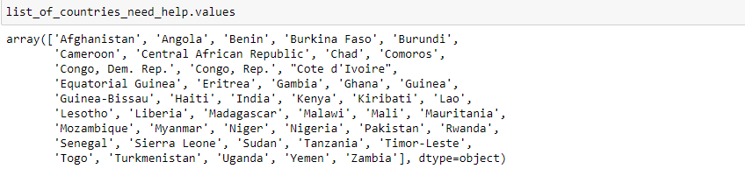
Result:
Cluster with ‘cluster_id’=2 needs more attention compared to other clusters.
Here is a list of countries that come under this cluster.

Slide 6
1. Compare and contrast Kmeans Clustering vs Hierarchical clustering?
Kmeans need a predefined K.
Hierarchical time complexity is 0(N³ ). So, it is complex for large datasets.
Also, visualization for large datasets via dendrogram is highly impossible.
2. Briefly explain the steps for the K-Means clustering algorithm?
Step1: Understand and Prepare data for modelling
Step2: Rescale the data to model the Kmeans Algorithm
Step3: Model the Kmeans, with predefined K value and using elbow method and silhouette score find the accurate K .
Step4: With calculated K remodel the Kmeans algorithm and analyse the result.

Slide 7
3. How is the value of ‘k’ chosen in K-means clustering? Explain both the statistical and business aspect of it.
Statistical -> K value is chosen with the help of elbow method and silhouette score.
Business -> With the help of client requirement, knowing how the data need to be segmented, we can define the K value.
4. Explain the necessity for scaling/ standardization before performing clustering.
A variable age can be in a range of (0-100). Also, a variable salary can be in a range of (0-1000000), Calculating Euclidean distance for these 2 variables can give a large difference hence scaling is needed.

Slide 8
5.Explain the different linkages used in the Hierarchical clustering.
->Single linkage : The distance between 2 clusters is the minimum distance between data points in the cluster.
->Complete linkage: The distance between 2 clusters is the maximum distance between data points in the cluster.
->Average linkage: The distance between 2 clusters is the average distance between data points in the cluster.

