Slide 1
Attack_Analysis_Story
File created on: 11/28/2024 3:29:28 AM

Slide 2
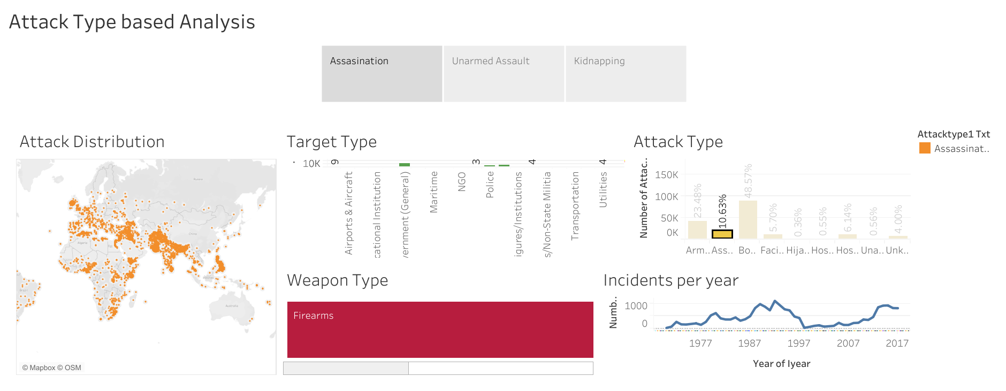

Slide 3
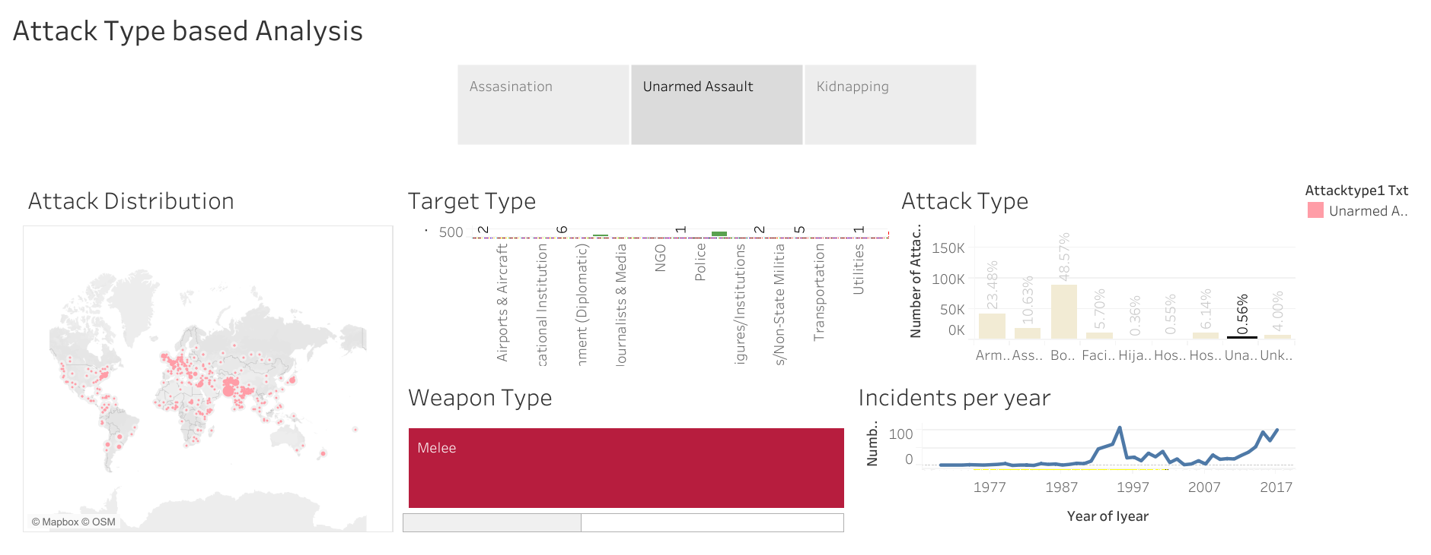

Slide 4
