Slide 1
Regional Analysis Story
File created on: 11/28/2024 3:13:39 AM

Slide 2
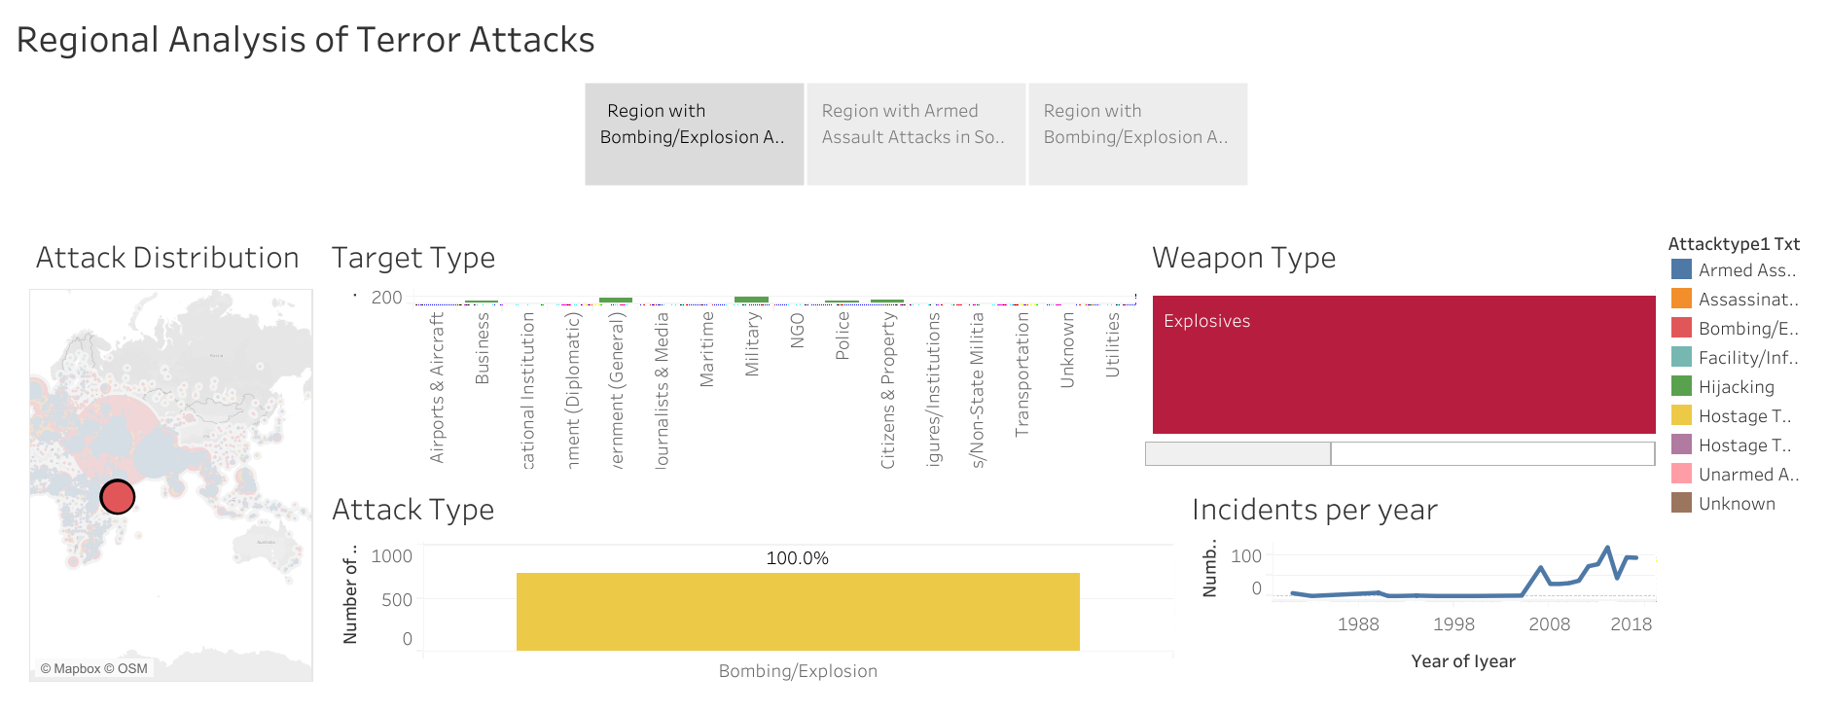

Slide 3
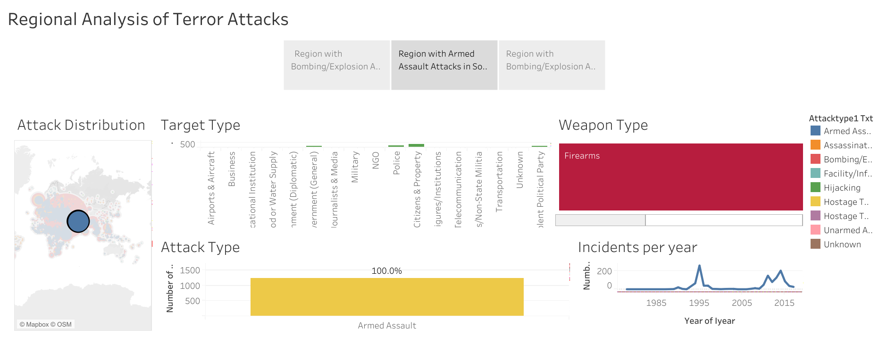

Slide 4
