Slide 1
Target_Analysis_Story
File created on: 11/28/2024 3:35:09 AM

Slide 2
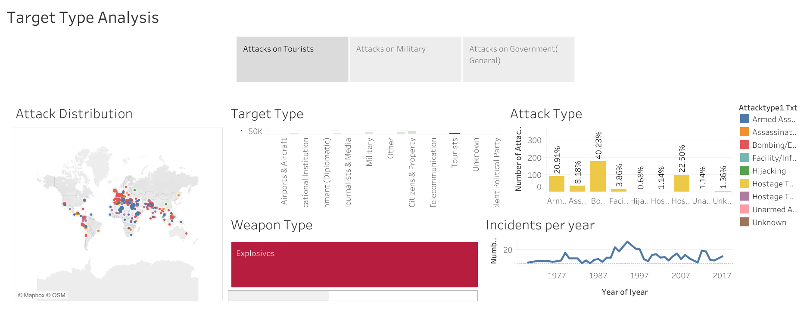

Slide 3
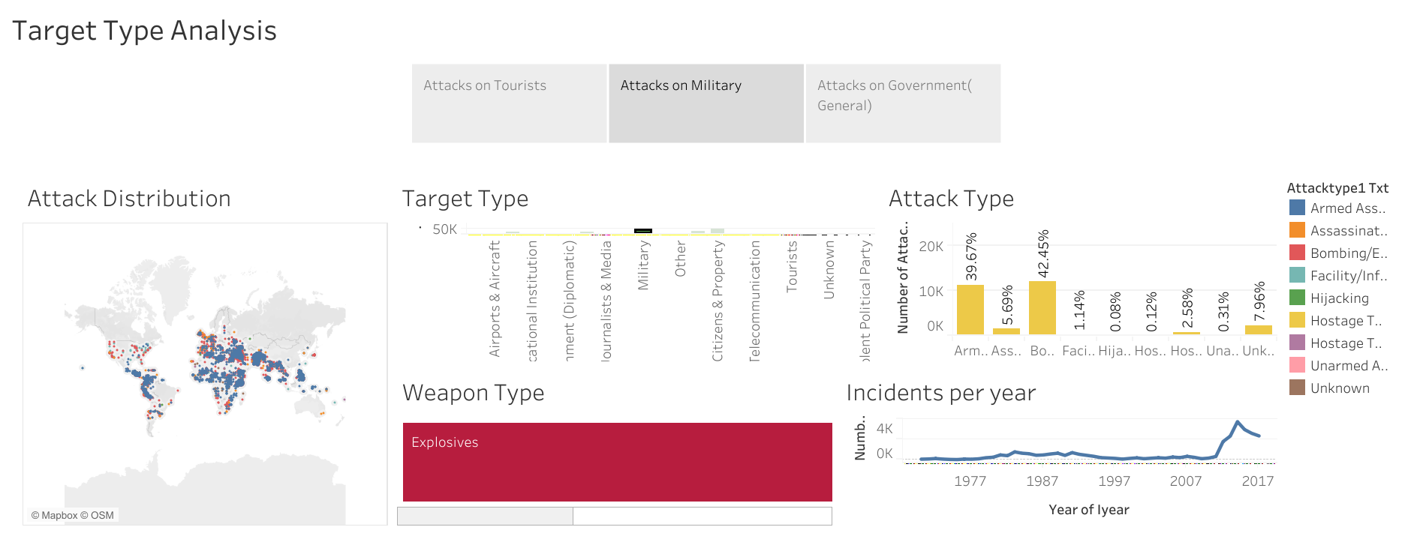

Slide 4
