Slide 1
Experiential Learning
Applied Statistical Methods
Group-5

Slide 2
PEARSON GROUP (Q2)

Slide 3
Problem Statement
Understanding about Renewable energy.
Understanding the terminologies used in the data set.
Inspecting whether GHI and wind speed dataset for the year 2000 follow Normal distribution.
If not, which distribution do they follow?
Constructing time series plot for wind speed dataset for years 2000-2010.
Decompose the time series plots into various components and forecasting the Wind Speed.

Slide 4
INSPECTING THE DISTRIBUTION

Slide 5
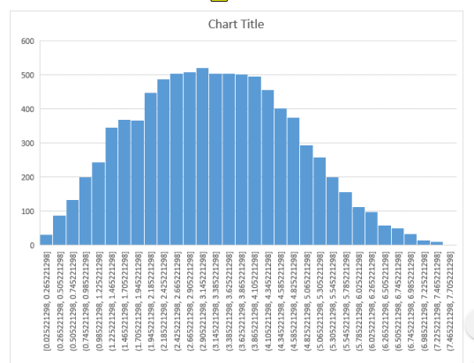
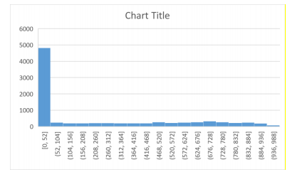
PLOTTING THE HISTOGRAMS

Slide 6
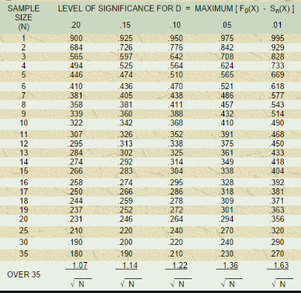
Kolmogorov-Smirnov(KS) test

Slide 7
About this test…
In this test, the cumulative probabilities of values in the data are compared with cumulative probabilities in a theoretical normal distribution.
The critical value is found from K-S table. This value comes to be 0.014531.
The null hypothesis is this distribution follows normal distribution.
Test Statistic, D = max_{1≤Y ≤N} [F(Y_{i}) – (i-1)/N , (i/N) – F(Y_{i})]
If the test statistic is LESS THAN the critical value, we ACCEPT the null hypothesis.
The test statistic for wind speed came out to be 0.027018.
The test statistic for GHI data came out to be 0.285966.
Both are more than the critical value.

Slide 8
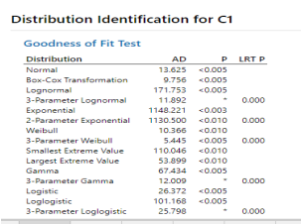
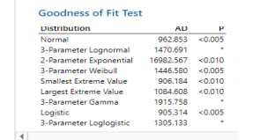
Using Minitab.
GHI DATASET
WIND SPEED DATASET

Slide 9
Conclusion
This Data doesn’t follow any of the above Distributions.

Slide 10
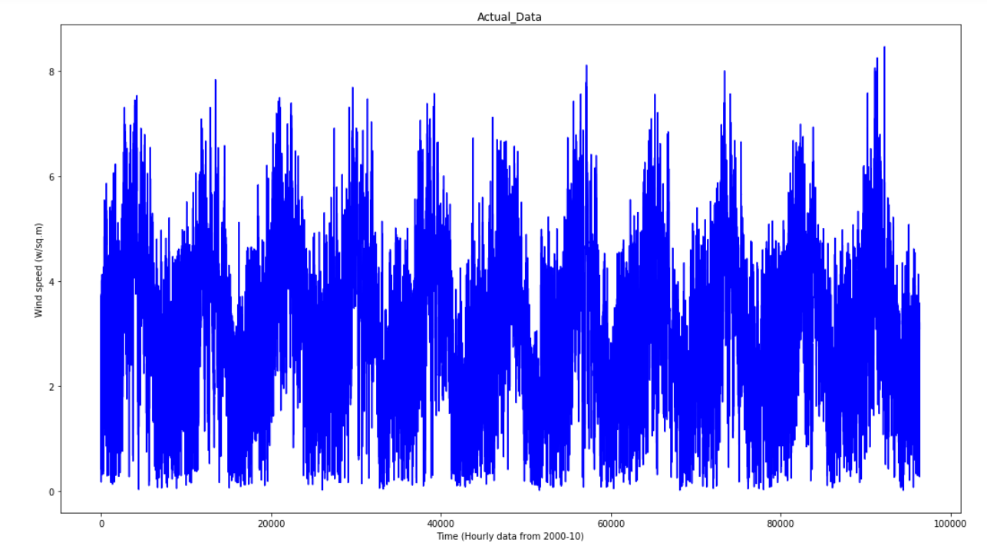
Plotting Time series data

Slide 11
Inferences from Data Plot
From the data plot we can observe that, there is seasonal component.
This seasonal variation is relatively constant over time i.e., it’s magnitude doesn’t increase over time.
So, in such cases Additive Decomposition is much useful than Multiplicative Decomposition.
Anyways, we will do both and analyse them.

Slide 12
How is this decomposition done?
Firstly, we have to calculate the trend.
Here, we have done that by Moving Averages Smoothing method.
Next, we have de-trend the series. This means, we have to subtract/divide trend from series in additive/multiplicative models respectively.
Next, we estimate these effects by averaging the de-trended values for a specific season.
Finally, we calculate Residual.
For the additive model, Residual = series – (trend + seasonal). For the multiplicative model, Residual = series / (trend*seasonal).

Slide 13
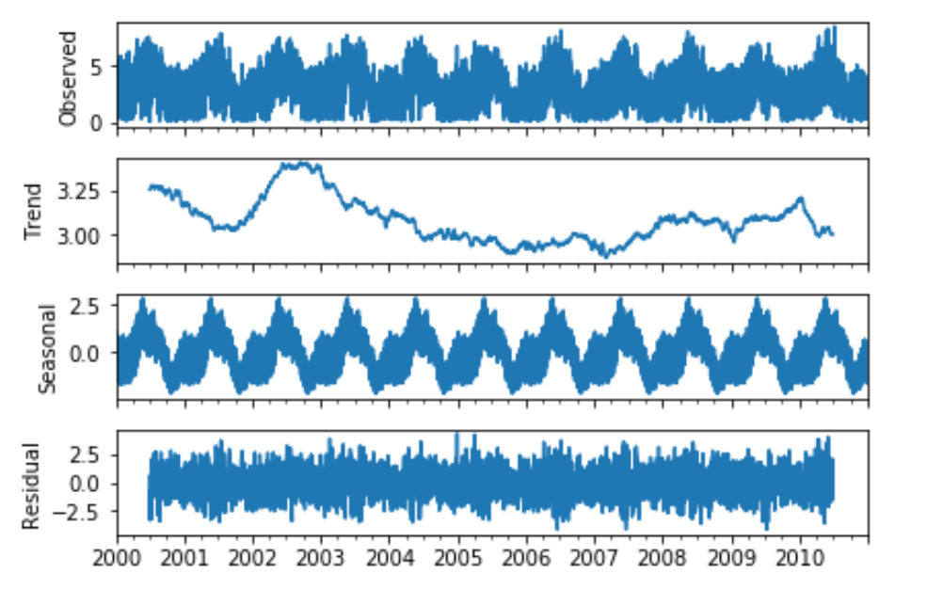
Additive Decomposition

Slide 14
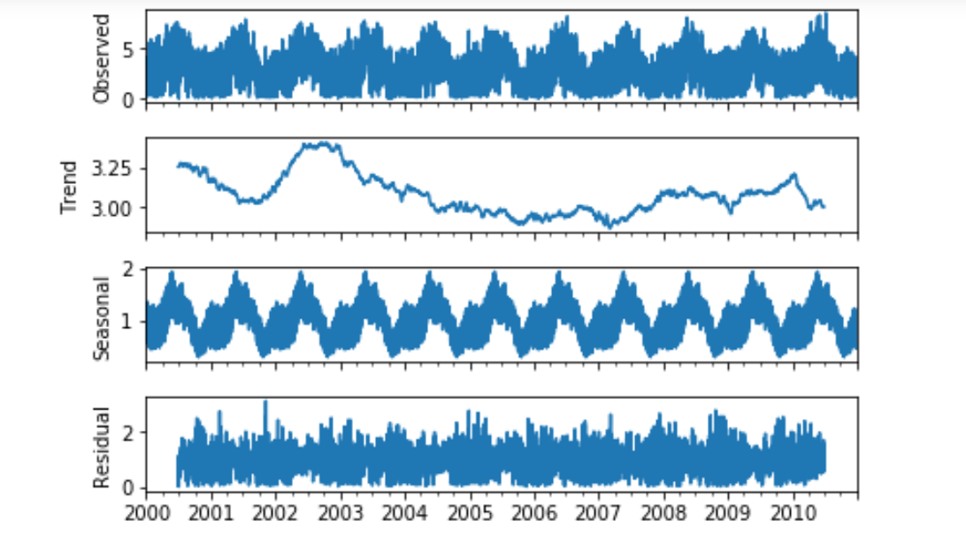
Multiplicative Decomposition

Slide 15
Observations
From the graphs of residuals of both Decompositions, the residuals of Additive Decomposition are more random than Multiplicative Decomposition.
So, also by residual Analysis we can conclude that Additive Decomposition is better for our data.

Slide 16
FORECASTING
We used SARIMA(Seasonal Auto Regressive Integrated Moving Average) for forecasting.
ARIMA model was not that effective because it expects data to be non-seasonal or has seasonality component removed.
Moving average was not effective because it is a smoothing technique and it smoothes data which is not that accurate.

Slide 17
PROCEDURE
We used NUMXL package in EXCEL for SARIMA.
We collected two data per month from year 2000 to 2010.
Using NUMXL we conducted SARIMA.
The predicted values, standard deviations, upper limit and lower limits are written in report.

Slide 18
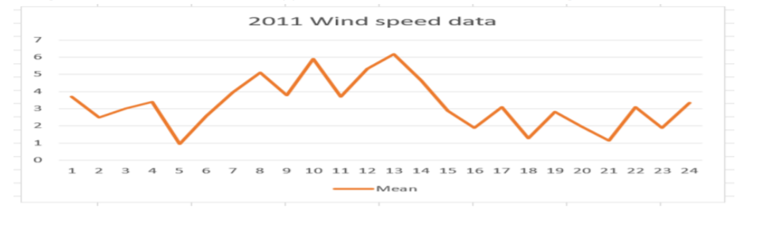
Prediction for 2011

Slide 19
References
https://newonlinecourses.science.psu.edu/stat510/lesson/5/5.1
https://machinelearningmastery.com/sarima-for-time-series-forecasting-in-python/
https://machinelearningmastery.com/decompose-time-series-data-trend-seasonality/

Slide 20
THANK YOU

