Slide 1
PERSON GROUP (Q2)

Slide 2
PROBLEM STATEMENT.
Understanding about Renewable energy.
Understanding the terminologies used in the data set.
INSPECTING WHETHER GHI AND WIND SPEED DATASET FOR THE YEAR 2000 FOLLOW NORMAL DISTRIBUTION.
If not, which distribution do they follow.
Constructing time series plot for wind speed dataset for years 2000-2010.
DECOMPOSE THE TIME SERIES PLOTS INTO VARIOUS COMPONENTS AND FORECASTING THE WIND SPEED FOR JAN 2011.

Slide 3
INSPSECTING THE DISTRIBUTION

Slide 4
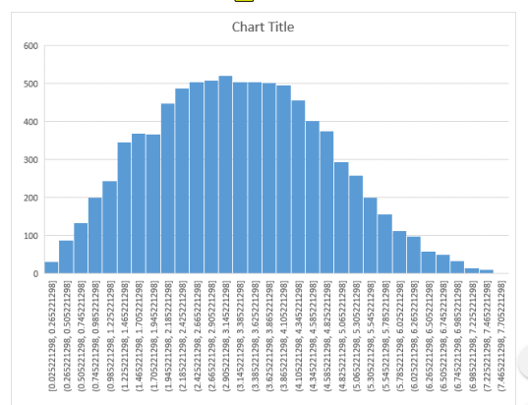
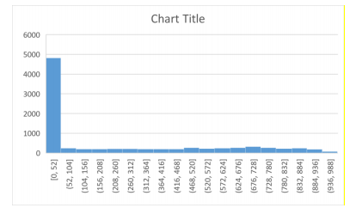
PLOTTING THE HISTOGRAMS: -

Slide 5
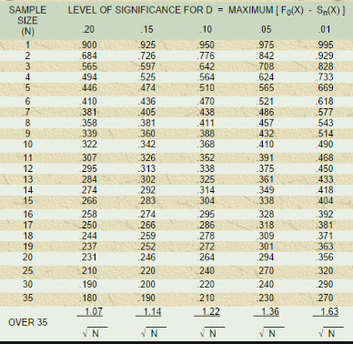
Kolmogorov-Smirnov(KS) test

Slide 6
About this test…
In this test, the cumulative probabilities of values in the data are compared with cumulative probabilities in a theoretical normal distribution.
The critical value is found from K-S table. This value comes to be 0.014531.
The null hypothesis is this distribution follows normal distribution.
If the test statistic is LESS THAN the critical value, we ACCEPT the null hypothesis.
The test statistic for wind speed came out to be 0.027018.
The test statistic for GHI data came out to be 0.285966.
Both are more than the critical value.

Slide 7
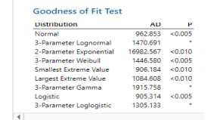
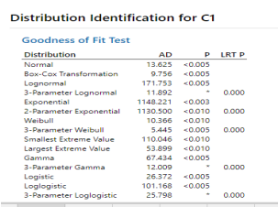
Using Minitab.
GHI DATASET
WIND SPEED DATASET

