Slide 1
SEGMENTATION OF RETINAL
BLOOD VESSELS USING
MATCHED FILTER
FIRST-PHASE PRESENTATION
MENTORED BY-
Asst Prof. R MANJUNATH

Slide 2
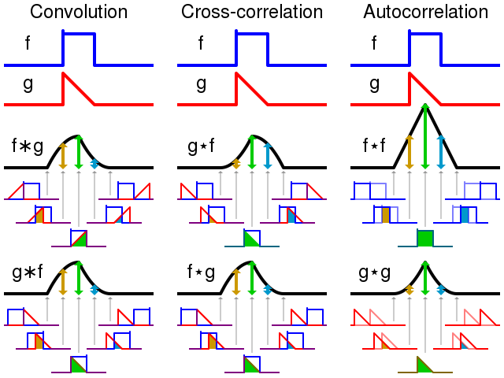
WHAT IS MATCHED FILTER?
MATCHED FILTER IS OBTAINED BY CO-RELATING A KNOWN SIGNAL OR TEMPLATE WITH AN UNKNOWN SIGNAL TO DETECT THE PRESENCE OF THE TEMPLATE IN THE UNKNOWN SIGNAL. THIS IS SIMILAR TO CROSS-CORELATION.

Slide 3
2D MATCHED FILTER
The two-dimensional MF locally exploits the correlation between local image areas and 2D masks(kernels) developed according to the appearance of typical blood vessel segments of different widths (diameters) and orientations. These masks(kernels) were created by measuring numerous perpendicular cross-sectional intensity profiles of retinal vessels in the images

Slide 4

KERNEL CREATION
--ROTATED COORDINATES
--ROTATIONAL MATRIX
--KERNEL FORMATION

Slide 6
ORIGINAL FUNDUS PHOTO

Slide 8
MODIFICATIONS

