Slide 1
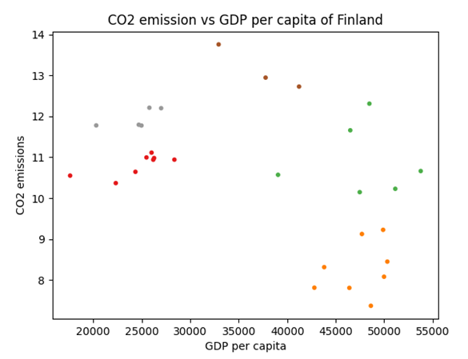
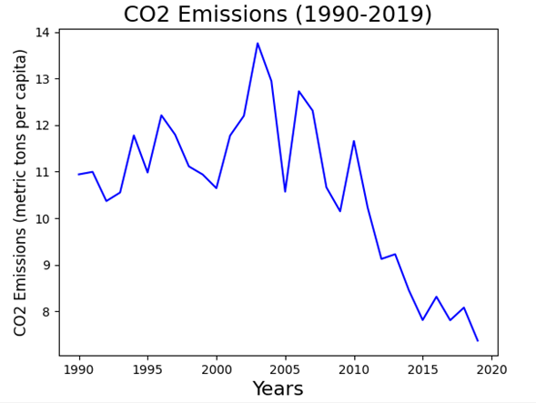
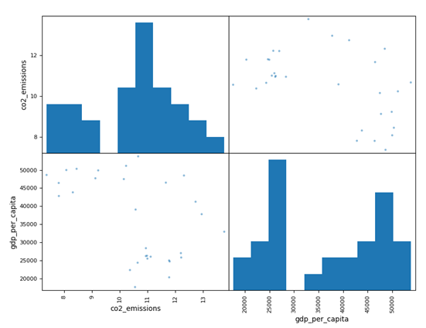
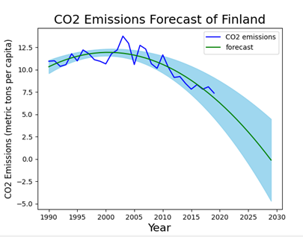
CO2 Emission Versus GDP Per Capita of Finland
Student Name- Hemanth Tak
Student ID- 22073706
Introduction
An economic development of nation is deeply associated with the emission of gases responsible for degrading the environment. The purpose of this study is to conduct a critical evaluation between GDP per capita of Finland and CO2 emission.
CO2 Emission versus GDP per capita of Finland
The relationship between carbon dioxide (CO2) emissions and GDP per capita can provide insights into a country's economic and environmental performance. Typically, this analysis helps assess the efficiency of an economy in terms of resource use and environmental impact. The similar pattern has been observed in its visualization presented in the scattered form. Finland has experienced a trend of decoupling economic growth from CO2 emissions. This means that its economies are growing without a corresponding increase in greenhouse gas emissions.
K-Cluster Means of CO2 Emission versus GDP
From visualization, a distinct form of scaling as well as measurement become evident that mention about the CO2 emission interrelating with GDP per capita of Finland. Different clusters are presented by different quadrant using K-cluster mean technique.
CO2 Emissions
Based-on the visual of CO2 emission versus year, it has been found that Finland has successfully controlled the emission of carbon dioxide in its environment with increasing number of years. By the year 2020, it has been reduced to the minimum level.
CO2 Emissions Forecast of Finland
By looking at the CO2 emission in metric tons, the visuals of prediction become so clear that exhibited an optimistic results in controlling the pollution happening in the environment. The prediction has been done till the year 2030 where the last records are also considered for evaluation. The CO2 emission is gradually declining and it will remain continued even in the coming years.
Conclusion
Based-on the various studies, it has been concluded that GDP growth of a nation is not always a cause for excessive CO2 emission and Finland has proved this theory with its efficient administration. Finland has successfully impose control over its environment which have been revealed from various outcomes in the form of visualization.
Github Source: https://github.com/Hemanthtak2000/Applied-Data-Science-1.git

