Slide 1

Network [REDACTED] Diagram
Internal Team Reviews and Updates

Slide 2
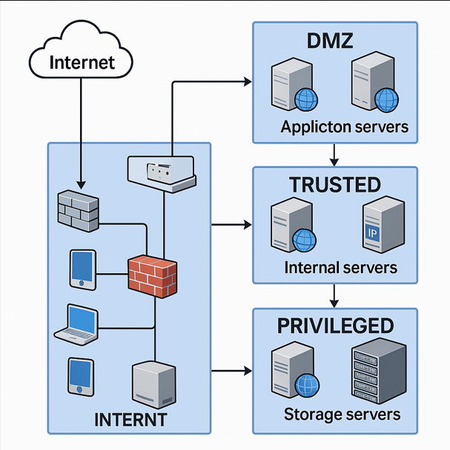

Slide 3
Revision History
Revision | Full Name | Email | Reviewed Date | Changes Made (If Any)
1.0 | Sarah Thompson | sarah.thompson@cadence.com | 2023-06-01 | Initial draft of network topology diagram created.
1.1 | Michael Chen | m.chen@cadence.com | 2023-12-03 | Updated IP addressing scheme and VLAN assignments.
1.2 | Aisha Rahman | aisha.rahman@cadence.com | 2024-05-07 | No changes. Reviewed and approved existing diagram.
1.3 | Priya Desai | priya.desai@cadence.com | 2024-10-15 | No changes. Confirmed compliance with updated security policies.

