Slide 1
Handwritten Character Recognition
N Vamsi Krishna(1210313444)
Ch Chanukya(1210313414)
M Hema Prasanthi(1210313434)
Ch Praneeth(1210313417)

Slide 2
How it is useful ???
Reduces human efforts
Easy for preservation
Easy for translation
Widespread of knowledge
Saves Trees

Slide 3
Introduction
Take English Characters as input,process the character,train the neural network algorithm, to recognise the pattern and modify the character to a beautified version of the input.
A new method called diagonal based feature extraction is used for extracting the features of the handwritten alphabets.
The proposed recognition system performs quite well yielding higher levels of recognition accuracy compared to the systems employing the conventional horizontal and vertical methods of feature extraction

Slide 4
Software Requirement Specifications

Slide 5
Hardware and Software Requirements
MATLAB
Processor : Intel Core2Duo or Higher.
RAM : 2GB or Higher.
Disk Space : 3-5GB.
Graphics Adapter : 32-bit or 64-bit OpenGL graphics adapter is recommended.

Slide 6
Functional Requirements
System should process the input only if it is an image file.
System displays error message when the input is not a valid image file.
System should detect characters present in the image.
System should retrieve characters present in the image and display them to the user.

Slide 7
Non-Functional Requirements
Performance : Characters should be recognised with an accuracy of 90% or more.
Availability : Software will retrieve characters only if the image has it.
Flexibility : It provides easy way for user to upload the image.
Reliability : It should produce reliable results every time even for low-resolution images.
Learn ability : It should be easy to learn and use.

Slide 8
Process
Image Acquisition
Pre-processing
Segmentation
Feature Extraction
Classification and Recognition
Post Processing

Slide 9
Preprocessing
Preprocessing is a series of operations performed on the scanned input image.
This is done to enhance the image to make it suitable for rendering.
Any noise present in the image is removed from it first.
The image is then converted into grayscale to make it uniform color and easy for rendering.
Later Binarization is applied to the image.

Slide 10
Preprocessing
During binarization process, the grayscale image is converted into binary image using global thresholding technique.
Detection of Edges is done using sobel technique.
Finally Dilation of image and filling of holes present in it are done to make the image suitable for segmentation.

Slide 11
Segmentation
During segmentation, an image of a sequence of characters is decomposed into sub-images of individual characters.
Preprocessed input image is segmented into isolated characters by assigning a number to each character using a labelling process.
Labelling provides information about number of characters present in the image.
Later each individual character is resized into uniform pixels.

Slide 12
Segmentation
Extracted character will be normalised.
There will be large variations in the sizes of each character.
To prevent any anomalies we will normalise the size of the characters.

Slide 13
Feature Extraction
Recognition of characters is done using the features of the character which are extracted.
Diagonal based feature extraction is used for extracting the features.
Every resized character image is divided into some zones of equal size.
Now features are extracted from these zones by moving along the diagonals.

Slide 14
Feature Extraction
Diagonal based features extracted can be combined with horizontal and vertical based feature extraction methods to improve accuracy of recognition in classification.
During horizontal and vertical based feature extraction features are extracted from zoned image by moving along the rows and columns respectively.
Diagonal based method delivers much better results compared to horizontal and vertical based methods individually.

Slide 15
Classification and Recognition
Artificial Neural Network is used for classification and recognition of the character.
Feedforward Artificial Neural Network is used for Recognition.
In a feedforward ANN, information flow is unidirectional.
The inputs to the ANN will be the features extracted in the Feature Extraction stage.
Feedforward Back propagation ANN is used to train the ANN.

Slide 16
Classification and Recognition
Learning in feedforward neural networks belongs to supervised learning.
Backpropagation is used for training the neural network.
Initially pairs of input and output values are fed into the network in cycles using which the neural network adjusts the weights to be closer to the expected output values.
Once the training is done,the neural network is used for classification and recognition.

Slide 17
UML Diagrams

Slide 18
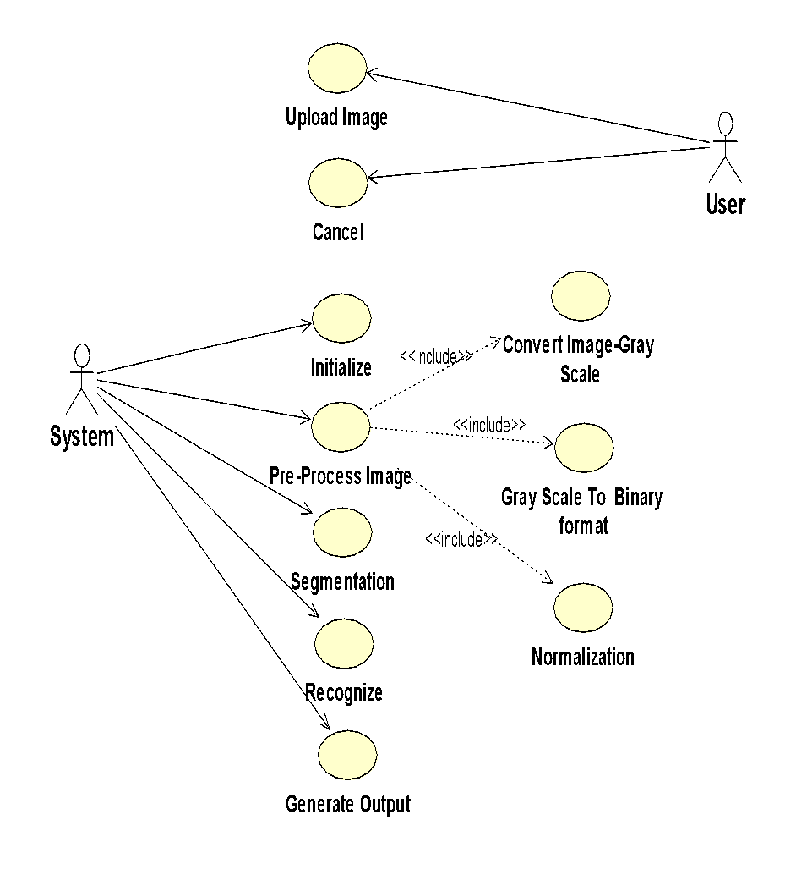
UseCase Diagram

Slide 19
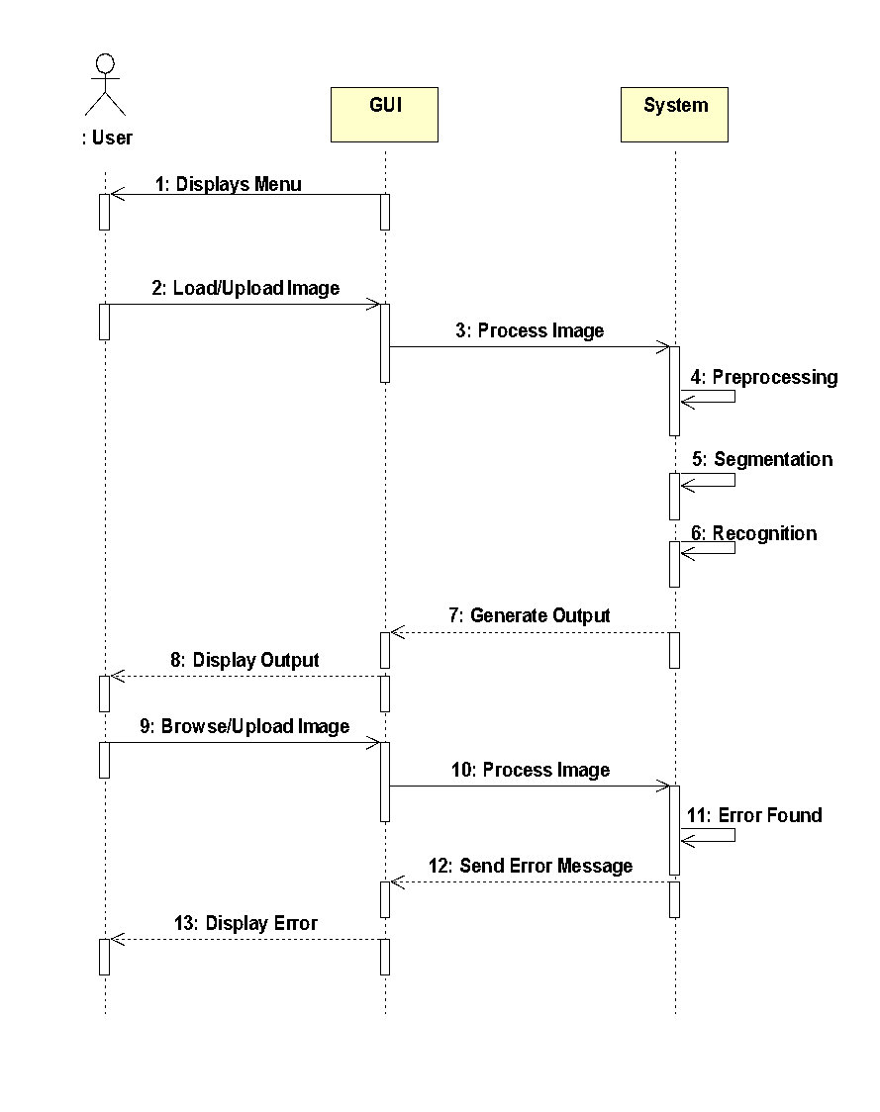
Sequence Diagram

Slide 20
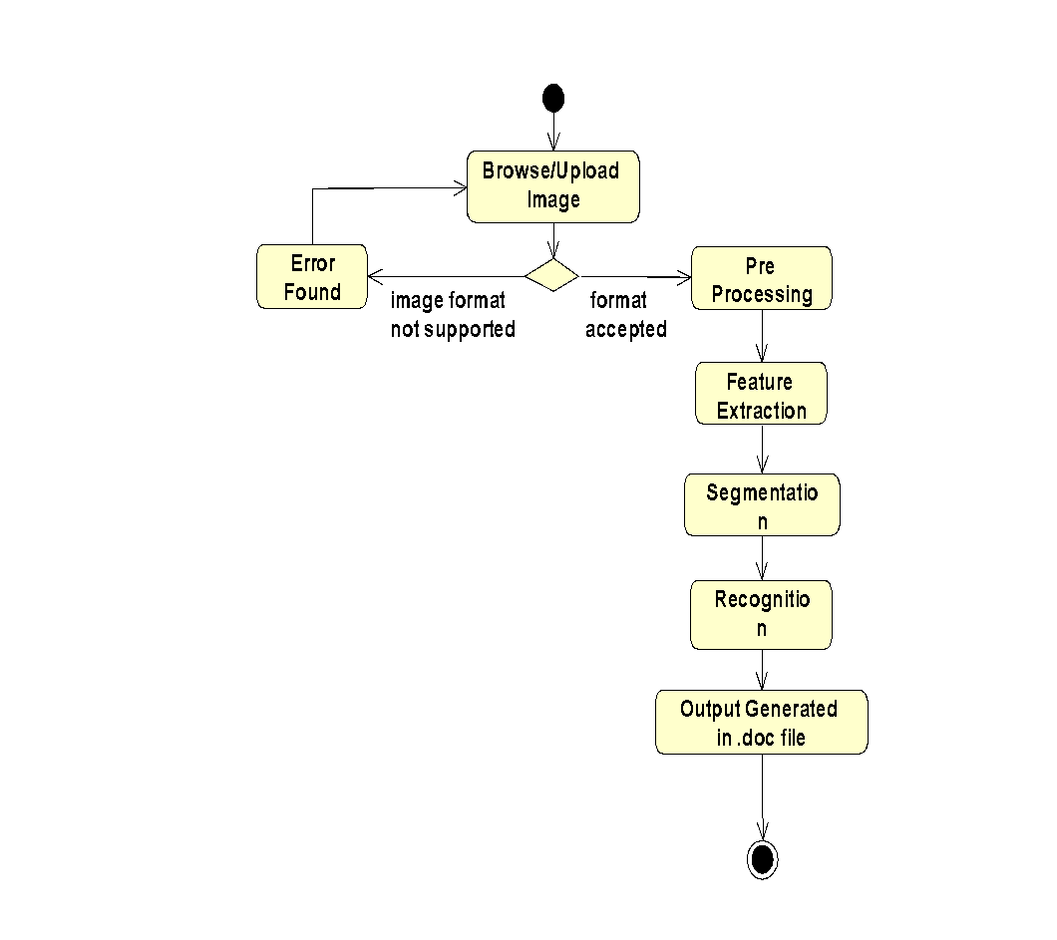
Activity Diagram

Slide 21
Limitations
Character recognition support is limited only to english alphabets and digits.
Character recognition support doesn’t cover cursive handwriting.
Character recognition works better on High Quality input image data similar to scanned papers.
Perfect Accuracy(100%) cannot be achieved

Slide 22
Thank You
Any Queries?

